Slide 1
Mars Habitat Automation Platform
Distributed Event-Driven System for Habitat Monitoring & Control
Deda Daniel • Macrì Francesco • Pagliarini Paolo • Torresi Flavio
Laboratory of Advanced Programming – Hackathon Exam 2025/2026

Slide 2
Agenda
01
Project Overview
Problem statement and objectives
02
System Architecture
Microservices and event-driven design
03
Data Ingestion
REST polling and SSE streaming
04
Automation Engine
IF-THEN rule processing
05
Frontend Application
Real-time dashboard features
06
Technology Stack
Tools and frameworks used
07
Conclusions
Achievements and future work
2/24

Slide 3
The Challenge
A Mars habitat's automation stack has partially failed, leaving devices operating with incompatible protocols.
Multiple Data Sources
Heterogeneous Formats
REST sensors, SSE streams, WebSocket telemetry
Different payload schemas requiring normalization
Real-time Requirements
Automation Needs
Immediate response to environmental changes
Rules-based actuator control for habitat safety
3/24

Slide 4
Our Solution
A distributed event-driven platform with unified monitoring and control
Unified Ingestion
REST polling + SSE streams normalized to single event schema
Event-Driven Core
RabbitMQ message broker for decoupled microservices
Smart Automation
IF-THEN rules with automatic actuator control
Real-Time Dashboard
React SPA with live updates and manual controls
4/24

Slide 5
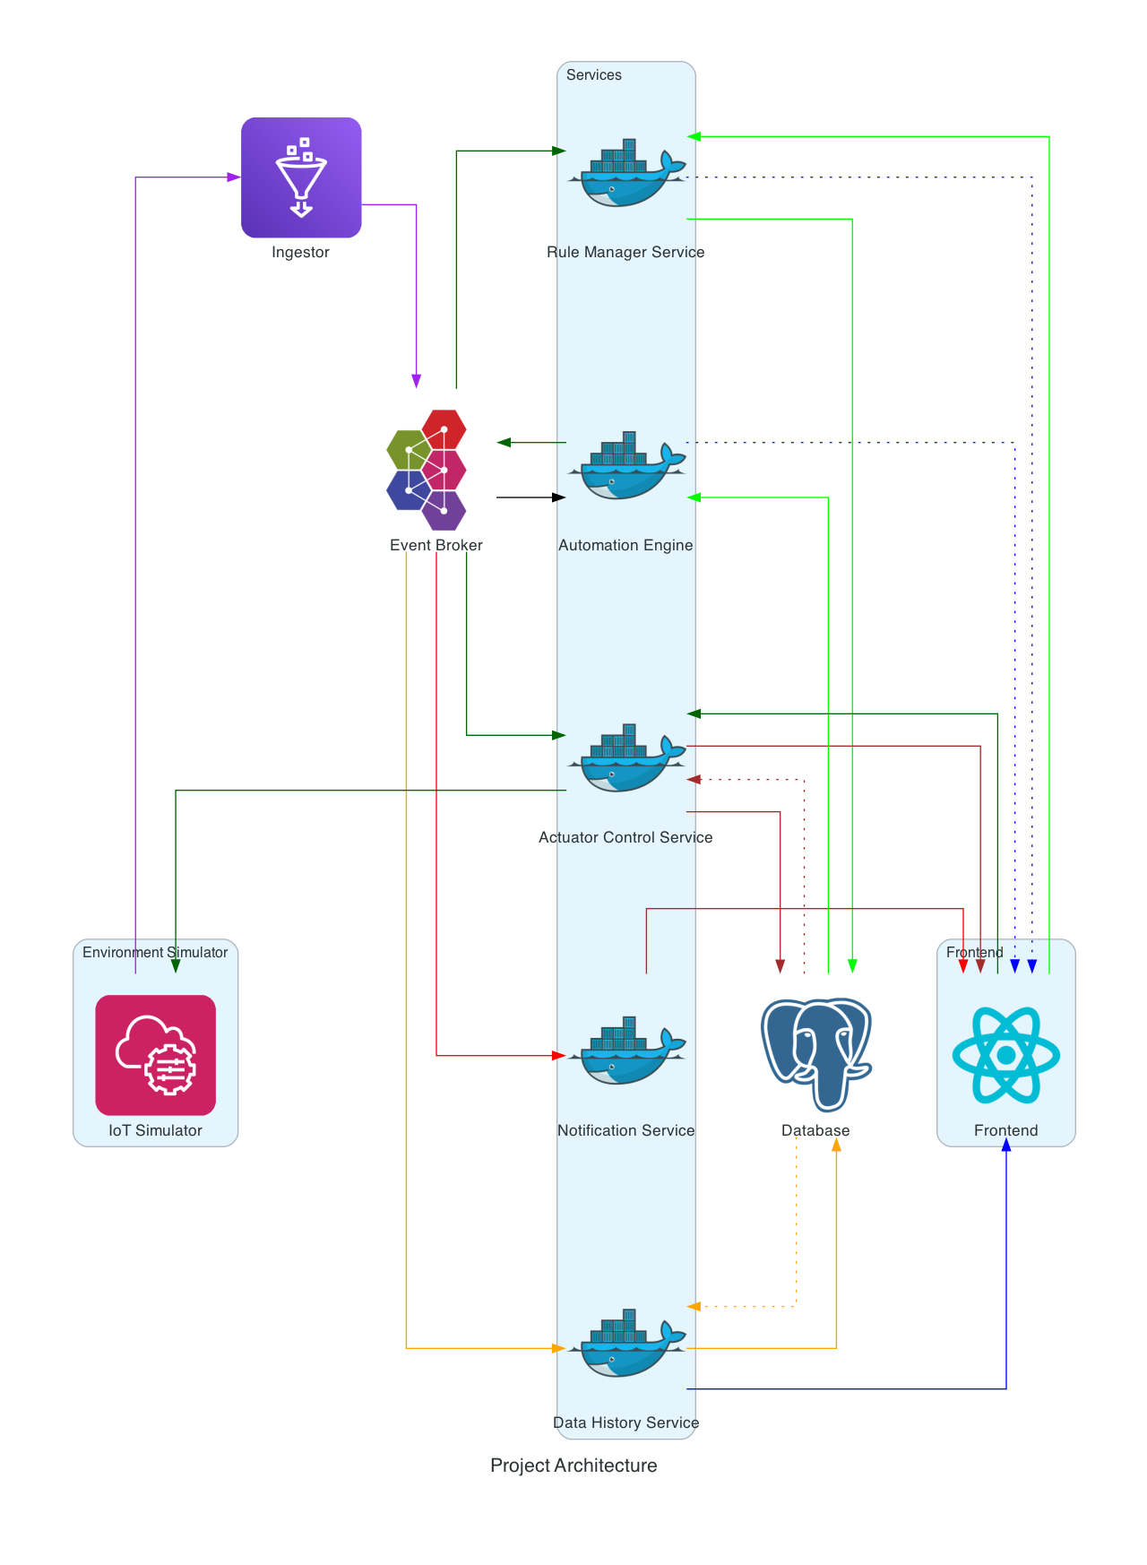
System Architecture
5/24

Slide 6
Microservices Architecture
Ingestion
8001
Automation Engine
8002
Rule Manager
8003
REST polling & SSE streams Schema normalization
Rule evaluation Event-driven triggers
CRUD API for automation rules persistence
Notification
8004
Actuator Control
8005
Data History
8006
Real-time SSE alerts Event broadcasting
Historical queries In-memory cache
Device command execution Audit logging
6/24

Slide 7
Infrastructure Services
RabbitMQ Message Broker
PostgreSQL Database
• AMQP protocol (port 5672) • Topic exchange: mars_events • Event-driven pub/sub architecture • Durable queues with TTL • Management UI on port 15672
• PostgreSQL 16 (port 5433) • automation_rules table • sensor_readings history • actuator_commands audit • Persistent volume storage
Unified Event Schema
{ event_id, sensor_id, timestamp, metric, value, unit, source, status, raw_schema }
All sensor data normalized to a single format • REST polls + SSE streams → unified events
7/24

Slide 8
Data Ingestion Service
REST Sensors (Polling)
Telemetry Streams (SSE)
• greenhouse_temperature
• solar_array
• entrance_humidity
• radiation
• co2_hall
• life_support
• hydroponic_ph
• thermal_loop
• water_tank_level
• power_bus
• corridor_pressure
• power_consumption
• air_quality_pm25
• airlock
• air_quality_voc
Normalization Pipeline
8 different REST schemas + 7 telemetry schemas → Single unified event format Published to RabbitMQ with routing key: events.sensor.{sensor_id}
8/24

Slide 9
Raw Data to JSON (Normalization)
Standardizing Telemetry and Events
Raw Telemetry (Varies)
Unified Event JSON
{ "sensor": "DHT22", "data": { "temp": 39.99, "flow": 12.0 } }
{ "event_id": "evt_101", "sensor_id": "thermal_loop", "timestamp": "2026-03-10T12:00:00Z", "metric": "temperature_c", "value": 39.99, "unit": "C", "source": "sse", "status": "warning" }
9/24

Slide 10
In-Memory Cache & Mapping
Ingestion service maintains the latest values for every sensor, exposed via GET /sensors/latest to the frontend with real-time updates.
Event Mapping Strategies
rest.scalar.v1
→
1 direct event (1:1 mapping)
rest.chemistry.v1
→
1 event per measurement in the measurements array
rest.particulate.v1
→
3 separated events (PM1, PM2.5, PM10)
rest.level.v1
→
2 events (level_pct in % and level_liters in L)
topic.power.v1/environment.v1
→
1 event per metric
topic.thermal_loop.v1
→
2 events (temperature_c, flow_l_min)
topic.airlock.v1
→
1 event (last_state encoded as status)
10/24

Slide 11
Automation Engine
Event-Driven Rule Processing
1
2
3
4
5
Receive
Parse
Match
Evaluate
Execute
RabbitMQ event
Extract sensor_id
Find rules
Check condition
Publish command
IF-THEN Rule Model
IF <sensor_id> <operator> <value> THEN set <actuator_id> to ON | OFF
Operators: < <= = > >= • Example: IF greenhouse_temperature > 28 THEN set cooling_fan to ON
11/24

Slide 12
Frontend Application
Technology Stack
Application Pages
• React 18 + TypeScript
Sensors
REST sensors dashboard with real-time updates
• Vite 6 Build Tool
Telemetry
Streaming data visualization with charts
• React Router 7
• Tailwind CSS 4
Actuators
Device control and command history
• Recharts for Charts
Rule Builder
Create and edit automation rules
• Radix UI Components
Rules
List, enable/disable, delete rules
Status
System health and notification log
Real-Time Features
Server-Sent Events (SSE) for live notifications • Aggressive polling for sensor updates React state management for instant UI feedback • Recharts for live data visualization
12/24

Slide 13
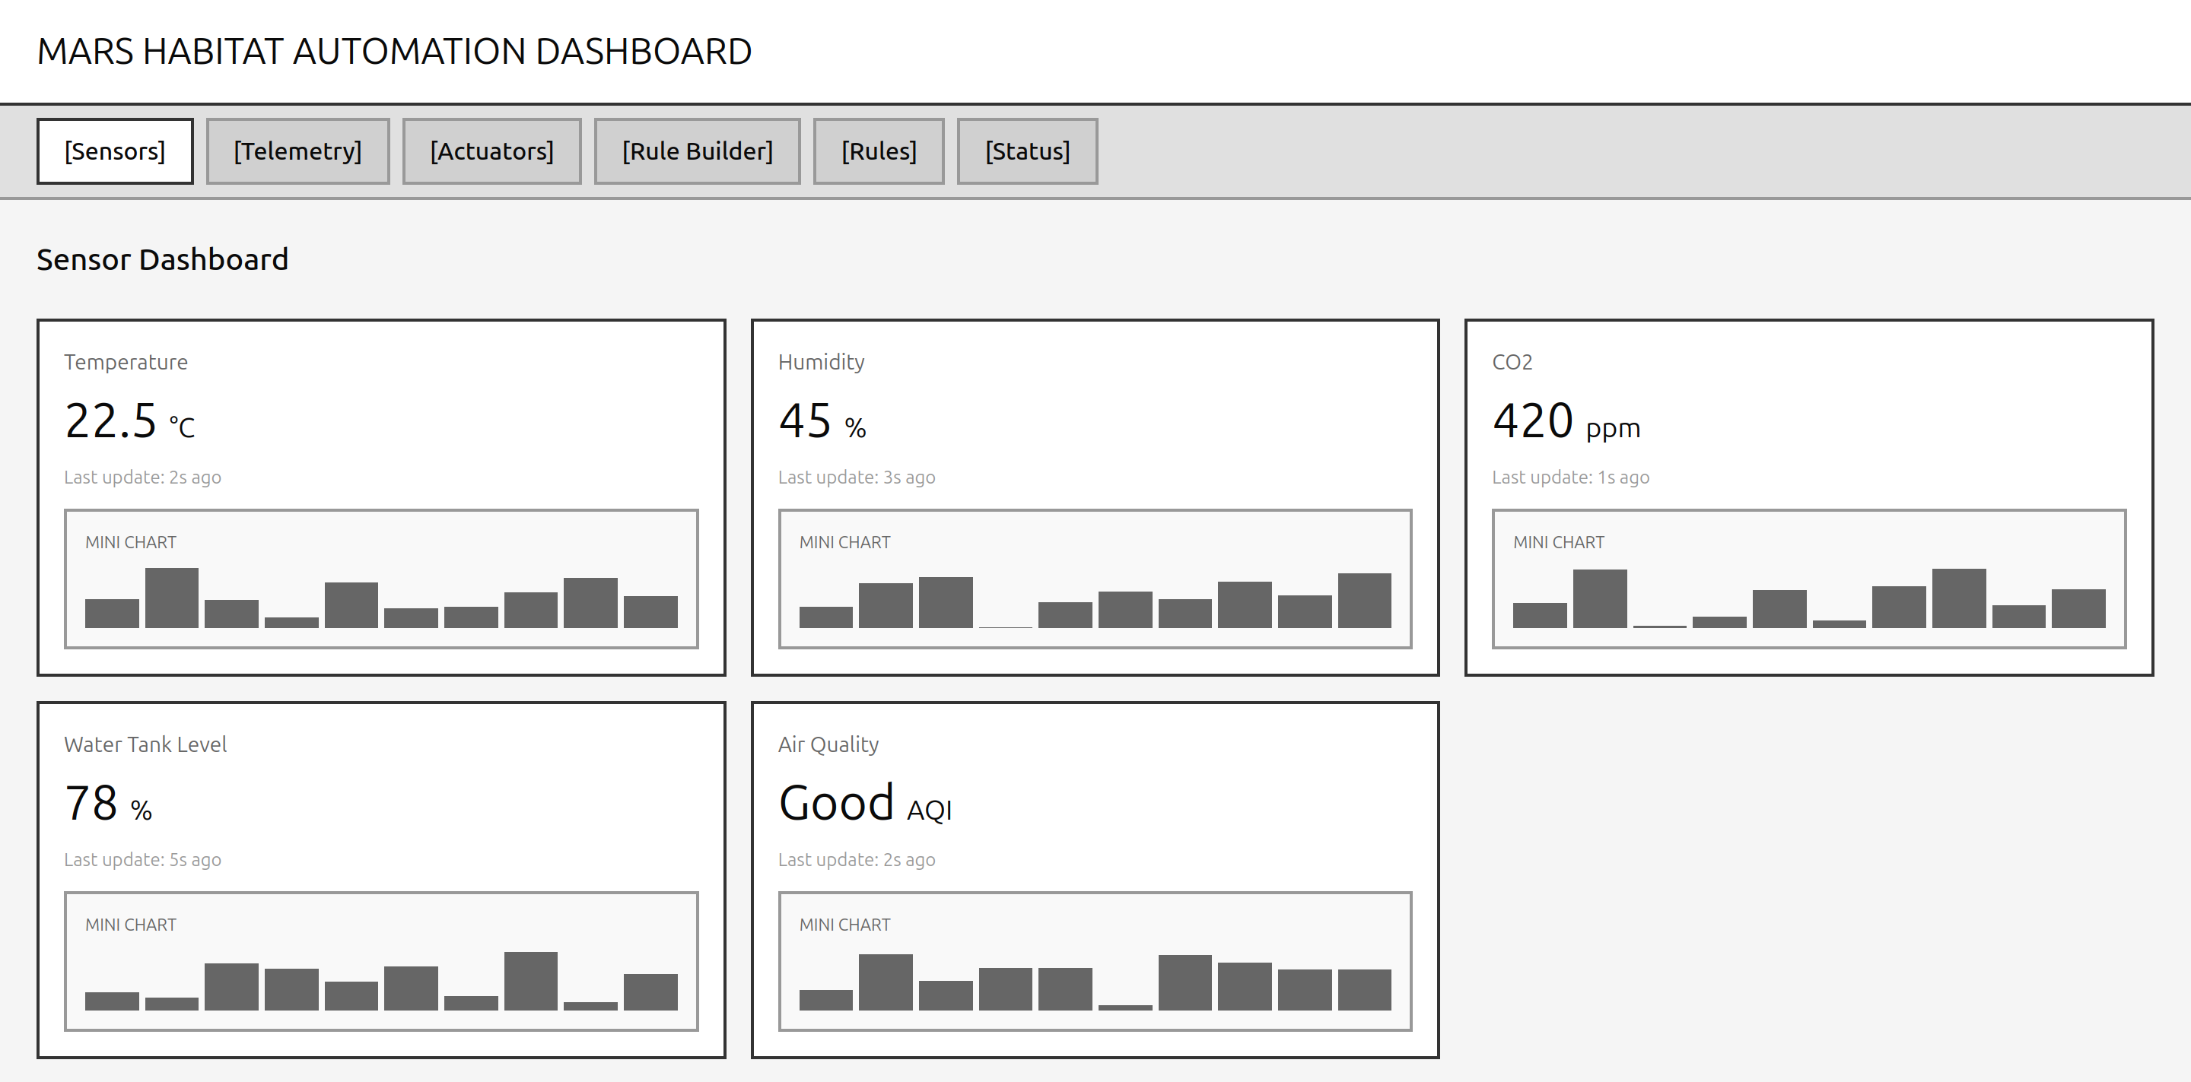
Sensors Dashboard
Real-time REST sensor monitoring with status indicators
11/22

Slide 14
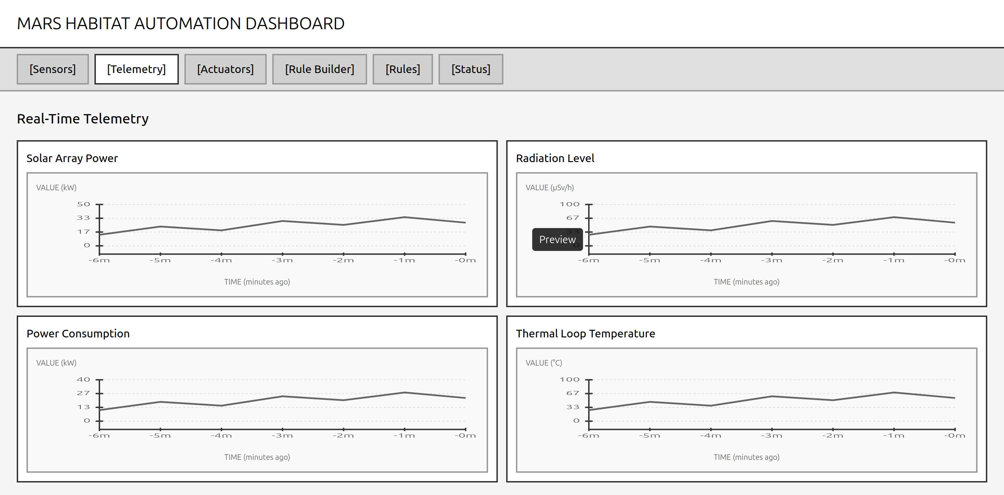
Telemetry Streaming
SSE-powered live data visualization
12/22

Slide 15
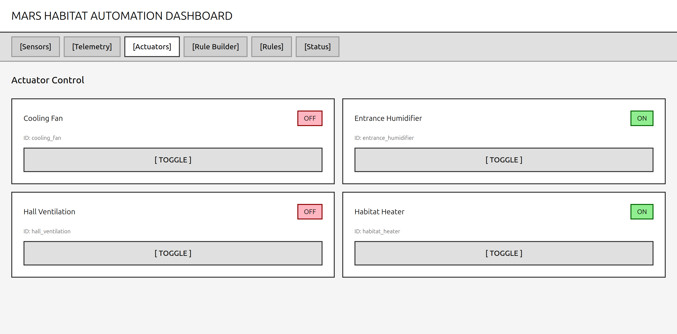
Actuator Control
Manual control and command history audit trail
13/22

Slide 16
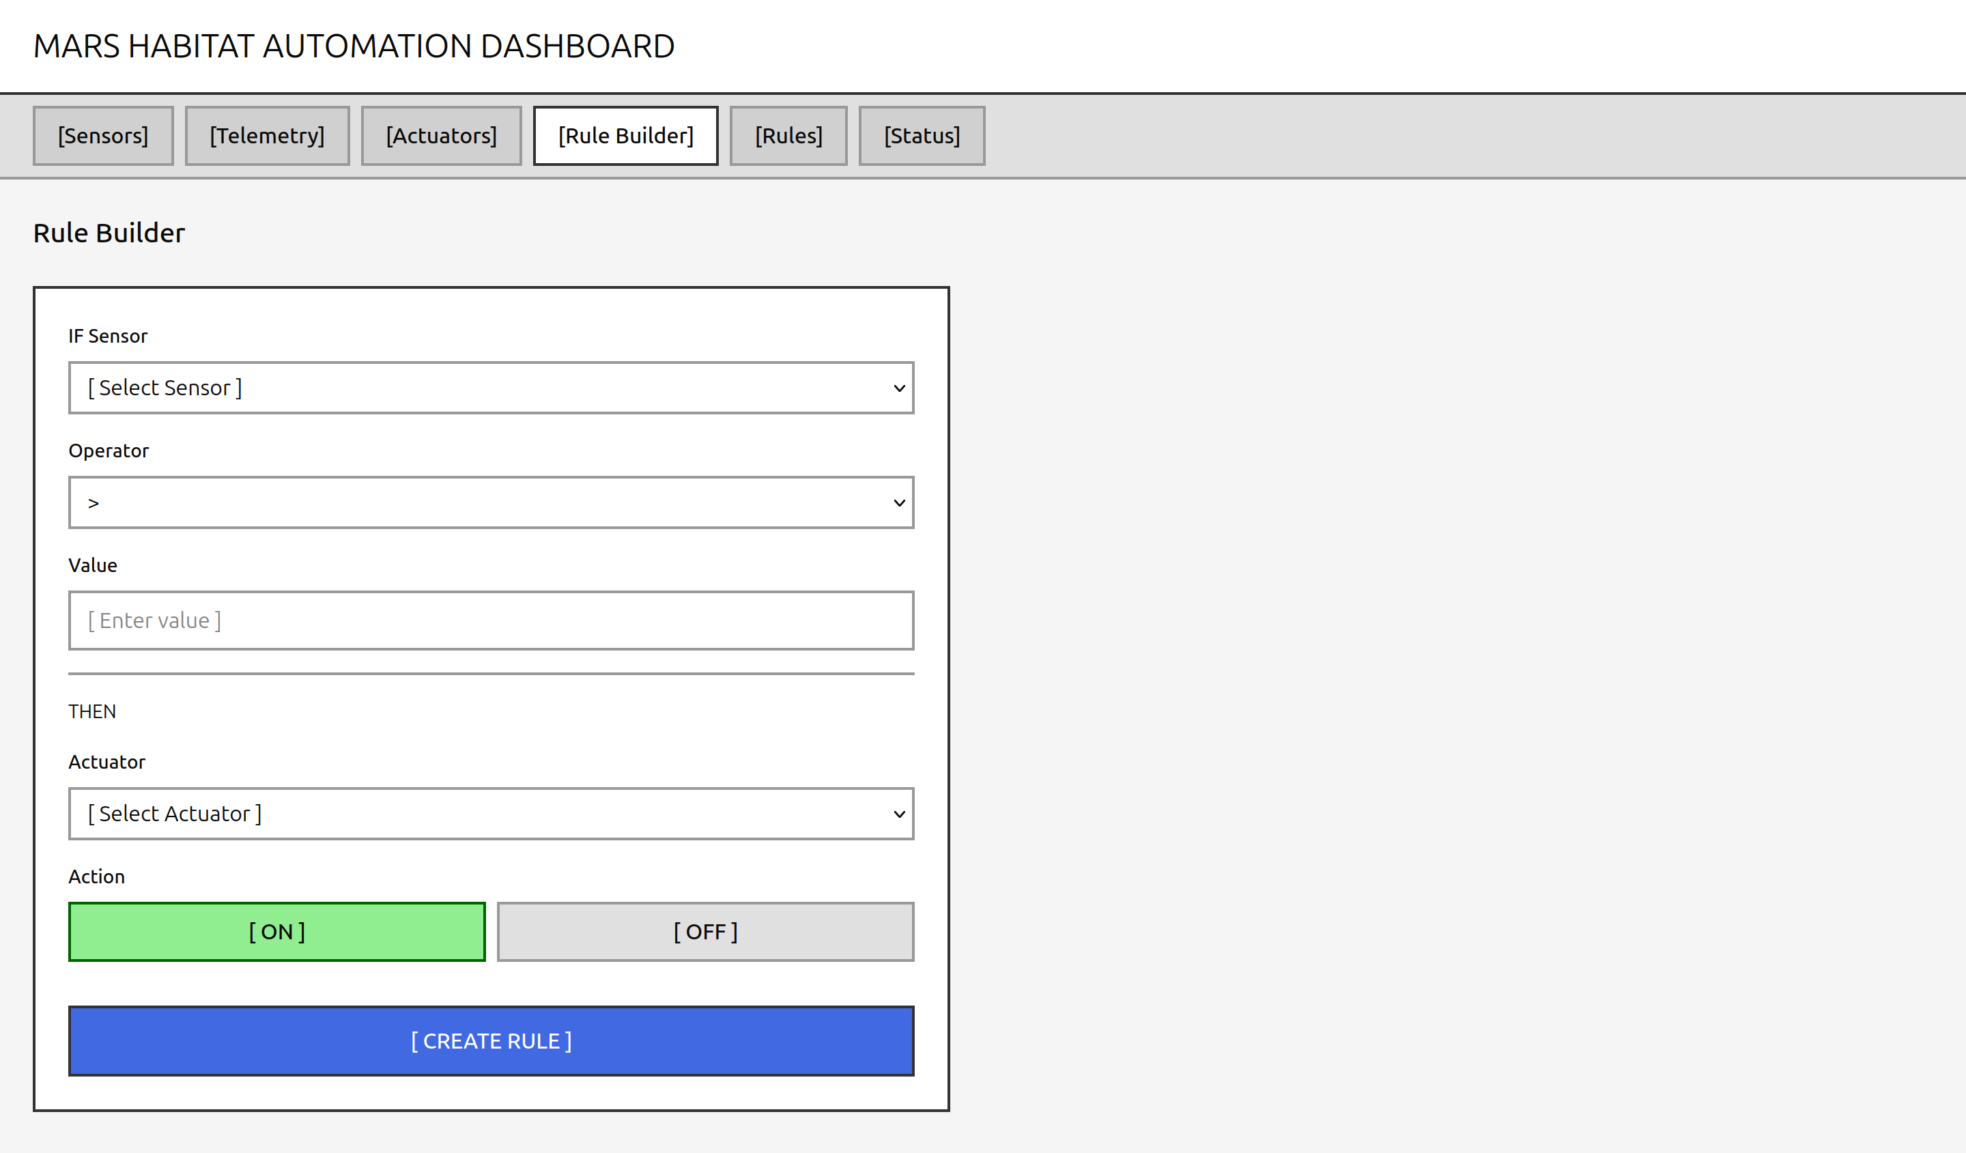
Rule Builder
Create IF-THEN automation rules visually
14/22

Slide 17
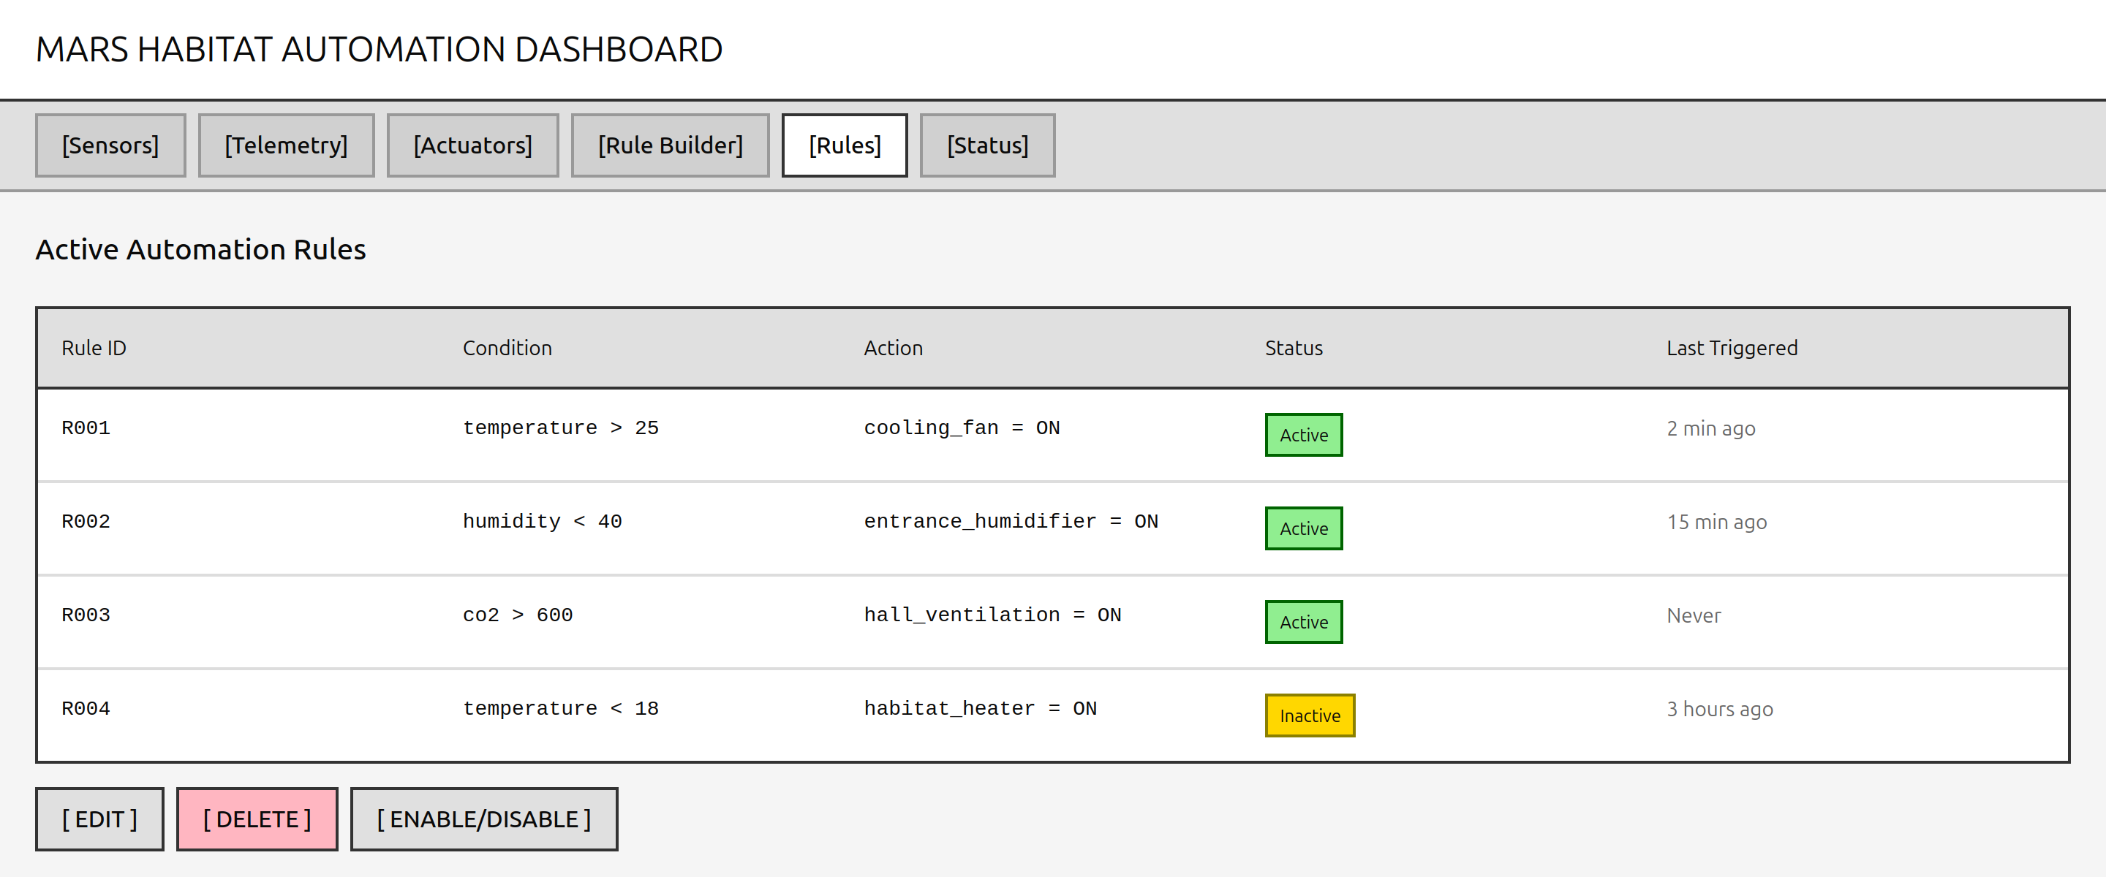
Rules Management
List, toggle, edit, and delete automation rules
15/22

Slide 18
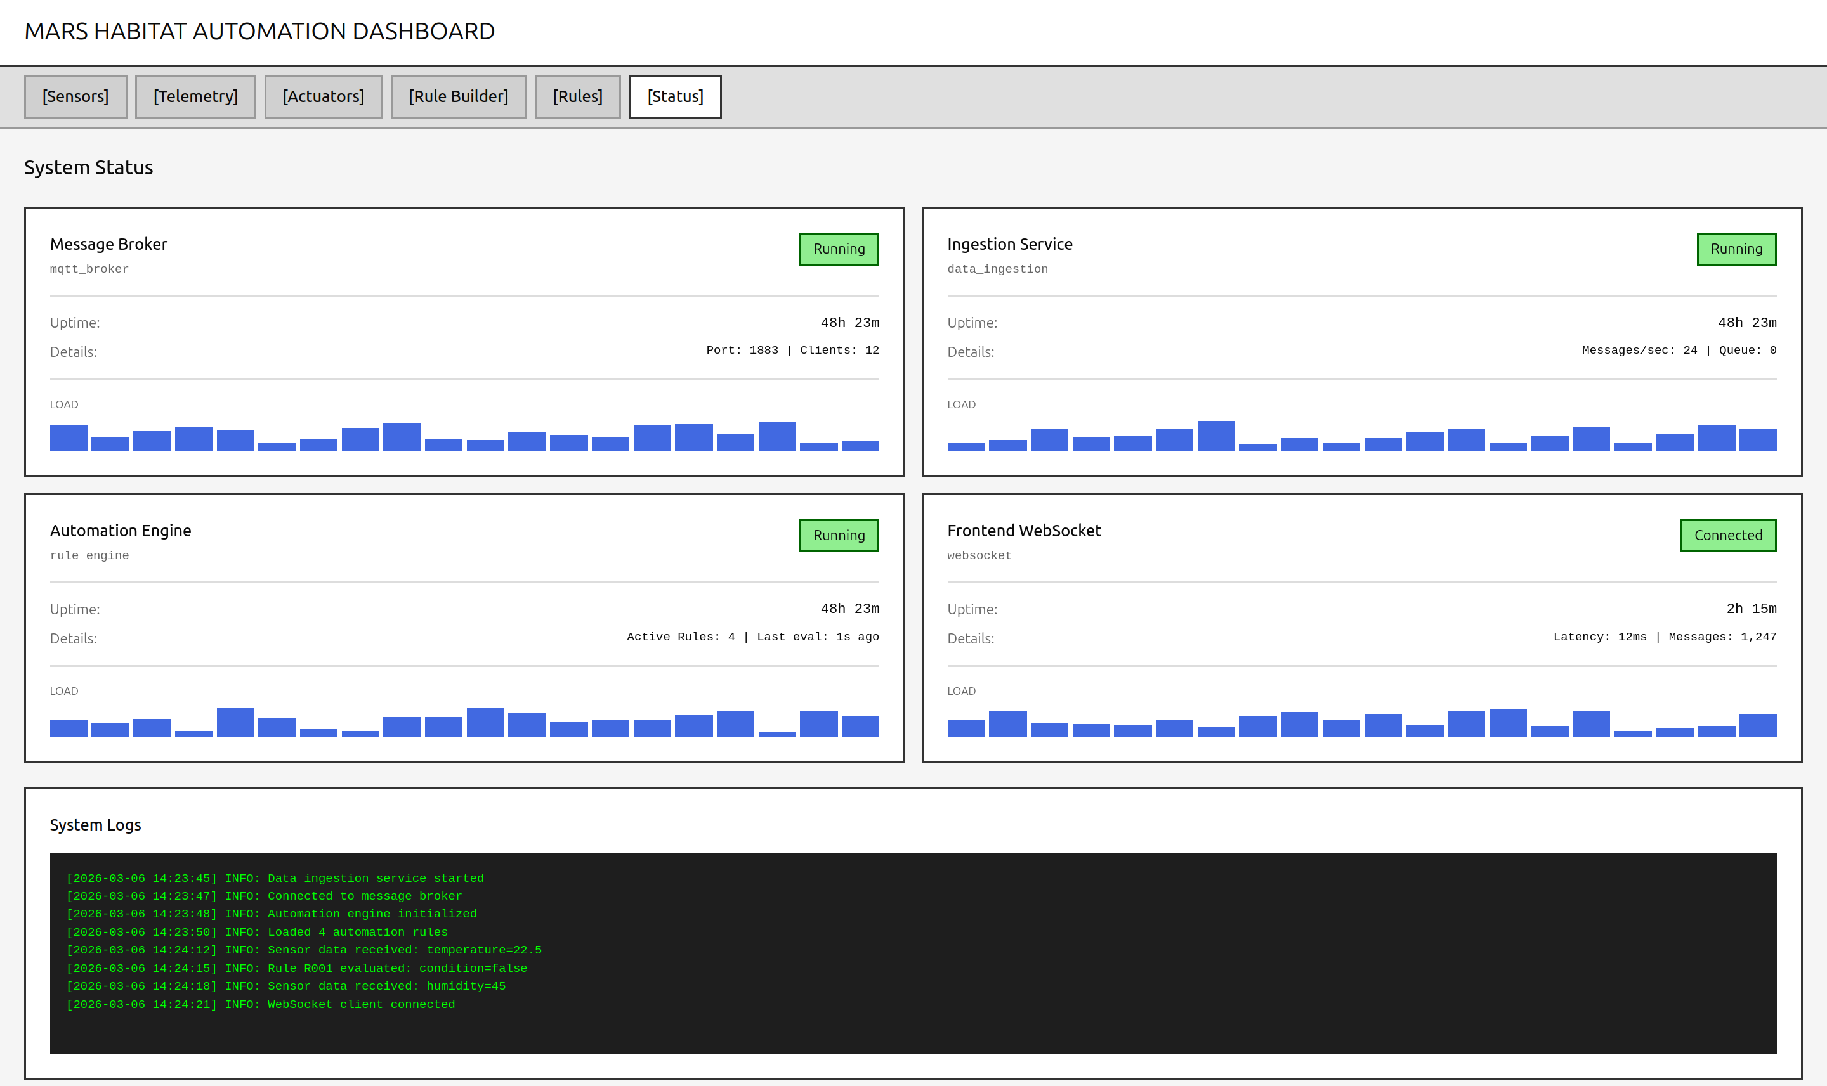
System Status
Health monitoring and notification center
16/22

Slide 19
Database Design
automation_rules
sensor_readings
actuator_commands
• id (SERIAL PK)
• id (BIGSERIAL PK)
• id (BIGSERIAL PK)
• name, description
• sensor_id (VARCHAR)
• actuator_id (VARCHAR)
• sensor_id, operator
• value (DECIMAL)
• previous_state, new_state
• threshold_value, threshold_unit
• unit (VARCHAR)
• source (auto/manual)
• actuator_id, actuator_action
• source (rest/stream)
• reason (TEXT)
• is_active (BOOLEAN)
• recorded_at (TIMESTAMP)
• rule_id (FK)
• created_at, updated_at
• created_at (TIMESTAMP)
• executed_at (TIMESTAMP)
19/24

Slide 20
Data Flow Architecture
IoT Simulator
Ingestion
RabbitMQ
Consumers
Frontend
REST API SSE Streams
Normalize Events
Route Events
Process & Store
Display & Control
Event Routing Keys
Sensor Events:
Actuator Commands:
Notifications:
events.sensor.{sensor_id}
commands.actuator.{actuator_id}
events.#
20/24

Slide 21
Technology Stack
Backend Services
Frontend
Infrastructure
• Python 3.11+
• React 18
• PostgreSQL 16
• FastAPI (Async)
• TypeScript
• RabbitMQ (AMQP)
• aio-pika (RabbitMQ)
• Vite 6
• Docker
• asyncpg + SQLAlchemy
• React Router 7
• Docker Compose
• httpx (HTTP Client)
• Tailwind CSS 4
• Nginx (Reverse Proxy)
• Pydantic (Validation)
• Recharts
• Uvicorn (ASGI)
• Radix UI
Containerized Microservices with Event-Driven Architecture
21/24

Slide 22
Key User Stories
Monitoring
Control
Automation
Analytics
• Real-time sensor values
• View actuator ON/OFF states
• Create IF-THEN rules
• Live time charts
• Live telemetry from SSE
• Manual actuator toggle
• View all automation rules
• Historical data queries
• Automatic dashboard updates
• Automatic rule-based control
• Edit existing rules
• System health summary
• Status indicators (ok/warning)
• Command history audit
• Delete/enable/disable
• Connectivity monitoring
• Sensor filtering by category
• Real-time trigger alerts
22/24

Slide 23
Conclusions
Project Achievements
Distributed microservices architecture with event-driven communication
Real-time monitoring and control of simulated Mars habitat
IF-THEN automation rules with automatic actuator control
Modern React dashboard with SSE-based live updates
Containerized deployment with Docker Compose
Unified event schema for heterogeneous data sources
Future Enhancements
→ Machine Learning:
Predictive maintenance and anomaly detection
→ Mobile App:
Remote monitoring and push notifications
→ Advanced Alerting:
Email/SMS notifications for critical events
23/24

Slide 24
Thank You
Deda Daniel • Macrì Francesco • Pagliarini Paolo • Torresi Flavio
Laboratory of Advanced Programming – Hackathon Exam 2025/2026
24/24

