Slide 1
Mind-Balloons
An educational platform for Adults with ADHD

Slide 2
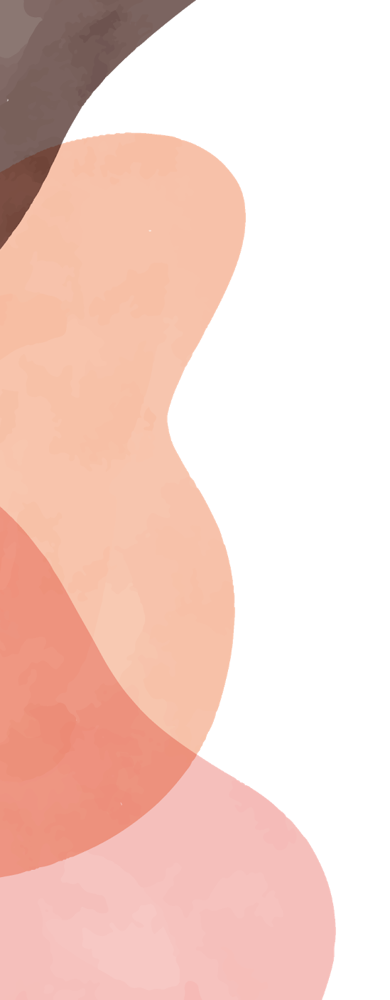
WHAT IS ADHD? [Attention Deficit/Hyperactivity Disorder]
Neurodevelopmental disorder that impairs executive function

Slide 3
What is an Executive function?
IDEA
ACTION
20%
50%
---The Link between Idea and action ----
Paying attention, organization & planning, starting task, staying focus

Slide 4
—Margaret Weiss, MD
“The single most difficult task for a patient with ADHD is to prioritize. Patients complain that they procrastinate, lack motivation, become easily distracted, and cannot stay on task”

Slide 5
Isn’t that a kids thing?
“A significant number of individuals, male and female alike, suffering with ADHD in their childhood, continue to suffer and lead lives at less of their capacity often into their geriatric years”.
– Sam Goldstein, MD

Slide 6
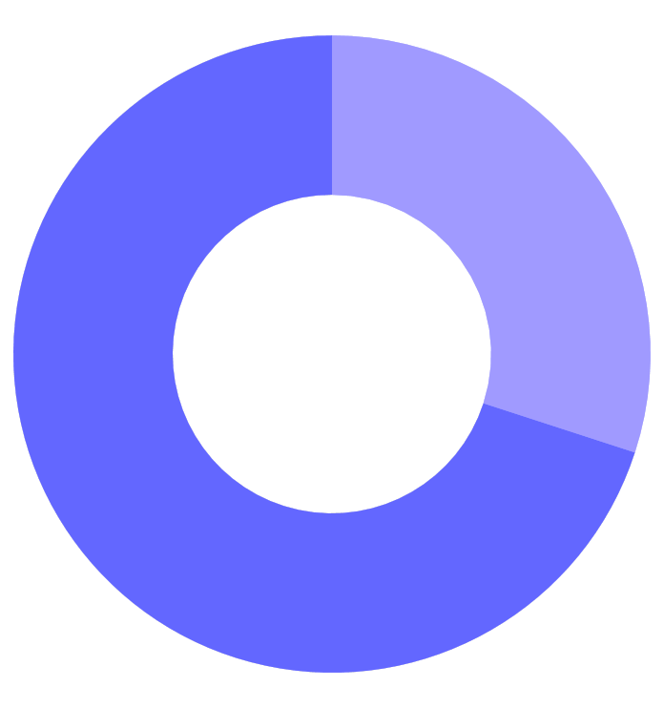
Learning Goals
70%
30%
Bring awareness to specific ADHD topics by providing detailed knowledge on their own behaviors and the characteristic of their non-neurotypical brains.
Teach ADHD adults what are the executive functions deficits tied to their condition and help them to learn individual strategies to prioritize, organize and manage time efficiently, make better decisions and design their lives around their needs.

Slide 7
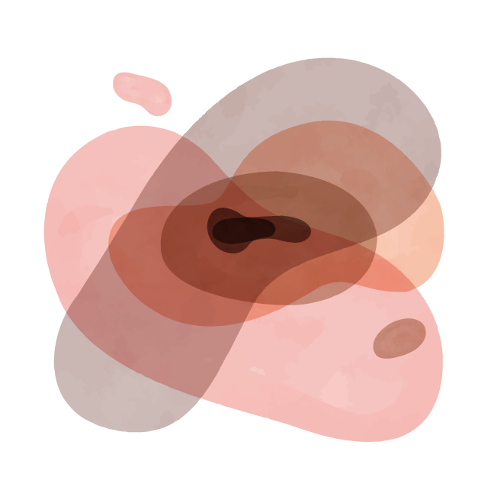
Executive Function my design wants to concentrate on
ATTENTION
PLANNING
ENDURANCE
STARTING TASKS
Easily distracted
Organize and prioritize
Stay motivated to endure a tasks
Procrastinate the initiation of an activity

Slide 8
Building on top of previous work [Evidence is still to be collected]
01
02
03
Diagnostic Procedures
Training Software
Computer based learning env.
Computationally assisted ADHD test taking & LD diagnosis (reading, writing, spatial thing, vision).
Brain camp: Training working memory and self monitoring (ATS)
Cognitive training using gaming platform (gamifying task & activities)

Slide 9
Specific Design Strategy
 | Personalize (ADHD triggers) | Question (Time & Emotions) | Learning Strategy (& Affordances)
Colors | Calming Palette | How r u feeling bout it? | Non-stress inducing color Encoding
Size | Pain Scale | How urgent? | Visualizing time in space
Position | Relative importance | When its due? | Priority by gravitation

Slide 10

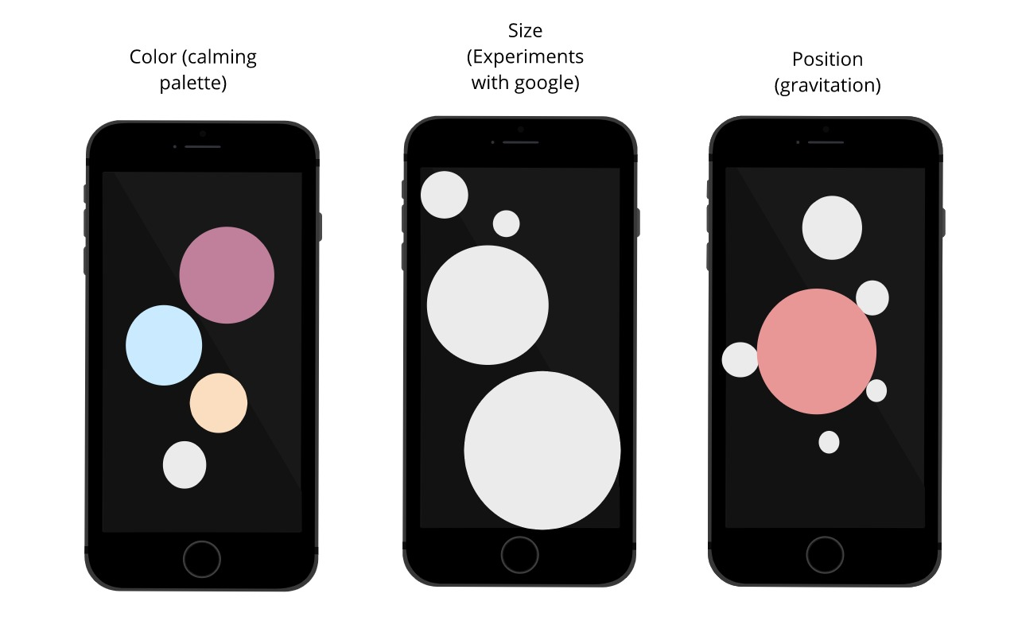
Designing all features in a single, uninterrupted and decluttered space

Slide 11
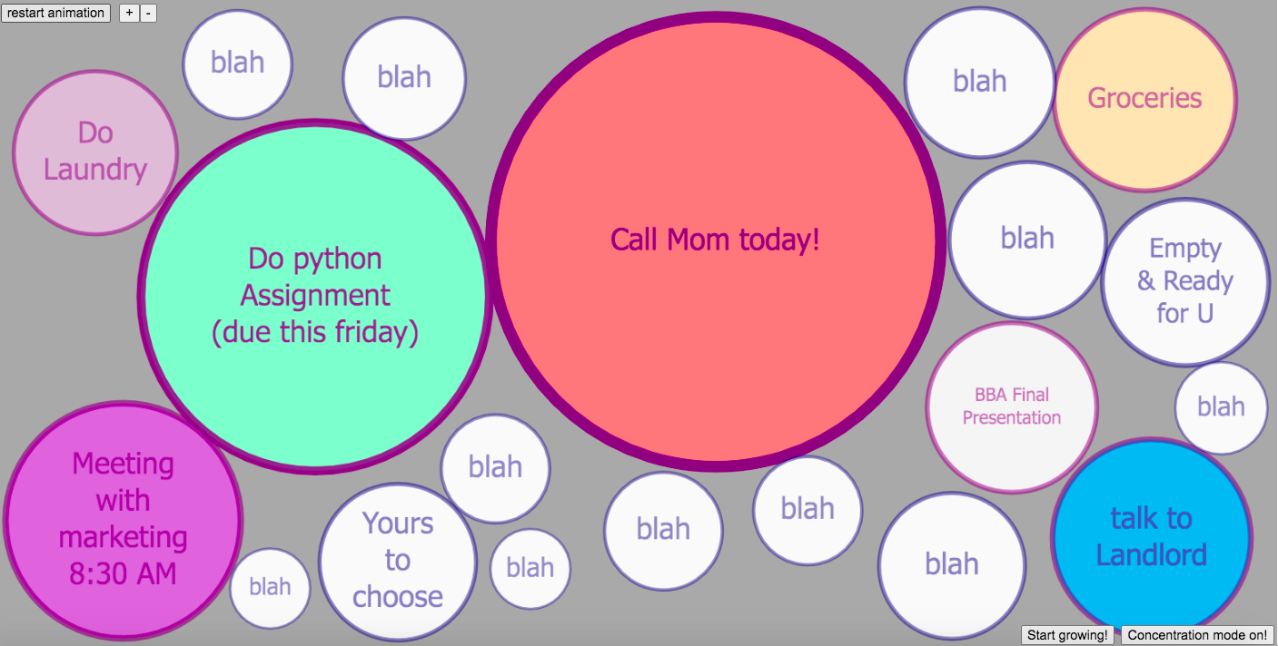
02
Demo
First Prototype!

Slide 12
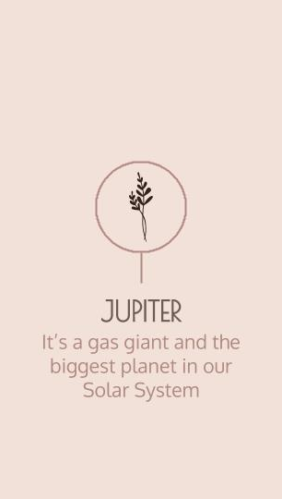
How would you use this platform?
Add balloon!
https://www.youtube.com/watch?v=9GqpRjcZzHQ
Grown over time!
https://www.youtube.com/watch?v=TlpMCB7BGcw

Slide 13
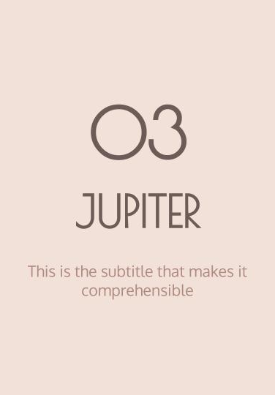
How would you use this platform? (II)
Popping a balloon out!
https://www.youtube.com/watch?v=n-DTQM2l0jw
Concentration mode on!
https://www.youtube.com/watch?v=zVq1GCjVrtA

Slide 14
Next Step
Instructional material added to the visualization platform
Adding more functionalities
Collect Data to help & improve

Slide 15
Mind Balloons is an educational methodology (I haven’t forget that, I know)
Things that are critical to my design but still missing in my prototype
Educational content for specific EF common problems added to the platform
Audiovisual content explaining the use of the platform in plain English
Design strategies to avoid distractions

Slide 16
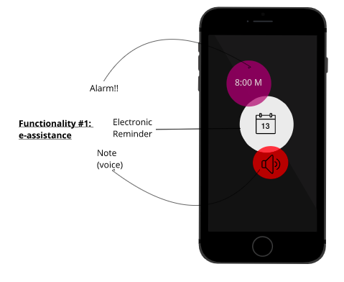
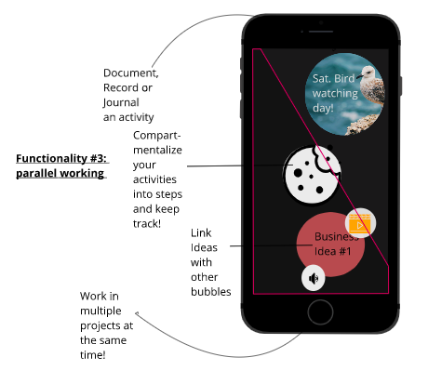
Other functionalities I would like to include
E-assistance
Parallel Working

Slide 17
THANKS
Here is the github link of my project:
https://github.com/paolorivas/mind-balloons

