Slide 1

Historical Inflation and World Events Data sets from 1913 to 2021
Estela, paola, ramiro

Slide 2

Extract
Transform
Load

Slide 3
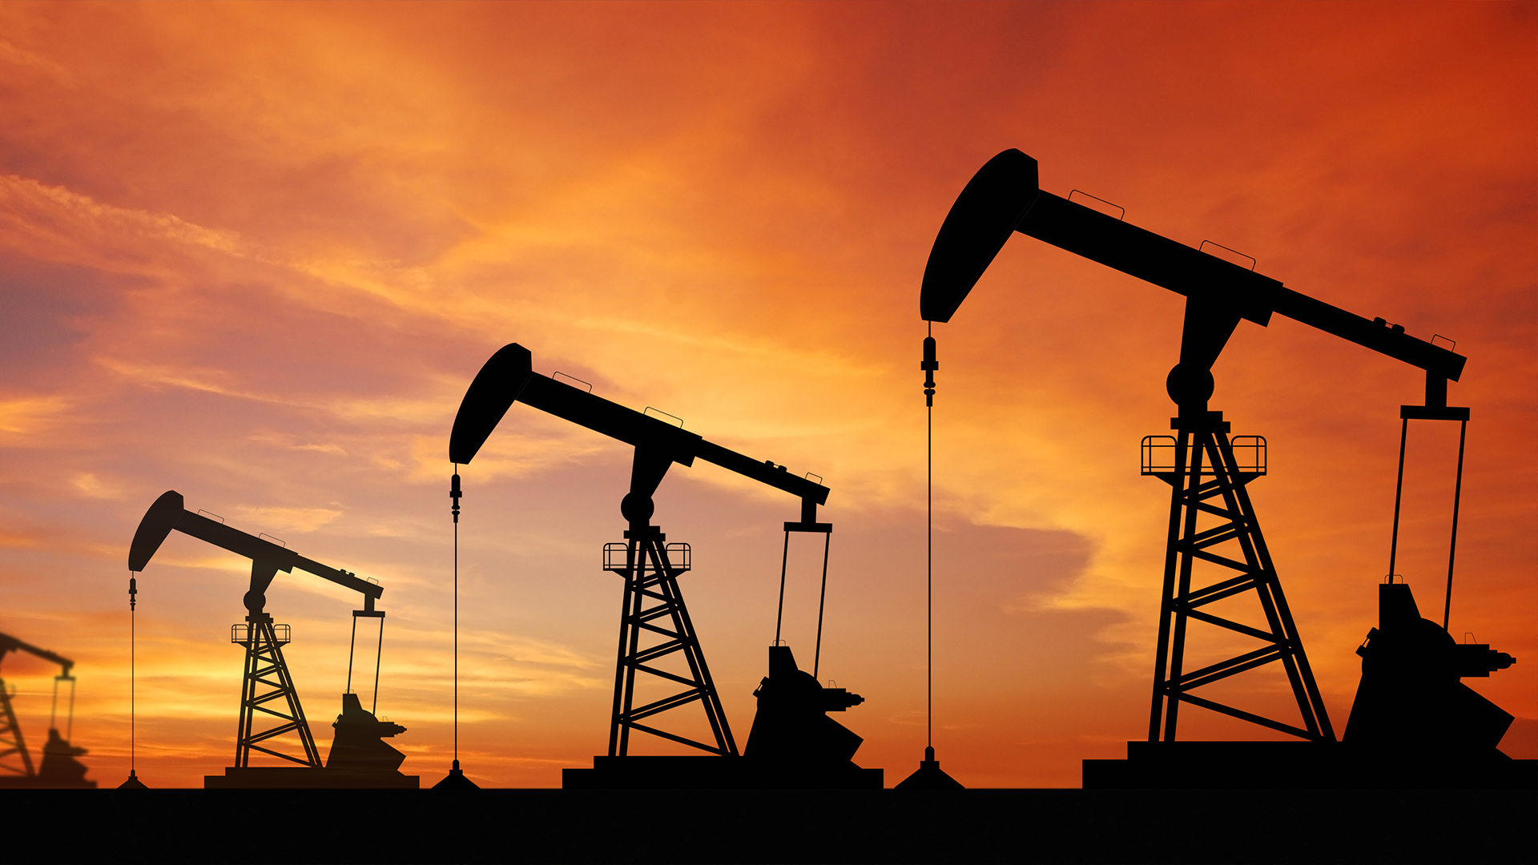
Extract Files: CSV, URL
Annual_Inflation_by_GDP_Deflator.csv
inflation.csv
inflation_interest_unemployment.csv
income_growth.csv
https://www.thebalance.com/u-s-inflation-rate-history-by-year-and-forecast-3306093

Slide 4
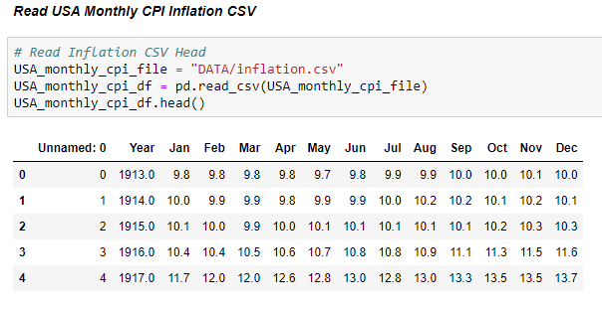
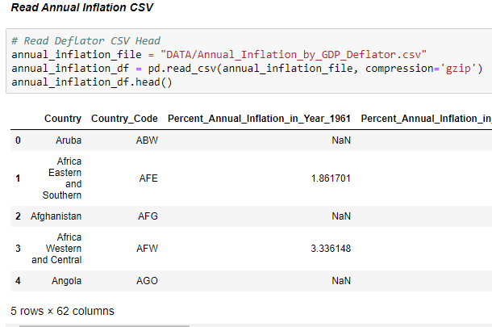
Extract Annual_Inflation_by_GDP_Deflator.csv & inflation.csv

Slide 5
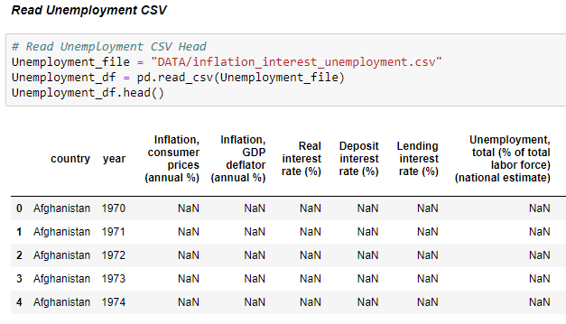
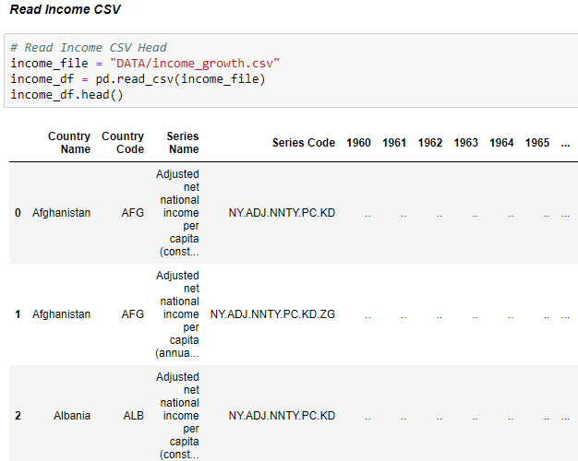
Extract inflation_interest_unemployment.csv & income_growth.csv

Slide 6
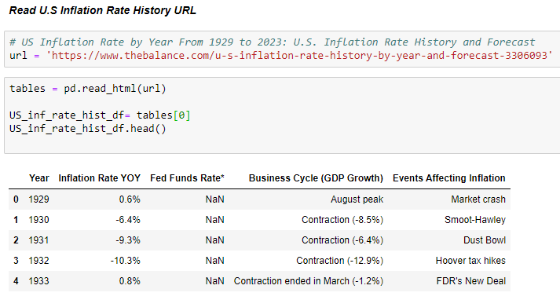
Extract https://www.thebalance.com/u-s-inflation-rate-history-by-year-and-forecast-3306093

Slide 7

Transform

Slide 8
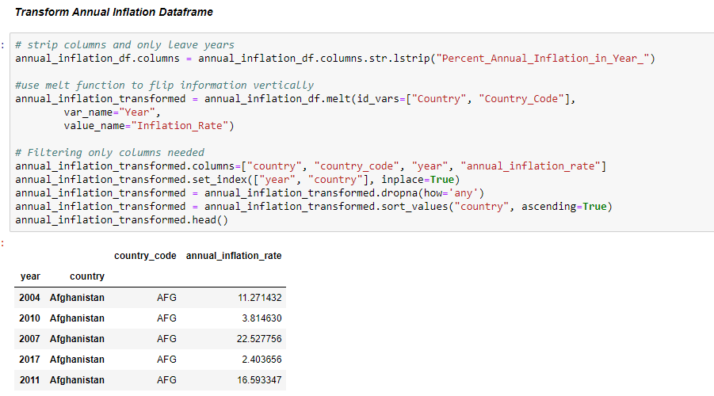
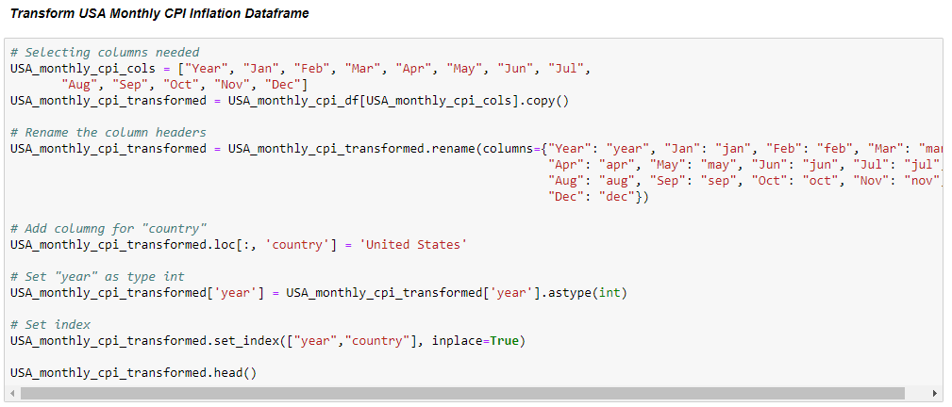
Transform Annual_Inflation_by_GDP_Deflator.csv & inflation.csv

Slide 9
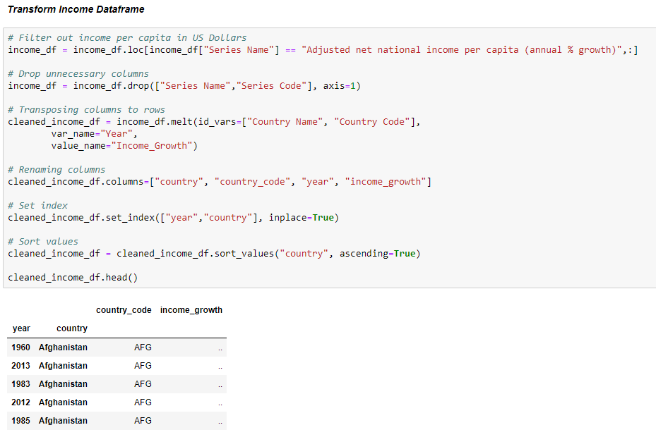
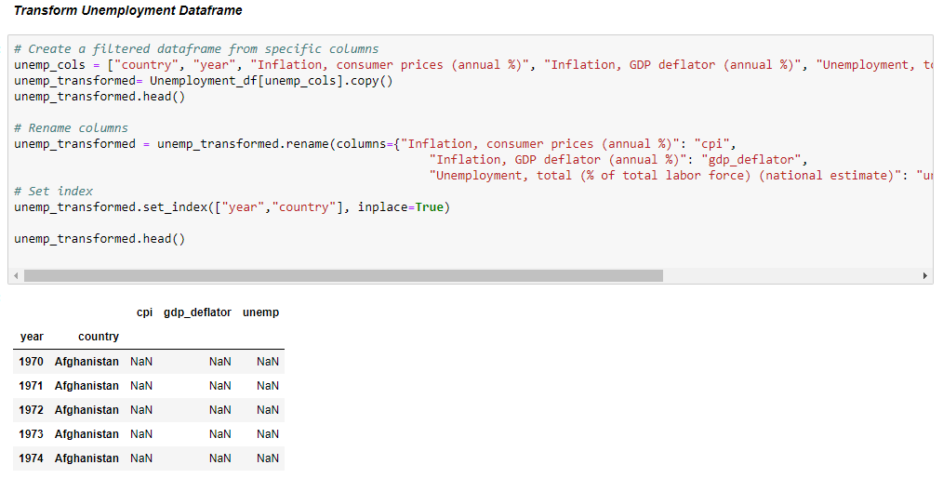
Transformed inflation_interest_unemployment.csv & income_growth.csv

Slide 10
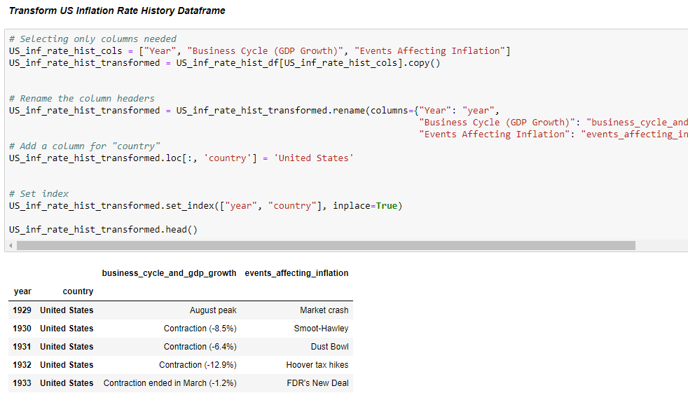
Transform https://www.thebalance.com/u-s-inflation-rate-history-by-year-and-forecast-3306093

Slide 11
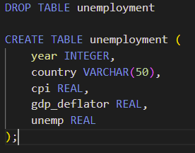
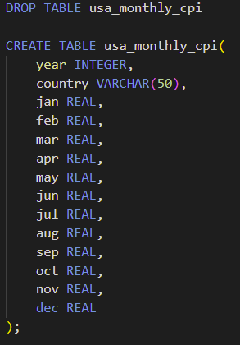
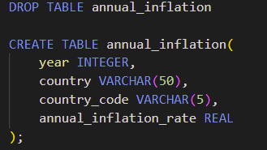
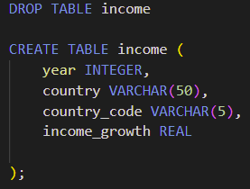
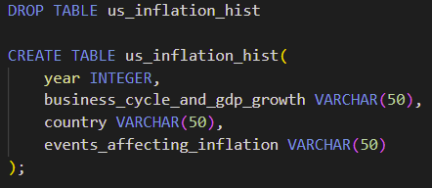
Schema

Slide 12

Load

Slide 13
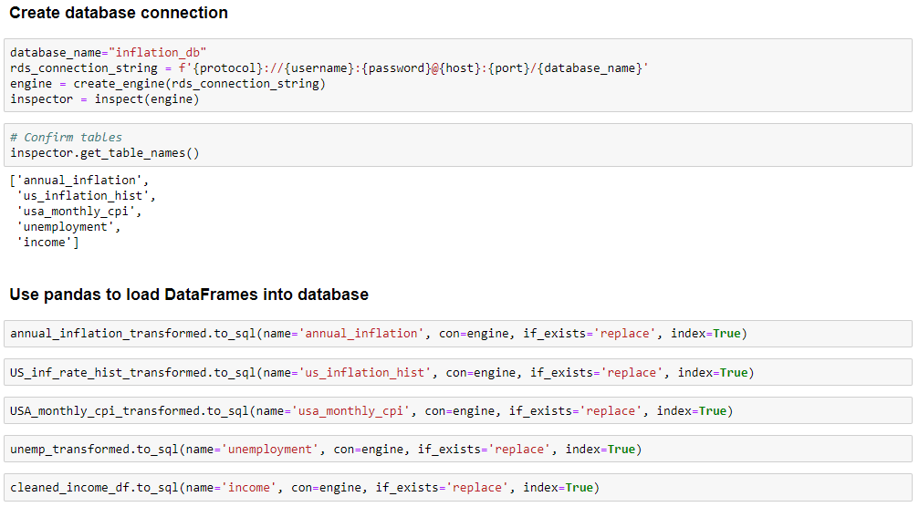
Load 1) create_engine 2) inspector 3) pandas to load

Slide 14
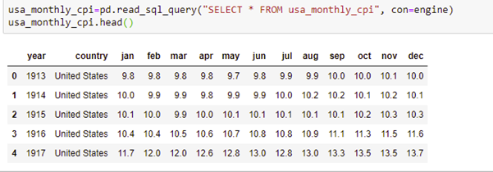
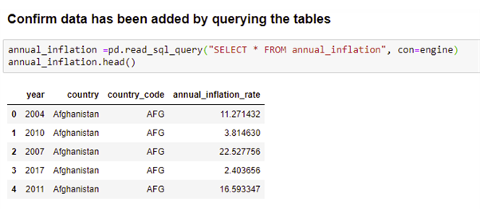
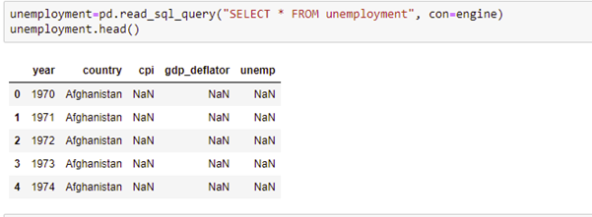
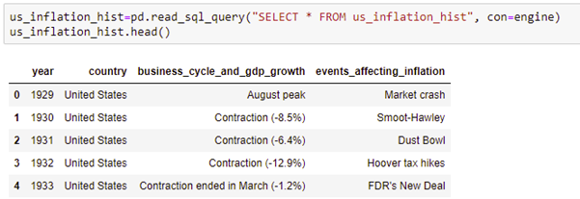
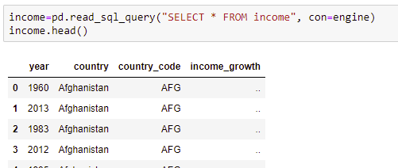
Load Confirm Data load

Slide 15

Story Time
On average how long has an inflation or deflation lasted?
What precedent world events are similar to events happening in the world now, and how will this affect current inflation rates within the next two years in the U.S?
Have annual income growth and employment rates kept up with the changes from annual inflation rates in the past?
Knowing that the Federal Reserve intervenes when inflation rate is not at a healthy 2%, then by looking at annual inflation rates we can predict the Federal Reserve’s next move. It will either be an Expansion to slow down inflation or a Contraction during a recession.

Slide 16
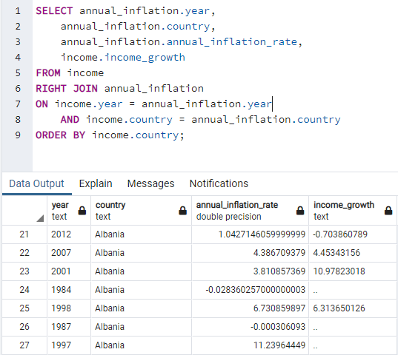
pgAdmin Table Joining

Slide 17
Limitations
Time Zone (Spain)
Format Columns to match
Reading Large Files (Zip)
Reformatting Date within Database

Slide 18
Resources
https://www.kaggle.com/datasets/neelgajare/usa-cpi-inflation-from-19132022
https://www.kaggle.com/datasets/prasertk/inflation-interest-and-unemployment-rate
https://data.world/johnsnowlabs/annual-inflation-by-gdp-deflator
https://databank.worldbank.org/source/world-development-indicators#
https://www.thebalance.com/u-s-inflation-rate-history-by-year-and-forecast-3306093

Slide 19

Questions

