Slide 1
FPT algorithmic techniques:
Treewidth (1)
Hans L. Bodlaender
Notes:
© Hans Bodlaender, May/June 2007

Slide 2
This talk
Roots of treewidth
Definition
Some applications
Using treewidth to obtain FPT algorithms
Conclusions

Slide 3
1. Roots
Resistance of network of resistors
Problems on trees and series parallel graphs
Gauss elimination

Slide 4

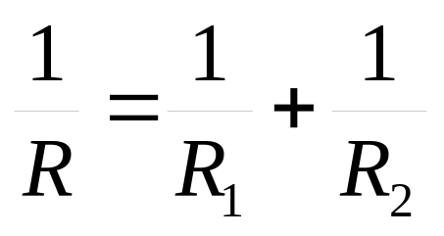
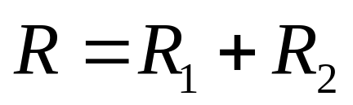
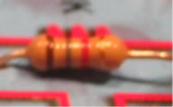
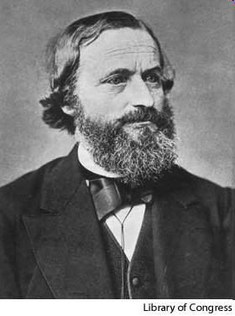
Computing the Resistance of Network of Resistors
Ohm
1789-1854
R₁
R₂
R₁
R₂
Kirchhoff
1824-1887

Slide 5
Repeated use of the rules
Has resistance 4
6
6
5
2
2
1
7
1/6 + 1/2 = 1/(1.5)
1.5 + 1.5 + 5 = 8
1 + 7 = 8
1/8 + 1/8 = 1/4

Slide 6
A tree structure
5
P
7
6
2
S
S
P
P
5
7
1
1
6
2
6
2
6
2

Slide 7
Series parallel graphs
Graphs formed by series composition and parallel composition are series parallel graphs
1970’s and 1980’s: Many (NP-hard) problems are linear (or polynomial) time solvable on series parallel graphs and trees
Series parallel graphs have treewidth at most 2

Slide 8
Trees
Many NP-hard problems are linear time solvable on trees
  Often with Dynamic Programming
  Trees have treewidth one
Trees: glue with one vertex
Series parallel graphs: glue with two vertices.
Treewidth: glue with k vertices…

Slide 9
Gauss elimination of sparse symmetric matrices
Eliminating a row and column when doing Gauss elimination in a sparse symmetric matrix may create new non-zero elements
When we eliminate row/column k, a_{ij} can become non-zero when
a_{ik} ≠ 0 and a_{jk} ≠ 0

Slide 10
Symmetric matrix =
Undirected graph
Take vertices 1, 2, …, n, and edge {i,j} whenever a_{ij} ≠ 0
0 | 1 | 0 | -3
1 | 0 | 4 | 0
0 | 4 | 0 | 2
-3 | 0 | 2 | 0
1
2
3
4

Slide 11
Gauss elimination as
Graph elimination
Eliminating a vertex:
  Make its neighborhood a clique and then remove the vertex
Different vertex orderings (elimination schemes) are possible
  Fill-in: minimum over all elimination schemes of number of added edges (new non-zero’s)
  Chordal graphs: fill-in 0
  Treewidth: minimum over all elimination schemes of maximum degree of vertex when eliminated (min max number of non-zero’s in a row when eliminating row)

Slide 12
2. Treewidth
Birth
Definition
Complexity
Representation as ordering problem

Slide 13
Birth of treewidth
In 198*’s, several researchers independently invented similar notions:
  Partial k-trees (Arnborg, Proskurowski)
  Treewidth and tree decompositions (Robertson and Seymour)
  Clique trees (Lauritzen, Spiegelhalter)
  Recursive graph classes (Borie)
  k-Terminal recursive graph families (Wimer)
  Decomposition trees (Lautemann)
  Context-free graph grammars (Lengauer, Wanke)
Notes:
First, as far as I know: Arnborg and Proskurowski
I hope I do not forget anything
Several WG talks
Treewidth appeared “winning” notion.

Slide 14
Tree decomposition
a
e
A tree decomposition:
  Tree with a vertex set called bag associated to every node.
  For all edges {v,w}: there is a set containing both v and w.
  For every v: the nodes that contain v form a connected subtree.
g
b
c
f
d
a
a
e
g
c
f
a
e
b
c
f
f
c
d

Slide 15
Tree decomposition
a
e
A tree decomposition:
  Tree with a vertex set called bag associated to every node.
  For all edges {v,w}: there is a set containing both v and w.
  For every v: the nodes that contain v form a connected subtree.
g
b
c
f
d
a
a
e
g
c
f
a
e
b
c
f
f
c
d

Slide 16
Tree decomposition
a
e
A tree decomposition:
  Tree with a vertex set called bag associated to every node.
  For all edges {v,w}: there is a set containing both v and w.
  For every v: the nodes that contain v form a connected subtree.
g
b
c
f
d
a
a
e
g
c
f
a
e
b
c
f
f
c
d

Slide 17
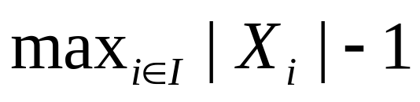
Treewidth (definition)
a
e
g
Width of tree decomposition:
Treewidth of graph G: tw(G)= minimum width over all tree decompositions of G.
b
c
f
d
a
a
e
g
c
f
a
e
b
c
f
f
c
d
a
b
c
d
e
g
f

Slide 18
Complexity
Treewidth Problem:
  Given: Graph G, integer k
  Question: Is the treewidth of G at most k?
NP-complete (Arnborg, Corneil, Proskurowski, 1987)
Results for approximation, special cases, fixed parameter case, heuristics, exact algorithms, …
For our purposes: parameterized version in FPT ( ☹(n) time for fixed k, ☺(n) if n<4)

Slide 19
Related notions 1: Pathwidth
Pathwidth: tree in tree decomposition must be a path
Treewidth ≤ pathwidth
a
a
e
g
c
f
a
e
b
c
f
f

Slide 20
Related notions 2
Branchwidth = minimum width of branch decomposition
Branch decomposition: take a binary tree, and a bijection between the leaves of the tree and the edges of G
Width of an edge e in branch decomposition: number of vertices that are an endpoint of an edge mapped to leaves at both sides of e
Width of branch decomposition: maximum width of edge in branch decomposition
Example on board
Treewidth and branchwidth differ by factor at most 1.5

Slide 21
3. Applications
Solving problems with Dynamic Programming
Probabilistic Networks
Graph minors

Slide 22
Dynamic programming algorithms
Many NP-hard (and some PSPACE-hard, or #P-hard) graph problems become polynomial or linear time solvable when restricted to graphs of bounded treewidth (or pathwidth or branchwidth)
  Well known problems like Independent Set, Hamiltonian Circuit, Graph Coloring
    Experiments (Dorn et al., Pönitz & Tittmann)
  Frequency assignment (Koster et al.)
  TSP (Cook, Seymour)

Slide 23
Dynamic programming with tree decompositions
6
For each bag, a table is computed:
  Contains information on subgraph formed by vertices in bag and bags below it
  Bags are separators =>
  Size of tables often bounded by function of width
Computing a table needs only tables of children and local information
4
5
3
1
2

Slide 24
Monadic second order logic
Linear time algorithm for problems expressible in MSOL or extensions (Courcelle)
  Quantification over vertices, sets of vertices, edges, sets of edges
  Adjacency and incidence checks
  Or, and, not
Also optimization

Slide 25
Example
An MSOL-formulation for 3-coloring

Slide 26
Extension
Min_{W set of vertices} |W|: P(W), with P in MSOL,
Max_{W set of vertices} |W|: P(W), with P in MSOL
Min_{F set of edges} |W|: P(F), with P in MSOL,
Max_{F set of edges} |W|: P(F), with P in MSOL
Example: minimum independent set

Slide 27
Probabilistic networks
Underlying decision support systems
Representation of statistical variables and (in)dependencies by a graph
Central problem (inference) is #P-complete
Lauritzen-Spiegelhalter, 1988: linear time solvable when treewidth (of moralized graph) is bounded
  Treewidth appears often small for actual probabilistic networks
  Used in several modern (commercial and freeware) systems

Slide 28
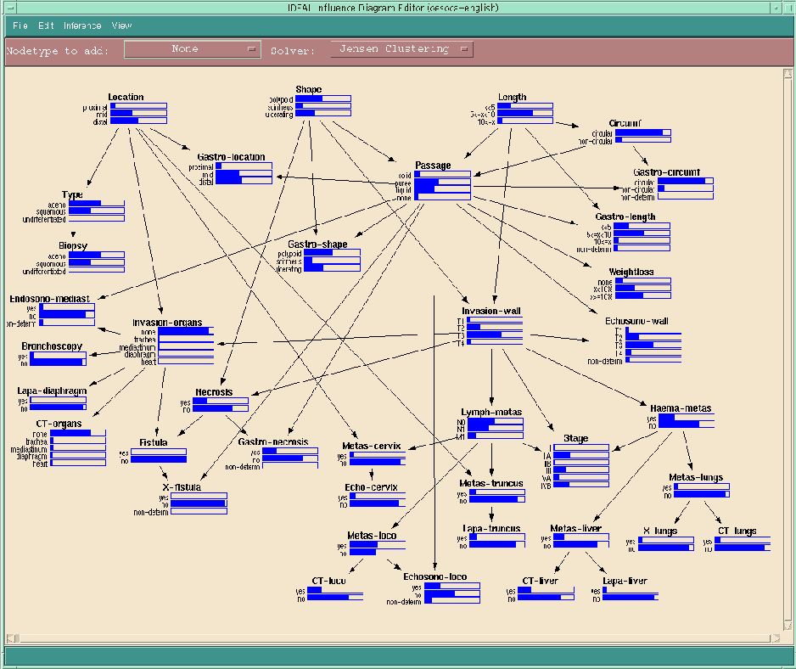
Notes:
Probabilistic network

Slide 29
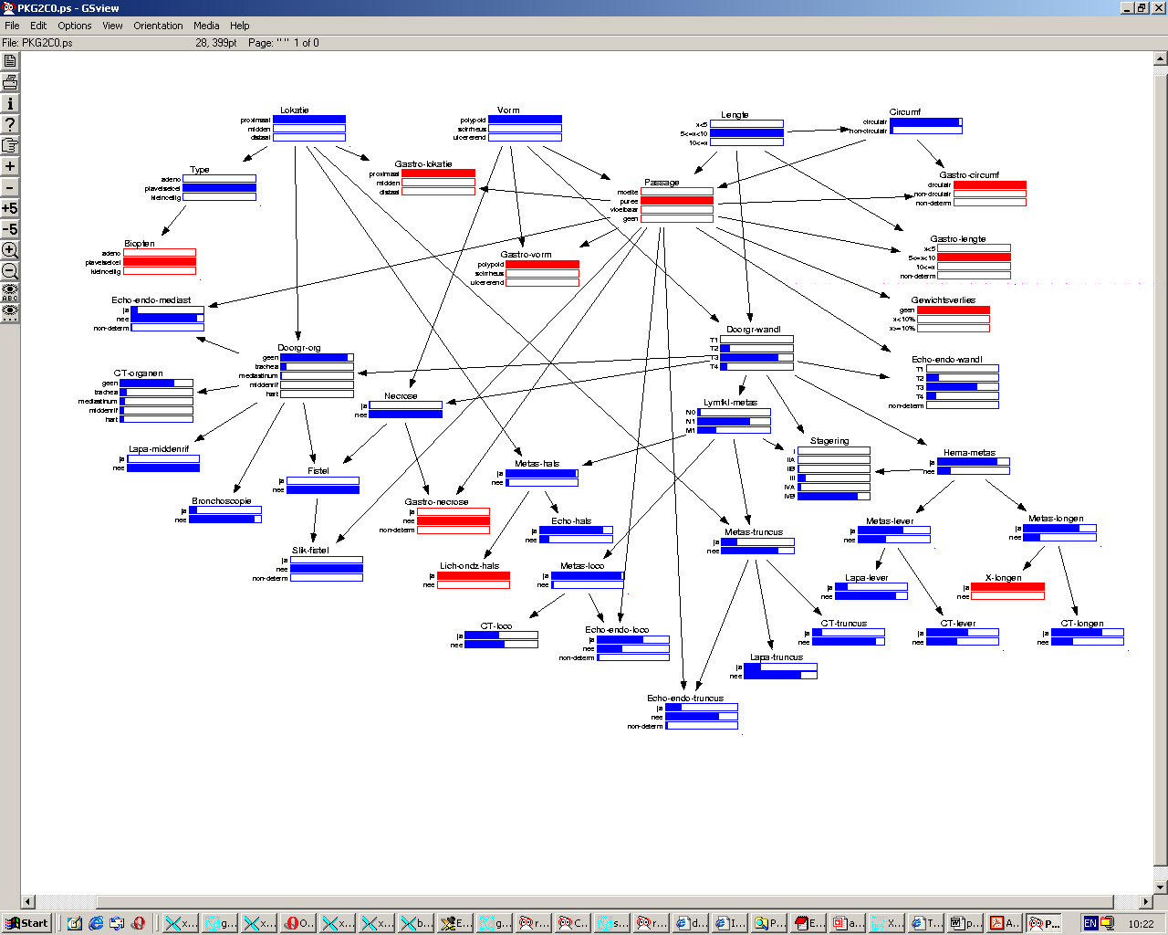
Notes:
Probabilistic network with data given to the system, en inference computed

Slide 30
Graph minors
G is a minor of H, if G can be obtained from H by zero or more vertex deletions, edge deletions and/or edge contractions
Graph minor theorem (Robertson and Seymour)
Let G be a class of graphs that is closed under taking of minors. Then there is a finite set of graphs ob(G), the obstruction set of G, such that a graph H ∈ G, if and only if H has no graph in ob(G) as a minor.

Slide 31
Examples
Obstruction set of planar graphs: {K₅, K_{3,3}}
Obstruction set for forests: {K₃}

Slide 32
Minor testing
For fixed H, testing if H is a minor of a given graph can be done in O(n³) time.
For fixed H, and k, testing if H is a minor of a given graph of treewidth at most k can be done in O(n) time.
Theorem (Robertson and Seymour): For each planar H, there is a constant c_{H}, such that each graph that does not have H as minor has treewidth at most c_{H}.

Slide 33
Decision algorithms
Consequences
  If G is a minor-closed class of graphs, then there exists an O(n³) algorithm for membership-testing for G.
  If G is a minor-closed class of graphs that does not contain all planar graphs, then there exists an O(n³) algorithm for membership-testing for G.
    Do a minor-test for each graph in ob(G).
Non-constructive!

Slide 34
Use of minors
Minor-taking gives sometimes very fast proofs for problems to be in FPT
  If a parameter does not increase when taking minors: O(n³)
  If a parameter does not increase when taking minors, and planar graphs have arbitrary large values: O(n)
Bad news: non-constructive and usually very impractical algorithm

Slide 35
Examples of minor closed classes
Longest Cycle(k):
{G | G does not have a cycle of length at least k}
Longest Path-k
Treewidth-k
Genus:
{G | G can be drawn without crossing edges on a surface of genus k} (Genus of surface: +- number of “ears”)

Slide 36
Example: Interval Routing Schemes
B, Thilikos, Tan, van Leeuwen: use of method for deciding if there is an interval routing scheme
k-Interval routing:
  Label nodes in network by integers 0, 1, …
  Label each outgoing edge at each node by collection of at most k intervals (disjoint, spanning all integers)
  If we want to route a message to a node with label l, then send it, until it reaches its destination, along the edge with an interval that contains l
  This succeeds via shortest route in a valid scheme

Slide 37
Graph class k-IRS
G belongs to k-IRS, if we can label the nodes, such that for each assignment of lengths to edges, there is an assignment of at most k intervals to each outgoing edge, such that the result is a valid scheme
  Variants of this class are also studied, and similar techniques apply
k-IRS is closed under taking of minors!
K_{2,k+1} ∉ k-IRS (from Frederickson and Janardan)

Slide 38
k-IRS is closed under taking of minors
Sketch
  Removing edge is like giving it very large length
  Contracting edge (u,v): give new node label of u
    Is like giving edge (u,v) zero length
    Detail: gap in numbering can be removed easily

Slide 39
Testing membership in k-IRS
Theorem: K_{2,k+1} ∉ k-IRS (from Frederickson and Janardan)
Consequence: For each k, there is a linear time algorithm that tests if a given graph has treewidth at most k.

Slide 40
4. Using treewidth to obtain FPT results
Feedback Vertex Set
Convex tree recoloring

Slide 41
Treewidth as parameter
Many problems of the form
  Given: Graph G, additional information
  Parameter: the treewidth of G
  Question: some question on G
Are linear or polynomial time solvable
However, we can also often solve the ‘usual’ variants of problems with treewidth

Slide 42
Feedback vertex set
Given: graph G=(V,E), integer k
Parameter: k
Question: is there a set of at most k vertices, that, when taken out of G gives a forest
Yes-instances have treewidth at most k+1
  Take a tree decomposition of the forest of width 1
  Add all vertices in the feedback vertex set to each bag

Slide 43
Algorithm for FVS
Check if the treewidth of G is at most k+1
If not: return NO
Else: solve the problem with dynamic programming on the tree decomposition of width at most k+1
  Algorithm uses O(n) time for fixed k

Slide 44
Convex recoloring of trees
Build a graph from T=(V,E)
Add to T a new vertex for each color, and make the color-vertex adjacent to all vertices with that color

Slide 46
Using G to solve the problem
If there is a solution with at most k recolored vertices, then G has treewidth at most 2k+3
  Take a tree decomposition of T of width 1
  Add to each bag the vertices of the colors of the vertices in the bag, and the vertices of all broken colors (at most 2k broken colors)
The problem to decide if T has a convex recoloring with at most k recolored vertices can be formulated as a property in Monadic Second Order Logic on G
Thus, we can decide, for fixed k, in O(n) time

Slide 47
Conclusions: treewidth
Treewidth is a useful tool to show that problems are fixed parameter tractable
Often
  Relatively easy, “fast” proofs and arguments
  Relatively slow algorithms
Sometimes also useful in practice

Slide 48
Conclusions: FPT
Fixed parameter complexity is a fruitful and interesting new research area in algorithm design
Several new (and old) techniques to obtain FPT-algorithms

