Slide 1
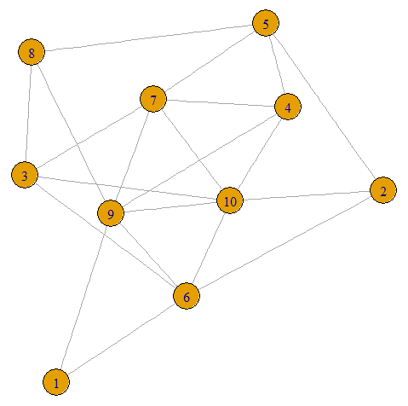

Exploring Rank-Width
Papachristou Dimitra
supervisor: prof. dr. H.L. Bodlaender

Slide 2
Contents
General notions
Definition
Example
My implementation
Experiments
Conclusion & Improvements
Questions

Slide 3
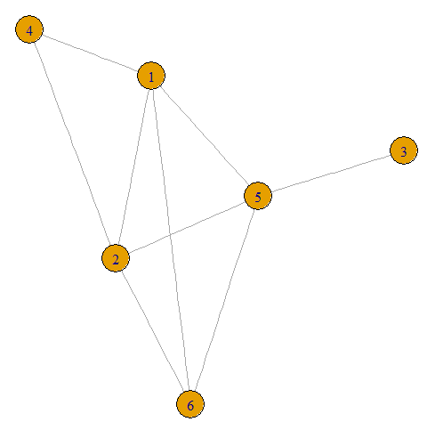
Graph & its adjacency matrix
N: vertices
E: edges

Slide 4
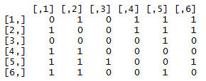
Graph & its adjacency matrix
N: vertices
E: edges
Size: nxn

Slide 5
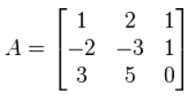
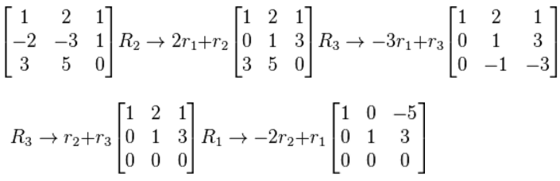
Rank of a matrix (linear algebra)
# of linearly independent rows
row echelon form
elementary row operations
Notes:
^we say rows (#of rows=#of columns) OXI, krataw to smallest one

Slide 6

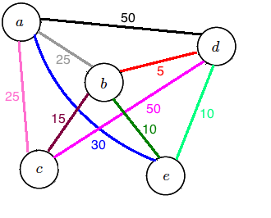

Why Rank-Width is important
Problems in real-life Graph problems NP-hard
solution:
bounded clique-width polynomial time
rank-width efficiently computable approximation of clique-width
Intoduced by Oum and Seymour in 2006
Notes:
Problems in real-life can be translated and handled as graph problems. Most graph problems are known to be NP-hard in general. Now, many hard graph problems (in particular all those expressible in MSO logic of adjacency graphs) are solvable in polynomial time [6, 10, 16, 12], as long as the input graph has bounded clique-width.
rank-width is a rather new structural graph measure introduced by Oum and Seymour in 2003 in order to find an efficiently computable approximation of clique-width of a graph

Slide 7

Definition
M: adjacency matrix of G
Cut-rank of a set A ⊆ V (G) = rank of N ⊆ M
N: rows A columns V(G)\ A
A rank decomposition of G is a pair (T, L)
T: binary tree L: bijection from V(G) to leaves of T
The width of an edge e = cutrank of Ae.
Width of rank-decomposition = max width in T.
Rank-width of G = min width over ALL rank-decompositions
Notes:
A ⊆ V (G)

Slide 8
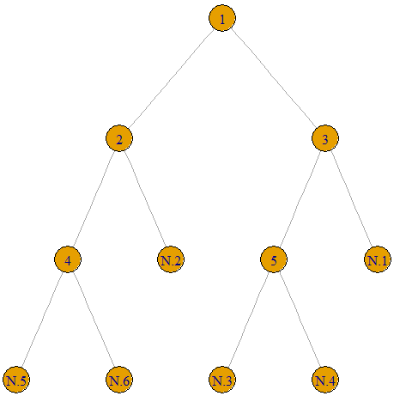
Decomposition
n: # of vertices
internal nodes: n-1
leaves : n
labels: N.1, N.2, …

Slide 10
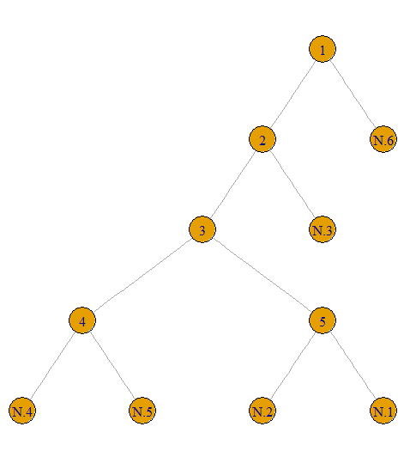
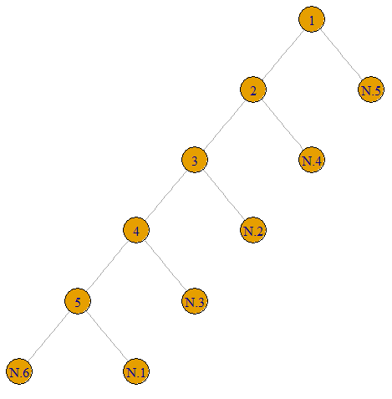
II.
III.
I.

Slide 11

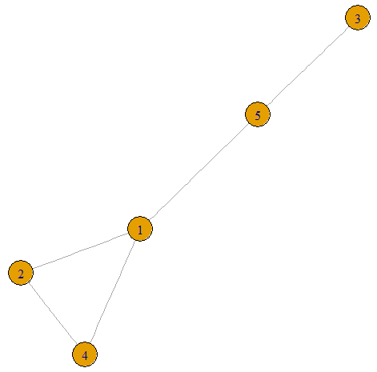
Example

Slide 12
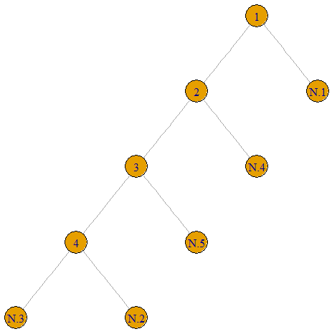
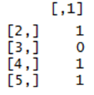
Example (cont.)
Rank:
Node2 – 1
Node3 –
Node4 –
Notes:
Rank of edge=rank of node

Slide 13
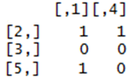
Example (cont.)
Rank:
Node2 – 1
Node3 – 2
Node4 –

Slide 14

Example (cont.)
Rank:
Node2 – 1
Node3 – 2
Node4 – 2
Notes:
Allo paradeigma me diaforetiko rank!!!????

Slide 15
Example (cont.)
Rank:
Node2 – 1
Node3 – 2
Node4 – 2
Width of decomposition = 2
Rank-Width ?

Slide 16
Example (cont.)
Rank:
Node2 – 1
Node3 – 2
Node4 – 2
Width of decomposition = 2
Rank-Width NP-hard

Slide 17

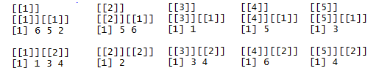
My implementation
Programming Language: Rstudio
Data structure (of decompositions): LIST
Each element (internal node) has
L child R child

Slide 18
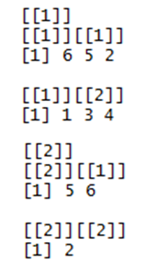
Decomposition of a graph G=(6,E)
Using “igraph” package

Slide 19
IterRandom()
uses a big number of iterations
100 1,000 10,000
creates a random decomposition
calculates the width of that decomposition
outputs the smallest width of these decompositions

Slide 20
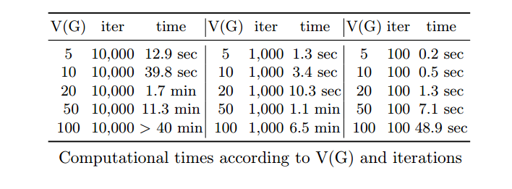
IterRandom()
uses a big number of iterations
100 1,000 10,000
creates a random decomposition
calculates the width of that decomposition
outputs the smallest width of these decompositions

Slide 21
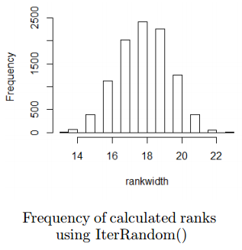
IterRandom()
min width of decompositions NOT UNIQUE
Uses functions:
TreeDecomposition()
RankWidth()
DrawDecop()

Slide 22
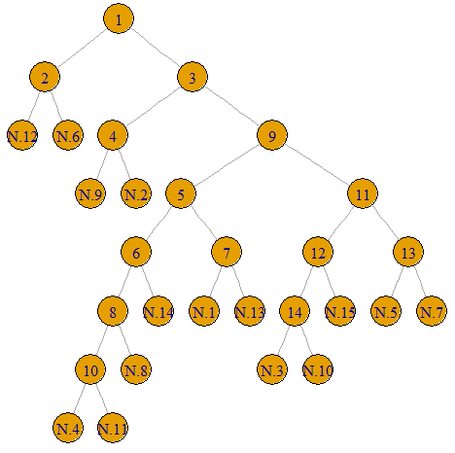
RankLocal()
Initial decomposition: random
Candidates: children of nodes achieving max. rank
Neighborhood: “available” leaves
End criteria: no improvement

Slide 23
RankLocal()

Slide 24
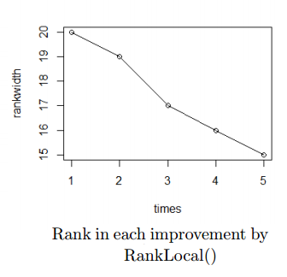
RankLocal()
Uses functions:
TreeDecomposition()
RankWidth()
Replace()
DrawDecop()

Slide 25
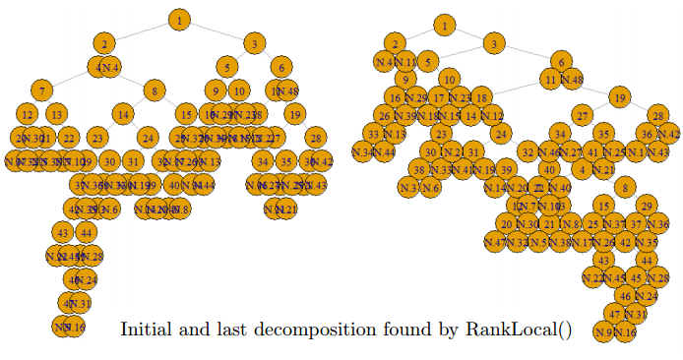
RankLocal()

Slide 26
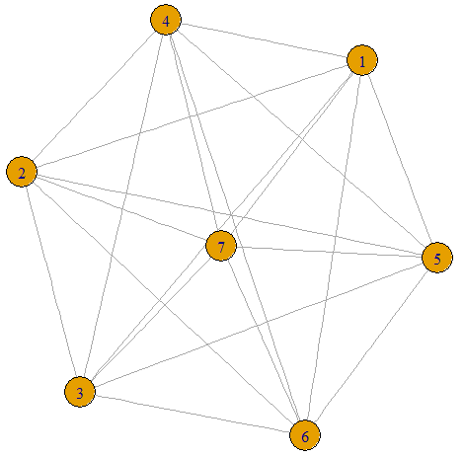
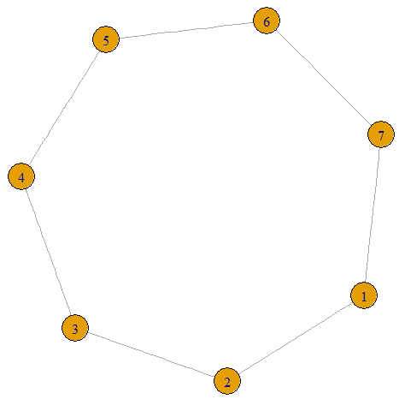
Experiments
Tested properties of Rank-Width:
The rank-width of a complete graph is always 1
The rank-width of a cycle Cn is 1 for n 4 and 2 otherwise
Notes:
IterRandom not ok for n>=4. IterRandom difficulties!!!!!!!We will see later….

Slide 27
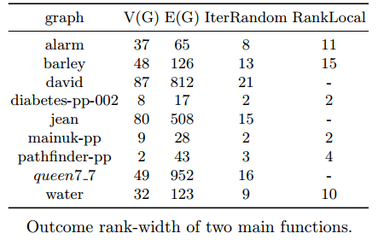
Experiments
9 graphs from TreewidthLIB

Slide 28
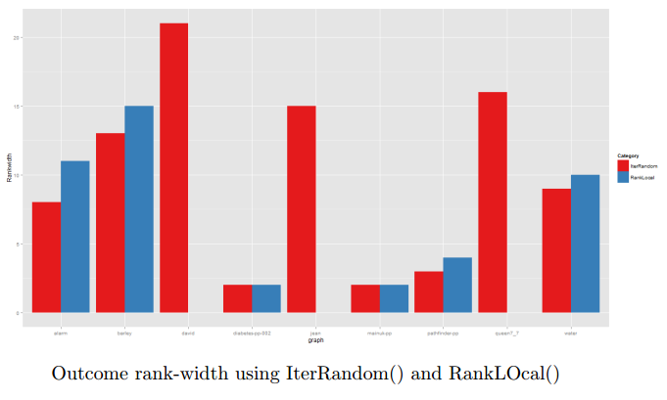
Experiments

Slide 29
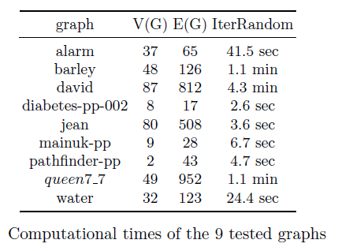
Experiments
RankLocal()
diabetes-pp-002, mainuk-pp,
pathfinder-pp
< 10 sec.
water 11 minutes
alarm 25 minutes

Slide 30
Conclusions & Improvements
IterRandom()
fast
accurate
not tested for BIG graphs
RankLocal()
- fast for small graphs, slow for bigger
- depends on initial decomposition

Slide 31
Conclusions & Improvements
IterRandom()
fast
accurate
not tested for BIG graphs
RankLocal()
- fast for small graphs, slow for bigger
- depends on initial decomposition
Level of randomness
No repeat
Guide the construction
Same for initial decomposition
Less candidates

Slide 32
Conclusions & Improvements
IterRandom()
fast
accurate
not tested for BIG graphs
RankLocal()
- fast for small graphs, slow for bigger
- depends on initial decomposition
Level of randomness
No repeat
Guide the construction
Same for initial decomposition
Less candidates
Research about the structure of decomposition(s) achieving min width
Linear algebra

Slide 33
Questions?

