Slide 1
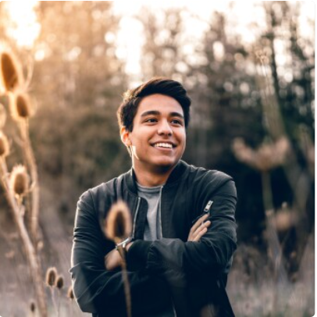





Bio
Maud is an international student. He is a freshman in the family of university. During the period of studying, he does not want to merely focus on academic career, as well as, meet more new friends and learn some useful skill.
Technical Capability
Website ★★★★☆
Software ★★★☆☆
Mobile app ★★★★★
Favourite Phone Brand
Goal
desire to push himself to be sociable
At least attend two social groups on our web
Meet more friends who have the same interest
Privacy data must be secured on our web
Maud Leonard
“The preparation for the ritual is the ritual”
Age: 21
Society: None
Accessibility: None
Work: History of Art Student
Family: Father and mother
Location: Birmingham, UK
Personality: Introversive
Favourite App
Frustrations
He dislikes too complicated recommend feature
He really needs a Simple system to check the subscription
Need some notifications to remind himself on events

