Slide 1

AUTOMATED Machine learning
Panagiotis Papaemmanouil
Course: Machine Learning, 1st Semester, 2019-2020
Professor: Ioannis Vlahavas
Department of Informatics, AUTh

Slide 2
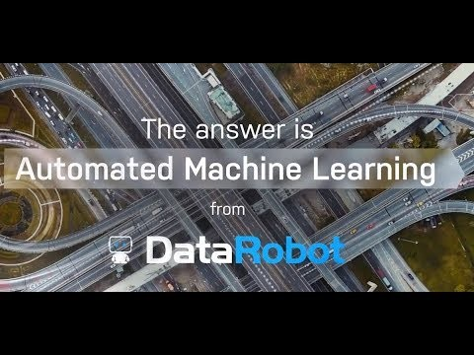
WHY automated machine learning?
https://www.youtube.com/watch?v=TlqML5gkVWg

Slide 3
presentation outline
Automated Machine Learning motivation
What is automated machine learning?
Applications of Auto ML at every step of ML pipeline
Advantages / Risks of Auto ML
The future of Auto ML
Auto ML tools
Conclusions

Slide 4
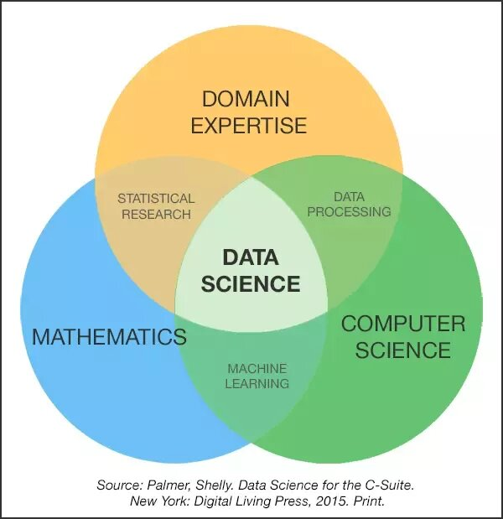
List of skills required to be a Data Scientist.
1. Knowledge of the business domain and
business problems
2. Knowledge of the data
3. Ability to write code to gather data
4. Ability to write code to explore/inspect data
5. Ability to write code to manipulate data
6. Ability to write code to extract insights
7. Ability to write code to build models
8. Ability to write code to implement models
9. Statistics
10. Internal of Algorithms
11. Practical Knowledge and experience
12. Knowing how to interpret and explain models
Real Data scientists are rare creatures!

Slide 5
Automated Machine learning motivation
Businesses needs: Expertise, Speed, Trust
There is a lack of skilled data scientist
Model building is complex and time consuming
Business users lack data science expertise
Data Science challenges:
Combinatorial complexity (Large number of features and candidate models)
A lot of iterative time consuming tasks (data cleaning, hyperparameters tuning)

Slide 6
The answer requires:
Automation
Expertise
Enterprise scale
The answer is Automated Machine Learning!

Slide 7
What is Automated Machine learning?
“Automated Machine learning refers to the automated process of feature engineering, algorithm selection, hyperparameter tuning, iterative modeling, and model assessment.
It is NOT automated data science, nor automated development of artificial intelligence. It is, however, transforming model building.”
Definition by Data Robot

Slide 8
Traditional Machine Learning pipeline ML still requires a lot of manual programming
What steps can be possibly automated?

Slide 9
Auto ML aims to automate the entire ML workflow

Slide 10
Auto ml tools in every step of machine learning pipeline
Step 0: Machine Learning task definition
Step 1: Collecting raw data/ Merging data sources
Step 2: Cleaning raw data
Step 3: Feature Engineering
Step 4: Model selection
Step 5: Hyperparameter tuning
Step 6: Model validation
Step 7: Deployment

Slide 11
Step 1: Automatic feature engineering (I)
Feature Engineering tasks:
Feature Cleaning
Feature Preprocessing
Feature Extraction
Feature Selection
Motivation
Identify most relevant features to improve model performance
Maybe create new feautures
Reduce model training time without degrading score

Slide 12
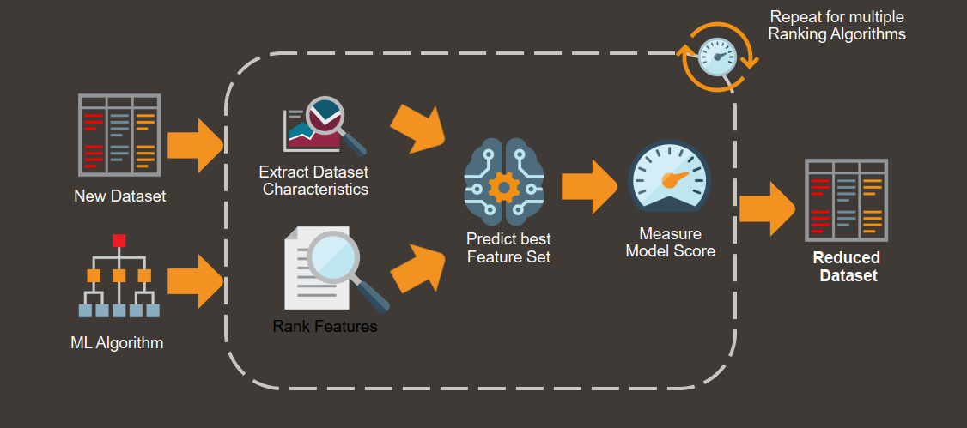
Step 1: Automatic feature engineering (II)

Slide 13
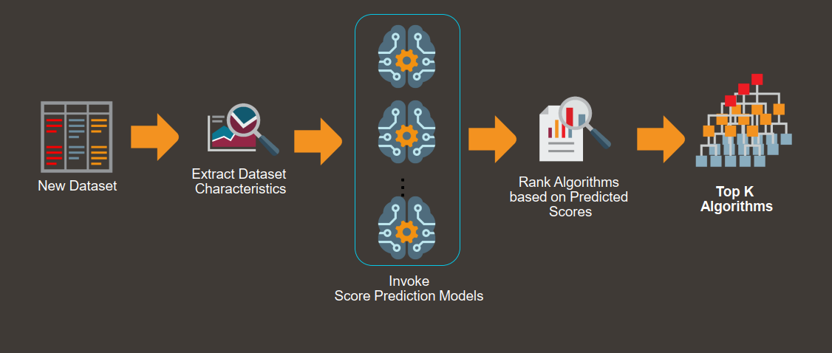
STEP 2: Automatic Algorithm Selection
Motivation
There is no best algorithm for all problems
Best algorithm it is not intuitive
Complex models are not always optimal (bias-variance trade-off)

Slide 14
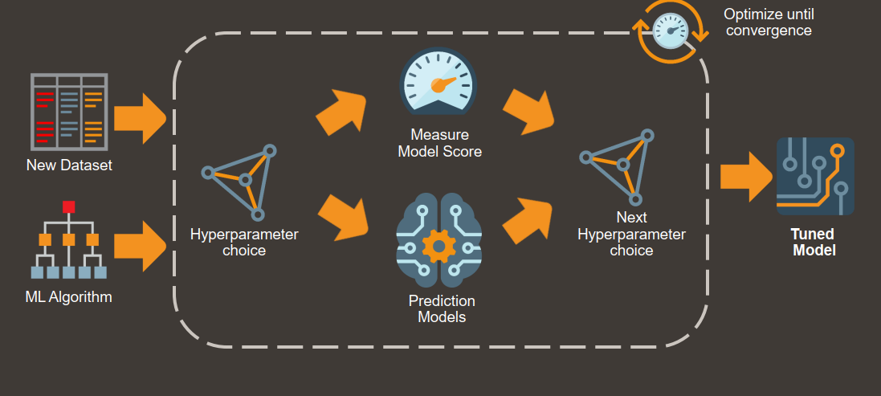
STEP 3: Hyperparameter tuning
Motivation
Default parameters are almost always bad
Hyperparameter tuning requires a lot of repeating experiments
Selection of best hyperparameters set is based on experiments and heuristics

Slide 15
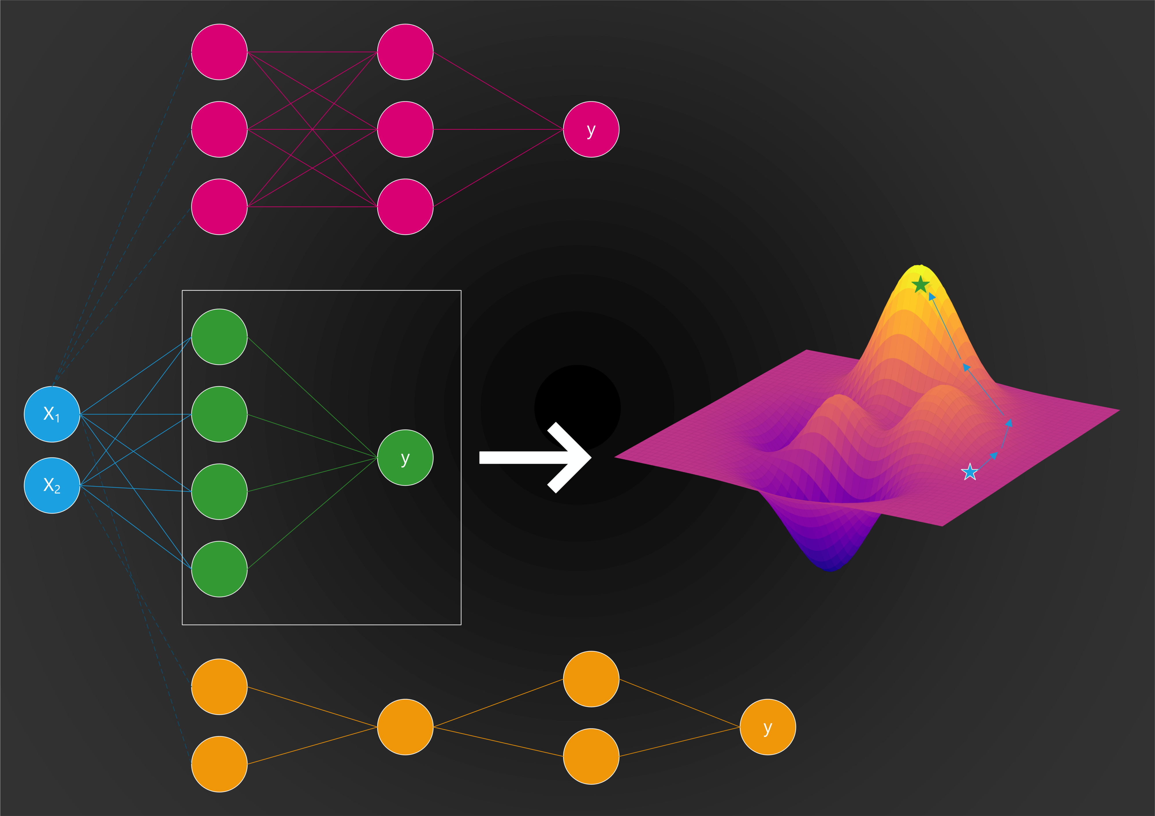
Automated Deep Learning Network architecture Search (NAS)
NAS approaches taxonomy;
Search space
Search strategy
Performance estimation strategy

Slide 16
Combinatorial complexity Search space (Need for optimal search strategies!)
Brute force approaches (grid search, random search)
Smarter approaches (adaptive search)
Bayesian optimization
Genetic programming
Multiarmed bandit
Meta-learning

Slide 17
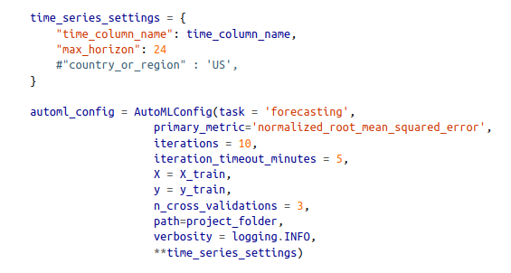
How do Auto ML tools Look like?
ML tools are accessible via
web interface or
simple API through a scripting language
Steps:
1. Define configuration (task, target, time)
2. Select the dataset
3. Hit the start button
Output:
Recommended model, preprocessing steps, description of features, hyperparameters, model details, visualizations, explanations, logs etc.

Slide 18
Advantages
Speed up the development process. Huge time saver.
Fast experimentation.
Automatically search an entire space of candidate Machine learning pipelines and
returns the best one. Shows what approaches are the best for the specific dataset
and the specific task.
Handles the boring stuff (hyperparameter tuning etc.) and helps
the data scientist to focus on important things (business problem modeling)
Democratization of Machine Learning
No need for programming skills and/or understanding of Machine Learning
(I’m not sure this is an advantage)

Slide 19
Disadvantages
Not fully automated
Not customized solutions.
Not human competitive (yet)
There aren’t any Reinforcement Learning applications.
Lack of domain knowledge. Poor feature extraction skills.

Slide 20
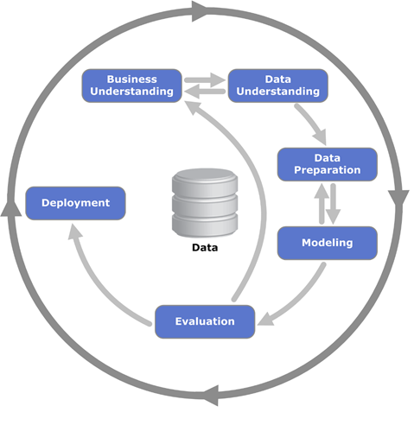
Role of The modern data scientist.
Are the Data Scientist role in danger? No!
Auto ML it is just a Productivity tool
Virtual assistant
The purpose of AutoML is to free data scientists from the burden of repetitive and time-consuming tasks.
What is the core job of the modern Data Scientist?
Transform the business problem to a Machine Learning problem.
Problem formulation, modeling
Debugging of ML model
Implement the remaining pipeline

Slide 21
Auto ML is another powerful tool in our toolkit! Yay!

Slide 22
The future of automated machine learning

Slide 23
Auto ML in the near future
Auto ML will also handle most of the data cleaning process
Unstructured data → tabular data ready for analysis
Capture & automate human approaches to data cleaning
Auto ML will vastly improve Deep Learning
Automated DNN architecture design
Automated preprocessing of data prior to modeling
Auto ML will scale to large datasets
Auto ML is very slow right now on “Big Data”
Spark, dask, TensorFlow, etc. will help bring Auto ML to scale
Auto ML will become human-competitive
Already human-competitive on several Kaggle challenges
Already human-competitive in DNN architecture design (Google AutoML)

Slide 24
Auto ML in the future
Auto ML will transform the practice of data science as we know it
“Data Science Assistant” → Junior Data Scientist level
Less focus on choosing the right ML workflow
More focus on posing the right questions, collecting & curating the right data, and “thinking like a data scientist”
Auto ML will become productized
Not AutoMLaaS!
“Siri, set an alarm for 6am” → “Siri, set an alarm for the best time for me to wake up”
“Siri, [given my personal medical history] should I worry about this rash on my face?”
AutoML is only a small part of a greater meta-learning movement
Computer programming is focused on automating rote tasks
Machine learning is focused on automating the automation of rote tasks
Meta-learning is focused on automating the automation of automation
i.e., enabling the machine to learn how to learn in the best way possible

Slide 25
Auto ML tools
Add system dependencies!

Slide 26
Commercial Auto ML Tools
Data Robot
- web based interface
- Fixed search over thousands of ML pipelines.
H2O.ai Driverless AI.
- Web-based interface.
- H2O.ai AutoML + better feature construction.
Google AutoML.
- Integrated in the Google Cloud Compute platform.
- DNN architecture search.
SAS Factory Miner.
- Fixed search over a handful of ML methods.
IBM SPSS Modeler/ IBM Watson
- Basic automated data preparation and ML modeling.
Oracle Machine Learning
Integrated auto ml tools with Oracle databases
Amazon Web services
Microsoft Azure auto ML

Slide 27
Open-source Auto ML tools
Auto-sklearn [Python]
- Bayesian optimization over a fixed 3-step
ML pipeline.
- github.com/automl/auto-sklearn
Auto-Weka [Java].
- Similar to auto-sklearn, but build
on top of Weka.
- github.com/automl/autoweka
TPOT [Python].
- Genetic programming over a configurable
ML pipeline.
- github.com/EpistasisLab/tpot
H2O.ai AutoML [Java w/ Python, Scala & R APIs
and web GUI].
- Basic data prep w/ mix of grid and
random search over ML algorithms.
- github.com/h2oai/h2o-3.
Devol [Python].
- Deep learning architecture search via genetic programming.
- github.com/joeddav/devol
Auto – keras
Featuretools
ML-box
ML-jar

Slide 28
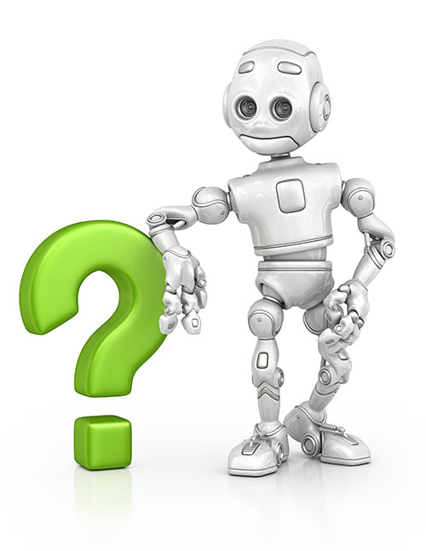
Thank you for your attention! Any questions?

