Slide 1

HI MY ANGEL AUNTY@SUPPU
THESE ARE THE BEST WISHES TO YOU
FROM UR ANGEL “ PRATHYUSHA”.

Slide 2
THIS IS BEST OPENING TO U FOR NEW YEAR FROM UR “ANGEL”
Wish you all the best for your future carrer.
I hope and pray to god that your life can become more Beautiful and mush stronger than now. All your Dreems come true my dear.
I am very happy for having u as my best friend.
Thank you so much for your best support in my
life.

Slide 3
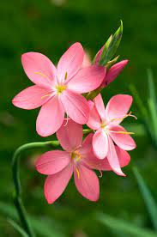
SUPPU
HAPPY NEW YEAR

