Slide 2
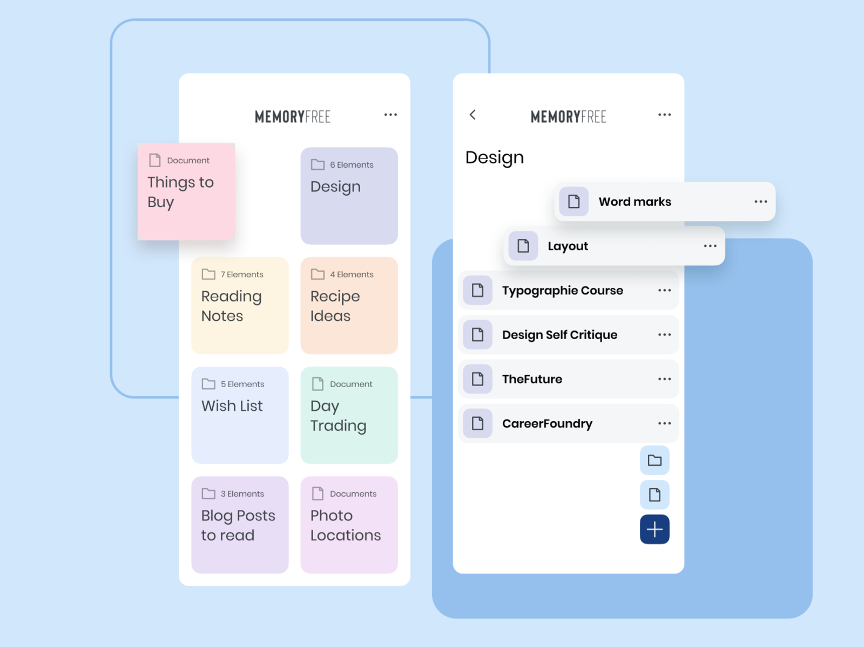



Target application
Create an application that handles a list of tasks/notes/memos
FRONTEND
APIS
BACKEND
Server
Database
https://dribbble.com/shots/3981527-memo/attachments/10130698?mode=media

Slide 3
Development environment
Programming Language:
Php
Java
Js
Python
Framewok:
Django
Flask
Fastapi
Code Editor:
Visual Studio
IDLE
VIM
Notepad++
VScode
Other Technologies
Git
Docker

Slide 4
Initial installation
Install fastapi (Ubuntu)
pip install "fastapi[all]“
https://fastapi.tiangolo.com/tutorial/

Slide 5
First run
from typing import List
from fastapi import FastAPI
from fastapi.responses import JSONResponse
from pydantic import BaseModel
from typing import List
app = FastAPI()
@app.get("/")
async def root():
return "Hello Advanced Programming....."
Save a file as course.py
Navigate to folder
To run
uvicorn course:app --port 10000 --reload
Check result
http://localhost:10000/
http://localhost:10000/docs
(course1.py in github)

Slide 6
Get API (1/X)
from typing import List
from fastapi import FastAPI
from fastapi.responses import JSONResponse
from pydantic import BaseModel
from typing import List
app = FastAPI()
my_memos={
"AdvProgCourse":"Do not forget projects" ,
"JuneExams":"Study" ,
"Vacations":"Make resrvations"
}
@app.get("/")
async def root():
return "Hello Advanced Programming....."
@app.get("/getNotes")
async def getNotes():
return my_memos
Check result
http://localhost:10000/getNotes
http://localhost:10000/docs
(course2.py in github)

Slide 7
Get API (3/X)
from typing import List
from fastapi import FastAPI
from fastapi.responses import JSONResponse
from pydantic import BaseModel
from typing import List
class Memo(BaseModel):
Title: str
Content: str
class Error(BaseModel):
code: int
reason: str
app = FastAPI()
my_memos={
"AdvProgCourse":"Do not forget projects" ,
"JuneExams":"Study" ,
"Vacations":"Make resrvations"
}
@app.get("/")
async def root():
return "Hello Advanced Programming....."
@app.get("/getNotes",
response_model=List[Memo],
responses={404: {"model": Error}},
tags=["READ"],
summary="List current memos",
)
async def getNotes():
my_memos_list=list()
for key, value in my_memos.items() :
print (key, value)
tmp_memo=Memo(Title=key,Content=value)
my_memos_list.append(tmp_memo)
return my_memos_list
(course3.py in github)

