Slide 2
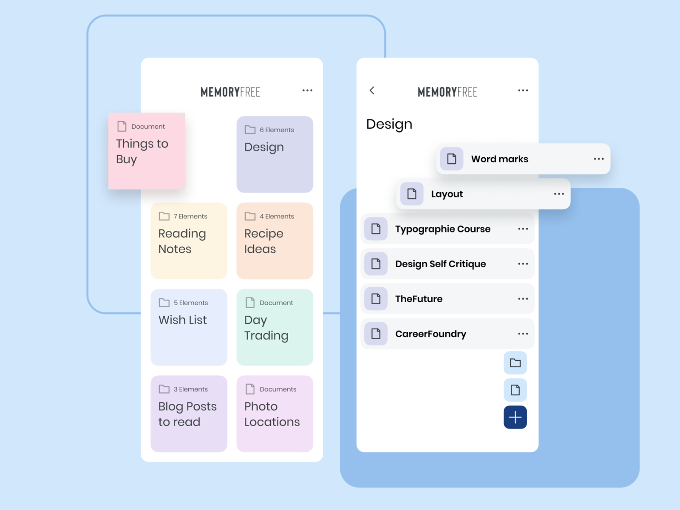



Target application
Create an application that handles a list of tasks/notes/memos
FRONTEND
APIS
BACKEND
Server
Database
https://dribbble.com/shots/3981527-memo/attachments/10130698?mode=media

Slide 3
Development environment
Programming Language:
Php
Java
Js
Python
Framewok:
Django
Flask
Fastapi
Code Editor:
Visual Studio
IDLE
VIM
Notepad++
VScode
Other Technologies
Git
Docker

Slide 4
Initial installation
Install fastapi (Ubuntu)
pip install "fastapi[all]“
https://fastapi.tiangolo.com/tutorial/

Slide 5
First run
from typing import List
from fastapi import FastAPI
from fastapi.responses import JSONResponse
from pydantic import BaseModel
from typing import List
app = FastAPI()
@app.get("/")
async def root():
return "Hello Advanced Programming....."
Save a file as course.py
Navigate to folder
To run
uvicorn course:app --port 10000 --reload
Check result
http://localhost:10000/
http://localhost:10000/docs
(course_1.py in github)

Slide 6
Get API (get all notes ) (1/3)
from typing import List
from fastapi import FastAPI
from fastapi.responses import JSONResponse
from pydantic import BaseModel
from typing import List
app = FastAPI()
my_memos={
"AdvProgCourse":"Do not forget projects" ,
"JuneExams":"Study" ,
"Vacations":"Make resrvations"
}
@app.get("/")
async def root():
return "Hello Advanced Programming....."
@app.get("/getNotes")
async def getNotes():
return my_memos
Check result
http://localhost:10000/getNotes
http://localhost:10000/docs
(course_2.py in github)

Slide 7
Get API (get all notes ) (2/3)
from typing import List
from fastapi import FastAPI
from fastapi.responses import JSONResponse
from pydantic import BaseModel
from typing import List
class Memo(BaseModel):
Title: str
Content: str
class Error(BaseModel):
code: int
reason: str
app = FastAPI()
my_memos={
"AdvProgCourse":"Do not forget projects" ,
"JuneExams":"Study" ,
"Vacations":"Make resrvations"
}
@app.get("/")
async def root():
return "Hello Advanced Programming....."
@app.get("/getNotes",
response_model=List[Memo],
responses={404: {"model": Error}},
tags=["READ"],
summary="List current memos",
)
async def getNotes():
my_memos_list=list()
for key, value in my_memos.items() :
print (key, value)
tmp_memo=Memo(Title=key,Content=value)
my_memos_list.append(tmp_memo)
return my_memos_list
(course_3.py in github)

Slide 8
Get API (get specific note)(3/X)
@app.get("/getNote/{memo_title}",
response_model=Memo,
responses={
401: {"model": Error},
404: {"model": Error}
},
tags=["READ"],
summary="List a specific memo",
)
async def getNote(memo_title):
if memo_title in my_memos:
selected_memo=Memo(Title=memo_title,Content=my_memos[memo_title])
return selected_memo
else:
error=Error(code=404,reason="This memo does not exist")
return JSONResponse(status_code=404, content={"code": error.code,"reason":error.reason})
Check result
http://localhost:10000/getNote/{Title}
http://localhost:10000/docs
(course_4.py in github)

Slide 9
POST API
#create a new memo
@app.post("/createNote",
response_model=List[Memo],
responses={
401: {"model": Error},
422: {"model": Error}
},
tags=["WRITE"],
summary="Create a new memo",
)
async def insertNote(new_memo:Memo):
print(new_memo.Title)
if new_memo.Title in my_memos:
error=Error(code=422,reason="This memo already exists")
return JSONResponse(status_code=422, content={"code": error.code,"reason":error.reason})
else:
#append new memo in memo list
my_memos[new_memo.Title]=new_memo.Content
my_memos_list=list()
for key, value in my_memos.items() :
print (key, value)
tmp_memo=Memo(Title=key,Content=value)
my_memos_list.append(tmp_memo)
return my_memos_list
Check result
http://localhost:10000/docs
(course_5.py in github)

Slide 10
PATCH API
#modify an existing memo
@app.patch("/modifyNote/{memo_title}",
response_model=List[Memo],
responses={
401: {"model": Error},
422: {"model": Error}
},
tags=["WRITE"],
summary="Modify an existing memo",
)
async def modifyNote(memo_title, change_memo:Memo):
if memo_title not in my_memos:
error=Error(code=422,reason="No such memo")
return JSONResponse(status_code=422, content={"code": error.code,"reason":error.reason})
else:
#modiy memo entry in memo list
#check if title of new memo is the same
if memo_title==change_memo.Title:
#Same title update content
my_memos[memo_title]=change_memo.Content
else:
#change Title,remove entry and create new one
my_memos.pop(memo_title)
my_memos[change_memo.Title]=change_memo.Content
my_memos_list=list()
for key, value in my_memos.items() :
print (key, value)
tmp_memo=Memo(Title=key,Content=value)
my_memos_list.append(tmp_memo)
return my_memos_list
Check result
http://localhost:10000/docs
(course_6.py in github)

Slide 11
DELETE API
DELETE API should remove a note from the list
Homework?

