Slide 1
Advance Programming Techniques
Python/Containers
June 2022

Slide 2
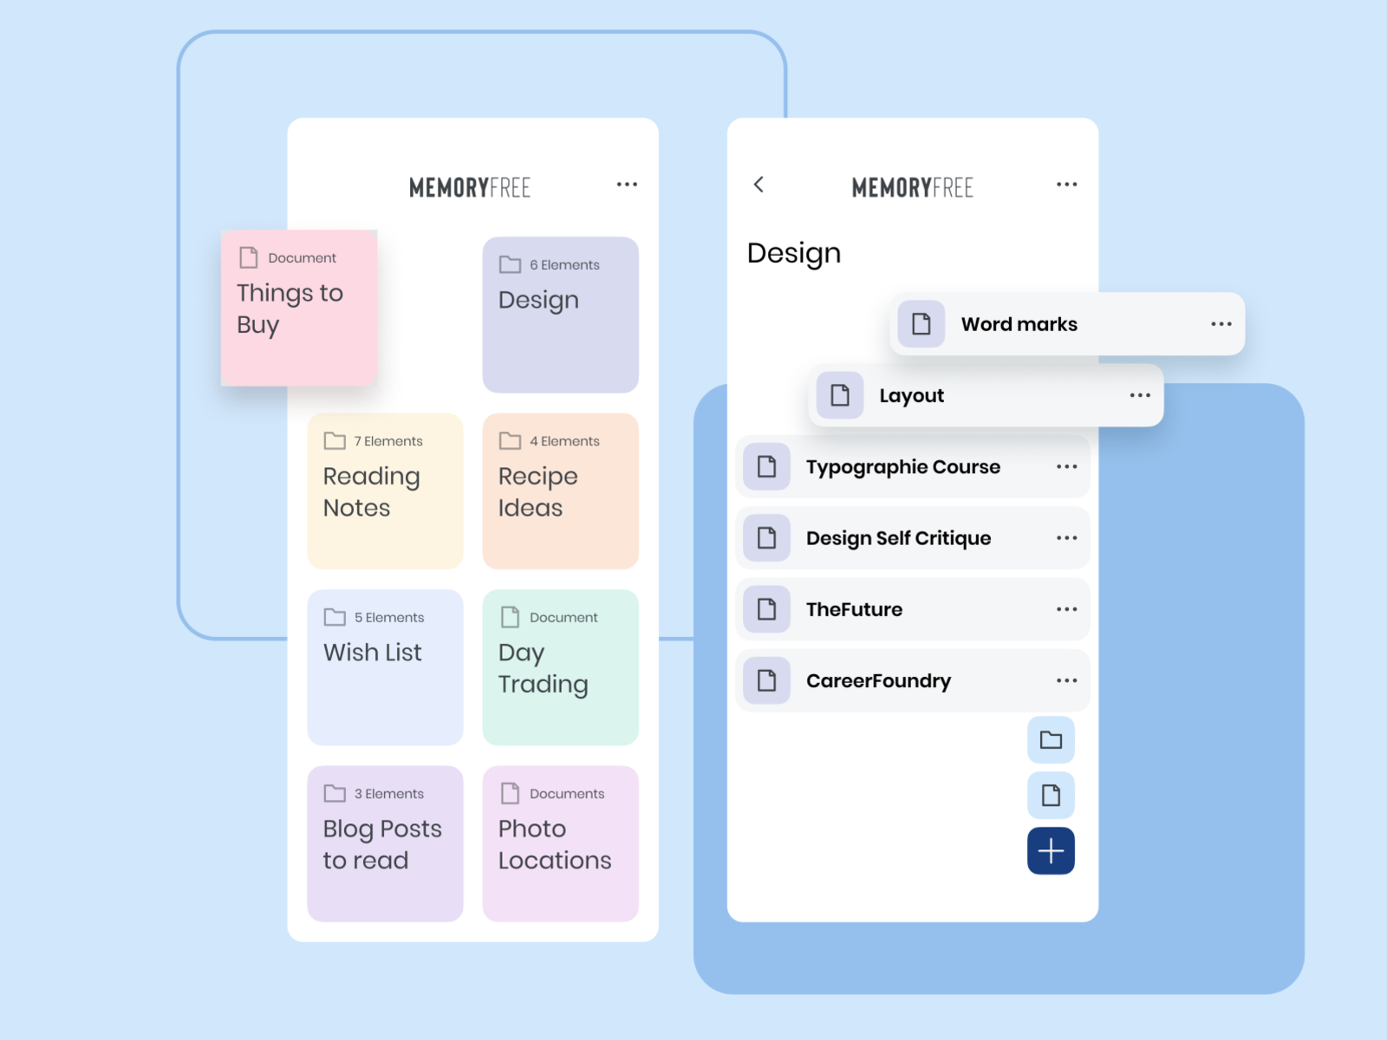



Target application
Create an application that handles a list of tasks/notes/memos
FRONTEND
APIS
BACKEND
Server
Database
https://dribbble.com/shots/3981527-memo/attachments/10130698?mode=media

Slide 3
Development environment
Programming Language:
Php
Java
Js
Python
Framewok:
Django
Flask
Fastapi
Code Editor:
Visual Studio
IDLE
VIM
Notepad++
VScode
Other Technologies
Git
Docker

Slide 4
Initial installation
Install fastapi (Ubuntu)
pip install "fastapi[all]“
https://fastapi.tiangolo.com/tutorial/
Code
git clone https://github.com/papajohn-uop/ADVANCED_PROGRAMMING_TECHNIQUES.git

Slide 5
First run
from typing import List
from fastapi import FastAPI
from fastapi.responses import JSONResponse
from pydantic import BaseModel
from typing import List
app = FastAPI()
@app.get("/")
async def root():
return "Hello Advanced Programming....."
Save a file as course.py
Navigate to folder
To run
uvicorn course:app --port 10000 --reload
Check result
http://localhost:10000/
http://localhost:10000/docs
(course_1.py in github)

Slide 6
Get API (get all notes ) (1/3)
from typing import List
from fastapi import FastAPI
from fastapi.responses import JSONResponse
from pydantic import BaseModel
from typing import List
app = FastAPI()
my_memos={
"AdvProgCourse":"Do not forget projects" ,
"JuneExams":"Study" ,
"Vacations":"Make resrvations"
}
@app.get("/")
async def root():
return "Hello Advanced Programming....."
@app.get("/getNotes")
async def getNotes():
return my_memos
Check result
http://localhost:10000/getNotes
http://localhost:10000/docs
(course_2.py in github)

Slide 7
Get API (get all notes ) (2/3)
from typing import List
from fastapi import FastAPI
from fastapi.responses import JSONResponse
from pydantic import BaseModel
from typing import List
class Memo(BaseModel):
Title: str
Content: str
class Error(BaseModel):
code: int
reason: str
app = FastAPI()
my_memos={
"AdvProgCourse":"Do not forget projects" ,
"JuneExams":"Study" ,
"Vacations":"Make resrvations"
}
@app.get("/")
async def root():
return "Hello Advanced Programming....."
@app.get("/getNotes",
response_model=List[Memo],
responses={404: {"model": Error}},
tags=["READ"],
summary="List current memos",
)
async def getNotes():
my_memos_list=list()
for key, value in my_memos.items() :
print (key, value)
tmp_memo=Memo(Title=key,Content=value)
my_memos_list.append(tmp_memo)
return my_memos_list
(course_3.py in github)

Slide 8
Get API (get specific note)(3/X)
@app.get("/getNote/{memo_title}",
response_model=Memo,
responses={
401: {"model": Error},
404: {"model": Error}
},
tags=["READ"],
summary="List a specific memo",
)
async def getNote(memo_title):
if memo_title in my_memos:
selected_memo=Memo(Title=memo_title,Content=my_memos[memo_title])
return selected_memo
else:
error=Error(code=404,reason="This memo does not exist")
return JSONResponse(status_code=404, content={"code": error.code,"reason":error.reason})
Check result
http://localhost:10000/getNote/{Title}
http://localhost:10000/docs
(course_4.py in github)

Slide 9
POST API
#create a new memo
@app.post("/createNote",
response_model=List[Memo],
responses={
401: {"model": Error},
422: {"model": Error}
},
tags=["WRITE"],
summary="Create a new memo",
)
async def insertNote(new_memo:Memo):
print(new_memo.Title)
if new_memo.Title in my_memos:
error=Error(code=422,reason="This memo already exists")
return JSONResponse(status_code=422, content={"code": error.code,"reason":error.reason})
else:
#append new memo in memo list
my_memos[new_memo.Title]=new_memo.Content
my_memos_list=list()
for key, value in my_memos.items() :
print (key, value)
tmp_memo=Memo(Title=key,Content=value)
my_memos_list.append(tmp_memo)
return my_memos_list
Check result
http://localhost:10000/docs
(course_5.py in github)

Slide 10
PATCH API
#modify an existing memo
@app.patch("/modifyNote/{memo_title}",
response_model=List[Memo],
responses={
401: {"model": Error},
422: {"model": Error}
},
tags=["WRITE"],
summary="Modify an existing memo",
)
async def modifyNote(memo_title, change_memo:Memo):
if memo_title not in my_memos:
error=Error(code=422,reason="No such memo")
return JSONResponse(status_code=422, content={"code": error.code,"reason":error.reason})
else:
#modiy memo entry in memo list
#check if title of new memo is the same
if memo_title==change_memo.Title:
#Same title update content
my_memos[memo_title]=change_memo.Content
else:
#change Title,remove entry and create new one
my_memos.pop(memo_title)
my_memos[change_memo.Title]=change_memo.Content
my_memos_list=list()
for key, value in my_memos.items() :
print (key, value)
tmp_memo=Memo(Title=key,Content=value)
my_memos_list.append(tmp_memo)
return my_memos_list
Check result
http://localhost:10000/docs
(course_6.py in github)

Slide 11
DELETE API
DELETE API should remove a note from the list
Homework?

Slide 12

Next steps
Code recipient
Backend developer
Frontend developer
Deployment server
Multiple projects
Different python
Different packets
Multiple sites deployed
Various software versions
Packet install not allowed
Different OS (windows, Mac)
CONTAINERS

Slide 13
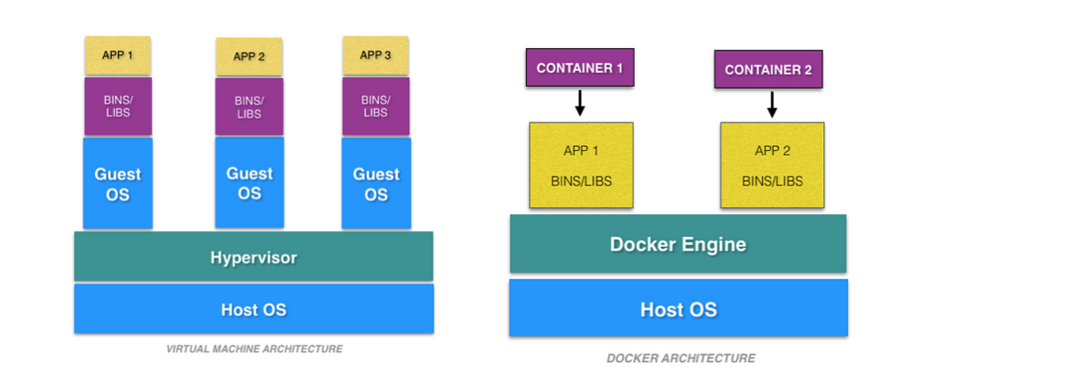
Containers vs VMs
https://cloudacademy.com/blog/docker-vs-virtual-machines-differences-you-should-know/

Slide 14
Containers
Container Advantages
Small size
Fast deployment
Modularity (split applications)
Container Types
Lxc
Hyper-V
Docker
Light weight packages consisting of
Running env
Application
Dependencies
Binary files
Configuration files

Slide 15
Development
version: '3.6'
networks:
demo_net:
services:
memo_server:
container_name: memo_server
build:
context: .
ports:
- "20000:10000"
- "21000:11000"
- "22000:12000"
# depends_on:
# - mongodb
# - mysql
volumes:
#Mount . from host to docker. This allows to have changes show uu immediatelly
- .:/my_src_DEVELOP
command: uvicorn course:app --host 0.0.0.0 --port 10000 --reload
FROM python:3.7
WORKDIR /my_src_DEVELOP
#install whatever you want
RUN pip install "fastapi[all]"
Docker-compose file
Dockerfile

Slide 16
Deployment
version: '3.6'
networks:
demo_net:
services:
memo_server:
container_name: memo_server
build:
context: .
ports:
- "20000:10000"
depends_on:
- mongodb
- mysql
command: uvicorn course:app --host 0.0.0.0 --port 10000
FROM python:3.7
WORKDIR /my_src_dir
#install whatever you want
RUN pip install "fastapi[all]"
COPY . /my_src_dir/
Docker-compose file
Dockerfile

Slide 17

Thank you

