Slide 1
Discriminative Learning of Extraction Sets for Machine Translation
John DeNero and Dan Klein
UC Berkeley
TexPoint fonts used in EMF.
Read the TexPoint manual before you delete this box.: A

Slide 2
Identifying Phrasal Translations
In
the
past
two
years
,
a
number
of
US
citizens
…
过去
两
年
中
,
一
批
美国
公民
…
past
two
year
in
,
one
lots
US
citizen
Past | Go over
Phrase alignment models:
Choose a segmentation and a one-to-one phrase alignment
Underlying assumption:
There is a correct phrasal segmentation
Notes:
- Learning a translation model or synchronous grammar requires us to find a correspondence between sentences
- That correspondence is multi-level (big and small phrases)
We want to develop a model of alignment that directly models this
Example: Past has a lot of translations, but the following word helps disambiguate

Slide 3
Unique Segmentations?
In
the
past
two
years
,
a
number
of
US
citizens
…
过去
两
年
中
,
一
批
美国
公民
…
past
two
year
in
,
one
lots
US
citizen
Problem 1:
Overlapping phrases can be useful (and complementary)
Problem 2:
Phrases and their sub-phrases can both be useful
Hypothesis:
This is why models of phrase alignment don’t work well
Notes:
- Learning a translation model or synchronous grammar requires us to find a correspondence between sentences
- That correspondence is multi-level (big and small phrases)
We want to develop a model of alignment that directly models this
Example: Past has a lot of translations, but the following word helps disambiguate

Slide 4
Identifying Phrasal Translations
In
the
past
two
years
,
a
number
of
US
citizens
…
过去
两
年
中
,
一
批
美国
公民
…
past
two
year
in
,
one
lots
US
citizen
This talk:
Modeling sets of overlapping, multi-scale phrase pairs
Input: sentence pairs
Output: extracted phrases
Notes:
- Learning a translation model or synchronous grammar requires us to find a correspondence between sentences
- That correspondence is multi-level (big and small phrases)
We want to develop a model of alignment that directly models this
Example: we don’t know whether to make year plural in English w/o context

Slide 5
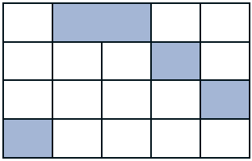
… But the Standard Pipeline has Overlap!
过去
past
两
two
年
year
中
in
In
the
past
two
years
Sentence Pair
Word Alignment
Extracted Phrases
Motivation
Notes:
We treat alignment as a task, but it’s plagued with much-maligned metrics, controversial test sets, and a tenuous relationship to machine translation performance.
We do need to decide which pieces of a sentence to recycle and how to translate them; the disconnect between alignment and extraction fuels these problems

Slide 6
Related Work
Extraction models:
Moore and Quirk, 2007
Fixed alignments; learned phrase pair weights
Translation models:
Sinuhe system (Kääriäinen, 2009)
Fixed alignments; learned phrase pair weights
Combining Aligners:
Yonggang Deng & Bowen Zhou (2009)
Fixed directional alignments; learned symmetrization
Sentence Pair
Word Alignment
Extracted Phrases
Motivation
Notes:
We treat alignment as a task, but it’s plagued with much-maligned metrics, controversial test sets, and a tenuous relationship to machine translation performance.
We do need to decide which pieces of a sentence to recycle and how to translate them; the disconnect between alignment and extraction fuels these problems

Slide 7

Our Task: Predict Extraction Sets
Conditional model of extraction sets given sentence pairs
0
0
过去
过去
1
1
两
两
2
2
年
年
3
3
中
中
0
1
2
3
4
5
4
0
1
2
3
4
5
4
In
the
past
two
years
In
the
past
two
years
Sentence Pair
Extracted Phrases + ``Word Alignments’’
Extracted Phrases
Motivation
Notes:
We treat alignment as a task, but it’s plagued with much-maligned metrics, controversial test sets, and a tenuous relationship to machine translation performance.
We do need to decide which pieces of a sentence to recycle and how to translate them; the disconnect between alignment and extraction fuels these problems

Slide 8
Alignments Imply Extraction Sets
Word-level alignment links
Word-to-span alignments
Extraction set of bispans
0
过去
past
1
两
two
2
年
year
3
中
in
4
0
1
2
3
4
5
In
the
past
two
years
Model
Notes:
We want (a) a notion of coherent extraction sets, and (b) a way of leveraging existing word alignment resources. The following definitions give us both.
- Meta point: I’m describing phrase extraction, but in the context of defining a phrase-to-phrase alignment model

Slide 9
Nulls and Possibles
据
according to
Nulls:
报道
news report
it
is
reported
据
according to
Possibles:
报道
news report
it
is
reported
Notes:
We let possibles do all the work of nulls, and make nulls unproductive.

Slide 10
Incorporating Possible Alignments
Sure and possible word links
Word-to-span alignments
Extraction set of bispans
0
过去
past
1
两
two
2
年
year
3
中
in
4
0
1
2
3
4
5
In
the
past
two
years
Model
Notes:
We want (a) a notion of coherent extraction sets, and (b) a way of leveraging existing word alignment resources. The following definitions give us both.
Meta point: I’m describing phrase extraction, but in the context of defining a phrase-to-phrase alignment model
Important message: We’re predicting extraction sets, but using word-level and word-to-span alignments to constrain the output space

Slide 11
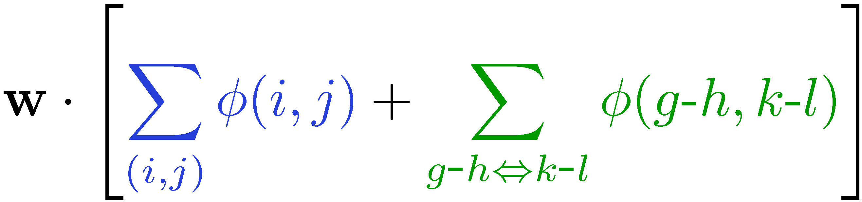
Linear Model for Extraction Sets
Features on sure links
0
过去
1
Features on all bispans
两
2
年
3
中
4
0
1
2
3
4
5
In
the
past
two
years
Model
Notes:
- Output is an extraction set projected from a word alignment
- Features on sure alignment links and extracted phrase pairs
- Linear model over all features in an extraction set

Slide 12
Features on Bispans and Sure Links
Some features on sure links
HMM posteriors
过
go over
Presence in dictionary
Numbers & punctuation
地球
Earth
Features on bispans
over
the
Earth
HMM phrase table features: e.g., phrase relative frequencies
Lexical indicator features for phrases with common words
Shape features: e.g., Chinese character counts
Monolingual phrase features: e.g., “the _____”
Features
Notes:
Moses features receive high weight
Distortion is a good idea, still
-Monolingual features help too

Slide 13
Getting Gold Extraction Sets
Hand Aligned: Sure and possible word links
Word-to-span alignments
Extraction set of bispans
Deterministic: Find min and max
alignment index for each word
Deterministic: A bispan is included iff every word within the bispan aligns within the bispan
Training
Notes:
- We really wouldn’t need word links (only word-to-span alignments) except that they are what we have annotated
-We can use existing resources to train our model

Slide 14
Discriminative Training with MIRA
Gold (annotated)
Guess (arg max w∙ɸ)
Loss function:
F-score of bispan errors (precision & recall)
Training Criterion:
Minimal change to w such that the gold is preferred to the guess by a loss-scaled margin
Training
Notes:
-MIRA works well, but we could try anything
- Loss was in fact 1 - F_5

Slide 15
Inference: An ITG Parser
ITG captures some bispans
Inference

Slide 16
Coarse-to-Fine Approximation
Coarse Pass:
Features that are local to terminal productions
Fine Pass:
Agenda search using coarse pass as a heuristic
We use an agenda-based parser. It’s fast!
Inference

Slide 17
Experimental Setup
Chinese-to-English newswire
Parallel corpus: 11.3 million words; sentences length ≤ 40
Supervised data: 150 training & 191 test sentences (NIST ‘02)
Unsupervised Model: Jointly trained HMM (Berkeley Aligner)
MT systems: Tuned and tested on NIST ‘04 and ‘05
Results

Slide 18
Baselines and Limited Systems
HMM:
Joint training & competitive posterior decoding
Source of many features for supervised models
State-of-the-art unsupervised baseline
ITG:
Supervised ITG aligner with block terminals
Re-implementation of Haghighi et al., 2009
State-of-the-art supervised baseline
Coarse:
Supervised block ITG + possible alignments
Coarse pass of full extraction set model
Results
Notes:
- While an extraction set model predicts phrase pairs, it can also be used as an aligner
- Comparing to aligners gives us the most direct form of evaluation

Slide 19
Word Alignment Performance
Results
Notes:
- We win

Slide 20
Extracted Bispan Performance
Results
Notes:
- We win

Slide 21
Translation Performance (BLEU)
Supervised conditions also included HMM alignments
Results
Notes:
- We win

Slide 22
Conclusions
Extraction set model directly learns what phrases to extract
Idea: get overlap and multi-scale into the learning!
The system performs well as an aligner or a rule extractor
Are segmentations always bad?
Notes:
- Extraction sets make sense from a modeling perspective
They work well in practice
We should think about annotating data with this sort of model in mind (possibles, nulls, etc.)

Slide 23
Thank you!
nlp.cs.berkeley.edu

Slide 24
The Role of Possible Alignments
Role-equivalent word/phrase pairs
If a word has no sure links, possible links define its span
被
passive marker
发现
discover
was
discovered
Language-specific function words
31%
过
go over
地球
65%
Earth
over
the
Earth
Model

Slide 25
Definition: Phrasal Extraction Set
Lexical type:
过去 两
the past two
0
过去
past
1
Position:
两
two
0-2
1-4
2
年
year
3
中
in
4
0
1
2
3
4
5
In
the
past
two
years
Model

