Slide 1
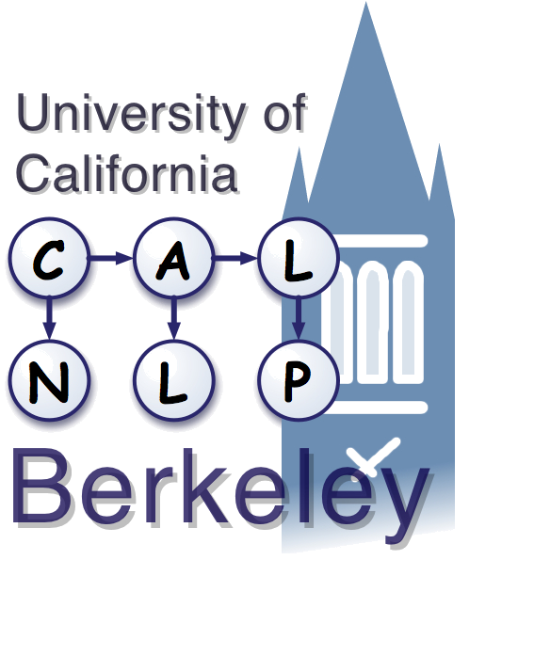
Why Generative Models Underperform Surface Heuristics
UC Berkeley
Natural Language Processing
John DeNero, Dan Gillick, James Zhang, and Dan Klein
Notes:
• Hi, I'm John DeNero
• shed some light on a puzzling result about phrase-based translation

Slide 2
Overview: Learning Phrases
cat ||| chat ||| 0.9
the cat ||| le chat ||| 0.8
dog ||| chien ||| 0.8
house ||| maison ||| 0.6
my house ||| ma maison ||| 0.9
language ||| langue ||| 0.9
…
Phrase table
(translation model)
Sentence-aligned
corpus
Directional word alignments
Intersected and grown word alignments
Notes:
• Key part of the phrase-based pipeline
• Word-alignment driven approach is a surface statistic
• Not maximizing any objective

Slide 3
Overview: Learning Phrases
Phrase-level generative model
cat ||| chat ||| 0.9
the cat ||| le chat ||| 0.8
dog ||| chien ||| 0.8
house ||| maison ||| 0.6
my house ||| ma maison ||| 0.9
language ||| langue ||| 0.9
…
Phrase table
(translation model)
Sentence-aligned
corpus
Early successful phrase-based SMT system [Marcu & Wong ‘02]
Challenging to train
Underperforms heuristic approach
Notes:
• Principled approach (Like IBM model 3)
• Past results
• What happened? Alignments should compete, while segmentations often should not. Forcing competition leads to overfitting.

Slide 4
Outline
I) Generative phrase-based alignment
  Motivation
  Model structure and training
  Performance results
II) Error analysis
  Properties of the learned phrase table
  Contributions to increased error rate
III) Proposed Improvements

Slide 5
Motivation for Learning Phrases
Translate!
Input sentence:
Output sentence:
J ’ ai un chat .
I have a spade .

Slide 6
Motivation for Learning Phrases
appelle
call
appelle
un
chat
un
chat
call
a
spade
a
spade
chat un chat
spade a spade
Notes:
Some segmentations are correct, segmenting phrases we want to translate atomically

Slide 7
Motivation for Learning Phrases
appelle
appelle un
appelle un chat
un
un chat
un chat un
chat
chat un
chat un chat
call
call a
call a spade
a x2
a spade x2
a spade a
spade x2
spade a
spade a spade
appelle
un
chat
un
chat
call
a
spade
a
spade
… appelle un chat un chat …
Notes:
Some segmentations are correct, segmenting phrases we want to translate atomically

Slide 8

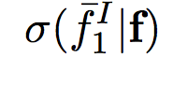
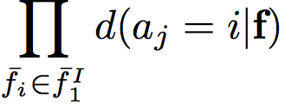

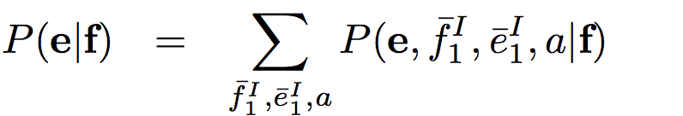
A Phrase Alignment Model Compatible with Pharaoh
les chats aiment le poisson frais .
cats like fresh fish .
Notes:
NOTE: Different from Marcu and Wong; Just like Pharaoh

Slide 9
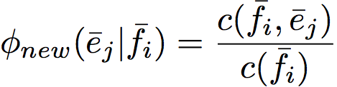
Training Regimen That Respects Word Alignment
aiment
poisson
aiment
poisson
les
chats
le
frais
.
les
chats
le
frais
.
cats
cats
like
like
fresh
fresh
fish
fish
.
.
.
.
X
Notes:
One-to-one constraint

Slide 10
Training Regimen That Respects Word Alignment
aiment
poisson
les
chats
le
frais
.
cats
Only 46% of training sentences contributed to training.
like
fresh
fish
.
.
Notes:
Too sparse or too rich cause problems
More word alignments constrain possible segmentations significantly

Slide 11
Performance Results
Heuristically generated parameters

Slide 12
Performance Results
Learned parameters with 4x training data underperform heuristic
Lost training data is not the whole story

Slide 13
Outline
I) Generative phrase-based alignment
  Model structure and training
  Performance results
II) Error analysis
  Properties of the learned phrase table
  Contributions to increased error rate
III) Proposed Improvements

Slide 14
Example: Maximizing Likelihood with Competing Segmentations
Training Corpus
French: carte sur la table
English: map on the table
French: carte sur la table
English: notice on the chart
carte
carte
carte sur
carte sur
carte sur la
carte sur la
sur
la
sur la
sur la table
sur la table
la table
la table
table
table
map
notice
map on
notice on
map on the
notice on the
on
the
on the
on the table
on the chart
the table
the chart
table
chart
0.5
0.5
0.5
0.5
0.5
0.5
1.0
1.0
1.0
0.5
0.5
0.5
0.5
0.5
0.5
Likelihood Computation
carte sur la table
0.25 * 7 / 7
= 0.25

Slide 15
Example: Maximizing Likelihood with Competing Segmentations
Training Corpus
French: carte sur la table
English: map on the table
French: carte sur la table
English: notice on the chart
carte
carte sur
carte sur la
sur
sur la
sur la table
la
la table
table
map
notice on
notice on the
on
on the
on the table
the
the table
chart
1.0
1.0
1.0
1.0
1.0
1.0
1.0
1.0
1.0
carte sur la table
Likelihood of “notice on the chart” pair:
1.0 * 2 / 7 = 0.28 > 0.25
Likelihood of “map on the table” pair:
1.0 * 2 / 7 = 0.28 > 0.25

Slide 16
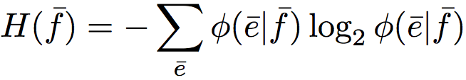
EM Training Significantly Decreases Entropy of the Phrase Table
French phrase entropy:
10% of French phrases have deterministic distributions
Notes:
Average entropy, weighted by frequency, for the most common 10,000 phrases : 1.55, comparable to 3.76

Slide 17
Effect 1: Useful Phrase Pairs Are Lost Due to Critically Small Probabilities
In 10k translated sentences, no phrases with weight less than 10⁻⁵ were used by the decoder.

Slide 18
Effect 2: Determinized Phrases Override Better Candidates During Decoding
Heuristic
the situation varies to an enormous degree
the situation varie d ' une immense degré
Learned
the situation varies to an enormous degree
the situation varie d ' une immense caractérise
degré
caractérise
degree
0.49
0.64
characterizes
0.49
0.001
level
0.38
0.26
characterized
0.21
0.001
extent
0.02
0.01
features
0.05
~0
amount
0.02
~0
degree
~0
0.998

Slide 19
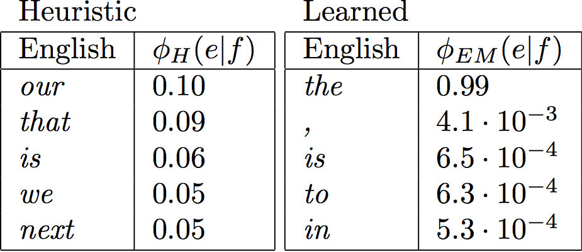
Effect 3: Ambiguous Foreign Phrases Become Active During Decoding
Translations for the French apostrophe
Deterministic phrases can be used by the decoder with no cost.

Slide 20
Outline
I) Generative phrase-based alignment
  Model structure and training
  Performance results
II) Error analysis
  Properties of the learned phrase table
  Contributions to increased error rate
III) Proposed Improvements

Slide 21
Motivation for Reintroducing Entropy to the Phrase Table
Useful phrase pairs are lost due to critically small probabilities.
Determinized phrases override better candidates.
Ambiguous foreign phrases become active during decoding.

Slide 22
Reintroducing Lost Phrases
Interpolation yields up to 1.0 BLEU improvement

Slide 23
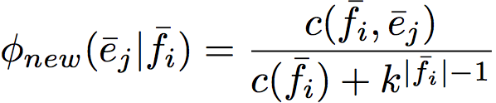
Smoothing Phrase Probabilities
Reserves probability mass for unseen translations based on the length of the French phrase

Slide 24
Conclusion
Generative phrase models determinize the phrase table via the latent segmentation variable.
A determinized phrase table introduces errors at decoding time.
Modest improvement can be realized by reintroducing phrase table entropy.

Slide 25
Questions?

