Slide 1
Introduction to User Interface

Slide 2
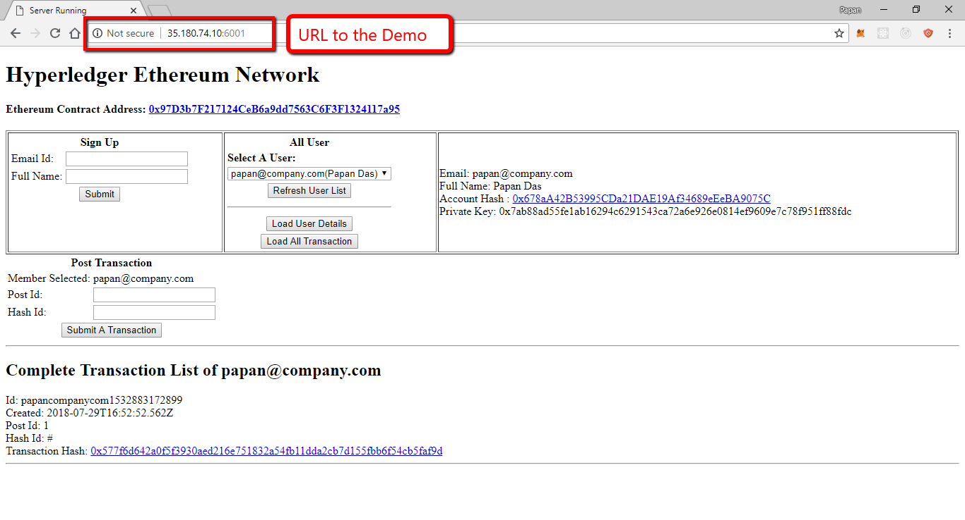

Slide 3
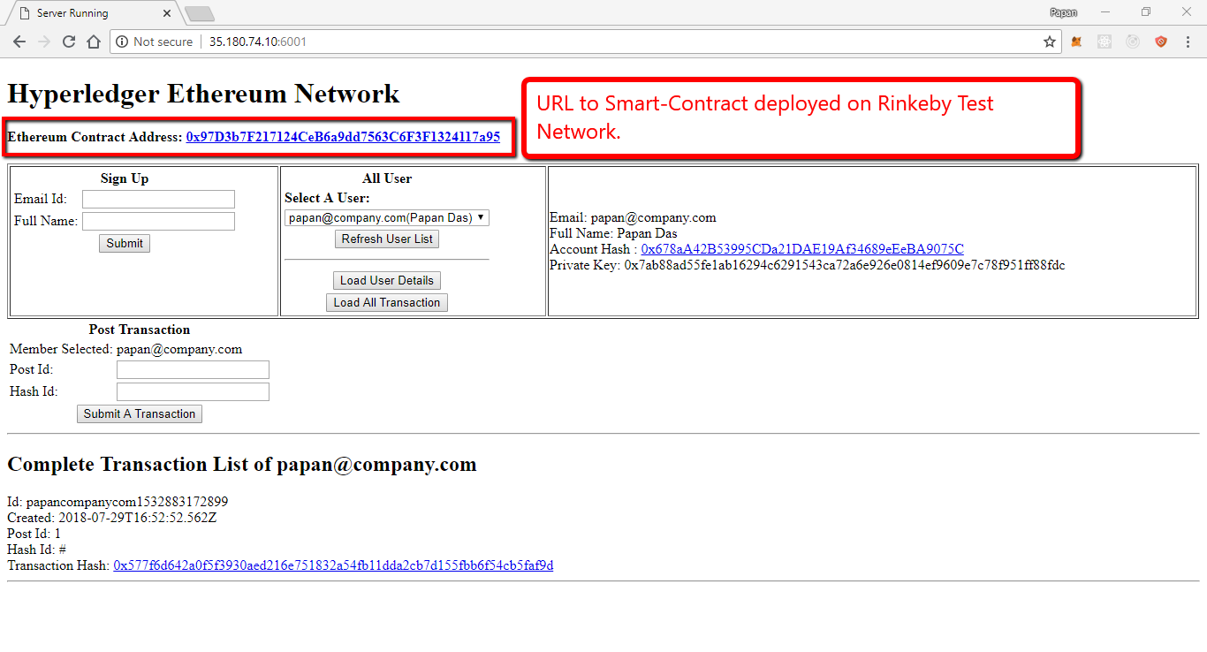

Slide 4
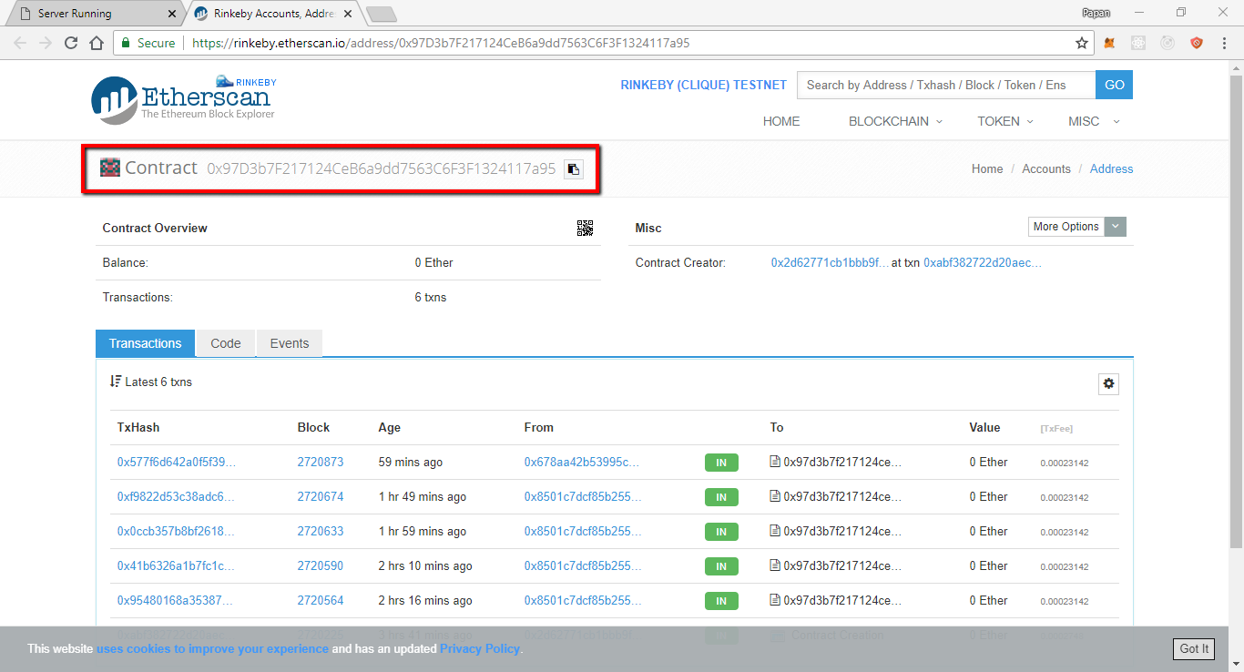

Slide 5
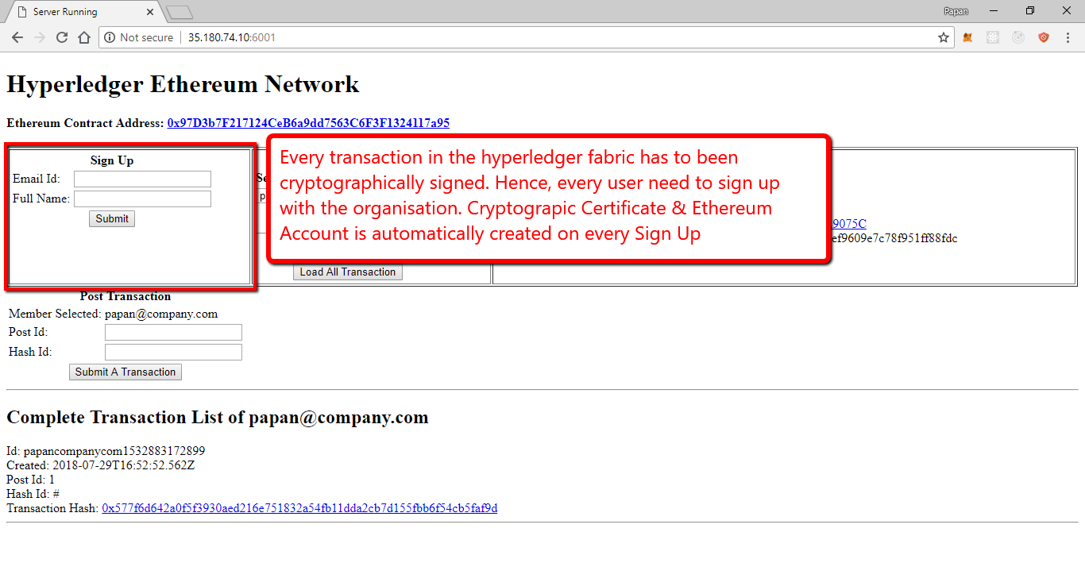

Slide 6
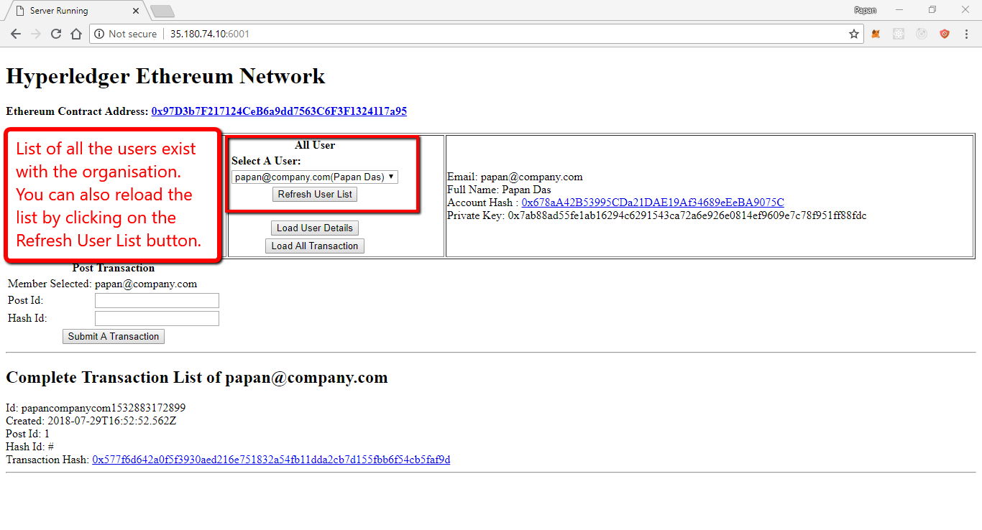

Slide 7
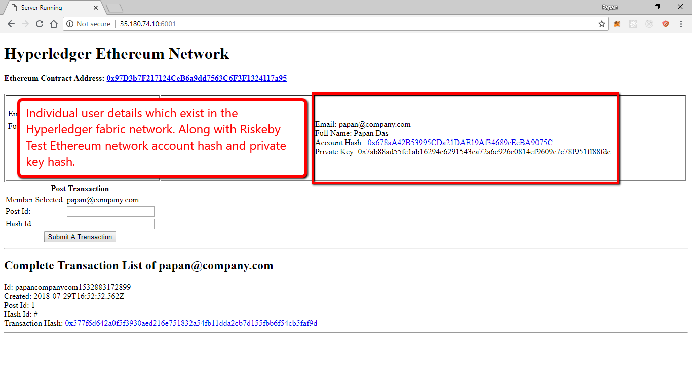

Slide 8
Please note that every time someone sign in, a new Ethereum Wallet is created. The wallet is initially empty. To create any transaction hash, the wallet need to have minimum Eth balance.

Slide 9
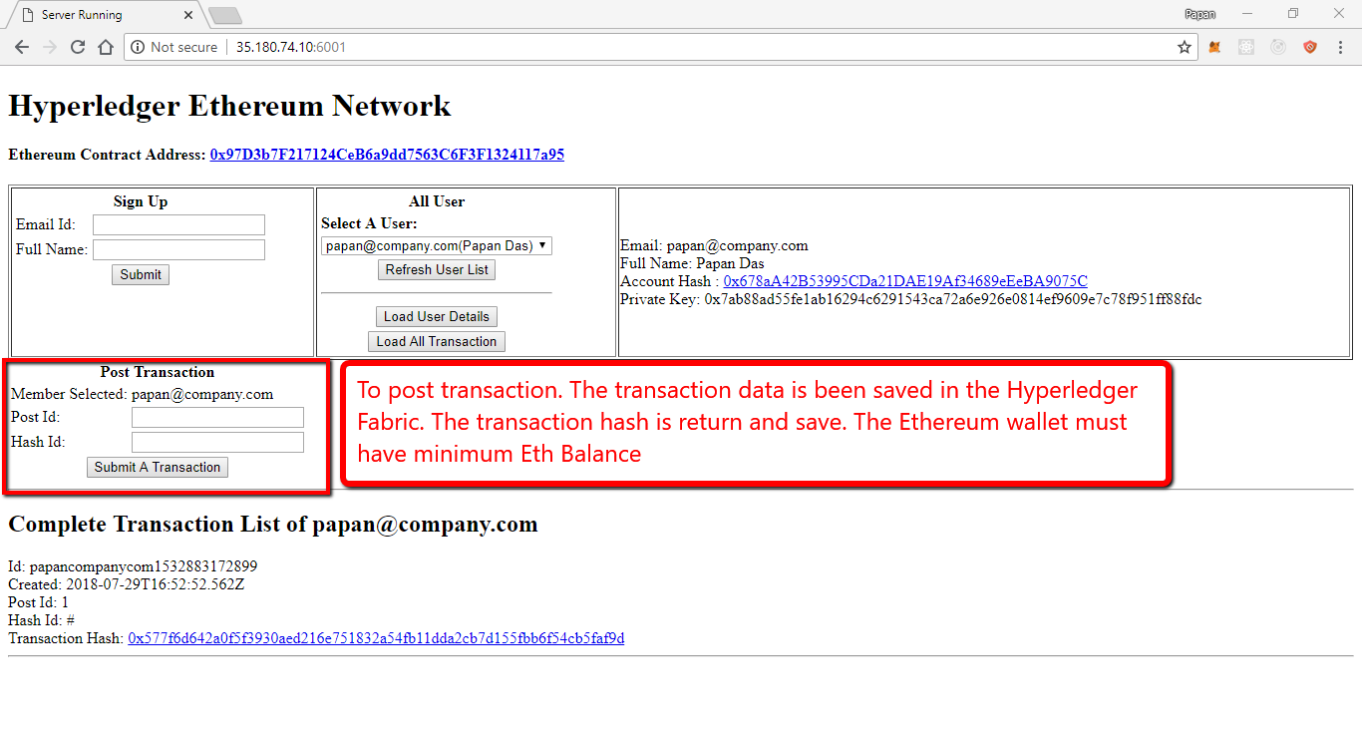

Slide 10
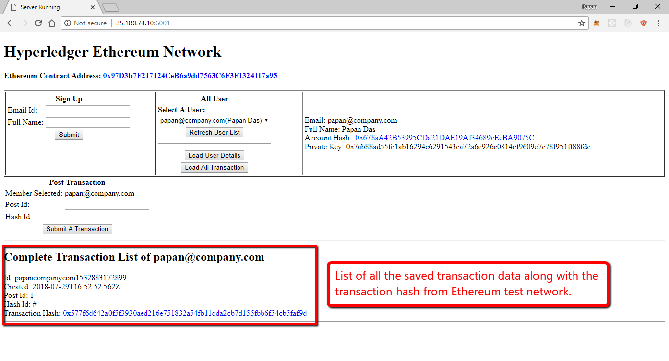

Slide 11
Let’s Sign Up a User

Slide 12
