Slide 1
Adding a Printer to an account
The Centre has a Fuji-Xerox printer attached to the network via ethernet cable.
The printer has been assigned to IP address 192.168.5.248.
The “Career” account allows printing, while the “Enderley” account, which has no password, does not allow printing.
This slide show demonstrates adding the printer to a “Career” account.
Version: 2021-02-11

Slide 2
Login and Launch Printer Utility
Login to the account that needs to have printing capability. E.g. “Career” account.
Click on System --> Administration --> Printers

Slide 3
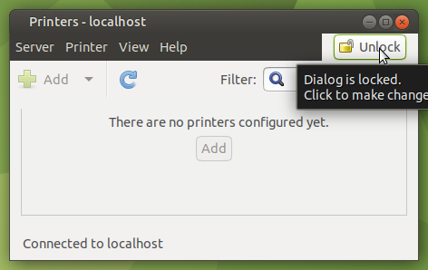
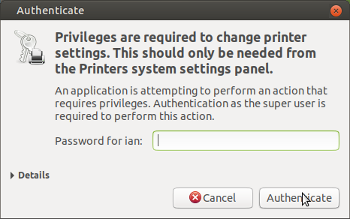
“Unlock” so a printer may be added
Click
Enter Administrator password
...then
Click

Slide 4
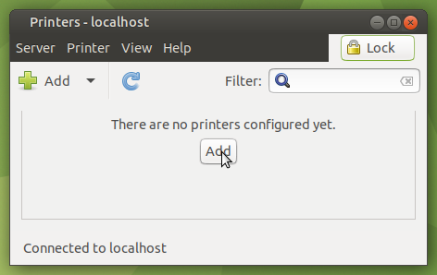
Add a printer...
Click

Slide 5
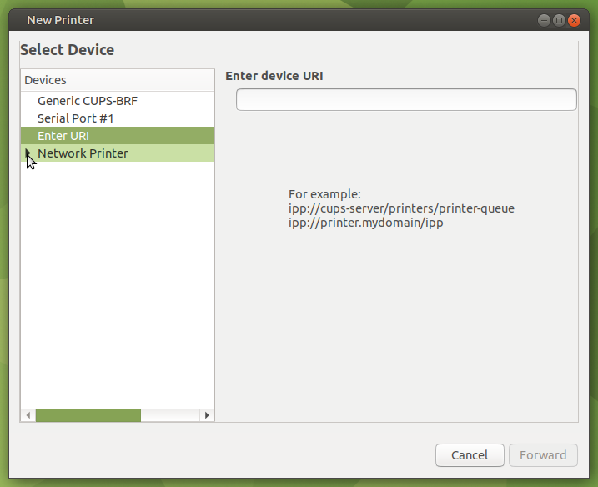
Detect the Network for the printer...
Click

Slide 6
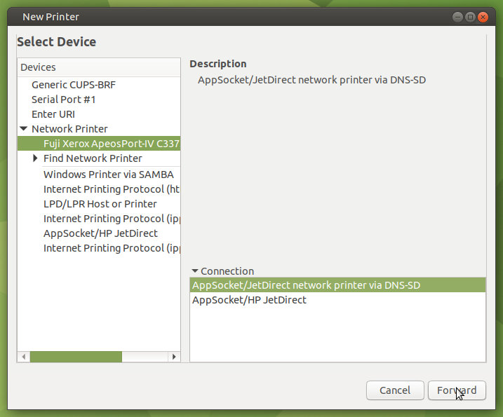
Detect the Network for the printer...
Printer detected
Click

Slide 7
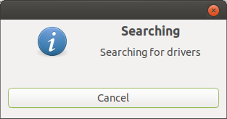
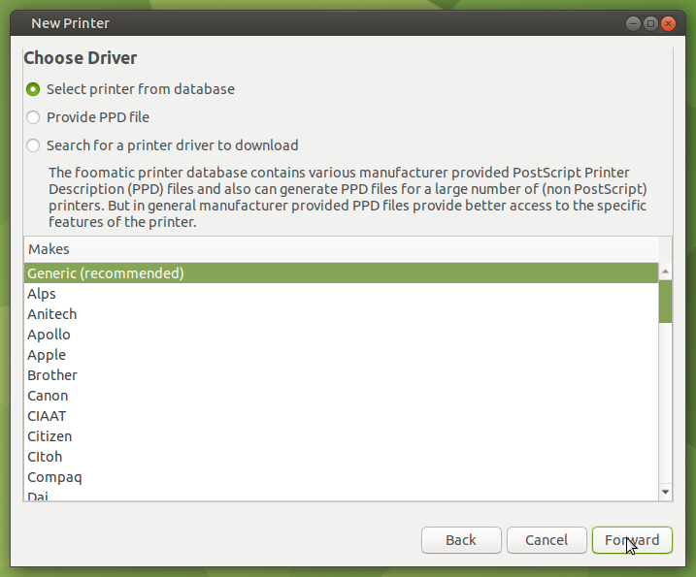
Search for driver...
Wait 15 seconds while searching for driver
Use Generic
Click

Slide 8
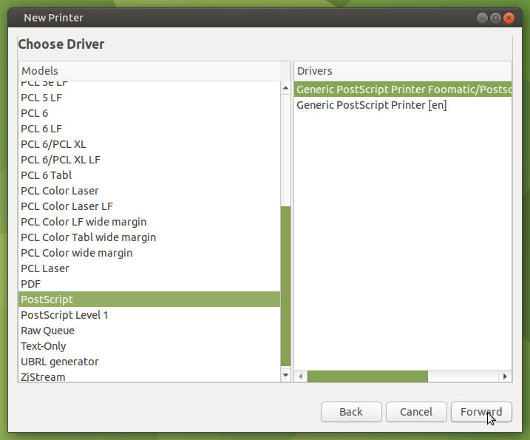
Select PostScript driver...
Select Postscript
Click

Slide 9
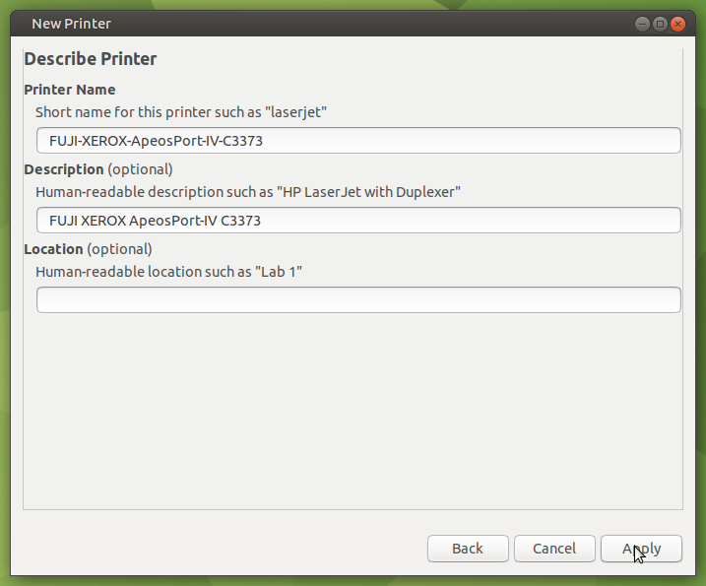
Apply the description...
Click

Slide 10
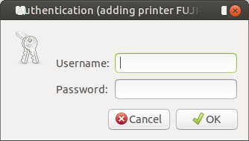
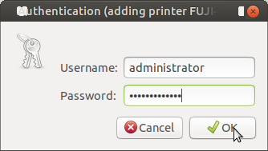
Authenticate...
Click

Slide 11
Completed...
Print a test page.

