Slide 1

Which Pokemon fits you?
March 2023
KBS
jan.bellavista, marc.escote, spencerjames.johnson

Slide 2
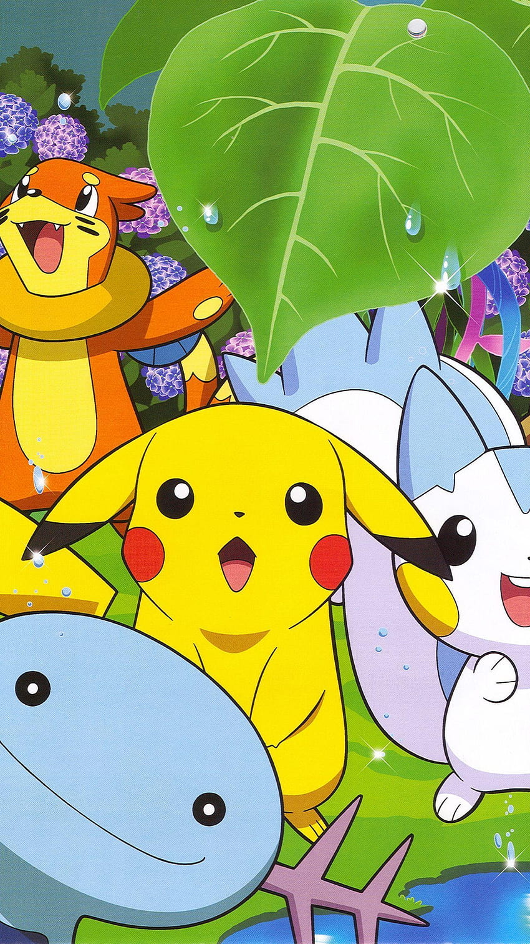
Domain
Target: Gaming Industry
Client persona: People that want to discover which pokemon fits them best

Slide 3
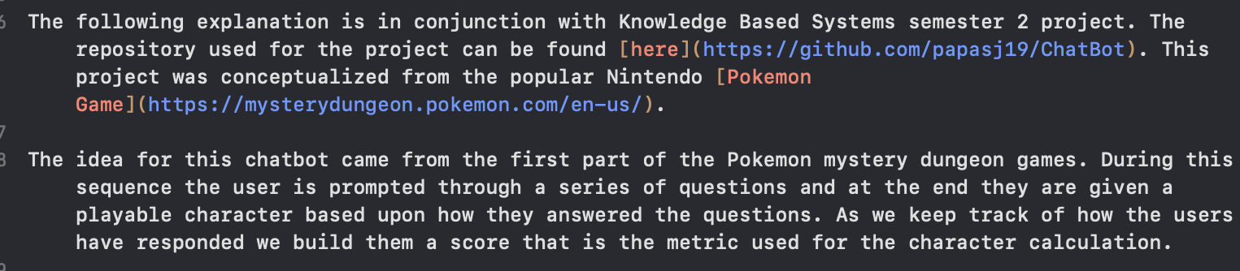
The problem we want to solve
Problem
We need a playable character for a videogame that should represent how they are in the real world. This would make the game experience more realistic and personalized.
https://www.youtube.com/watch?v=2R_1HEbxYhA
End at second 36

Slide 4

Design
Our data
User Scoring
Implementation
NLP, Presenting Questions

Slide 5
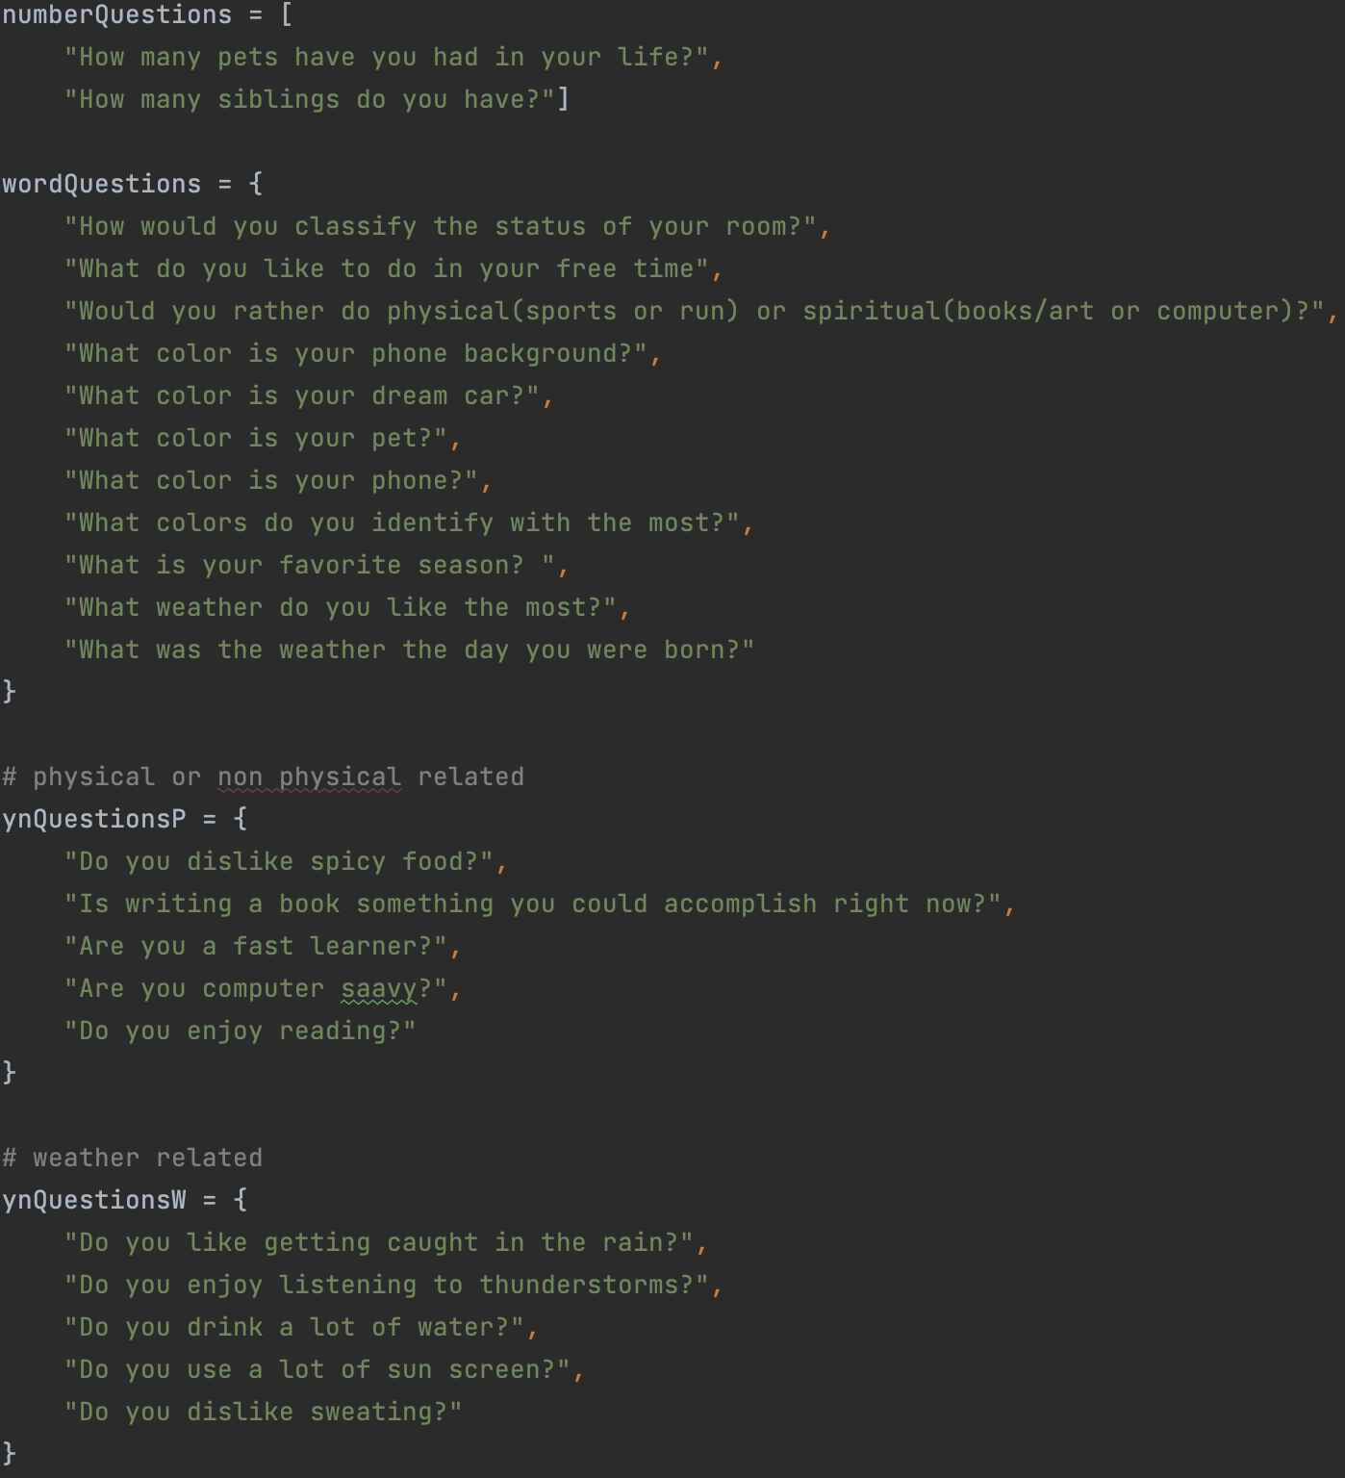
Questions To be Asked

Slide 6
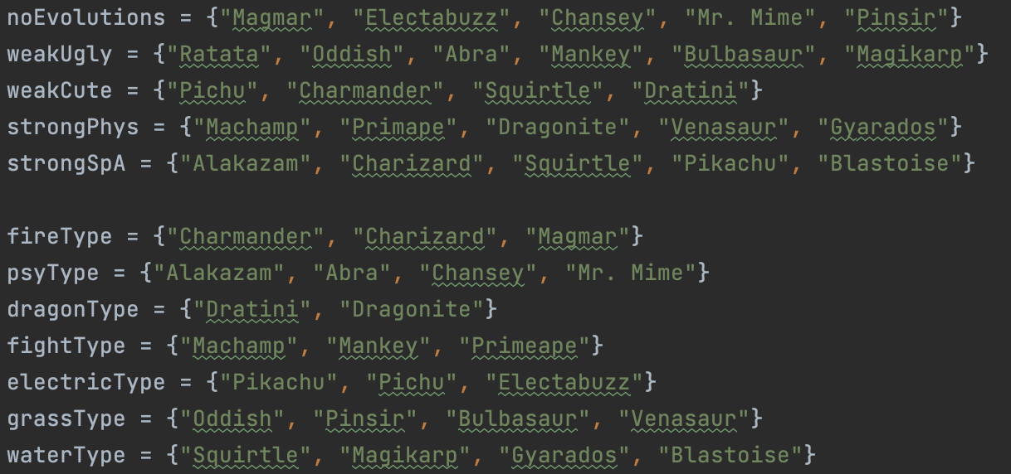
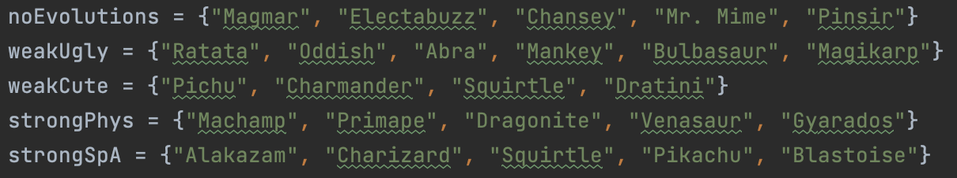
Chatbot Data

Slide 7
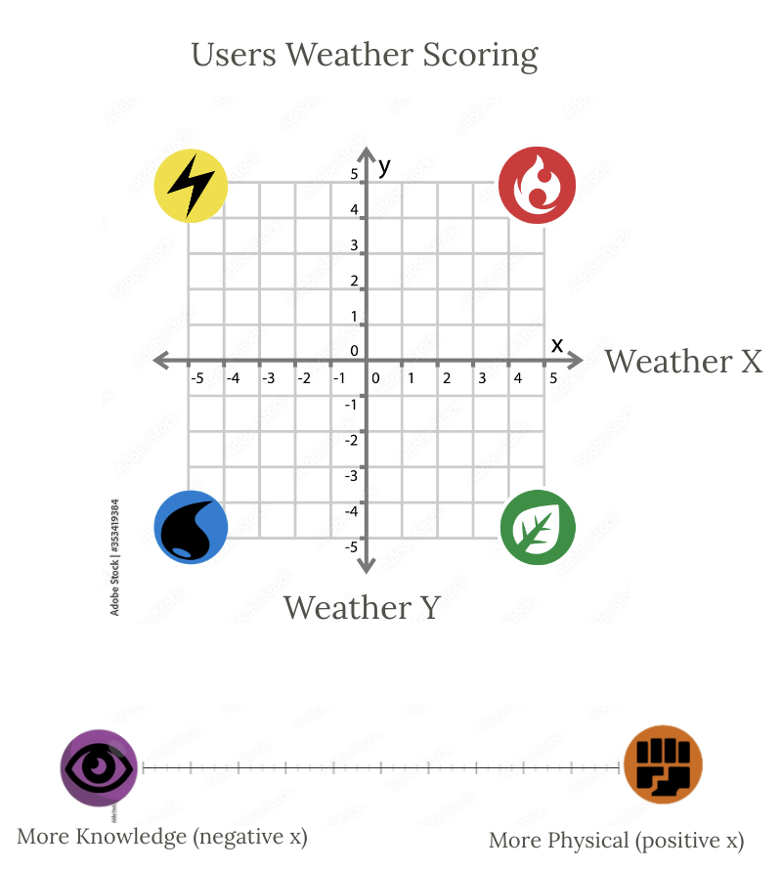
User Scoring
The user is scored based upon 3 metrics. The first two are the x and y components related to the users weather preference. The x in this stresses the user's overall enjoyment of water. The y component represents the amount of water that the user enjoys.
The second metric used is the user's physical preferences. This would mean if the user is normally an outdoors and very physically active person. The other end of the spectrum would be someone that prefers solitude with activities that involve brain power such as poetry or sculpting.

Slide 8
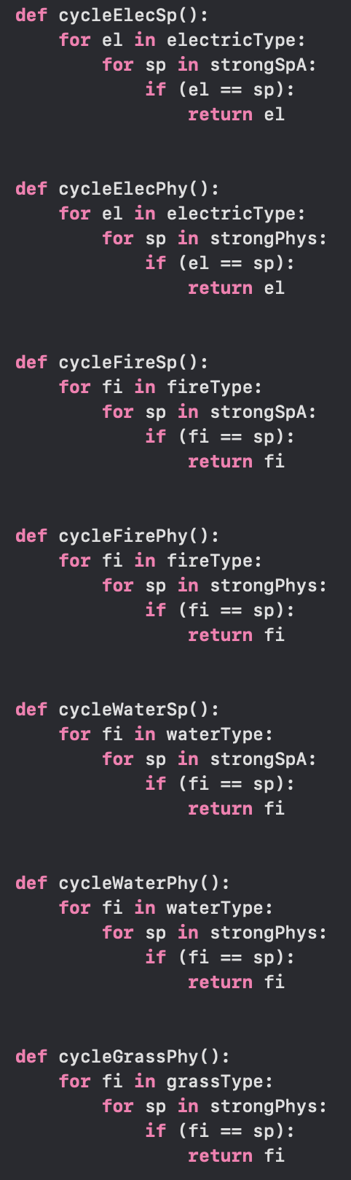
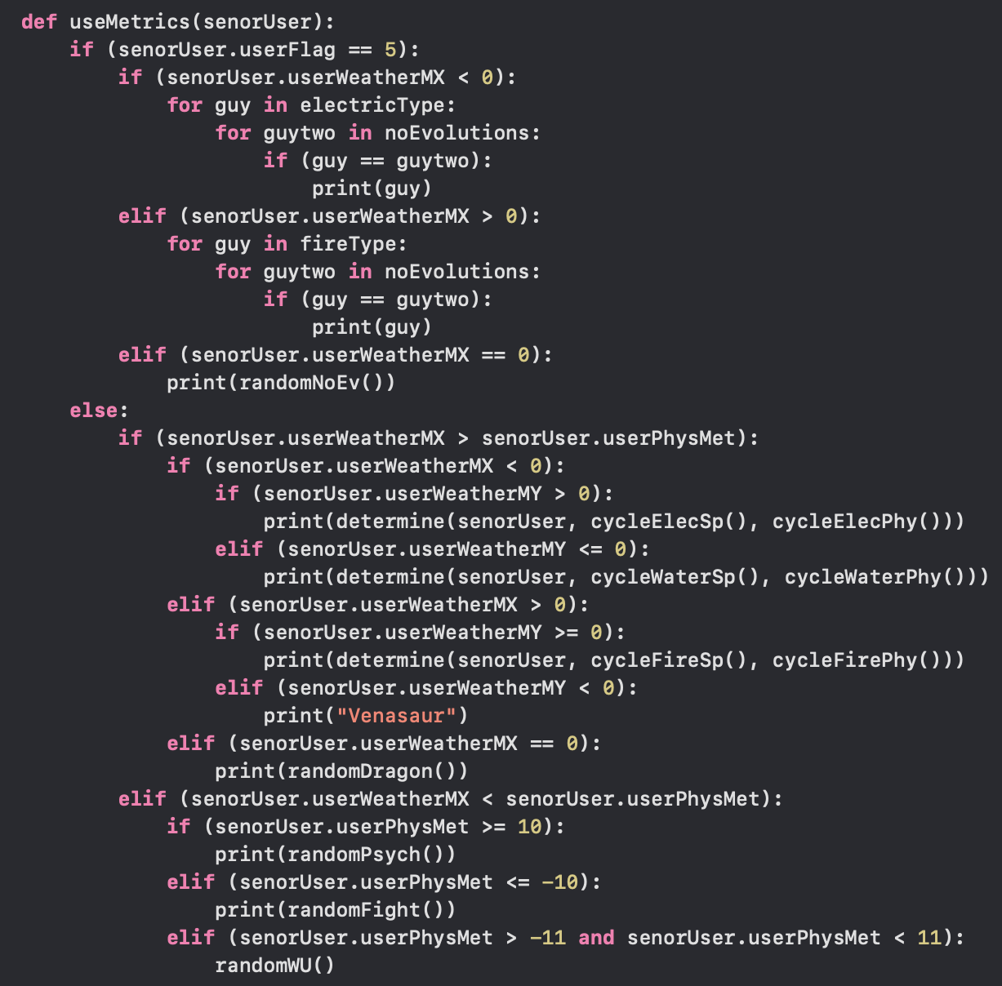
Using Metrics
First we determine if the user is allowed to have evolutions based upon their number of siblings.
Then we determine the highest metric that they have been scored and determine if they should be graded off one of two graphs.
From this graph selection we can select a following type.

Slide 9
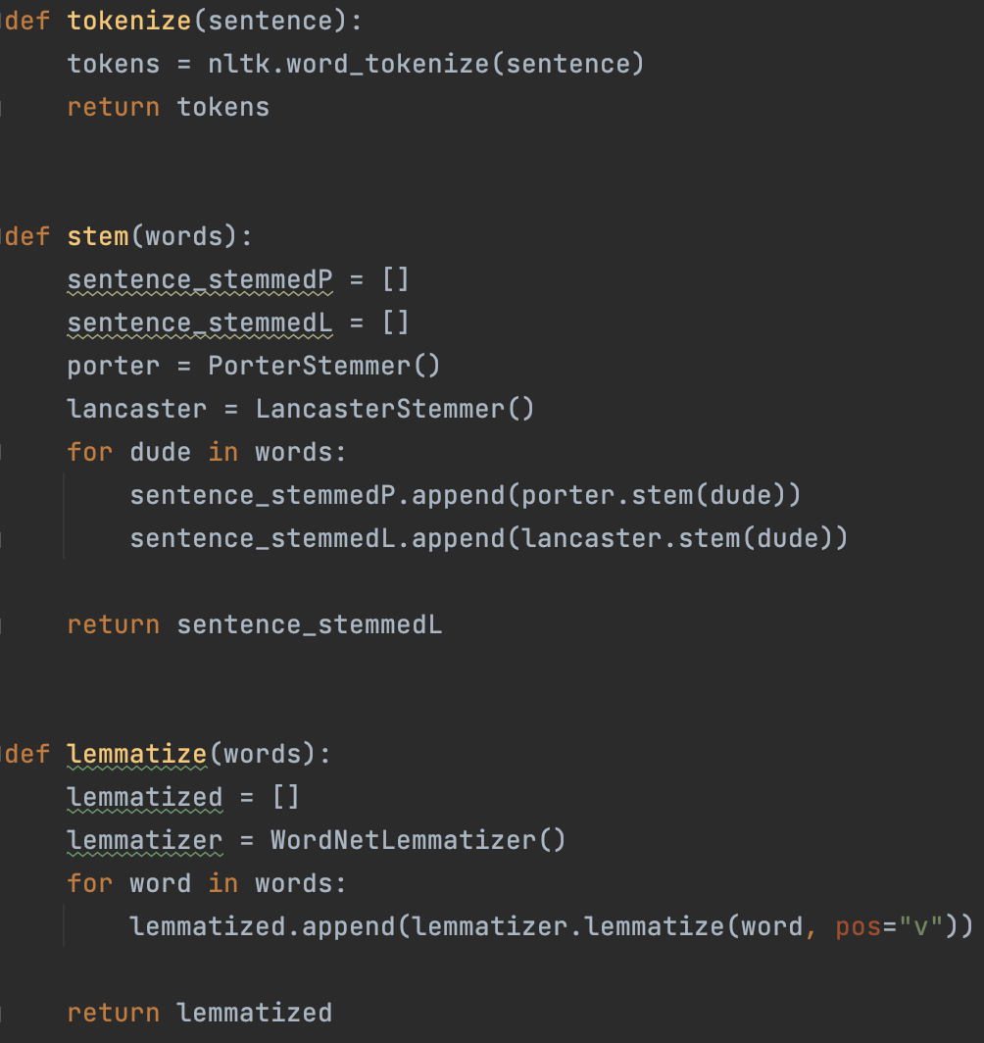
Implementation
Python NLTK library
Stem
Tokenize
Lematize
“FROM SCRATCH” APPROACH

Slide 10
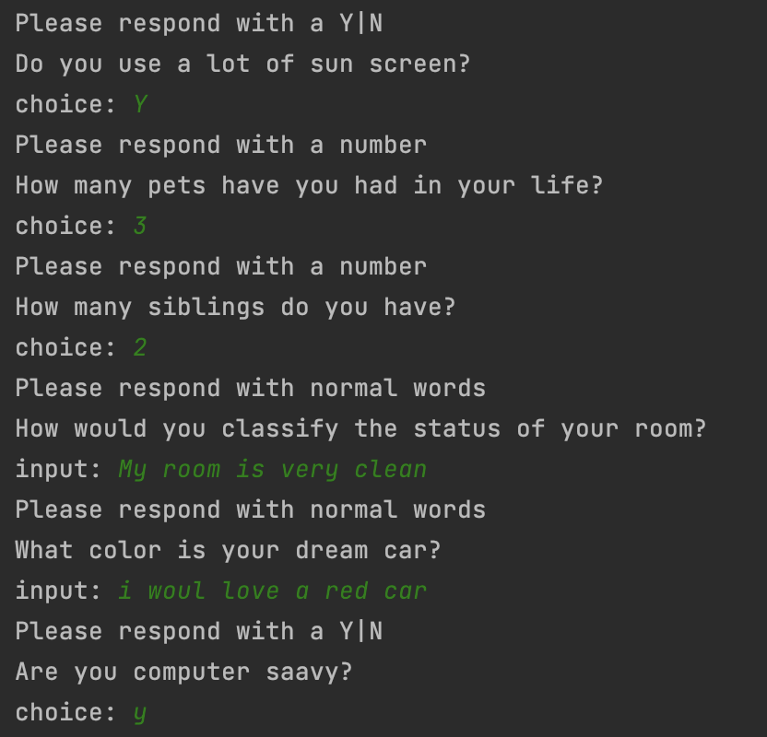
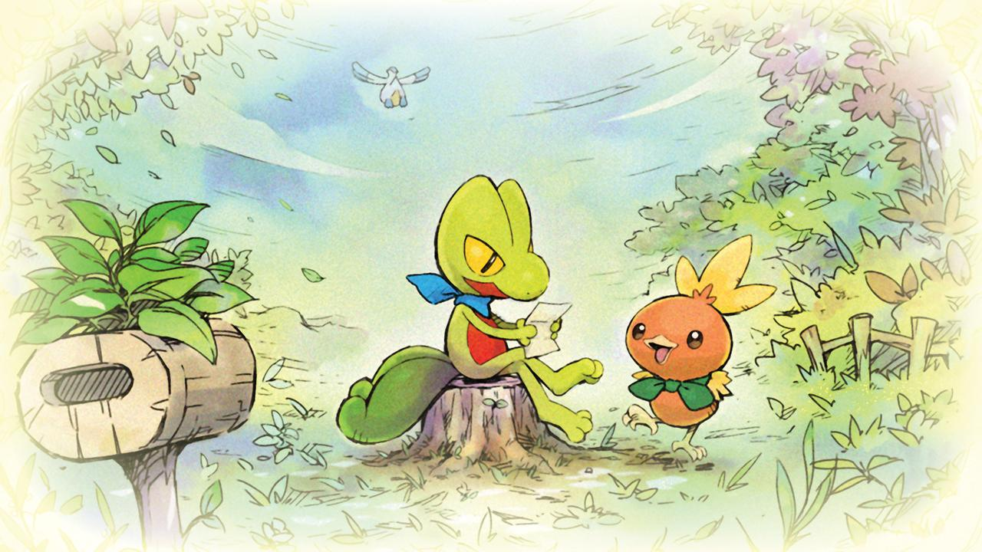
Implementation
Q&A Questions To Asked
We Pick Randomly from a list of questions
Yes/No
4 Weather Related/4Physical Related
5 Full sentence response
2 Integer response
We needed to include the 8 Y/N questions to force the score to be further separated

Slide 11
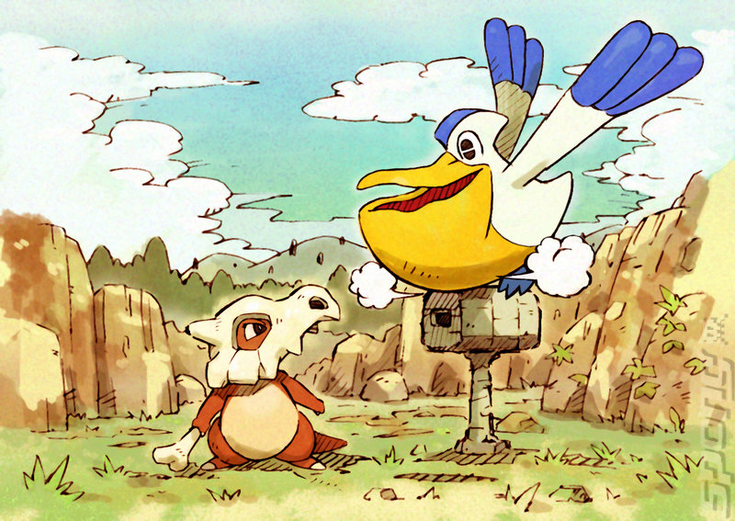
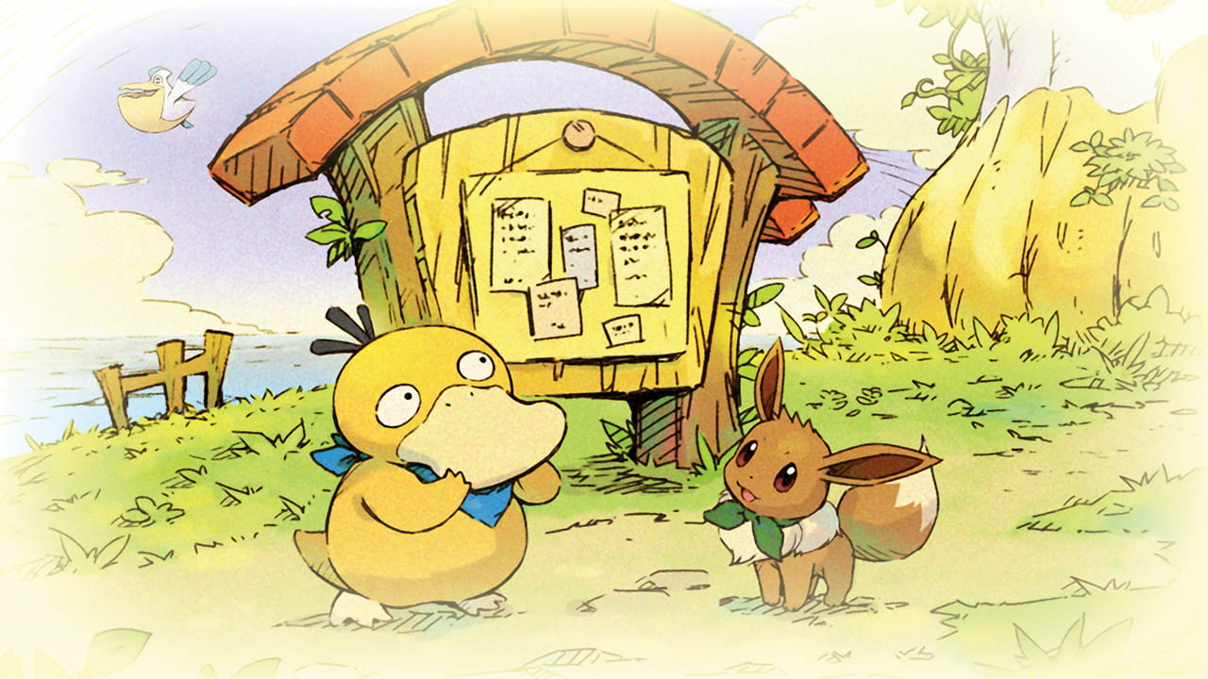



Conclusions
Instructive
Chatbot from Scratch
Thank You
Applying theoretical concepts.
Good learning experience.
Entertaining

