Slide 1
Introduction to mini-internet
Chris Papastamos

Slide 2
The platform
Mini-internet is an educational platform that simulates an internet topology and allows student to practice network configuration on it
Every device (host, switch, router) is simulated using docker containers
Virtual links connecting the topology is simulated using Open vSwitch links
Chris Papastamos

Slide 3
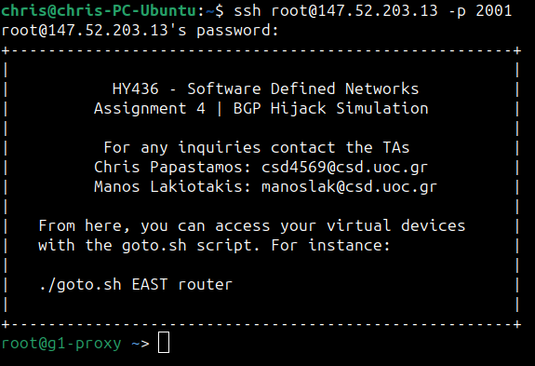
Connecting to the Proxy
Each AS has a proxy container where one can login with the AS password.
To connect to the proxy, ssh to the server IP: 147.52.203.13 as user root
For each AS the port number is equal to:
2000+[AS#]
Chris Papastamos

Slide 4
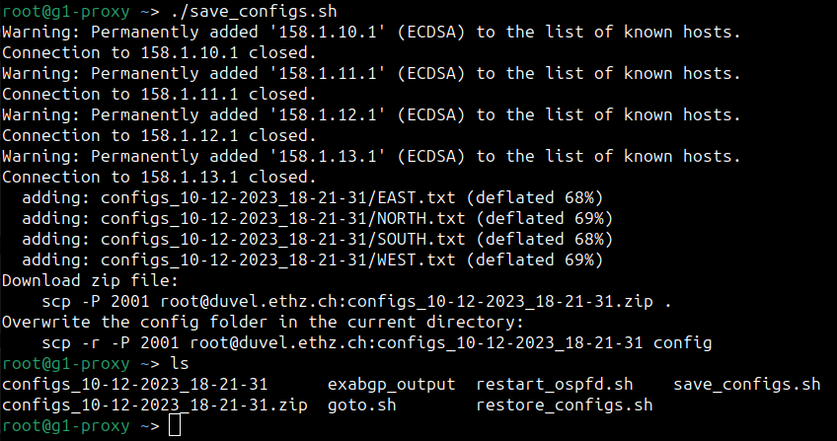
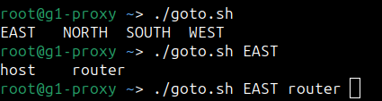
Connecting to the Proxy
./goto.sh script:
Using this script you can access all the devices in your topology. Pressing the TAB key will bring suggestions from the available devices.
./save_configs.sh script:
This script will save the configurations of each router in the proxy container. You will need to copy them to your device
Chris Papastamos

Slide 5
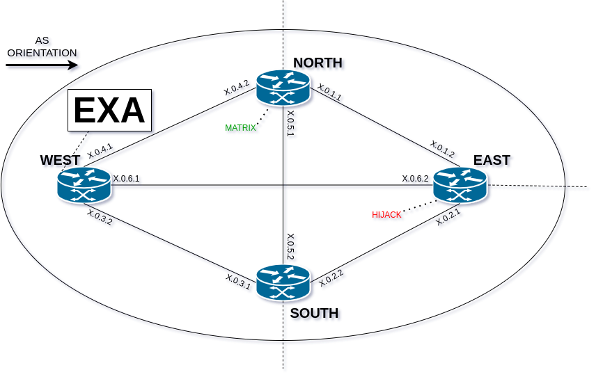
Inter AS Topology
Each AS contains 4 routers placed in a diamond configuration and they are connected in a full-mesh style.
3 out of the 4 routers (NORTH, SOUTH and EAST) have external connections to the neighboring ASes.
As seen on the top-left corner, the orientation of this demonstration AS follows the arrow displayed
Chris Papastamos

Slide 6
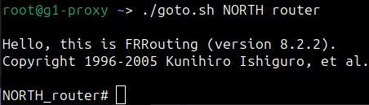
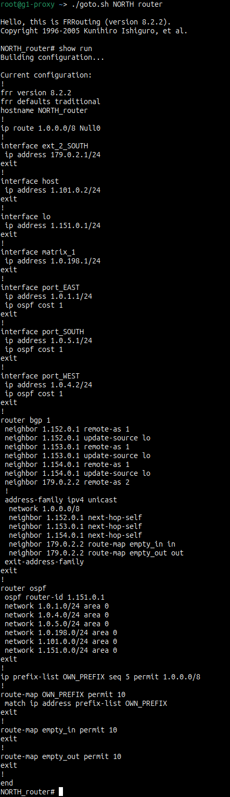
Connecting to a router
Using the ./goto.sh script you can connect to a router of your AS.
In the command line of the router you can execute the command “show run”. This command displays the current running configuration. The screenshot on the right displays the output of the command (It is a little bit long to fit in a slide).
Chris Papastamos

Slide 7
.
.
Chris Papastamos

Slide 8
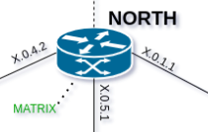
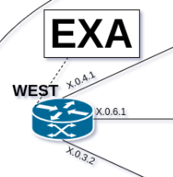
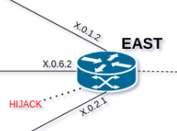
Inter AS Topology (Types of routers)
 | MATRIX router: The matrix router is used to create the connectivity matrix (will see later). A container is periodically pinging every other AS periodically (appox. every 2 minutes) throuth the MATRIX interface of the router. The target of the ping is the SOUTH router of each AS
Chris Papastamos

