Slide 1
Introduction to mini-internet
Chris Papastamos

Slide 2
The platform
Mini-internet is an educational platform that simulates an internet topology and allows student to practice network configuration on it
Every device (host, switch, router) is simulated using docker containers
Virtual links connecting the topology is simulated using Open vSwitch links
Chris Papastamos

Slide 3
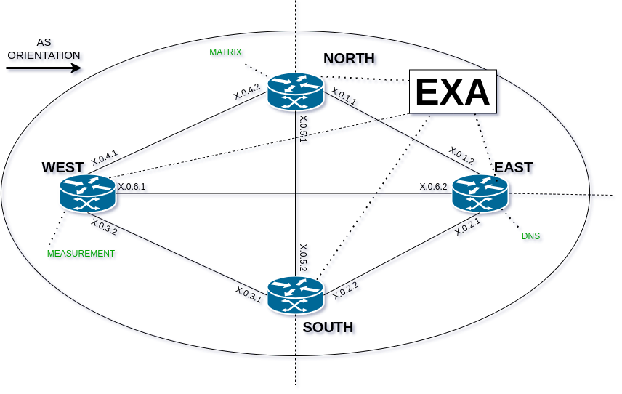
AS Topology - internal
Each AS contains 4 routers placed in a diamond configuration and they are connected in a full-mesh style.
3 out of the 4 routers (NORTH, SOUTH and EAST) have external connections to the neighboring ASes.
As seen on the top-left corner, the orientation of this demonstration AS follows the arrow displayed
Chris Papastamos

Slide 4
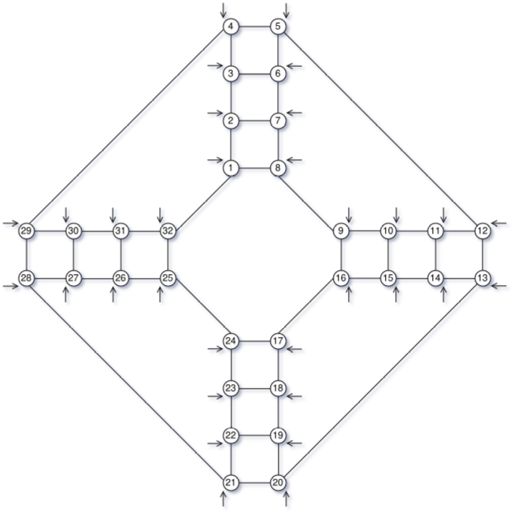
AS Topology - external
All Ases are connected according to the figure on the right. Every student will be assigned an AS and a Target AS.
Your objective is to hijack the target AS, calculate which ASes you will affect with your hijack.
While you attack a fellow student of yours, someone will target your AS! You have to detect the hijack and mitigate it accordingly.
Chris Papastamos

Slide 5
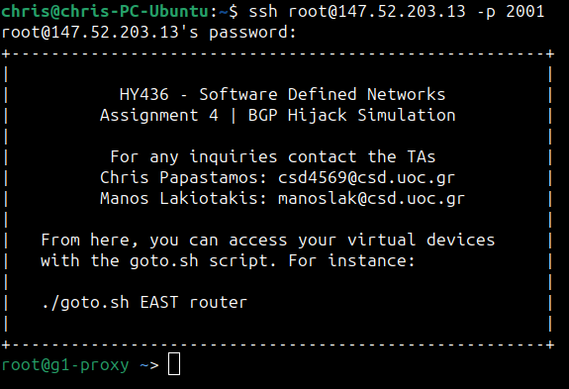
Connecting to the Proxy
Each AS has a proxy container where one can login with the AS password.
To connect to the proxy, ssh to the server IP: 147.52.203.13 as user root
For each AS the port number is equal to:
2000+[AS#]
Chris Papastamos

Slide 6
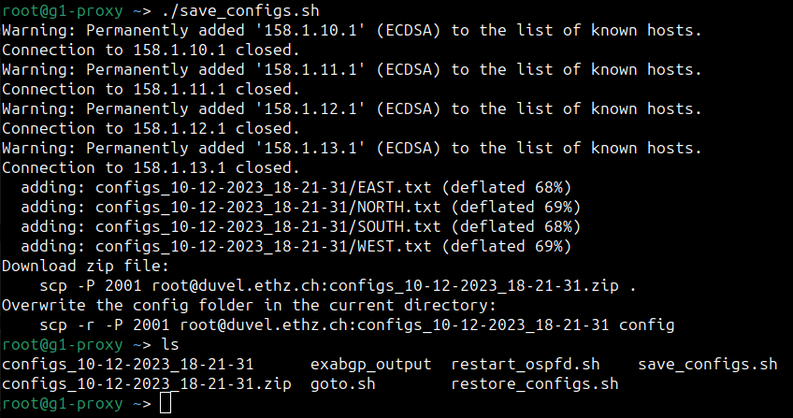
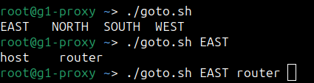
Connecting to the Proxy
./goto.sh script:
Using this script you can access all the devices in your topology. Pressing the TAB key will bring suggestions from the available devices.
./save_configs.sh script:
This script will save the configurations of each router in the proxy container. You will need to copy them to your device in order to turn them in with your report
Chris Papastamos

Slide 7
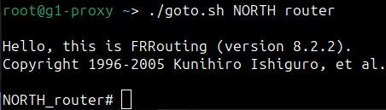
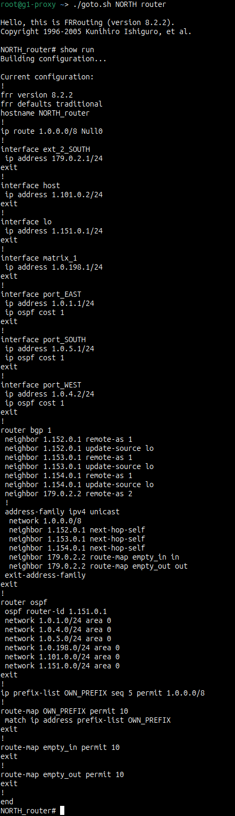
Connecting to a router
Using the ./goto.sh script you can connect to a router of your AS.
In the command line of the router you can execute the command “show run”. This command displays the current running configuration. The screenshot on the right displays the output of the command (It is a little bit long to fit in a slide).
Chris Papastamos

Slide 8
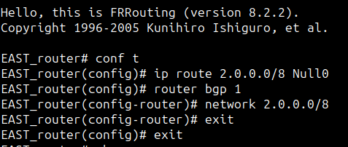
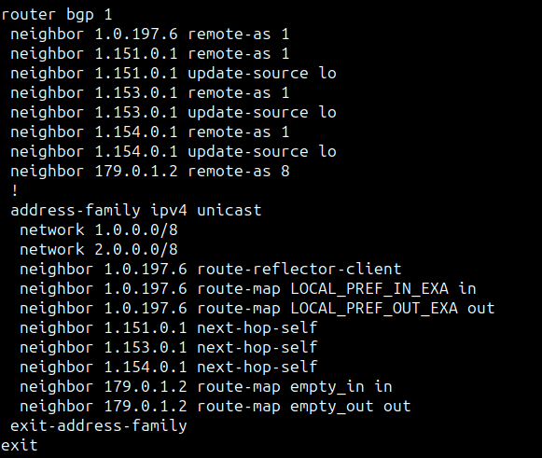

Advertising a prefix
On the top screenshot we can see an example where the EAST router of AS1 is configured to advertise the prefix 2.0.0.0/8.
You can verify the advertisement by looking at the output of the show run command and verifying that the commands you just ran exists in the running configuration.
Chris Papastamos

Slide 9
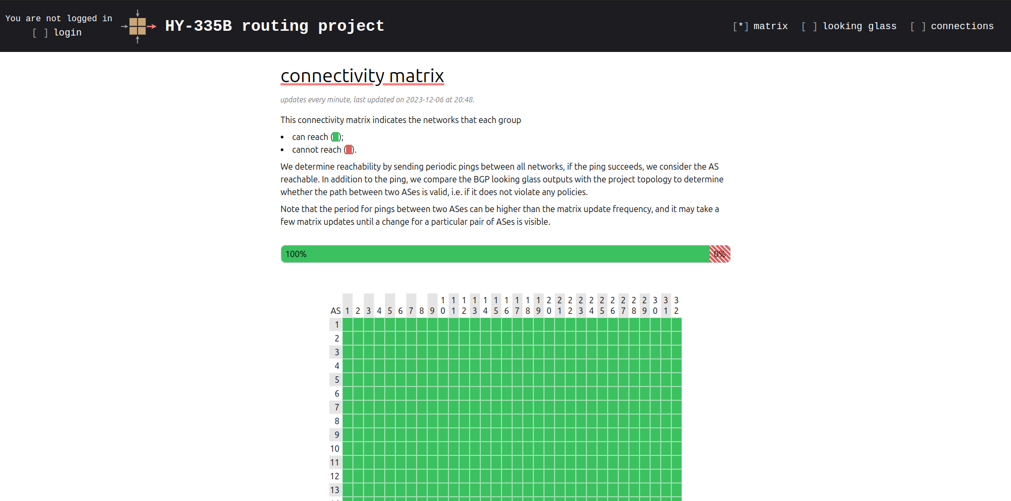
Platform’s Website
You can access the platform’s website in the by visiting hy436.duckdns.org:8000 on your web browser. The website consists of 3 main indexes:
Matrix
Looking Glass
Connections
Chris Papastamos

Slide 10
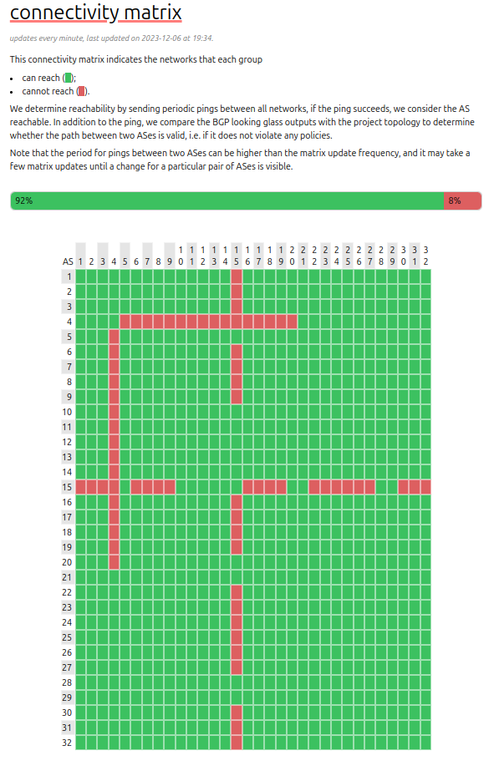
Connectivity Matrix
The connectivity matrix displays the status of the connectivity between any two ASes using a green square for connected and red for not connected.
Using the connectivity matrix you can quickly distinguish BNZ hijacks and their target.
The matrix has a response time of approximately 20 minutes so be patient with it.
Chris Papastamos

Slide 11
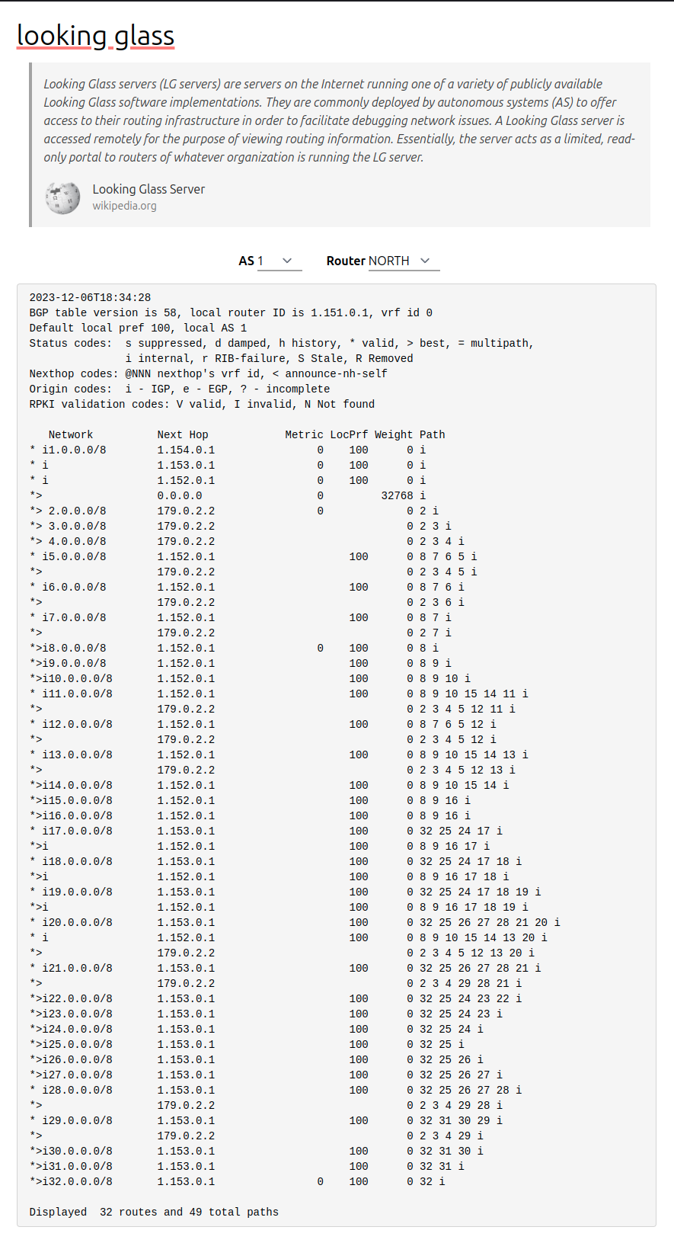
Looking Glass
The BGP Looking Glass is a tool that can be used to take a peek on the accepted routes of any router of any AS.
Using the filter fields on the top, you can select the desired router .
The output of the Looking Glass contains the selected path for each advertised prefix.
You can use this functionality to detect BGP Hijacks.
Chris Papastamos

Slide 12
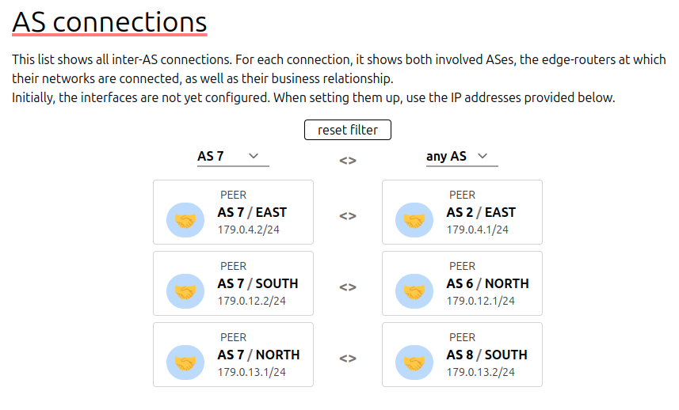
Connections
The Connections page displays the external connections of your AS with its neighbors.
In this index you can find information about the external links of your AS to further understand the topology.
Using the filter fields on the top, you can filter the results by source or destination AS .
Chris Papastamos

