Slide 1
GREEK BANKING SECTOR ANALYSIS
2022 – 2024
Eurobank · Alpha Bank · Piraeus Bank · NBG
Spyros Papastergiou
spyrossyo96@gmail.com | github.com/papastergiousp-maker/greek-banking-sector-analysis
Data sourced exclusively from audited annual reports · Not investment advice

Slide 2
Executive Summary
Key findings from 12 annual reports | FY2022–2024
+55% Sector NII Growth
NPE Cleanup Complete
Rate Cycle Now a Headwind
Net interest income rose from €5.5bn (2022) to €8.6bn (2024) driven almost entirely by ECB rate hikes. NBG leads with NIM of 3.14% — highest in the peer group.
All four banks reduced NPE ratios below 4% by 2024 (from 5–8% in 2022). NBG and Piraeus tied at 2.6% — a structural improvement that took a decade and €tens of billions of portfolio disposals.
ECB cuts beginning in 2024 will reduce sector NII by ~€170–220m per 25bp. Under EBA-style stress (+200bp CoR, −15% loans, −50bp NIM), Piraeus Bank's CET1 falls to ~9.9% — breaching the 10.5% SREP floor.
Bank
ROE 2024
NIM 2024
CET1 2024
NPE 2024
Net Profit 2024
Eurobank
16.9%
2.48%
17.6%
2.9%
€1,458m
Alpha Bank
8.2%
2.32%
15.4%
3.8%
€668m
Piraeus Bank
12.9%
2.61%
13.7%
2.6%
€1,066m
NBG
13.7%
3.14%
19.1%
2.6%
€1,158m
Greek Banking Sector Analysis 2022–2024 | Spyros Papastergiou | 2 / 12

Slide 3
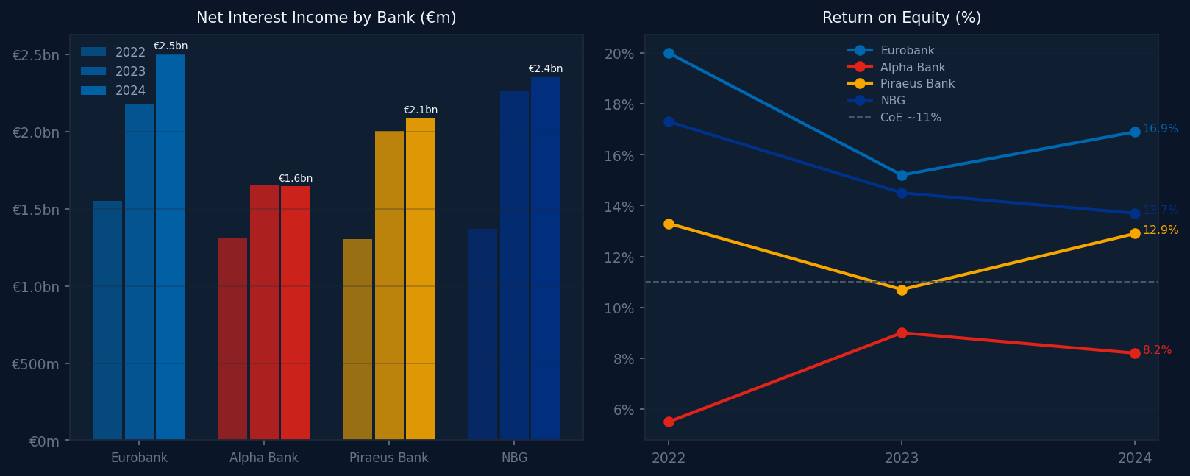
Sector Landscape — NII & Profitability
Net Interest Income surge driven by ECB rate cycle | All values €m
Greek Banking Sector Analysis 2022–2024 | Spyros Papastergiou | 3 / 12

Slide 4
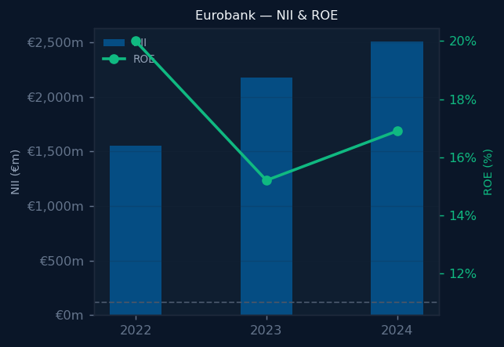
Eurobank
FY2024 Snapshot | 1 of 4
ROE
NIM
CET1
C/I
NPE
Net Profit
16.9%
2.48%
17.6%
32.6%
2.9%
€1,458m
+1.7pp
-0.24pp
+1.4pp
+1.5pp
-0.6pp
+27%
Investment Highlights
▸ ROE of 16.9% — highest in peer group; only bank trading below justified P/B (~1.5x vs market ~1.3x)
▸ Hellenic Bank consolidation adds Cypriot diversification; 71% of loans outside Greece by 2024
▸ Best earnings quality: lowest C/I in sector (32.6%); 710bp CET1 headroom above SREP floor
Greek Banking Sector Analysis 2022–2024 | Spyros Papastergiou | 4 / 12

Slide 5
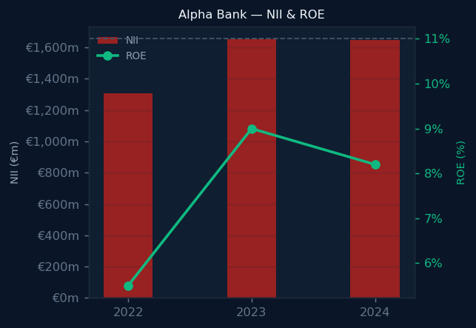
Alpha Bank
FY2024 Snapshot | 2 of 4
ROE
NIM
CET1
C/I
NPE
Net Profit
8.2%
2.32%
15.4%
37.7%
3.8%
€668m
-0.8pp
+0.05pp
+1.5pp
+0.5pp
-2.2pp
+2%
Investment Highlights
▸ ROE of 8.2% below CoE of ~11% — justified P/B ~0.7x; re-rate requires ROE expansion
▸ NPE cleanup accelerated: ratio fell from 7.8% (2022) to 3.8% (2024) via GAIA II and Project ACAC
▸ NII flat in 2024 (−0.3% YoY) as rate tailwind fades; operational leverage improving (C/I 37.7%)
Greek Banking Sector Analysis 2022–2024 | Spyros Papastergiou | 5 / 12

Slide 6
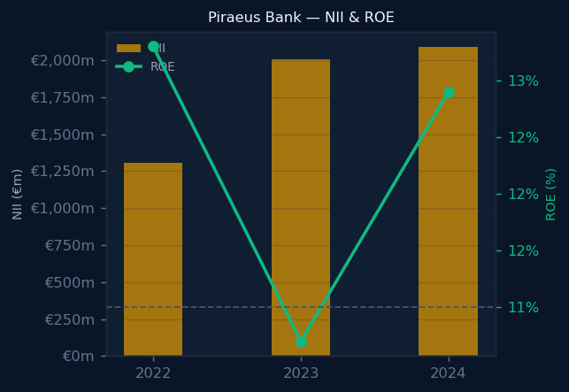
Piraeus Bank
FY2024 Snapshot | 3 of 4
ROE
NIM
CET1
C/I
NPE
Net Profit
12.9%
2.61%
13.7%
31.8%
2.6%
€1,066m
+2.2pp
-0.01pp
+0.9pp
-1.3pp
-0.9pp
+35%
Investment Highlights
▸ 2024 profit surge (+35% YoY) partly driven by ~€165m after-tax impairment benefit; underlying growth ~+14%
▸ Best-in-class efficiency: C/I of 31.8% — lowest in sector; strong operational improvement trajectory
▸ Tightest capital buffer: CET1 13.7%, only 320bp above SREP floor; breaches in EBA adverse stress
Greek Banking Sector Analysis 2022–2024 | Spyros Papastergiou | 6 / 12

Slide 7
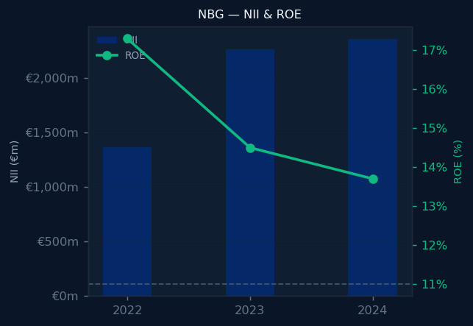
NBG
FY2024 Snapshot | 4 of 4
ROE
NIM
CET1
C/I
NPE
Net Profit
13.7%
3.14%
19.1%
36.5%
2.6%
€1,158m
-0.8pp
+0.11pp
+1.3pp
+2.9pp
-1.1pp
+5%
Investment Highlights
▸ Highest NIM (3.14%) and CET1 (19.1%) in sector; 860bp headroom above SREP floor
▸ NPE ratio of 2.6% — tied for sector-best; ROE of 13.7% sustained above CoE despite rate headwinds
▸ Structural rate sensitivity: higher fixed-spread SME/retail mix provides partial ECB rate hedge
Greek Banking Sector Analysis 2022–2024 | Spyros Papastergiou | 7 / 12

Slide 8
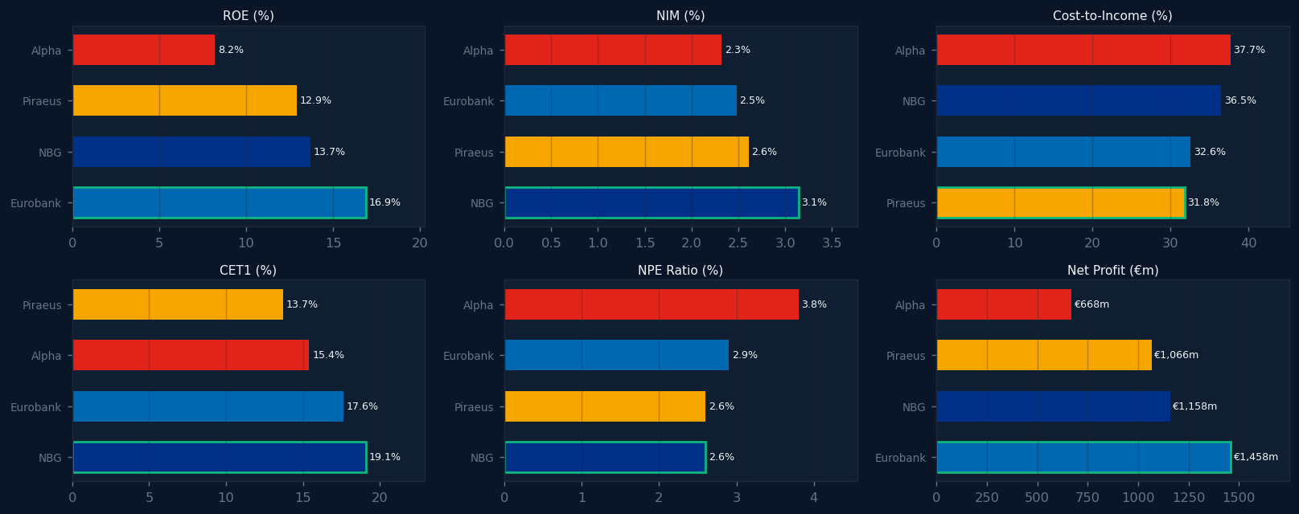
Peer Rankings — FY2024
Green = best in class per metric | Direction-adjusted (lower C/I, NPE = better)
Greek Banking Sector Analysis 2022–2024 | Spyros Papastergiou | 8 / 12

Slide 9
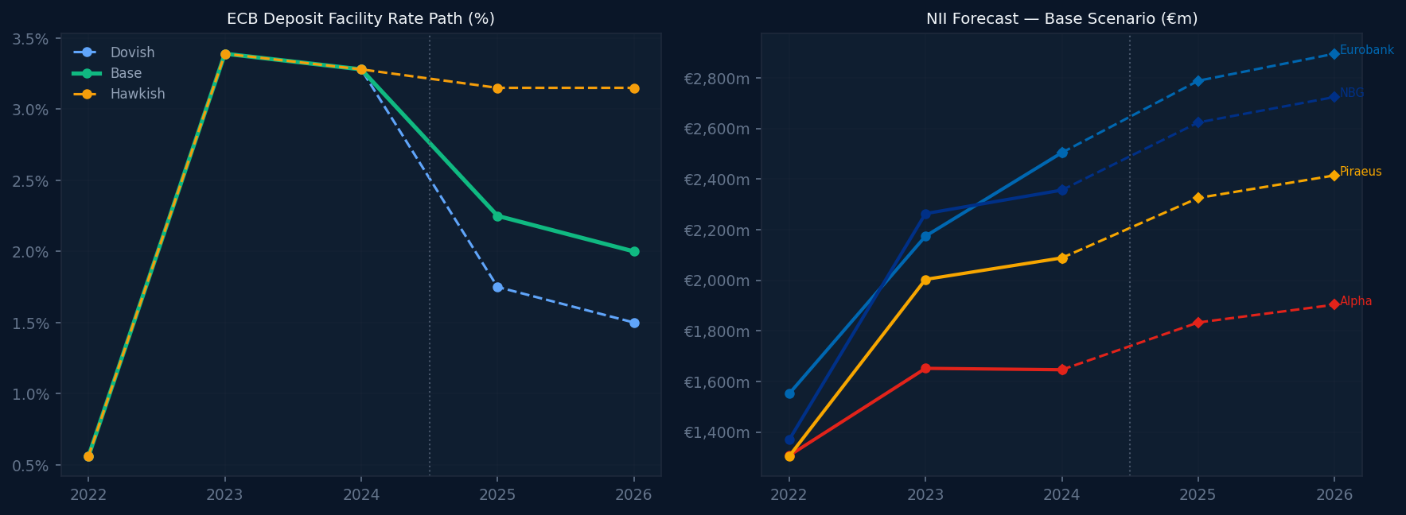
NII Forecast 2025–2026 — ECB Rate Scenarios
Rate sensitivity: ~€195m sector NII per 25bp ECB cut | Volume: +2% p.a. assumed
Greek Banking Sector Analysis 2022–2024 | Spyros Papastergiou | 9 / 12

Slide 10
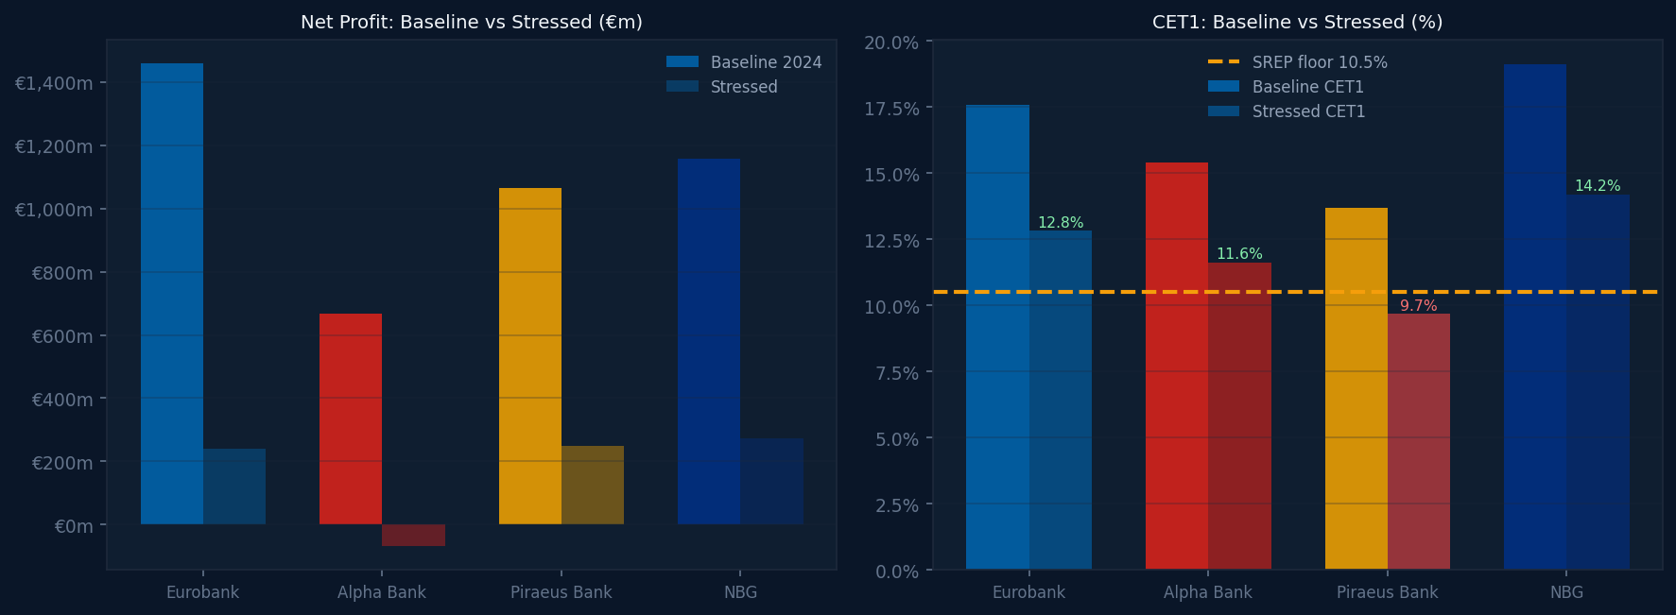
EBA-Style Stress Test
Adverse scenario: +200bp CoR · −15% loans · −50bp NIM | Piraeus breaches 10.5% SREP floor
Greek Banking Sector Analysis 2022–2024 | Spyros Papastergiou | 10 / 12

Slide 11
Valuation Framework — P/B vs Justified P/B
Gordon Growth model: Justified P/B = ROE / CoE | CoE 11% (Rf 3.5% + ERP 5.5% + CRP 2%)
Bank
Market P/B
ROE 2024
CoE
Justified P/B
vs Market
Investment Signal
Eurobank
~1.3x
16.9%
11.0%
~1.5x
~15% discount
Quality premium warranted
NBG
~1.3x
13.7%
11.0%
~1.2x
≈ fair value
Total return via buybacks
Piraeus Bank
~0.9x
12.9%
11.0%
~1.2x
~25% discount
CoR risk closes gap
Alpha Bank
~0.8x
8.2%
11.0%
~0.7x
Slight premium
Re-rate needs ROE > CoE
Methodology: CoE = Risk-free rate (3.5%) + Beta (1.0) × Equity Risk Premium (5.5%) + Country Risk Premium (2.0%) = 11.0% | Market P/B approximate end-2024 prices. Justified P/B = ROE / CoE (Gordon Growth, g=0).
Greek Banking Sector Analysis 2022–2024 | Spyros Papastergiou | 11 / 12

Slide 12
Methodology & Data Quality
All figures sourced from 12 audited annual report PDFs | No paid data vendors
Data Extraction
Data Quality
Financial Models
Deliverables
• 12 annual report PDFs
• 26 pytest assertions
• 5-step banking DuPont
• SQLite DB + 3 processed CSVs
• pdfplumber (Python) extraction
• KPIs re-computed from CSVs
• CAMELS scoring (1–5 scale)
• Plotly/sql.js browser dashboard
• Manual cross-validation per figure
• BS identity check (Assets = L + E)
• Z-score peer benchmarking
• Streamlit multi-page app (live)
• Source page cited for every KPI
• NPE ratios: 12/12 PDF-verified
• EBA-style single-period stress
• Excel model + this deck
Known limitations: Annual data only (no quarterly) · NIM uses year-end assets (proxy) · Market P/B values are end-2024 estimates · RWA proxy = loans × 50% · Not investment advice.
GitHub: github.com/papastergiousp-maker/greek-banking-sector-analysis
Live app: greek-banking-sector-analysis.streamlit.app
Greek Banking Sector Analysis 2022–2024 | Spyros Papastergiou | 12 / 12

