Slide 1
GREEK BANKING SECTOR ANALYSIS
FY2022–2024
Eurobank · Alpha Bank · Piraeus Bank · NBG
Consolidated group figures: Alpha Services and Holdings S.A., Eurobank Ergasias Services and Holdings S.A., National Bank of Greece S.A., Piraeus Financial Holdings S.A.
Latest restated figures. Every number is traced to a PDF page.
Spyros Papastergiou
papastergiousp@gmail.com | github.com/papastergiousp-maker/greek-banking-sector-analysis | phytai.com/dashboard
For portfolio and educational purposes only. Not investment advice.

Slide 2
Executive Summary
Four listed groups, FY2022–2024. €m unless stated.
Sector NII up 59.9% in two years
2022 profit includes one-offs
Alpha is the weak point under stress
Capital quality and funding
Net interest income of the four banks rose from €5,376m in 2022 to €8,596m in 2024. Most of it came in 2023, when wider margins added €2,891m (rate effect). In 2024 NII grew by only €497m: €270m from rate and €225m from volume.
Sector net profit for 2022 was €3,785m as reported and €2,577m on an underlying basis. On underlying figures 2023 profit rose about 42% instead of falling 3.5%.
In a one-year stress test three banks stay profitable and Alpha loses €118m. Alpha can absorb 209bp of extra cost of risk before a pre-tax loss, against 353 to 420bp for the other three.
DTCs fell from €13.5bn in 2022 to €12.0bn in 2024. At end-2024 they were 36% of CET1 capital at Eurobank and 63% at Piraeus. ECB funding of the four banks fell from €35.1bn (end-2022) to €2.6bn (end-2024), all of it at Alpha.
FY2024 key figures
Bank | Net profit | ROE | RoTE | NIM | Cost-to-income | CET1 | NPE ratio | DTC / CET1
Eurobank | €1,448m | 17.2% | 18.0% | 2.77% | 32.9% | 16.8% | 2.9% | 36%
Alpha Bank | €654m | 8.5% | 9.7% | 2.28% | 39.0% | 16.3% | 3.8% | 49%
Piraeus Bank | €1,066m | 13.7% | 15.7% | 2.67% | 31.8% | 14.5% | 2.6% | 63%
NBG | €1,158m | 14.4% | 15.5% | 3.15% | 36.5% | 18.3% | 2.6% | 51%
Green = best of the four (lowest for cost-to-income, NPE ratio and DTC / CET1). DTC = deferred tax credit, a tax claim on the Greek State that counts in CET1 capital.
Greek Banking Sector Analysis 2022–2024 | Spyros Papastergiou | Not investment advice | 2 / 12

Slide 3
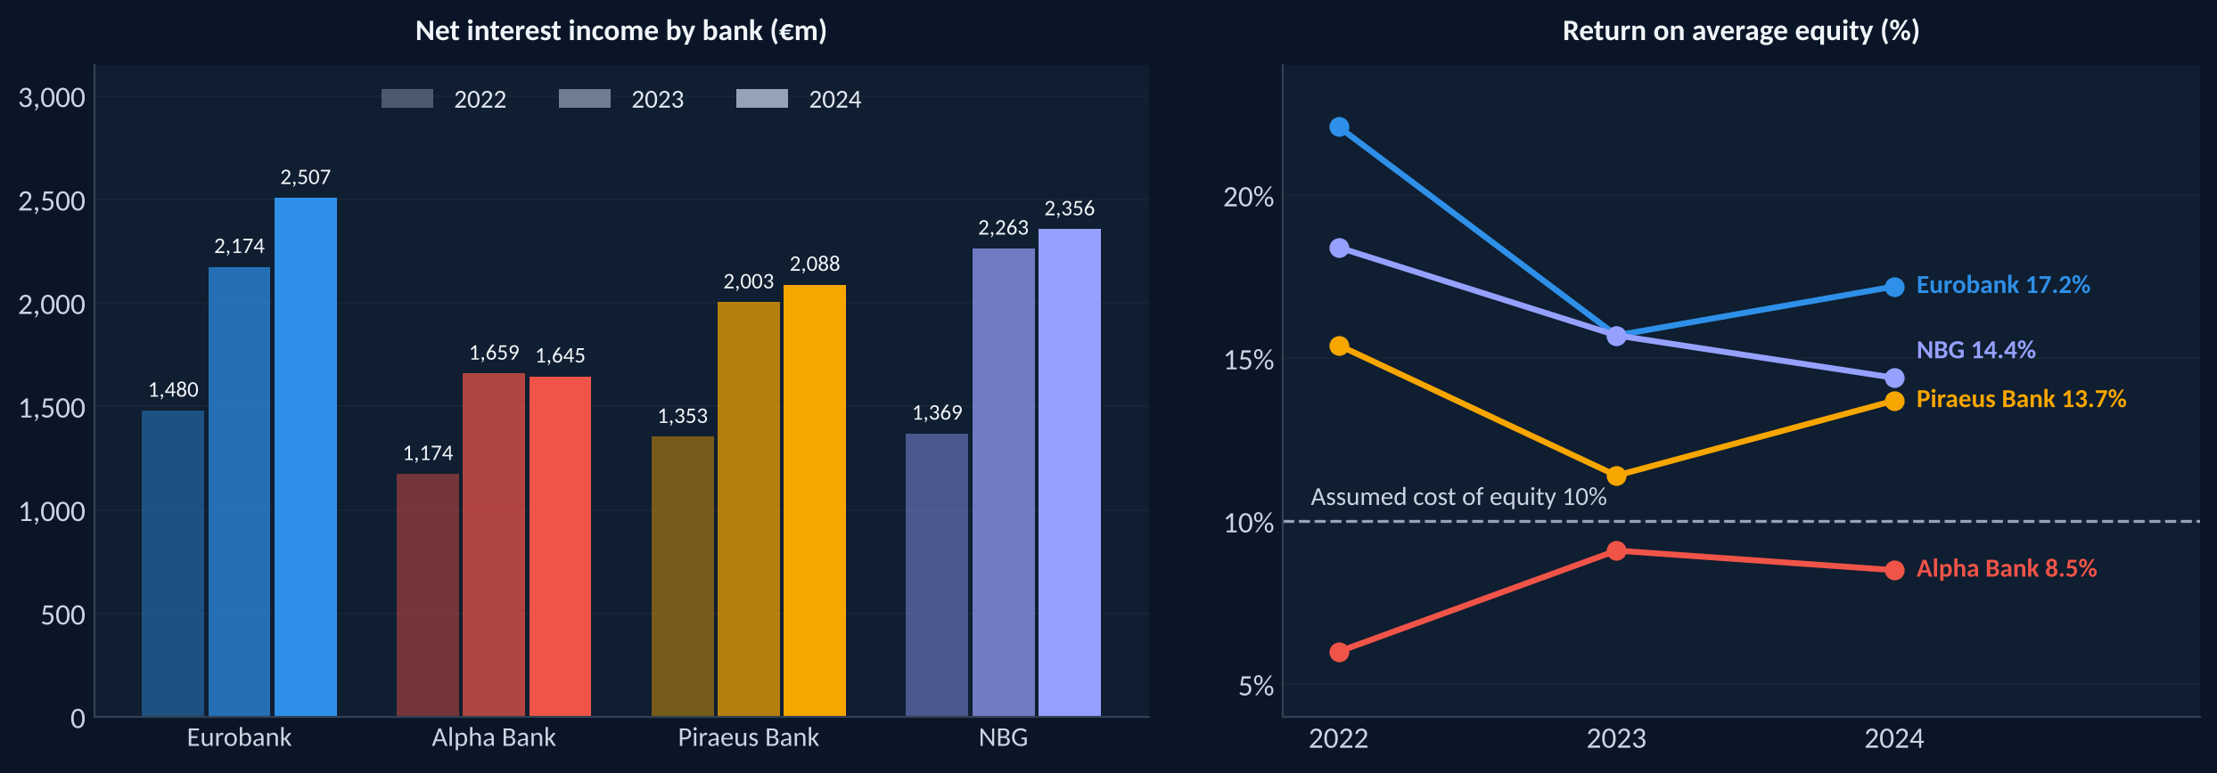
Sector Landscape: NII and Profitability
Sector NII rose 59.9% from 2022 to 2024. €m unless stated.
Net profit of the four banks: €3,785m (2022), €3,652m (2023), €4,326m (2024). 2022 includes one-off items (underlying €2,577m).
Eurobank 2024 includes Hellenic Bank, consolidated from 30 June 2024.
Greek Banking Sector Analysis 2022–2024 | Spyros Papastergiou | Not investment advice | 3 / 12

Slide 4
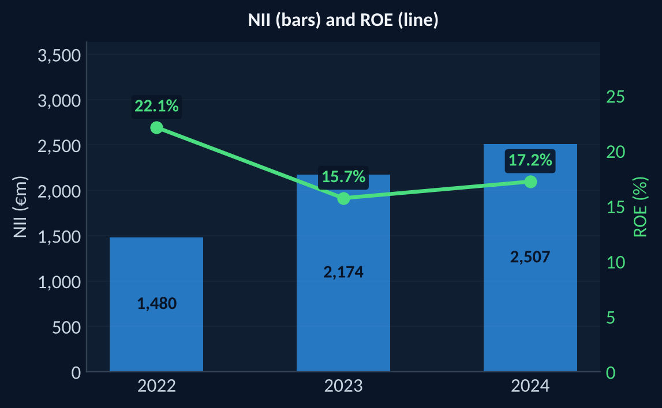
Eurobank
Eurobank Ergasias Services and Holdings S.A. | FY2024 snapshot
ROE
NIM
CET1
Cost-to-income
NPE ratio
Net profit
17.2%
2.77%
16.8%
32.9%
2.9%
€1,448m
+1.5 pp vs 2023
+0.07 pp vs 2023
-0.1 pp vs 2023
+1.5 pp vs 2023
-0.6 pp vs 2023
+27.0% vs 2023
What the numbers show
Returns. Highest ROE (17.2%) and largest net profit (€1,448m) of the four banks in 2024.
Hellenic Bank. Consolidated from 30 June 2024. Total assets rose 26.8% to €101,150m and deposits rose 36.8%. Its volume effect on NII was €265m.
Capital quality. DTCs were 36% of CET1 capital at end-2024, the lowest share of the four banks.
Stress test. Net profit stays at €402m and CET1 moves from 16.8% to 17.6%. Extra cost of risk before a pre-tax loss: 367bp.
Greek Banking Sector Analysis 2022–2024 | Spyros Papastergiou | Not investment advice | 4 / 12

Slide 5
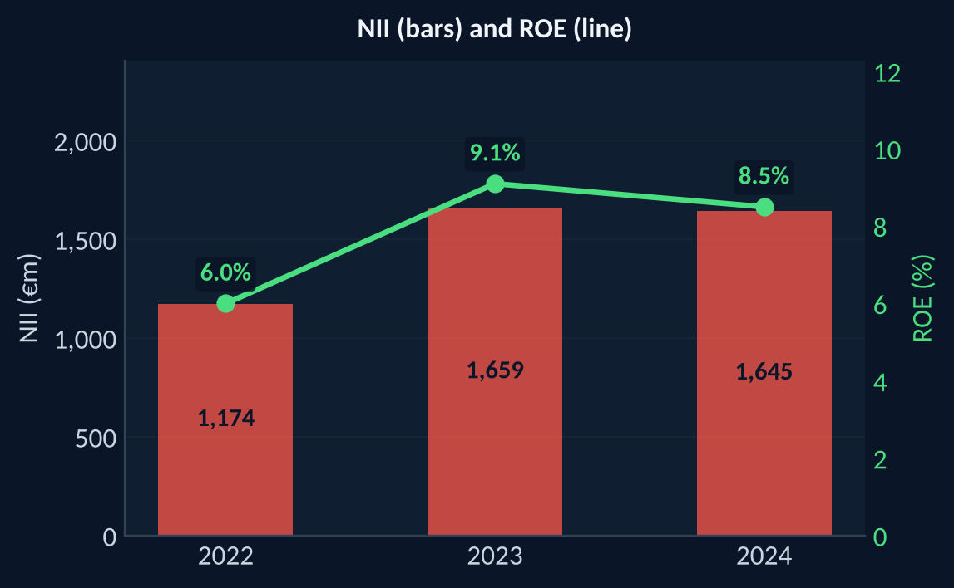
Alpha Bank
Alpha Services and Holdings S.A. | FY2024 snapshot
ROE
NIM
CET1
Cost-to-income
NPE ratio
Net profit
8.5%
2.28%
16.3%
39.0%
3.8%
€654m
-0.6 pp vs 2023
+0.07 pp vs 2023
+1.9 pp vs 2023
+0.7 pp vs 2023
-2.2 pp vs 2023
+5.8% vs 2023
What the numbers show
Returns. Lowest ROE (8.5%) and RoTE (9.7%) of the four banks in 2024.
NII. Fell 0.8% in 2024 after rising 41.3% in 2023. The volume effect took €65m off NII.
Asset quality and costs. NPE ratio fell from 7.8% (2022) to 3.8% (2024), still the highest of the four. Cost-to-income (39.0%) and cost of risk (0.96%) are the highest too.
Funding. The only bank still funded by the ECB at end-2024 (€2.6bn).
Stress test. It is the only bank with a loss, of €118m, and CET1 moves from 16.3% to 15.9%. Extra cost of risk before a pre-tax loss: 209bp, the least of the four banks.
EBA 2023. In the official adverse scenario fully loaded CET1 fell from 11.9% (Dec 2022) to 8.9% (end-2025), the largest fall of the four.
Greek Banking Sector Analysis 2022–2024 | Spyros Papastergiou | Not investment advice | 5 / 12

Slide 6
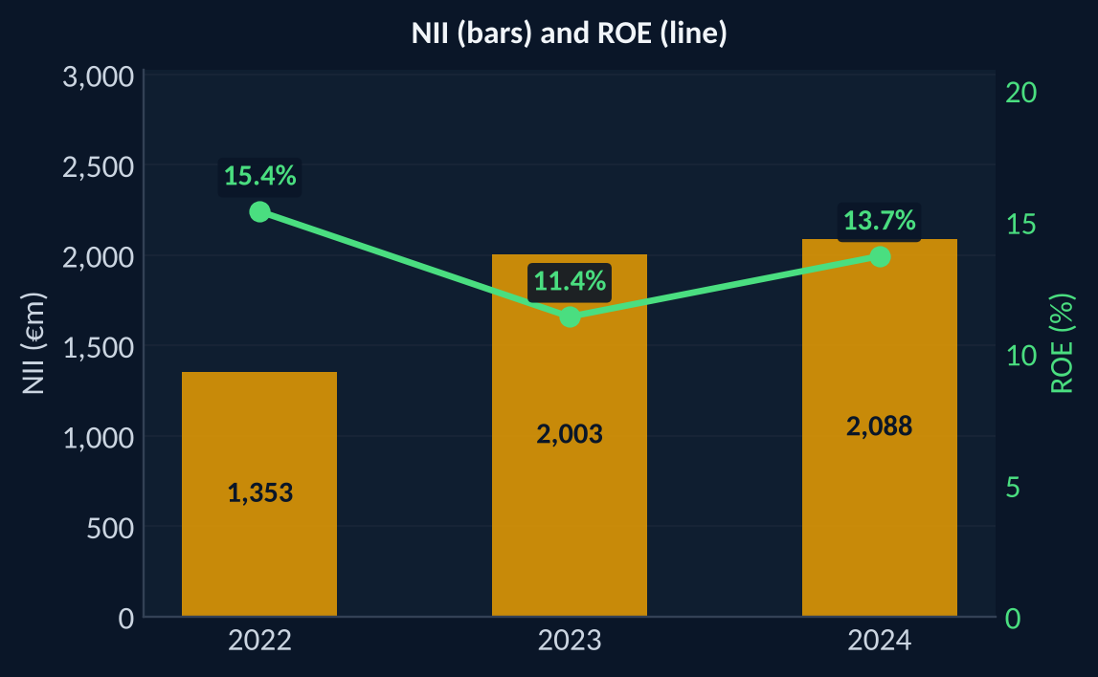
Piraeus Bank
Piraeus Financial Holdings S.A. | FY2024 snapshot
ROE
NIM
CET1
Cost-to-income
NPE ratio
Net profit
13.7%
2.67%
14.5%
31.8%
2.6%
€1,066m
+2.3 pp vs 2023
+0.02 pp vs 2023
+1.3 pp vs 2023
-1.3 pp vs 2023
-0.9 pp vs 2023
+35.3% vs 2023
What the numbers show
Efficiency. Lowest cost-to-income (31.8%) and lowest cost of risk (0.46%) of the four banks in 2024.
Profit. Net profit rose 35.3% to €1,066m, while NII grew only 4.2%. Loan impairments fell to €181m from €404m.
Capital quality. DTCs were 63% of CET1 capital at end-2024, the highest share of the four banks. CET1 ratio of 14.5% is the lowest of the four.
Stress test. Net profit stays at €217m and CET1 moves from 14.5% to 15.1%. Extra cost of risk before a pre-tax loss: 353bp.
Greek Banking Sector Analysis 2022–2024 | Spyros Papastergiou | Not investment advice | 6 / 12

Slide 7
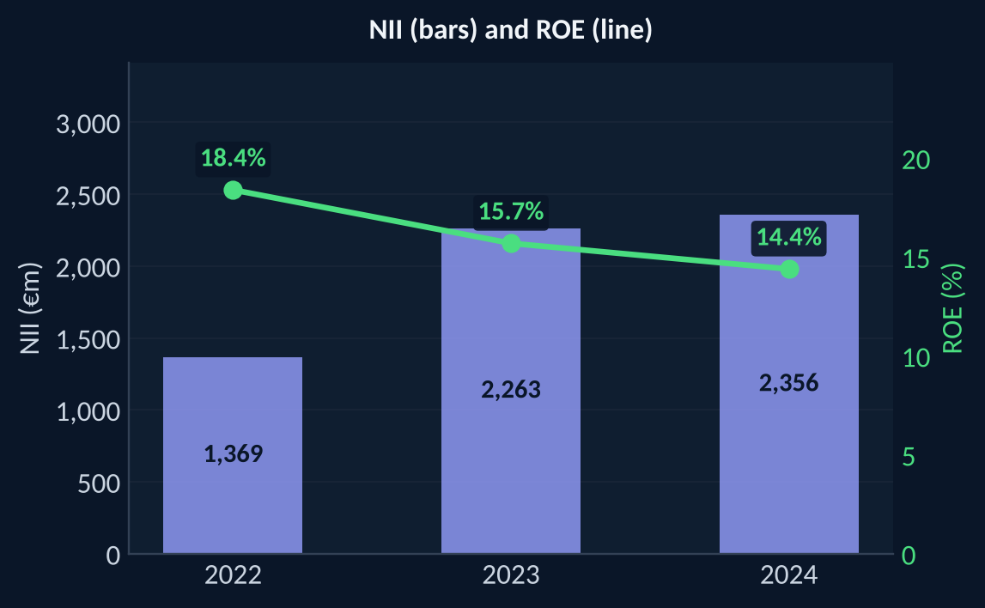
NBG
National Bank of Greece S.A. | FY2024 snapshot
ROE
NIM
CET1
Cost-to-income
NPE ratio
Net profit
14.4%
3.15%
18.3%
36.5%
2.6%
€1,158m
-1.3 pp vs 2023
+0.19 pp vs 2023
+0.5 pp vs 2023
+2.9 pp vs 2023
-1.1 pp vs 2023
+4.7% vs 2023
What the numbers show
Margin and capital. Highest NIM (3.15%) and highest CET1 ratio (18.3%) of the four banks in 2024.
Asset quality and liquidity. NPE ratio of 2.6%, level with Piraeus. Loan-to-deposit ratio of 62.7%, the lowest of the four.
Rough guide to 2026. In the base case NII falls 19.3% from 2024 to €1,902m, the largest fall of the four. This is not a forecast.
Stress test. Net profit stays at €371m and CET1 moves from 18.3% to 19.3%. Extra cost of risk before a pre-tax loss: 420bp, the most of the four banks.
Greek Banking Sector Analysis 2022–2024 | Spyros Papastergiou | Not investment advice | 7 / 12

Slide 8
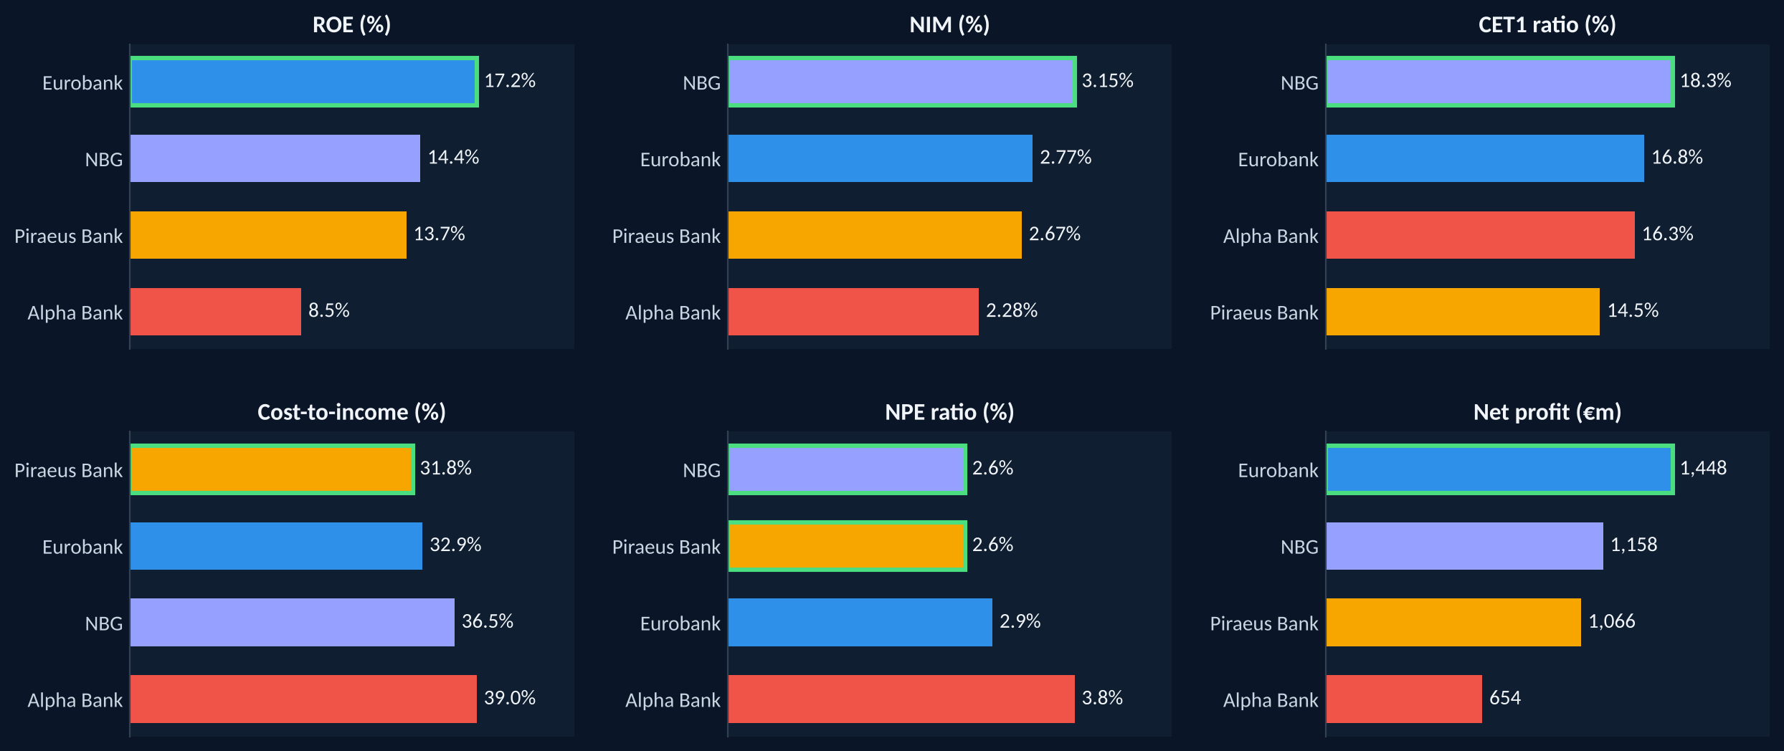
Peer Rankings: FY2024
Green outline = best of the four. Lower is better for cost-to-income and the NPE ratio.
Greek Banking Sector Analysis 2022–2024 | Spyros Papastergiou | Not investment advice | 8 / 12

Slide 9
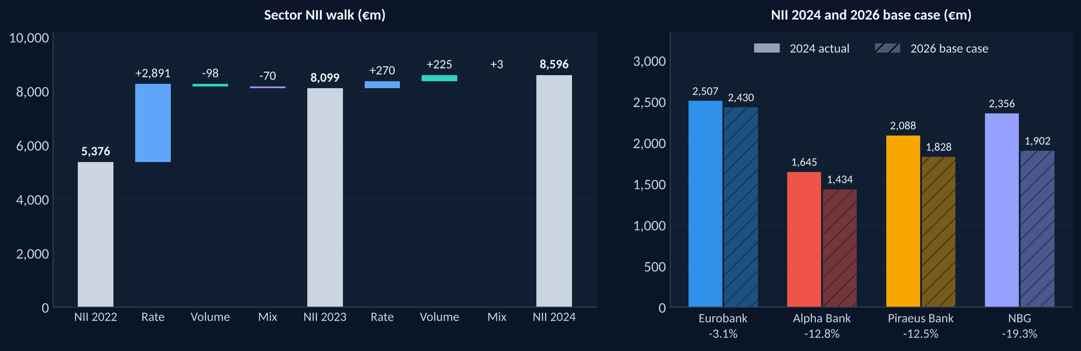
NII: Rate vs Volume, and a Rough Guide to 2026
Sector NII walk 2022 to 2024 and a base case for 2026. €m. A rough guide, not a forecast.
2022 to 2023. Wider margins (rate effect €2,891m) drove NII up by €2,723m. Volume and mix took a little back.
2023 to 2024. NII rose by €497m: rate €270m and volume €225m. Eurobank's volume effect was €265m, after it consolidated Hellenic Bank from 30 June 2024. Rounded effects can differ from the total by €1m.
2026 base case. Sector NII of €7,593m, 11.7% below 2024. The percentage under each bank is its change from 2024. NIM moves with the ECB yearly average deposit rate (gradual cuts) and total assets grow 2% a year. The rate sensitivity of each bank rests on three yearly points, so this is directional only. Banks may not add up to the sector total because of rounding.
Greek Banking Sector Analysis 2022–2024 | Spyros Papastergiou | Not investment advice | 9 / 12

Slide 10
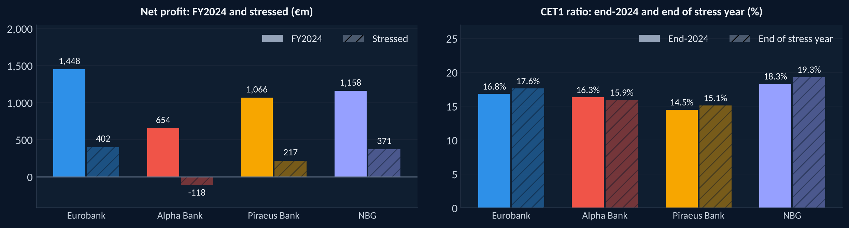
One-Year Stress Test
FY2024 base. Cost of risk up 200bp, loans down 15%, NIM down 50bp. Directional only.
Bank | Extra cost of risk before a pre-tax loss | EBA 2023: Dec 2022 | EBA 2023: adverse end-2025 | Change
Eurobank | 367bp | 14.4% | 12.2% | -2.2 pp
Alpha Bank | 209bp | 11.9% | 8.9% | -3.0 pp
Piraeus Bank | 353bp | 11.5% | 9.1% | -2.4 pp
NBG | 420bp | 15.9% | 14.5% | -1.4 pp
Costs flat, 29% tax on the change in profit, no dividends, RWAs unchanged. Stressed CET1 = (reported CET1 capital + stressed profit) / RWAs, so a bank that stays profitable ends the year with more CET1 because no dividend is paid. The EBA 2023 test is a three-year scenario on the 31.12.2022 balance sheet and cannot be compared with the simplified test.
Greek Banking Sector Analysis 2022–2024 | Spyros Papastergiou | Not investment advice | 10 / 12

Slide 11
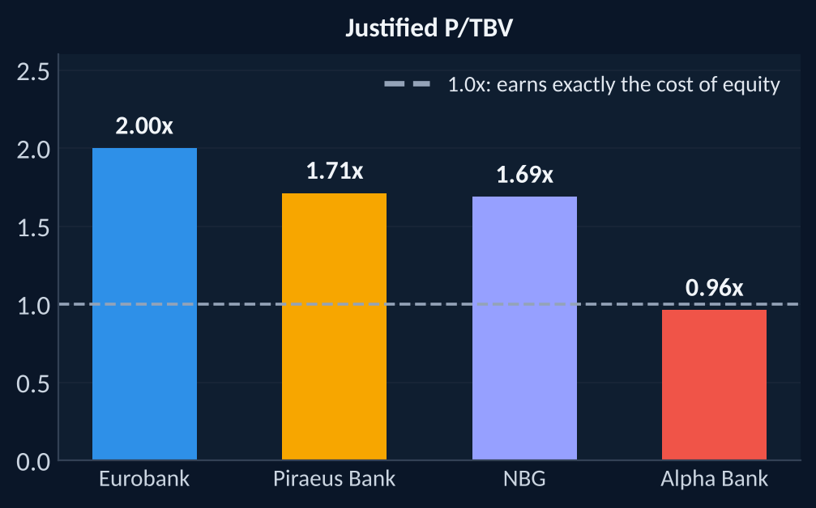
Valuation Framework: Justified P/TBV
Justified P/TBV = (RoTE - g) / (CoE - g), with CoE 10% and g 2% as assumptions. Not investment advice.
Bank | Net profit 2024 | Avg tangible equity | RoTE 2024 | Justified P/TBV | Reading
Eurobank | €1,448m | €8,025m | 18.0% | 2.00x | Earns above the assumed cost of equity
Alpha Bank | €654m | €6,737m | 9.7% | 0.96x | Earns slightly below the assumed cost of equity
Piraeus Bank | €1,066m | €6,776m | 15.7% | 1.71x | Earns above the assumed cost of equity
NBG | €1,158m | €7,450m | 15.5% | 1.69x | Earns above the assumed cost of equity
What it measures. The multiple of tangible book value that a bank's return would justify if it lasted. A bank that earns exactly its cost of equity is worth 1.0x.
What it does not do. No market prices are used, so the slide does not say whether any bank is cheap or expensive. It is a way to read returns, not a price target.
Assumptions. Cost of equity 10% and long-run growth 2% are stated assumptions. Change them and the multiples change. RoTE = net profit / average (equity less AT1 less goodwill and intangibles).
Greek Banking Sector Analysis 2022–2024 | Spyros Papastergiou | Not investment advice | 11 / 12

Slide 12
Methodology and Data Quality
Annual reports only. Report file and PDF page recorded for every figure.
Data
Checks
Methods
Limits
12 annual reports: FY2022, FY2023 and FY2024 of the four groups
2024 and 2023 from the FY2024 reports (2023 restated), 2022 from the FY2023 reports
Statements read with Python (pdfplumber). CET1, NPE, DTC and RWAs as reported at each year end
Automated tests recompute ROE, ROA, NIM, cost of risk, cost-to-income and loan-to-deposit from the statement lines
Assets equal liabilities plus equity for every bank and year
Every statement line and ratio has a report page
DTC share of CET1 is checked against the figure disclosed by Alpha and Eurobank
DuPont breakdown of ROE
CAMELS-style scorecard, own cut-offs, not a supervisory rating
NII rate, volume and mix walk
One-year stress test and the official EBA 2023 results
Justified P/TBV with stated assumptions
Yearly data only, so no view inside the year
CET1 ratios are as reported: Eurobank's 16.8% is before its FY2024 dividend accrual, the other three include FY2024 profit. NPE ratios follow each bank's own definition
Operating income and expenses follow each bank's own presentation
Stress test and NII scenario are simple and static: directional only
To check a number: find it in sources.csv in the repository. It lists the report file and the PDF page of every figure used here.
Entities (consolidated group figures)
Alpha Services and Holdings S.A., Eurobank Ergasias Services and Holdings S.A., National Bank of Greece S.A., Piraeus Financial Holdings S.A.
Spyros Papastergiou | papastergiousp@gmail.com | github.com/papastergiousp-maker/greek-banking-sector-analysis | phytai.com/dashboard
For portfolio and educational purposes only. Not investment advice.
Greek Banking Sector Analysis 2022–2024 | Spyros Papastergiou | Not investment advice | 12 / 12

