Slide 1
Presentation
12th of June 2017
A Comparison of Features Learned on
Natural vs. Drawn Image Datasets
Wang Biyuan

Slide 2
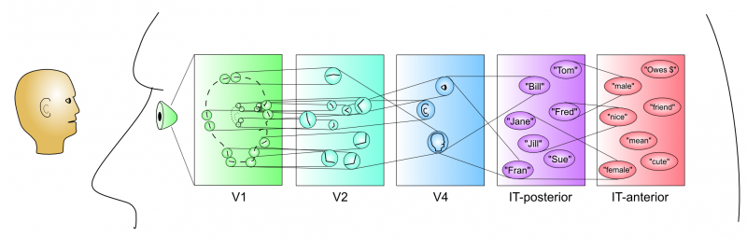
Introduction
Convolutional Neural Network is inspired by human visual system
Local connection by receptive fields
Layer structure from retina to visual cortex
Particular response of different cells
Notes:
In the past few years, there are quite amount of researches have shown that convolutional network can deliver outstanding performance on visual classification tasks. However there is still not enough insight into the internal operation of these models as well as how and what they actually learn in order to perform these tasks.
2

Slide 3
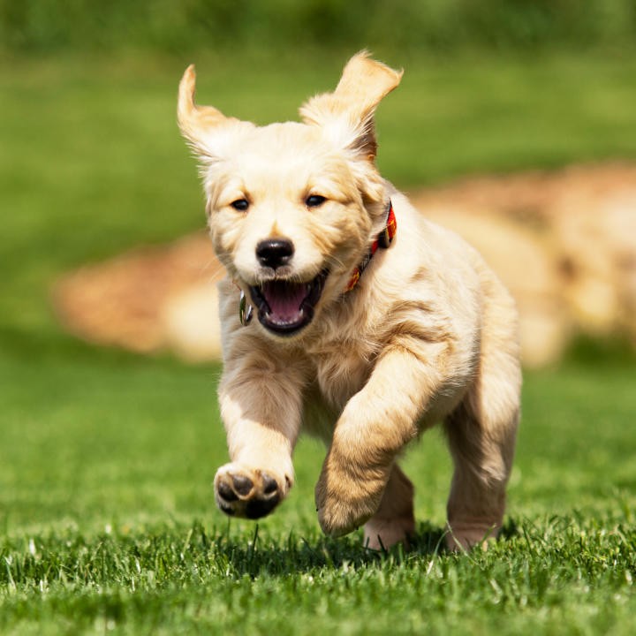
Introduction
Convolutional Neural Network has prominent performance in image understanding tasks, eg. Visual classification.
However, our understanding of image representations has been limited to natural images so far.
Dog
CNN model
Notes:
In the past few years, there are quite amount of researches have shown that convolutional network can deliver outstanding performance on visual classification tasks. However there is still not enough insight into the internal operation of these models as well as how and what they actually learn in order to perform these tasks.
3

Slide 4
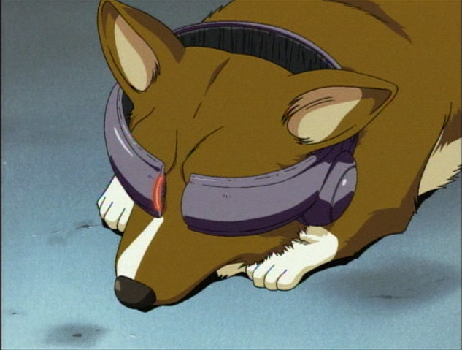
Introduction
Implement visualisation techniques.
Compare the features learned by networks of similar architecture but trained by two types of data of great contrasts in style.
CNN
model 1
Visualisation
Natural Features
Feature Comparison
CNN
model 2
Visualisation
Illustration
Features
Notes:
Therefore the implementation of visualisation techniques become very important in terms of making the behaviour of a deep CNN model human-comprehensible. My project is to study the features learned by different layers of the network and visualise them, also to compare the differences between features learned on natural images and illustrations. The results obtained from the visualisation are expected to help people explore more details about the deep CNN model in image recognition and therefore to design more efficient network to perform related tasks.
4

Slide 5
Methodology
Mahendran A, Vedaldi A. Visualizing deep convolutional neural networks using natural pre-images[J]. International Journal of Computer Vision, 2016: 1-23.
- Inversion: find pre-images of an image → reconstruction →
loss function to access reconstruction quality
- Activation maximization & Caricaturization: define scoring function for a certain class → visualise the representation which the response is maximized
Notes:
In my lit review, the 1st paper by Vedaldi’s group pointed out that due to most image processing methods are based on suitable image representations rather than image itself, we are still lack of understanding of these representations/features. They proposed three types of visualizations under the natural pre-images framework to explore the interpretation of representations. (natural pre-images is the notable representations in natural-looking images). In the experiments, they tuned the regularizers and optimization algorithms to investigate the effects on each layer induced by different parameters.
--inversion P10 5.1st para
--activated the most: has higher output from the scoring function, which is a scalar
5

Slide 6


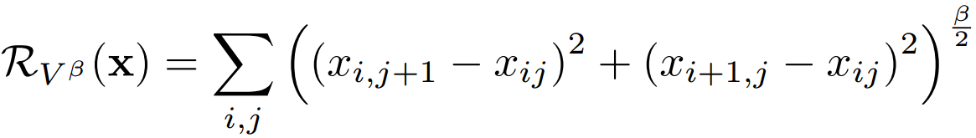
Methodology -- Inversion
Loss function: Mean Square Error
Regulariser I: Alpha norm
Regulariser II: Total variance
Notes:
In my lit review, the 1st paper by Vedaldi’s group pointed out that due to most image processing methods are based on suitable image representations rather than image itself, we are still lack of understanding of these representations/features. They proposed three types of visualizations under the natural pre-images framework to explore the interpretation of representations. (natural pre-images is the notable representations in natural-looking images). In the experiments, they tuned the regularizers and optimization algorithms to investigate the effects on each layer induced by different parameters.
--inversion P10 5.1st para
--activated the most: has higher output from the scoring function, which is a scalar
6

Slide 7
Methodology -- Inversion
Final objective function
Loss
Regularisers
Notes:
In my lit review, the 1st paper by Vedaldi’s group pointed out that due to most image processing methods are based on suitable image representations rather than image itself, we are still lack of understanding of these representations/features. They proposed three types of visualizations under the natural pre-images framework to explore the interpretation of representations. (natural pre-images is the notable representations in natural-looking images). In the experiments, they tuned the regularizers and optimization algorithms to investigate the effects on each layer induced by different parameters.
--inversion P10 5.1st para
--activated the most: has higher output from the scoring function, which is a scalar
7

Slide 8
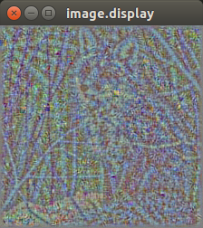
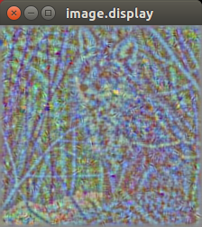
Results -- Inversion
Effects of regularisers
Without regularisers
With regularisers
Notes:
In my lit review, the 1st paper by Vedaldi’s group pointed out that due to most image processing methods are based on suitable image representations rather than image itself, we are still lack of understanding of these representations/features. They proposed three types of visualizations under the natural pre-images framework to explore the interpretation of representations. (natural pre-images is the notable representations in natural-looking images). In the experiments, they tuned the regularizers and optimization algorithms to investigate the effects on each layer induced by different parameters.
--inversion P10 5.1st para
--activated the most: has higher output from the scoring function, which is a scalar
8

Slide 9
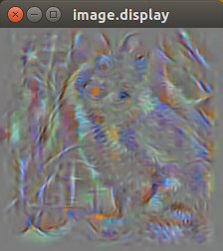
Results -- Inversion
Effects of layer
Layer 13 in VGG_m
Layer 1 in VGG_m
Notes:
In my lit review, the 1st paper by Vedaldi’s group pointed out that due to most image processing methods are based on suitable image representations rather than image itself, we are still lack of understanding of these representations/features. They proposed three types of visualizations under the natural pre-images framework to explore the interpretation of representations. (natural pre-images is the notable representations in natural-looking images). In the experiments, they tuned the regularizers and optimization algorithms to investigate the effects on each layer induced by different parameters.
--inversion P10 5.1st para
--activated the most: has higher output from the scoring function, which is a scalar
9

Slide 10
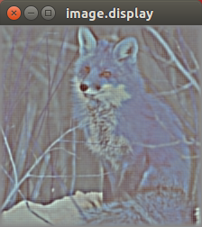
Results -- Inversion
Effects of normalization on loss
Without normalisation
With normalisation
Notes:
In my lit review, the 1st paper by Vedaldi’s group pointed out that due to most image processing methods are based on suitable image representations rather than image itself, we are still lack of understanding of these representations/features. They proposed three types of visualizations under the natural pre-images framework to explore the interpretation of representations. (natural pre-images is the notable representations in natural-looking images). In the experiments, they tuned the regularizers and optimization algorithms to investigate the effects on each layer induced by different parameters.
--inversion P10 5.1st para
--activated the most: has higher output from the scoring function, which is a scalar
10

Slide 11
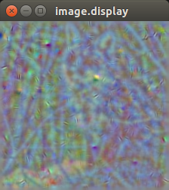
Results -- Inversion
Effects of reluariser hyperparameters
Strength 0.0005
Strength 0.00005
Notes:
In my lit review, the 1st paper by Vedaldi’s group pointed out that due to most image processing methods are based on suitable image representations rather than image itself, we are still lack of understanding of these representations/features. They proposed three types of visualizations under the natural pre-images framework to explore the interpretation of representations. (natural pre-images is the notable representations in natural-looking images). In the experiments, they tuned the regularizers and optimization algorithms to investigate the effects on each layer induced by different parameters.
--inversion P10 5.1st para
--activated the most: has higher output from the scoring function, which is a scalar
11

Slide 12


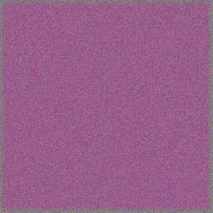
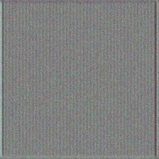





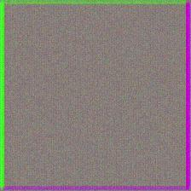
Methodology – Activation Maximisation
VGG_s Convolutional layer 1: 10 filters visualization out of 96
Loss function: Mean Square Error
Notes:
In my lit review, the 1st paper by Vedaldi’s group pointed out that due to most image processing methods are based on suitable image representations rather than image itself, we are still lack of understanding of these representations/features. They proposed three types of visualizations under the natural pre-images framework to explore the interpretation of representations. (natural pre-images is the notable representations in natural-looking images). In the experiments, they tuned the regularizers and optimization algorithms to investigate the effects on each layer induced by different parameters.
--inversion P10 5.1st para
--activated the most: has higher output from the scoring function, which is a scalar
12

Slide 13
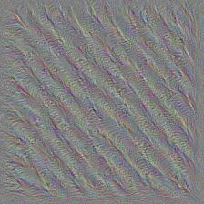
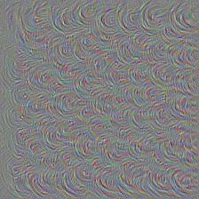
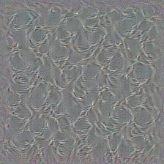
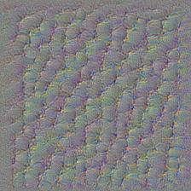
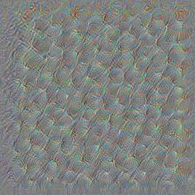
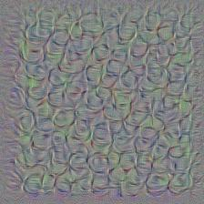
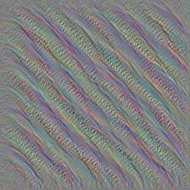
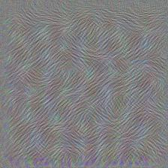
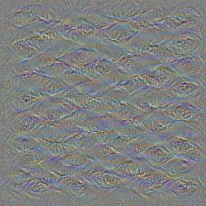
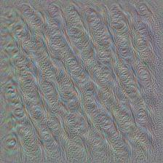
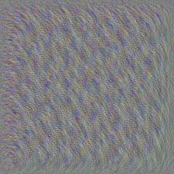
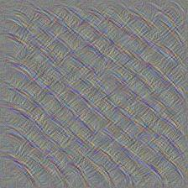
Methodology – Activation Maximisation
VGG_s Convolutional layer 3: 10 filters visualization out of 512
Notes:
In my lit review, the 1st paper by Vedaldi’s group pointed out that due to most image processing methods are based on suitable image representations rather than image itself, we are still lack of understanding of these representations/features. They proposed three types of visualizations under the natural pre-images framework to explore the interpretation of representations. (natural pre-images is the notable representations in natural-looking images). In the experiments, they tuned the regularizers and optimization algorithms to investigate the effects on each layer induced by different parameters.
--inversion P10 5.1st para
--activated the most: has higher output from the scoring function, which is a scalar
13

Slide 14
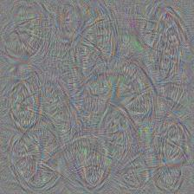
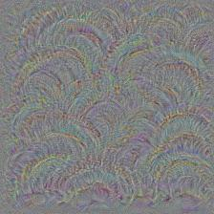
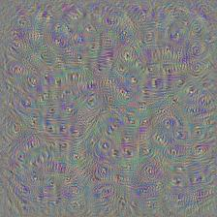
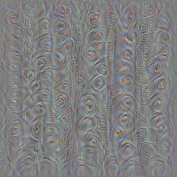
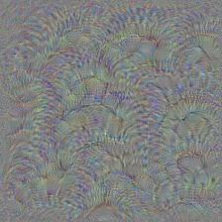
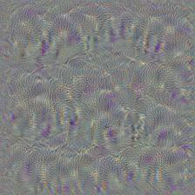
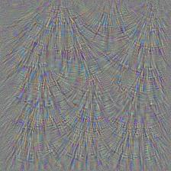
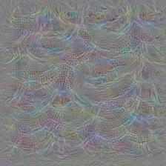
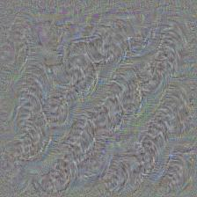
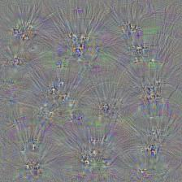
Methodology – Activation Maximisation
VGG_s Convolutional layer 5: 10 filters visualization out of 512
Notes:
In my lit review, the 1st paper by Vedaldi’s group pointed out that due to most image processing methods are based on suitable image representations rather than image itself, we are still lack of understanding of these representations/features. They proposed three types of visualizations under the natural pre-images framework to explore the interpretation of representations. (natural pre-images is the notable representations in natural-looking images). In the experiments, they tuned the regularizers and optimization algorithms to investigate the effects on each layer induced by different parameters.
--inversion P10 5.1st para
--activated the most: has higher output from the scoring function, which is a scalar
14

Slide 15





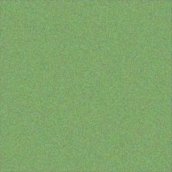




Methodology – Activation Maximisation
illu2vec Convolutional layer 1: 10 filters visualization out of 64
Notes:
In my lit review, the 1st paper by Vedaldi’s group pointed out that due to most image processing methods are based on suitable image representations rather than image itself, we are still lack of understanding of these representations/features. They proposed three types of visualizations under the natural pre-images framework to explore the interpretation of representations. (natural pre-images is the notable representations in natural-looking images). In the experiments, they tuned the regularizers and optimization algorithms to investigate the effects on each layer induced by different parameters.
--inversion P10 5.1st para
--activated the most: has higher output from the scoring function, which is a scalar
15

Slide 16
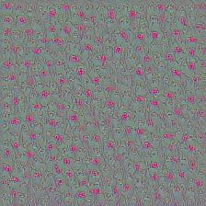
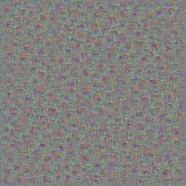
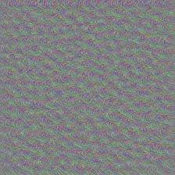
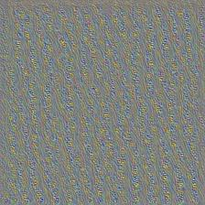
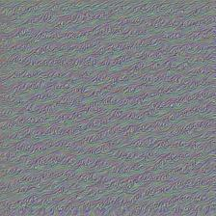
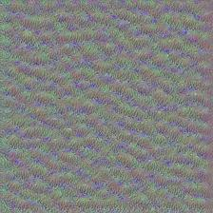
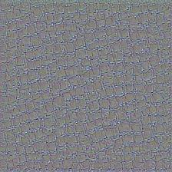
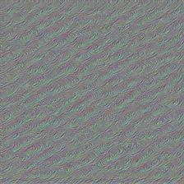
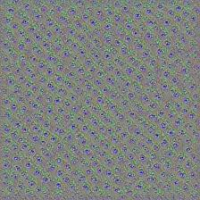
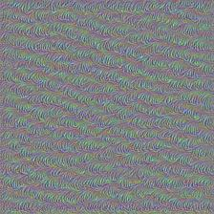
Methodology – Activation Maximisation
illu2vec Convolutional layer 5: 10 filters visualization out of 512
Notes:
In my lit review, the 1st paper by Vedaldi’s group pointed out that due to most image processing methods are based on suitable image representations rather than image itself, we are still lack of understanding of these representations/features. They proposed three types of visualizations under the natural pre-images framework to explore the interpretation of representations. (natural pre-images is the notable representations in natural-looking images). In the experiments, they tuned the regularizers and optimization algorithms to investigate the effects on each layer induced by different parameters.
--inversion P10 5.1st para
--activated the most: has higher output from the scoring function, which is a scalar
16

Slide 17
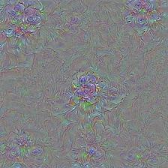
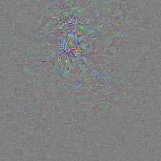
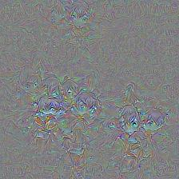
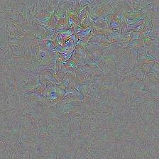
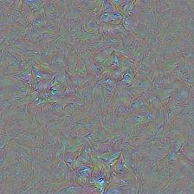





Methodology – Activation Maximisation
illu2vec Convolutional layer 11: 10 filters visualization out of 1024
Notes:
In my lit review, the 1st paper by Vedaldi’s group pointed out that due to most image processing methods are based on suitable image representations rather than image itself, we are still lack of understanding of these representations/features. They proposed three types of visualizations under the natural pre-images framework to explore the interpretation of representations. (natural pre-images is the notable representations in natural-looking images). In the experiments, they tuned the regularizers and optimization algorithms to investigate the effects on each layer induced by different parameters.
--inversion P10 5.1st para
--activated the most: has higher output from the scoring function, which is a scalar
17

Slide 18

Methodology – Caricaturization
Notes:
In my lit review, the 1st paper by Vedaldi’s group pointed out that due to most image processing methods are based on suitable image representations rather than image itself, we are still lack of understanding of these representations/features. They proposed three types of visualizations under the natural pre-images framework to explore the interpretation of representations. (natural pre-images is the notable representations in natural-looking images). In the experiments, they tuned the regularizers and optimization algorithms to investigate the effects on each layer induced by different parameters.
--inversion P10 5.1st para
--activated the most: has higher output from the scoring function, which is a scalar
18

Slide 19
Reference
Mahendran A, Vedaldi A. Visualizing deep convolutional neural networks using natural pre-images[J]. International Journal of Computer Vision, 2016: 1-23.
Mahendran A, Vedaldi A. Understanding deep image representations by inverting them[C]//2015 IEEE conference on computer vision and pattern recognition (CVPR). IEEE, 2015: 5188-5196.
Saito M, Matsui Y. Illustration2Vec: a semantic vector representation of illustrations[C]//SIGGRAPH Asia 2015 Technical Briefs. ACM, 2015: 5.
Notes:
19

Slide 20
Thank you

