Slide 1
Reading: Learning Dexterous In-Hand Manipulation
Wang Biyuan

Slide 2
Abstract
Using Shadow Dexterous Hand to manipulate the position or orientation of an object
Applied deep reinforcement learning based on:
Coordinates data of fingertips
Image data from three RGB cameras
Solved the following problems:
Feasibility of applying in the real world
High-dimensional control: 24 DF
Robust in noisy and partial observations
Universal to different object manipulation
Notes:
The topic of this paper is to use Shadow Dexterous Hand to manipulate the position or orientation of an object,
They Applied deep reinforcement learning training based on:
Coordinates of fingertips
Images from three RGB cameras.
And in the end they Solved the following problems:
Feasibility to apply the model in the real world
High-dimensional control: the experiment robotic hand can have 24 DF
Robust in noisy (because in real world) and partial observations (due to occlusion on sensors and uncompleted env simulation )
And this is Universal to different object manipulation

Slide 3
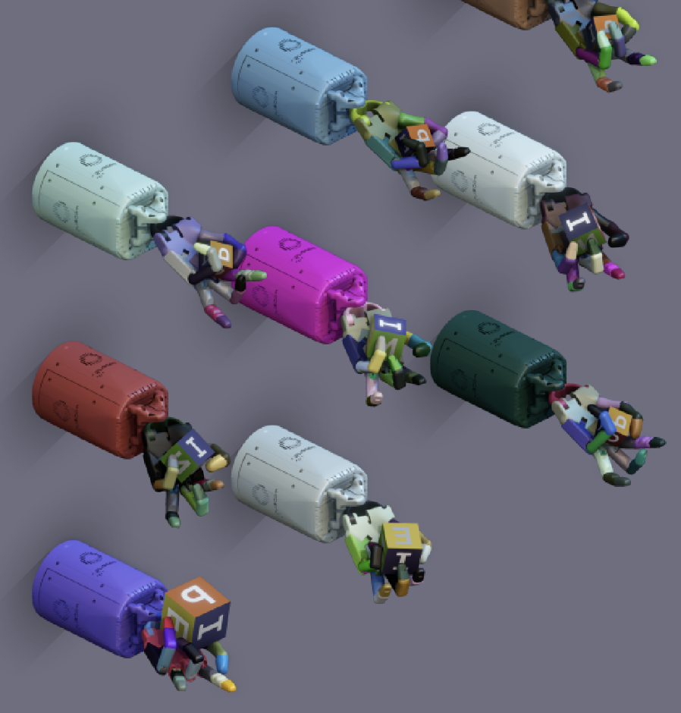
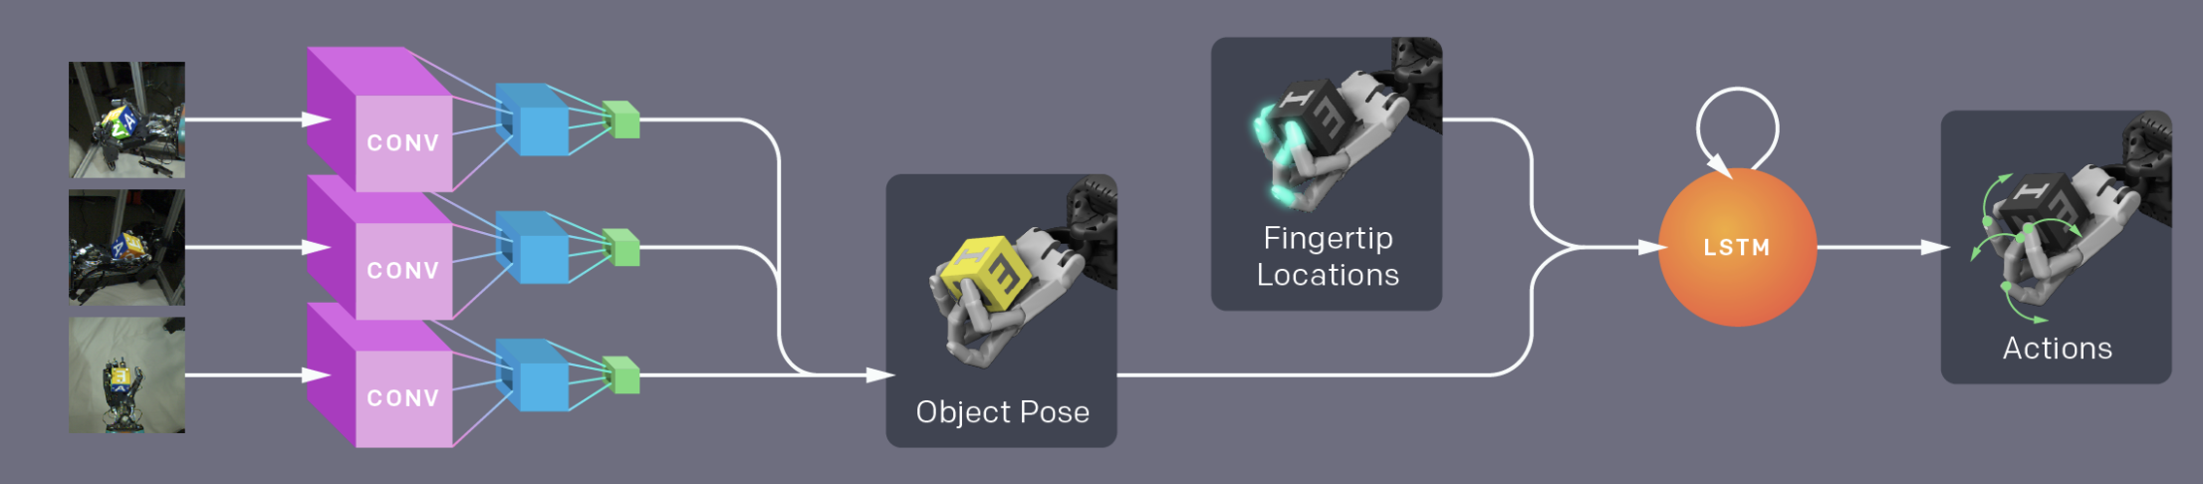
Methodology
Training in entire simulation environment
Domain randomization: provide various experience rather than maximizing realism
Routines:
1. Collect experience on simulation environment
2.1 Train control policy by LSTM to choose the next action based on fingertip positions and object pose
2.2 Train CNN to predict object pose based on simulated camera images
3. Combine models and transfer to the real world
Notes:
The methodology they use is to
1. Training in entire simulation environment: without any human inputs, fully replied on learning reward optimization
2. Domain randomization: provide various experience rather than maximizing realism: as in they scaling up the possible env by simulation rather than making env as real as possible

Slide 4
Methodology
Collect experience on simulation environment
Difficulties:
Simulate robotics setup parameters is difficult
Cannot simulate deformable objects and physiological factors
Solutions:
Train policy on randomly chosen physical and visual attributes
Randomized values create diversity in environment simulation to prevent overfitting
Notes:
【实验环境！】
Collect experience on simulation environment
Difficulties:
1. Simulate robotics setup parameters is difficult such as friction, damping, and rolling resistance
2. And we cannot accurately simulate deformable objects and physiological factors such as tendons stretching or rubber deformation when contact with fingers
So the Solutions they worked out is:
1. Train policy on randomly chosen physical and visual attributes to trade off the limitations in accurate physical system simulation
2. Use randomized values to create diversity in environment simulation so that prevent overfitting to a single simulated environment and improve the possibility to transfer the system into real world tasks

Slide 5
Methodology
Hardware
Humanoid robotic hand with 24 DF and actuated 20 pairs of tendons
Motion capture system to track the Cartesian positions of finger tips
Object pose:
Motion capture markers – physical based track
RGB cameras – vision based pose
Simulation
In MuJoc physics engine
Only rough approximation of physical setup
Modify the simulation to a distribution over many simulations
Notes:
【硬件！】
Hardware
1. Use Humanoid robotic hand with 24 degrees of freedom and Actuated 20 pairs of agonist-antagonist tendons
2. Use PhaseSpace motion capture system to track the Cartesian positions of finger tips
3. As for Object pose, the hardware used is:
PhaseSpace markers for physical based track
And addition with RGB cameras for vision based pose estimation – this is for the purpose of transfer to real world
The Simulation is running:
In MuJoc physics engine
In the simulation Only make rough approximation of physical setup due to complicated situations in real world (but this causes reality gap when transfer to real world)
(so to overcome the issue above) they modified the simulation to a distribution over many simulations (so that have a lot of random combinations to prevent overfit)

Slide 6
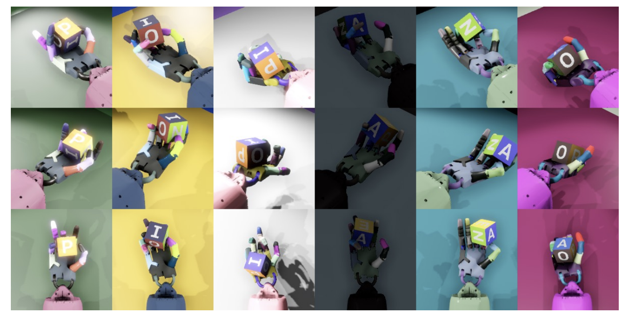
Methodology
Randomization
Physics factors
Object dimensions
Masses
Surface friction coefficients
Robot joint damping coefficients
Actuator force gains
Observation noise: added Gaussian noise
Unmodeled effects: added unexpected situations such as freezing, occlusion of marker, random forces etc.
Visual appearance: rendering, camera positions, lighting, textures, poses
Notes:
【参数调整！】
Randomization
Related Physical parameters
Object dimensions
Masses
Surface friction coefficients
Robot joint damping coefficients
Actuator force gains
Observation noise: added Gaussian noise to increase the robustness of model
Create Unmodeled effects by adding unexpected situations which might happen in the real world such as freezing, occlusion of marker, random forces etc.
Visual appearance: rendering, camera positions, lighting, textures, poses ( see pic: Rows correspond to the renderings from the same camera, and columns correspond to renderings from 3 separate cameras which are simultaneously fed into the neural network.)

Slide 7
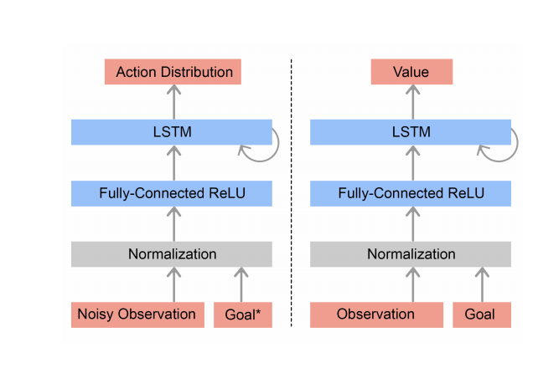
Methodology
Model A: Train control policy by LSTM to plan the next action based on fingertip positions and object pose
Concerns:
The ability of generalization
Dynamics parameters cannot be inferred from a single observation
Solution:
LSTM-network with memory to learn more dynamics of the environment
Consist of two parts: similar architecture but independent parameters
Policy network
Value network
Notes:
Model A: Train control policy by LSTM to choose the next action based on fingertip positions and object pose
concerns:
For generalization, policy should be able to response properly to environments with different dynamics
But Dynamics parameters cannot be inferred from a single observation
Solution:
LSTM-network with memory to learn more dynamics of the environment
Their model Consist of two parts: similar architecture but independent parameters
Policy network: map observations to actions
Value network: predicts the discounted sum of future rewards starting from a given state

Slide 8

Methodology
Model A: Policy network - map observations to actions
Discretization of action coordinates into 11 bins
Reward calculation:
Reach goal: +5
Object dropped: -20
reward
Current rotation angles
Post-transit rotation angles

Slide 9
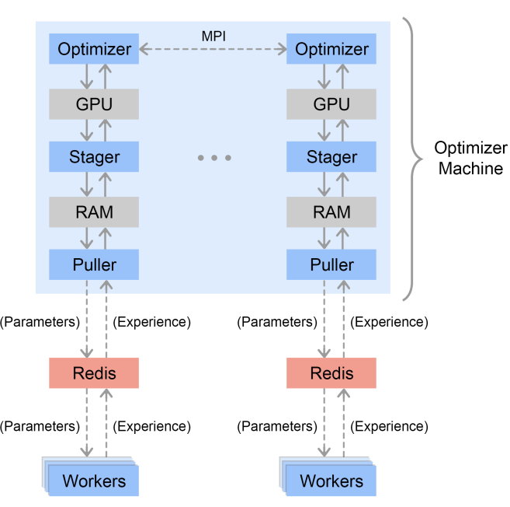
Methodology
Working flow of training process
workers generate experience by using current policy
workers download new policy parameters to generate new experience
training
buffer
server
Notes:
【训练流程！】
Left: flow
Right:
Blue squares are worker machines providing data randomly. They connect to servers then collect data to store in a buffer. Then a stager will sample minibatches from the buffer and stages them on the GPU. Finally, each Optimizer uses a GPU to optimize over a minibatch and new parameters are sent to the servers for worker machines to run a new episode.

Slide 10
Methodology
Model B: Train CNN to predict object pose based on simulated camera images
Concerns:
Require the ability to manipulate arbitrary objects
Ambiguities and occlusion caused by hand or object itself
Solution:
Use RGB camera images to estimate the position and orientation
CNN analyzes image to infer pose
Multiple cameras (3) to supplement the loss information caused by occlusion

Slide 11
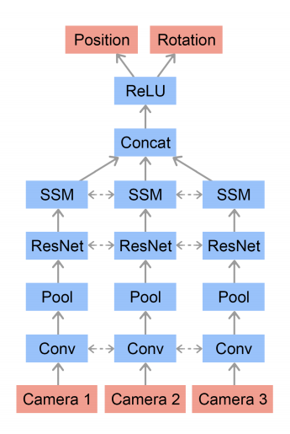
Methodology
Model B: Vision based pose estimation model
Shared weights between the feature stacks for each camera:
Resulting representations are flattened, concatenated to a fully connected network.
Linear outputs from the last layer form the estimations of the position and orientation of the object.
Notes:
Model B: Vision based pose estimation model:
we feed the prediction into the policy, which in turn produces the next action.
The weights are shared between the feature stacks for each camera:
resulting representations from each camara are flattened, concatenated to a fully connected network.
Linear outputs from the last layer form the estimations of the position and orientation of the object.

Slide 12
Methodology
Combine Model A and B and transfer to the real world
Control network: reorients object
Vision network: map estimated position to object pose

Slide 13
Verification
Tested how many rotations could achieve before it dropped the object, time out, or reached 50 successes.
Tested on control based on pose estimation from vision and directly from motion tracking sensors
Ablation study of the importance of randomizations and policies with memory capabilities in order to successfully transfer.
5 separated RL policies in environments with various randomizations held out:
3 different RL architectures:
(baseline) All randomizations | No observation noise | No unmodeled effects | No physics randomizations | No randomizations
LSTM policy & value func (baseline) | FF policy & LSTM value func | FF policy & FF value func
Notes:
【验证！】
Assessments on performance based on :
Testing how many rotations could achieve before it dropped the object, time out, or reached 50 successes.
Assessment on control based on:
pose estimation from vision and directly from motion tracking sensors: similar performance
Only using synthetic images is enough
Ablation study of the importance of randomizations and policies with memory capabilities in order to successfully transfer.
5 separate RL policies in environments with various randomizations held out: all randomizations (baseline), no observation noise, no unmodeled effects, no physics randomizations, and no randomizations (basic simulator, i.e. no domain randomization).
3 different RL architectures: LSTM policy and value function (baseline), a feed forward (FF) policy and a LSTM value function, and both a FF policy and FF value function.

Slide 14
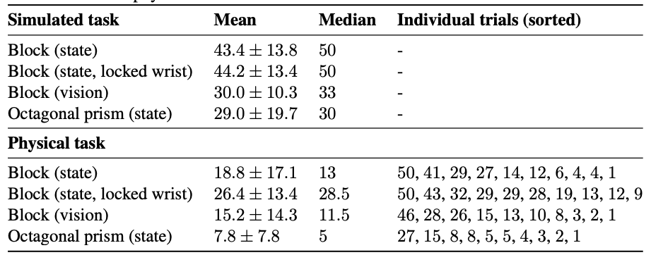
Conclusion
still worse in reality
Notes:
【performance结论！】
The number of successful consecutive rotations in simulation and on the physical robot are shown in the table.
All policies were trained on baseline environments settings with all randomizations enabled. Here are 100 trials in simulation and 10 trails per policy on the physical robot. Each trial terminates when the object is dropped, 50 rotations are achieved or a timeout is reached.
Simulation的median远远高于physical task
Even though randomizations and calibration narrow the reality gap, it still exists and performance on the real system is worse than in simulation.

Slide 15
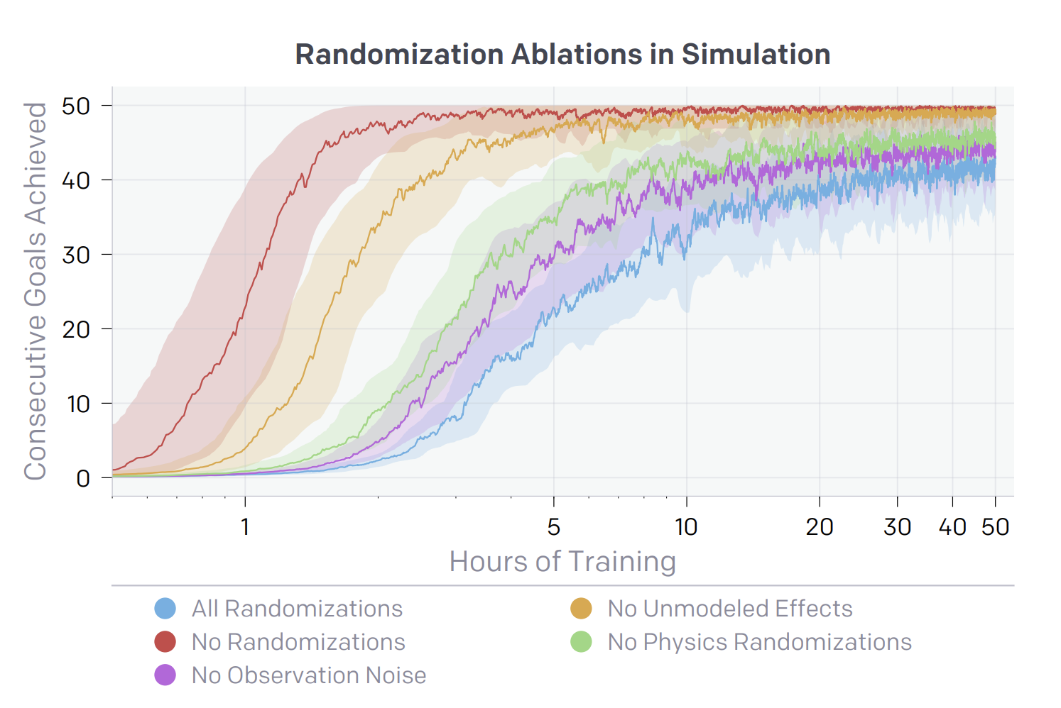
Conclusion
still worse in reality
Number of successful consecutive rotations
Notes:
【ablation 结论！】
Policies trained in environments with a more difficult set of randomizations, e.g. all randomizations （紫色） and no observation noise （蓝色）, converge much slower and therefore require more compute and simulated experience to train in.

Slide 16
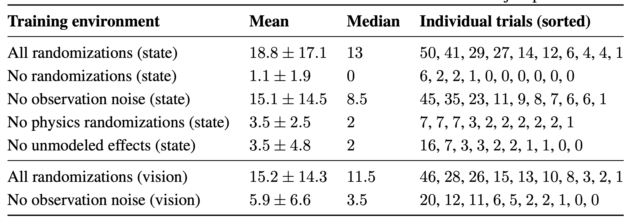
Conclusion
still worse in reality
Number of successful consecutive rotations
Notes:
【ablation 结论！】
圆圈
training with all randomizations median of 13 consecutive goals achieved
方块
trained with no randomizations, no physics randomizations, and no unmodeled effects achieve only median of 0, 2, and 2 consecutive goals,
结论：training with randomizations is critical for transfer
三角
When holding out observation noise randomizations, the performance gap is less clear than for the other randomization groups. they believe that is because the motion capture system has very little noise. However, we still include this randomization because it is important when the vision and control policies are composed. In this case, the pose estimate of the object is much more noisy, and, therefore, training with observation noise should be more important.

Slide 17
Conclusion
Dexterous robot hand manipulation in real world is possible due to extensive randomizations of the simulator, large-scale distributed training infrastructure, policies with memory.
Notes:
It is possible to complete the learning in a fully simulated environment and as long as the randomizations of factors are efficient enough, it can trade off the drawbacks of lack of accuracy in simulation.

Slide 18
Contribution
Traditional approaches on dexterous is slow and remain limited ability in manipulation in real world
High precision simulation system to reduce reality gap as much as possible
Extensive randomizations to mimic real world situations as much as possible
large-scale distributed training by using 6144 CPUs for data collection and 8 GPUs for training

Slide 19
Thank you very much !

