Slide 1


Relational Elements of the Gossip Triad
Presenter: Boróka Pápay
papay.boroka@tk.mta.hu
Coauthor: Károly Takács
MTA TK “Lendület” Recens
XXXVIII. Sunbelt Conference, Utrecht, June 26-July 1. 2018

Slide 2
Introduction
Gossip is “informal and evaluative talk in an organization, usually among no more than a few individuals, about another member of that organization who is not present” (Kurland and Pelled, 2000:429).
Gossip has a triadic nature
Coalition, closure and constraint triad (Wittek & Wielers, 1998)
They also show that frequent gossiping is likely to hurt cooperative relationships regardless of the network context. Gossip, in this case, appears to escalate conflict rather than resolving it (Wittek, Hangyi, Van Duijn, & Carrol, 2000)
Lack of trust (precondition for cooperation) toward the management leads to negative gossip about them (Ellwardt, Wittek, et al., 2012)
Structural ballance theory (Cartwright & Harary, 1956)
=> Coalition and closure triads

Slide 3
Different Functions of Gossip
Sender and the receiver maintain a good relationship in the gossip triad (coalition triad)
Gossip can enforce social norms
Gossip can be relational aggression against norm violators and hence aims at demolishing the target’s reputation. This implies that the sender has a negative tie to the target and this negative relationship is more likely to occur also between the receiver and the target, partly due to malicious gossip that has already taken place.
Are there any other types of triads?

Slide 4
Dataset
9 workgroups with a total of 225 employees (n≈25)
Receiver-reported gossip triads 696 positive, 460 negative, and 679 neutral gossip triads (1835 triads in total).
The occurrence of these triads has been compared to all possible within-workplace triads (167148) obtained by permutation.
Explanatory variables: dyads using 34 different network items
Atfer dimension reduction techniques (Vörös, 2015) to describe each dyadic relationship as ‘Positive’, ‘Negative’ or ‘Uninterested’. Considering the six possible dyads (S->R, R->S, S->T, T->S, R->T, T->R) between the three actors and their signed relations.

Slide 5
Research questions
Q1: What causes a formation of a triad?
In other words, what configurations of relations lead to the formation of a gossip triad...
Q2: How triadic configurations are related to types of gossip?
Which triads are related to positive, negative or neutral gossip
Explanations by the reduced explanatory networks

Slide 6
Explaining the formation of triads
Goal:
Get triadic configurations for gossip triads
Data-driven explanation for identifying those configurations that can explain gossip (no predefined theoretical data selection)
Interpretable results
First: dimensionreduction for our existing explanatory networks (Vörös, 2015)
Negative
Positive
Uninterested/distant

Slide 7
Methods to consider 1: Triadic relation model
In the fully Bayesian modeling approach for triadic data of Swartz et al (2015), the dependent variable are triadic ties, where dyadic configurations of N individuals (N*N two-dimensional adjacency matrices) are also observed by each of these entities (“judges”), creating N*N*N configurations represented by a three-dimensional matrix. In a gossip triad, senders spreading gossip about targets (S->T dyads) are observed by the receivers (R->S->T).
Advantages: Most correct method to apply Being able to use both existing and non-existing triads | Disadvantages: - Hard to form configurations - Way too high number of interactions to handle - Selection of interactions undermines the ‚data driven’ approach Demand for high computational power

Slide 8
Methods to consider 2: Hierarchical cluster
Hierarchical clustering: a form of cluster analysis, where different levels of hierarchy are estimated through a bottom-up process (agglomerative clustering)
Advantages: Being able to use both existing and non-existing triads See on which clusters gossip is more likely to form than random Interpretable | Disadvantages: Hard to see the exact configurations – each cluster has characteristics for all the variables

Slide 9
Results of Hierarchical Clustering
We checked in which clusters are gossip triads represented more likely than random

Slide 10
Methods to consider 2: CART
Classification and Regression Trees (CART): a supervised statistical method, where a target variable is predicted by splitting a set of input features into subsets based on how well they predict the dependent variable.
Advantages: We would be able to tell precisely on what set of relations lead to the formation of a gossip triad. We don’t have to determine how many interactions of dyadic relationships should be considered Clear decisions and outcome categories We will be able to tell the predictive power of our model . | Disadvantages: Non-existing triads are way overrepresented in the dataset – needs sampling By using sampling, we will not be able to tell if an existing gossip triad as an outcome category is more likely than random in that path or not Not frequently used in social sciences

Slide 11
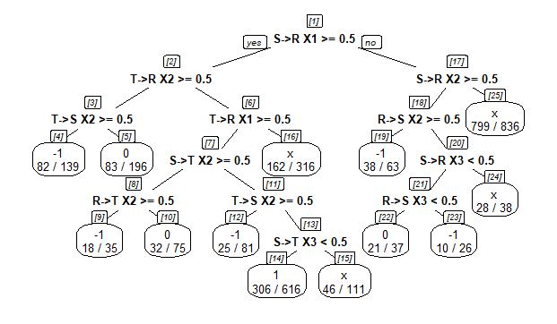
Results of the CART model

Slide 12
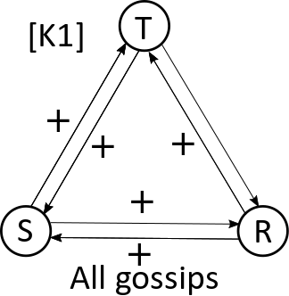
Results 1
Closure Triad
One of the frequent categories
Positive relations among all actors
All gossip types occur
Represented in cluster 1.

Slide 13
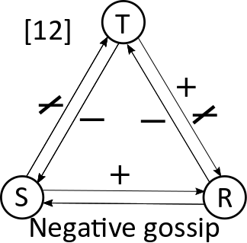
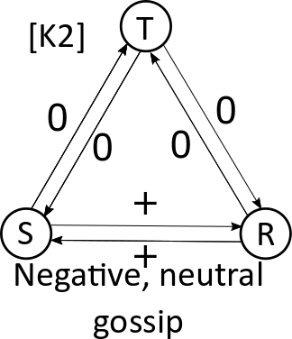
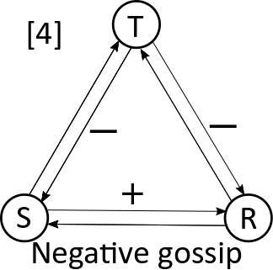
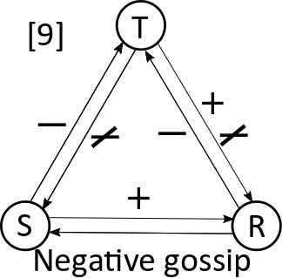
Results 2
Coalition triad
Classic exaple of positive S-R relationship, where both have negative relationship with T
Mostly results in negative gossip
Represented in the [4] outcome category of the decision three
Versions of coalition triad
Coalition triad with conflictual T-R or S-T relationship
Mostly resulting in negative gossip
Represented in [9,12] ] outcome categories of the decision three
Distant coalition triad
All S-T and R-T relationships are distant
Resulting in neutral and negative gossip
Represented in the second cluster [K2]

Slide 14
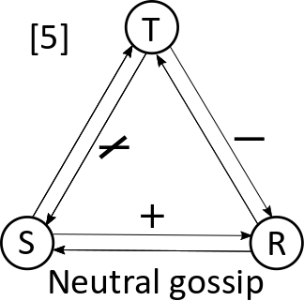
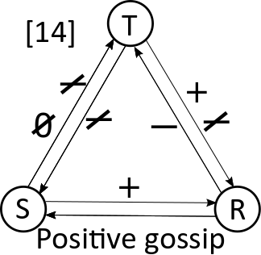
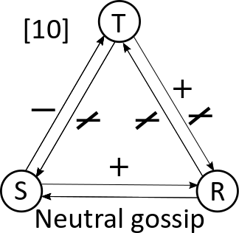
Results 3
Persuation or unstable triads
Looks like sender tries to change receivers mind
Resulting in neutral or positive gossip
Only T-R have negative or conflictual relationships:Represented in [5,14] outcome category of the decision tree
All relationships are positive except for S-T: Represented in [10] outcome category of the decision tree

Slide 15
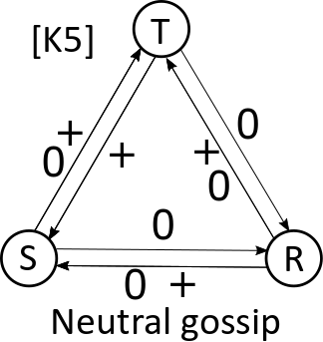
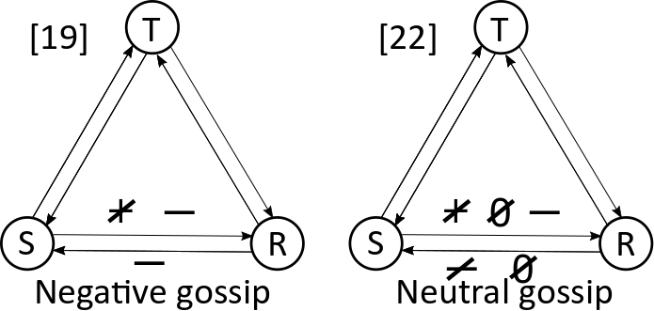
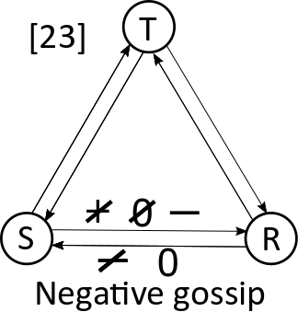
Results 4
Small talk Triad
One of the most frequent configurations
Positive, distant relationships
Neutral gossip
Represented in the fifth cluster [K5]
Negative triads
Not so frequent
Negative or conflictual relationship between S-R
Resulting in negative or neutral gossip
Represented in [19,22,23] outcome categories of the decision tree

Slide 16
Conclusion
We found mostly coalition and constraint triads
Persuation triads with a conflict in them might be an early state before triadic balance
New types of triads:
Considering distant relationships: small talk triad
All negative relations can lead to gossip as well
Future plans:
Put the configurations on TRM
Connect the configurations to motivations, functions

Slide 17
Sources
Cartwright, D., & Harary, F. (1956). Structural balance: a generalization of Heider’s theory. Psychological review, 63(5), 277.
Ellwardt, L., Wittek, R., & Wielers, R. (2012). Talking about the boss: Effects of generalized and interpersonal trust on workplace gossip. Group & organization management, 1059601112450607.
Kurland, N. B., Pelled, L. H., 2000. Passing the word: Toward a model of gossip and power in the workplace. Academy of Management Review, 25(2), 428-438
Swartz, T. B., Gill, P. S., & Muthukumarana, S. (2015). A Bayesian approach for the analysis of triadic data in cognitive social structures. Journal of the Royal Statistical Society: Series C (Applied Statistics), 64(4), 593–610.
Vörös, A. (2015). The emergence of multiple status systems in adolescent communities: a multiplex network theory of group formation (PhD Thesis). University of Oxford
Wittek, R., Hangyi, H., Van Duijn, M., & Carrol, C. (2000). Social capital, third party gossip, and cooperation in organizations. The Management of Durable Relations: Theoretical and Empirical Models for Organizations and Households, 100–101.
Wittek, R., & Wielers, R. (1998). Gossip in organizations. Computational & Mathematical Organization Theory, 4, 189–204.

