Slide 1
Modèle de production de biomasse
Application à la gestion de la pêcherie de merlu en Namibie
Etienne RIVOT & Eric PARENT
Février 2013

Slide 2
- 1 -
The Namibian hake fishery

Slide 3
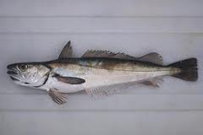
Namibian Hake
The most important fish resource in Namibia
2 species
Merluccius capensis (“white hake”)
“white hake”
the dominant species
Merlucius paradoxus
“black hake”
Treated as a single stock
Look very similar
Difficult to record data separately

Slide 4
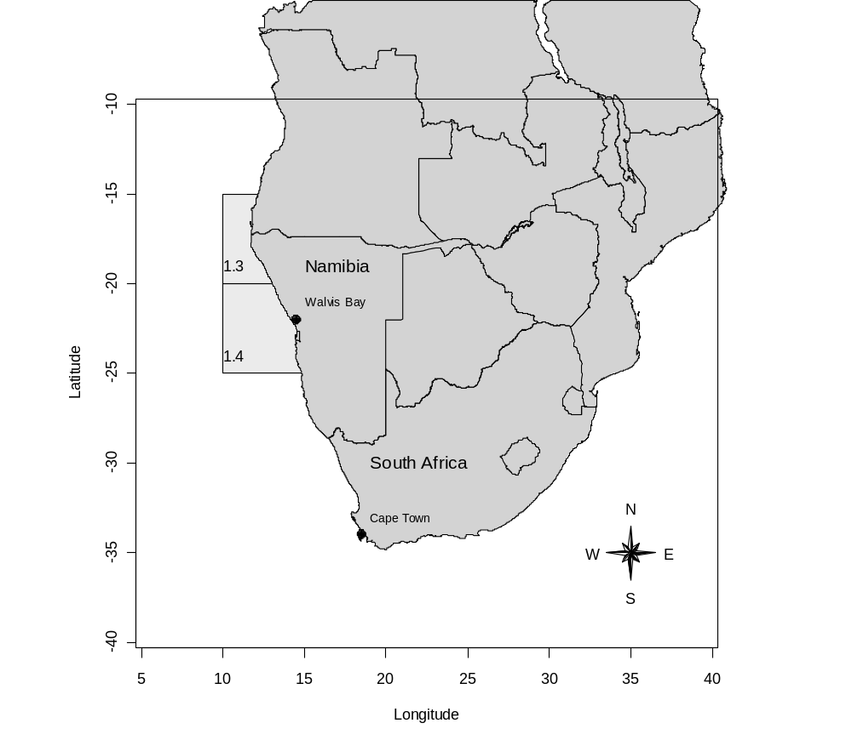
The Benguela upwelling system
One of the world‟s major eastern boundary upwelling systems

Slide 5
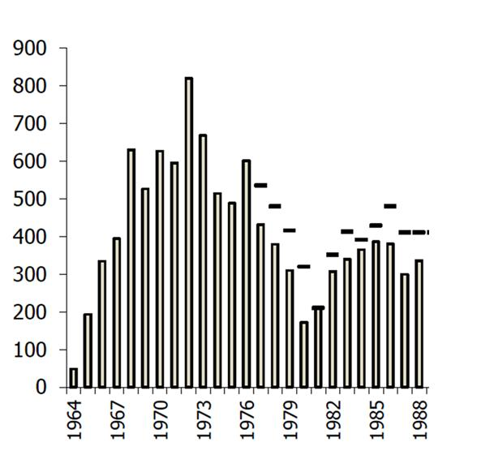
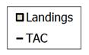
Namibian Hake fishery - 1964-1988
Exploitation of the Namibian hake resource commenced in 1964.
The fishery was unregulated over the period 1964-1976. During this period, an average of about 500 000 tonnes of hake was reported landed per year.
The International Commission for South East Atlantic Fisheries (ICSEAF) was formed in 1969.
A minimum mesh size of 110 cm was introduced in 1975.
From 1977 through 1989, the fishery is managed through annual TACs.
Between 1980 and 1990, the average annual catch was reduced to about 325 000 tons.

Slide 6
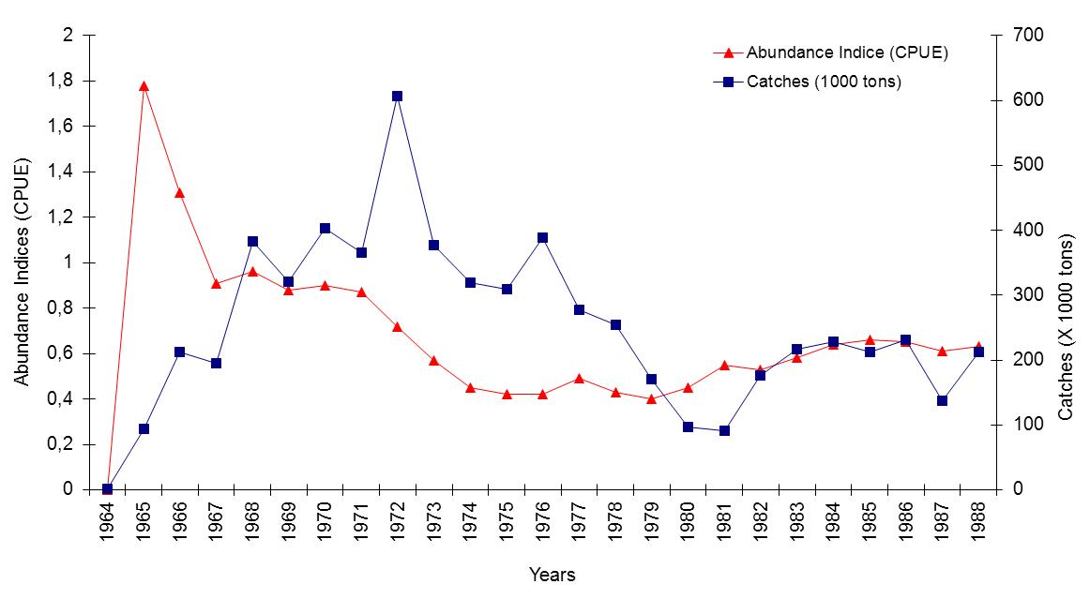
Namibian Hake fishery - 1964-1988

Slide 7
- 2 -
The Biomass production model

Slide 8
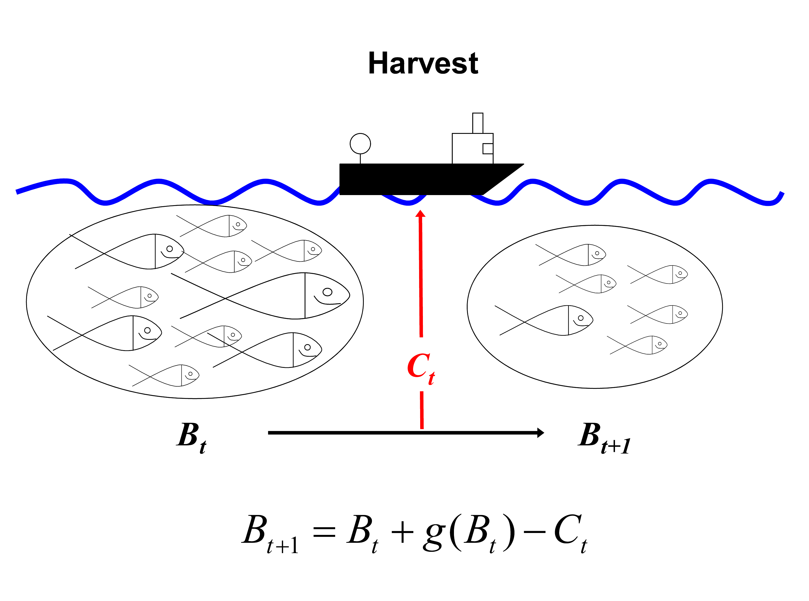
The Biomass production model

Slide 9
The Biomass production model
A model to mimic the dynamic of the Biomass
A non-age-structured model (global model) used in practical stock assessments and fisheries management
Pro’s of the surplus production model :
- Simple, parcimonious
- No need of detailed data (e.g. age –structured data)
- Quantity of interest for management are easily derived :
- C_{MSY}, : Captures at Maximum Sustainable Yield
- B_{MSY} : Biomass level at MSY
- F_{MSY} : Harvest rate at MSY
- Link with bio-economic modelling

Slide 10
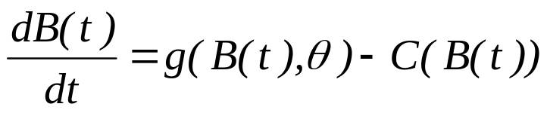
The Biomass production model
g = production function with parameters θ
C = captures (control). Generally C = F.B
Difference model (discrete time)
Next biomass =
old biomass + recruitment - nat. mortality - captures

Slide 11
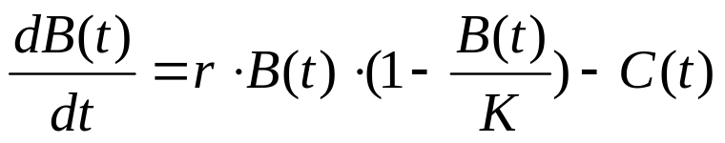
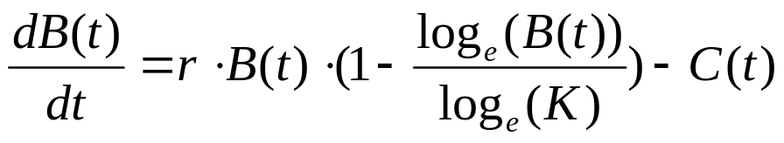
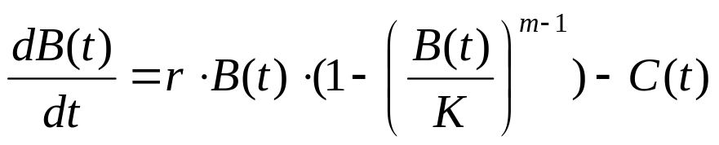
The Biomass production model
Production function g
Schaefer
Fox
Pella-Tomlison
(general prod. model)

Slide 12
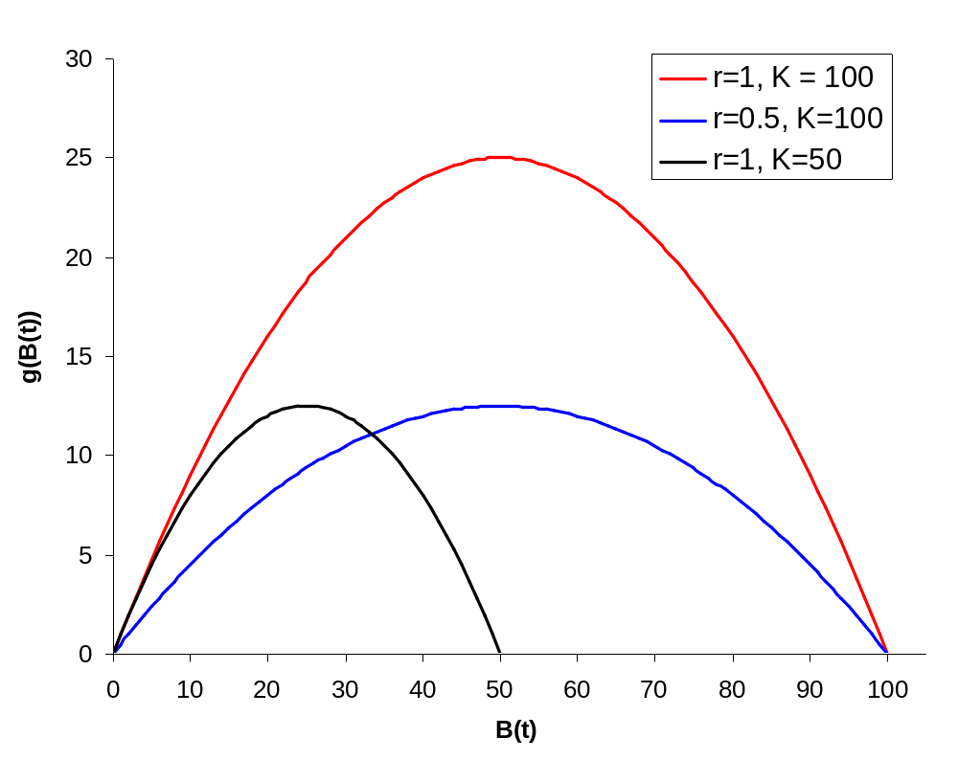
Reference points (for management)
Example : Schaefer
C_{MSY}= r⋅K/4
B_{MSY}= K/2

Slide 13

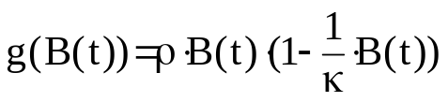

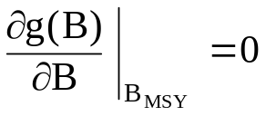
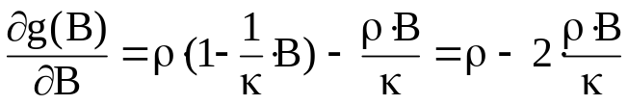
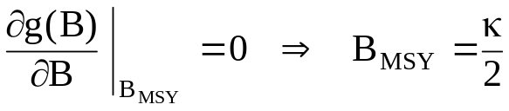
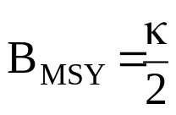
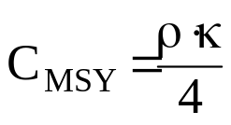
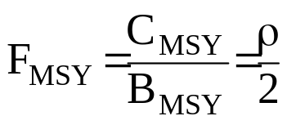
Deriving management reference points
Shaefer production model
Equilibrium state
MSY (maximum captures)

Slide 14
- 3 -
A HBM construction for learning from the data

Slide 15
« Counting fish is like counting trees, … except they are invisible and they move » (J. T. Schnute)
Observation (data) ?
- Time series : t = 1,…,n
- Captures
- Abundance indices (I)
I(t) = q·B(t) q = “Catchability”
Generally catch per unit effort (CPUE)
* Commercial
* Scientific survey
Others scientific Abundance Indices
* Accoustic
* CMR …

Slide 16



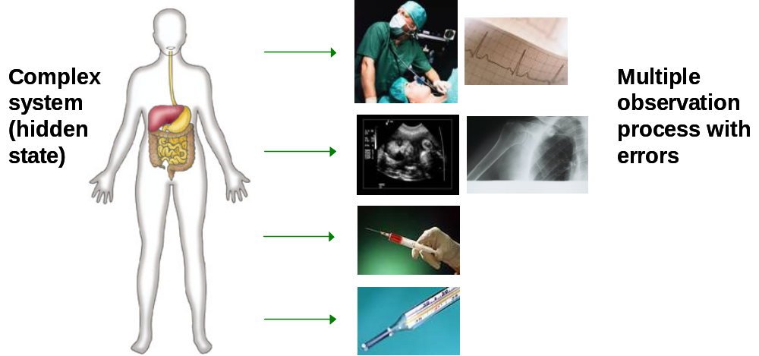
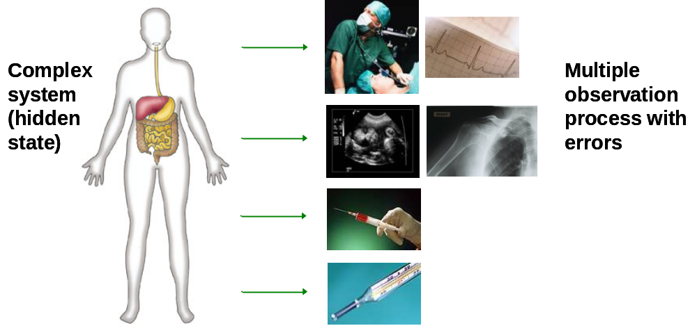



« Counting fish is like counting trees, … except they are invisible and they move » (J. T. Schnute)
Accoustic
CPUE
Trawl survey

Slide 17
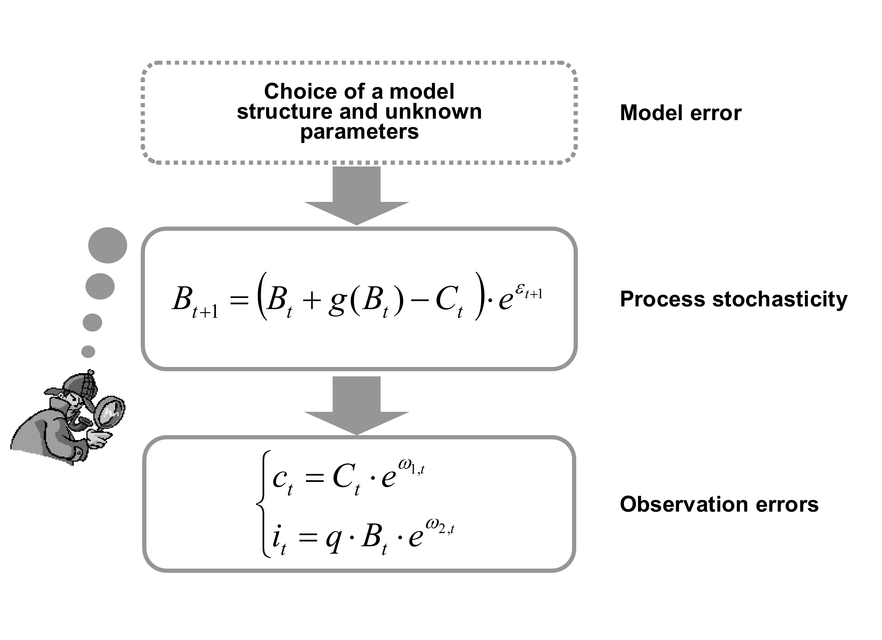
A HBM construction (state-space model)

Slide 18





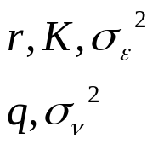
A HBM construction (state-space model)
• States process eq.
• Initialization
• Observation equation
• Priors for all free parameters in the model

Slide 19
Bayesian Graphic Models - Inferences
ρ, κ, σ_{p}
c_{t-1}
c_{t}
c_{n-1}
B₁
•••
B_{t}
B_{t+1}
•••
B_{n}
i₁
i_{t}
i_{t+1}
i_{n}
q, σ_{o} (σ_{o}=σ_{o})

