Slide 1
Effect of Friends’ Churn on Consumer Behavior in Mobile Networks

Slide 2







content
Background
Structural Model
Dataset
Empirical Strategy
Robustness Checks
1
of
19

Slide 3
Background
Dataset
Structural Model
Robustness Checks
Empirical Strategy
● Prices and switching costs have both decreased considerably in the mobile industry
● One important element of user churn is the behavior of the network.
● Another reason could be that many tariff plans have a differential pricing structure for calling inside versus outside the network.
2
of
19

Slide 4
Background
Dataset
Structural Model
Robustness Checks
Empirical Strategy
论文贡献
friends’ churn may have a nuanced impact on a user’s behavior. It can vary
from reducing the amount of time spent calling inside versus outside the carrier, to changing tariff plan, to eventually churning. No paper in the past has explored this question in this detail. Our work closes this gap and contributes to the extant literature in several ways
First, we develop a structural model of consumer behavior
Second, we use Call Detailed Records(CDRs) from a large mobile operator to infer the social network across a random sample of consumers and their friends
Using these CDRs and the choices of tariff plans made by users, we then explore how changes in the structure of this network affect the behavior of users.
3
of
19

Slide 5
Background
Dataset
Structural Model
Robustness Checks
Empirical Strategy
In our paper, we use instrumental variables to try to identify the effect of peer influence. We use the churn of friends of friends who are not friends of an ego to instrument the Churn of the friends of the ego .We provide multiple robustness checks showing that this instrumental variable is appropriate in our set up.
we are interested in measuring peer influence. We use the structure of the social network to derive instruments to avoid overestimating the effect of peer influence in our setting. Furthermore, we use an ordered probit model allowing us to characterize the stages that users go through before churning. a significant number of users tend to first adjust calling volumes, then they tend to change tariff plan inside the carrier and only latter consider churning to a competitor
4
of
19

Slide 6
Background
Dataset
Structural Model
Robustness Checks
Empirical Strategy
wi代表用户i分配给呼叫的固定预算
Fi代表用户i的朋友集
q_{i，j}代表用户i拨打用户j的次数
sp_{i}代表用户i是否订购内外相同价格资费计划
5
of
19

Slide 7
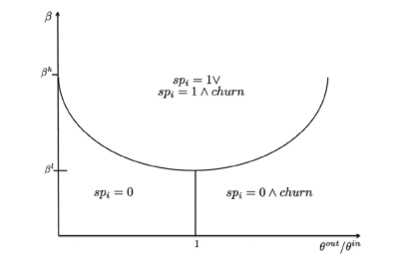
Background
Dataset
Structural Model
Robustness Checks
Empirical Strategy
1.risk loving: if β>β_{h} ,then users will always prefer to subscribe the tariff plan
that charges the same price to call inside and outside the carrier;
2. risk averse: if β<β_{m} ,users will always prefer to subscriber a tariff plan that
changes a lower price to call inside the carrier and will churn if θ^{out}/θ^{in} > 1;
3. otherwise: if β_{m}<β<β_{h}, then users will switch between tariff plan types
depending on θ^{out}/θ^{in} . If θ^{out}/θ^{in} <t_{o/I} ,they will prefer a tariff plan that chrges a lower price to call inside the carrier.
6
of
19

Slide 8
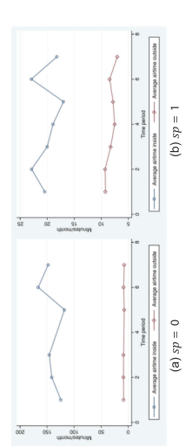
Background
Dataset
Structural Model
Robustness Checks
Empirical Strategy
figure 2. Average Airtime for Calls Placed Inside and Outside the Carrier Over Time
7
of
19

Slide 9
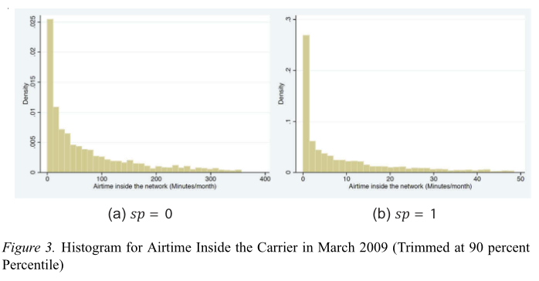
Background
Dataset
Structural Model
Robustness Checks
Empirical Strategy
8
of
19

Slide 10
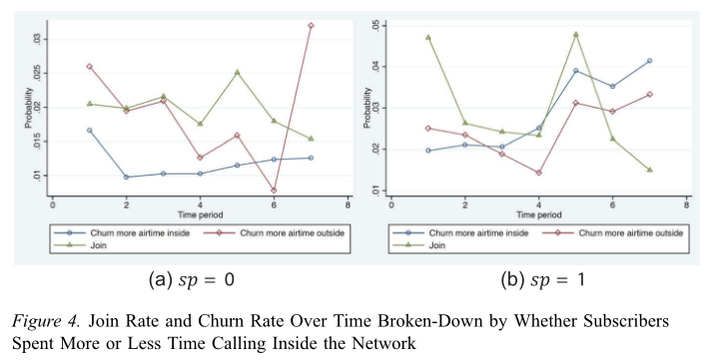
Background
Dataset
Structural Model
Robustness Checks
Empirical Strategy
9
of
19

Slide 11

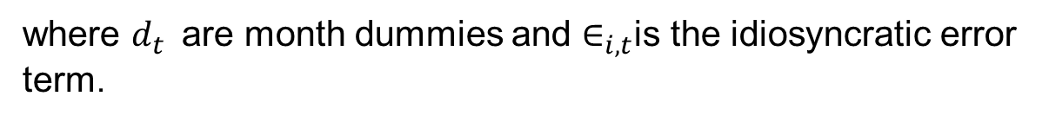
Background
Dataset
Structural Model
Robustness Checks
Empirical Strategy
where $d_{t}$are month dummies and $∈_{i,t}$is the idiosyncratic error term.
10
of
19

Slide 12
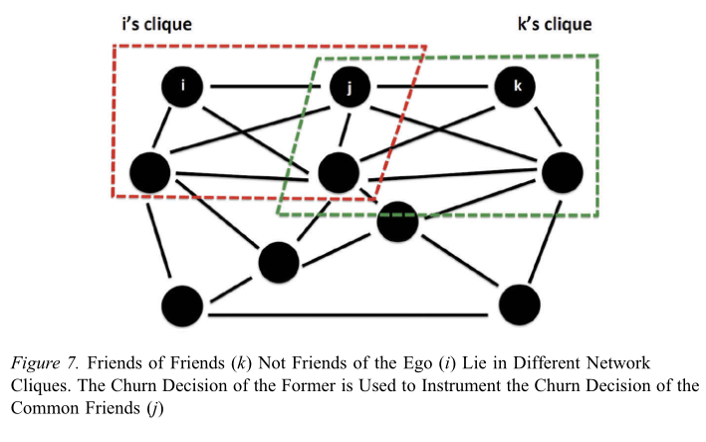
Background
Dataset
Structural Model
Robustness Checks
Empirical Strategy
11
of
19

Slide 13
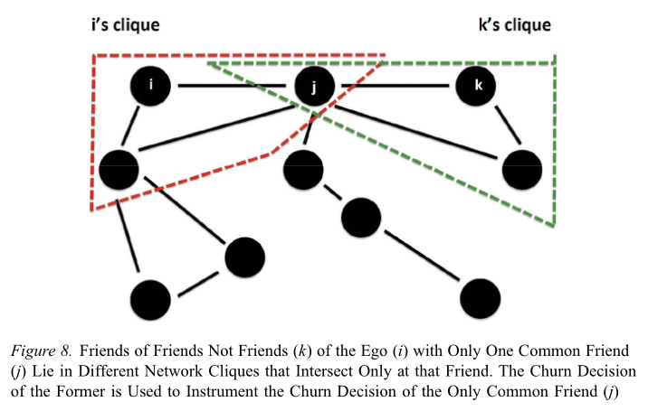
Background
Dataset
Structural Model
Robustness Checks
Empirical Strategy
不仅确保用户i和用户k属于不同的群，而且还确保用户j是这些群之间唯一的共同用户，这进一步降低了对用户i和用户k都起作用的未观察到的效果的可能性。
12
of
19

Slide 14
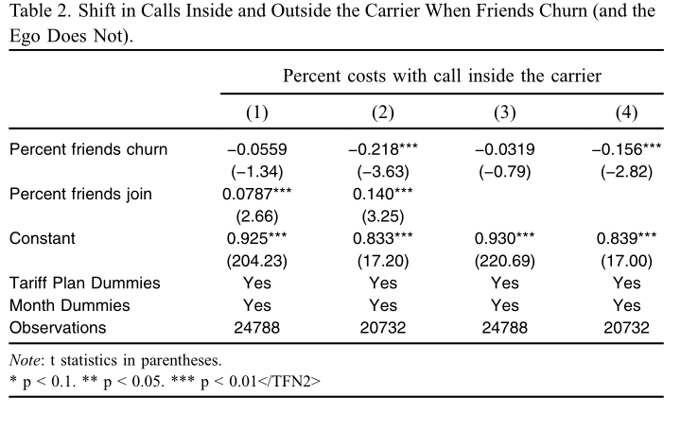
Background
Dataset
Structural Model
Robustness Checks
Empirical Strategy
第（1）列显示对在运营商内部使用收费较低的资费计划的用户的结果，第（2）列显示了在运营商内部和外部呼叫收取相同价格的资费计划的用户的结果。
13
of
19

Slide 15
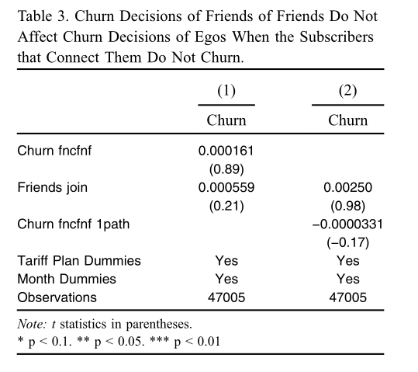
Background
Dataset
Structural Model
Robustness Checks
Empirical Strategy
this test provides some evidence that our instrumental variable is exogenous in our setting
14
of
19

Slide 16
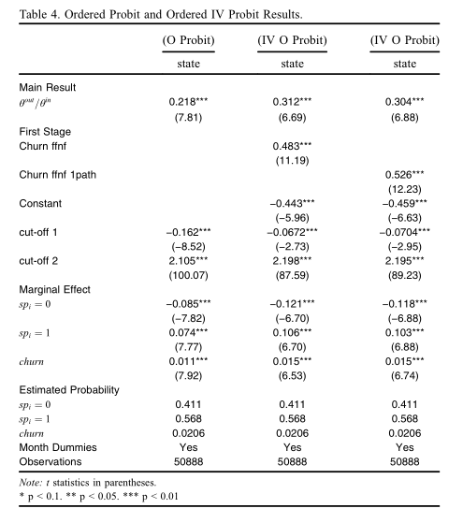
Background
Dataset
Structural Model
Robustness Checks
Empirical Strategy
15
of
19

Slide 17
Background
Dataset
Structural Model
Robustness Checks
Empirical Strategy
考虑一个完全连接的社会图，其中用户i和j之间的边被标记为它们之间的通话时间。在这个图中，我们可以用通话时间的份额来定义加权朋友，也就是说，用户i与用户j相关联的权重由airtime _{ij} /∑_{k∈Fi} airtime _{ik}
给出。
We perform a number of robustness checks to our IV results to show that our findings are not an artifact of the definition of friend or of the structure imposed by our theoretical model.
We also test for the appropriateness of our ordered model.
Finally, we study the nature of the effect of friends’ churn.
16
of
19

Slide 18
Background
Dataset
Structural Model
Robustness Checks
Empirical Strategy
Columns (1) and (2) in Table 6 show the results obtained for the
former decision. These results show that increases in θ^{out} /θ^{in} increase the likelihood of moving to a tariff plan that charges the same price to call inside and outside the carrier. Columns (3) and (4) in this table show the results obtained for the latter decision. We also observe here that increases in θ^{out} /θ^{in} increase the likelihood of churn.
Table 7 and 8 show the results obtained for the two instruments used throughout our paper. We observe that the effect of friends’ churn is still statistically significant in all specifications but, and as expected, its
magnitude reduces with x. The more consumers forget the past, the fewer signals from friends they have (or retain) to inform their decisions. In addition, we observe that there is still contagious churn when only contemporaneous signals are used by consumers (the case of x=0).
17
of
19

Slide 19
Background
Dataset
Structural Model
Robustness Checks
Empirical Strategy
我们的结果在三个方面都很重要。
首先，我们提供了经验证据，证明在移动市场上客户频繁流失的会走上死亡之路。当只有几个朋友退订时，即时的行为反应就是调整通话量。如果有更多的朋友流失，那么用户很可能会转向在运营商内部和外部通话资费相同的计划。最后，如果很多朋友都在退订，那么用户也可能流失。电信公司可以观察到这种有序的用户行为，因此可能提供用户的流失预警。
其次，我们展示了移动市场中具有传染性的客户流失的经验证据。这意味着顾客终身价值（CLTV）的定义，仅包括每个特定消费者未来利润流的现值，低估了消费者的价值，特别是对有很多朋友的消费者而言。相反，CLTV也应该考虑到社交网络中朋友影响的作用，以及一些消费者比其他消费者更有价值的事实。
第三，我们展示了引入具有特殊功能的资费计划如何有助于减少客户流失。在移动环境中，我们提供了经验证据，证明在网络内外对呼叫收取相同价格的资费计划能够有效地减少客户流失，并衡量其经济价值。
18
of
19

Slide 20
Background
Dataset
Structural Model
Robustness Checks
Empirical Strategy
Thanks！
19
of
19

