Slide 1
A peek into the black box : exploring classifiers by randomization

Slide 2
目录
Part 1: permutation test
Part 2: GoldenEye基本定义
Part 3: 迭代过程
Part 4: 实验结果

Slide 3
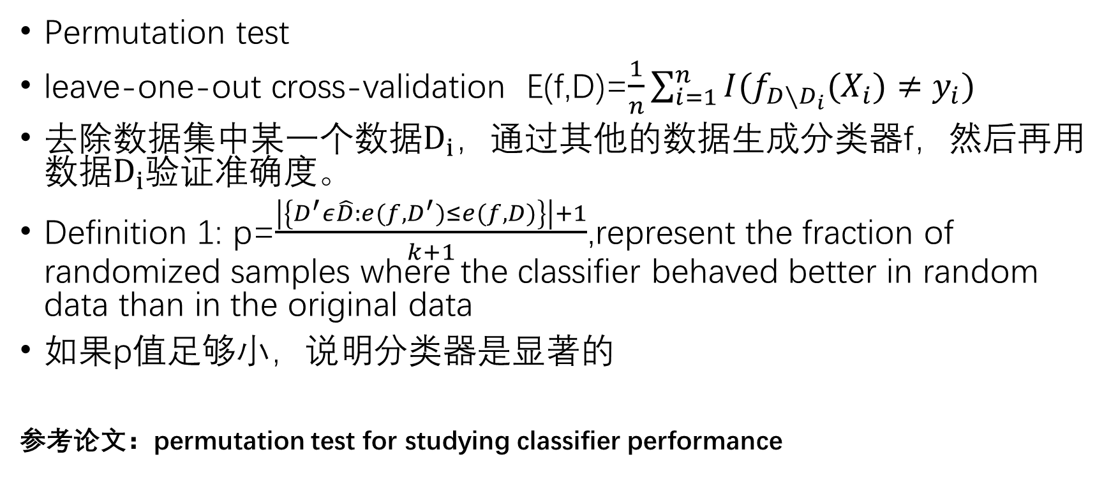
Part 1 Permutation test
Permutation test
leave-one-out cross-validation E(f,D)=$\frac{1}{n}\sum_{i=1}^{n}{I(f_{D∖D_{i}}(X_{i})≠y_{i})}$
去除数据集中某一个数据$D_{i}$，通过其他的数据生成分类器f，然后再用数据$D_{i}$验证准确度。
Definition 1: p=$\frac{\left|\left\{D^{′}ε\hat{D}:e(f,D^{′})≤e(f,D)\right\}\right|+1}{k+1}$,represent the fraction of randomized samples where the classifier behaved better in random data than in the original data
如果p值足够小，说明分类器是显著的
参考论文：permutation test for studying classifier performance

Slide 4
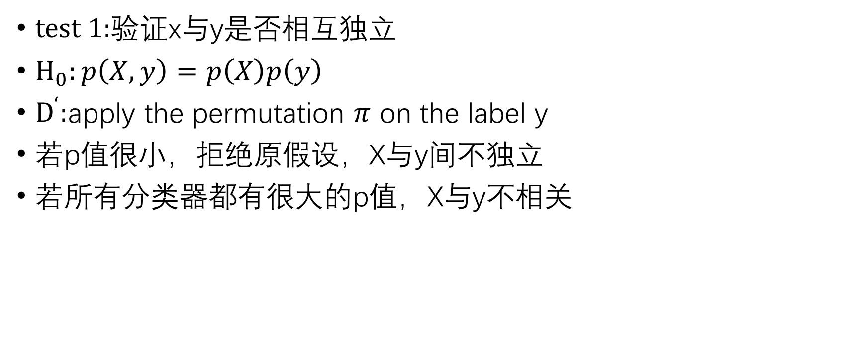
Part 1 Permutation test
test 1:验证x与y是否相互独立
$H_{0}:p\left(X,y\right)=p\left(X\right)p\left(y\right)$
$D^{‘}:$apply the permutation $π$ on the label y
若p值很小，拒绝原假设，X与y间不独立
若所有分类器都有很大的p值，X与y不相关

Slide 5
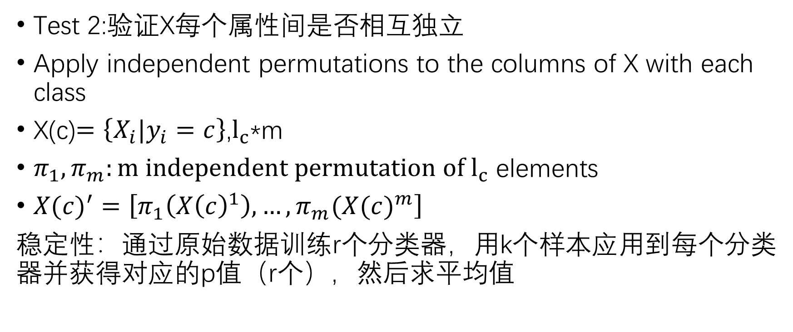
Part 1 Permutation test
Test 2:验证X每个属性间是否相互独立
Apply independent permutations to the columns of X with each class
X(c)$=\left\{X_{i}|y_{i}=c\right\}$,$l_{c}$*m
$π_{1},π_{m}:m independent permutation of l_{c}$ elements
${X(c)}^{′}=\left[π_{1}\left({X\left(c\right)}^{1}\right),…,π_{m}({X(c)}^{m}\right]$
稳定性：通过原始数据训练r个分类器，用k个样本应用到每个分类器并获得对应的p值（r个），然后求平均值

Slide 6
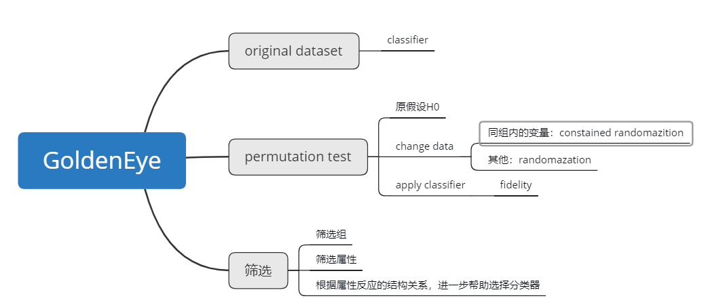
Part 2

Slide 7
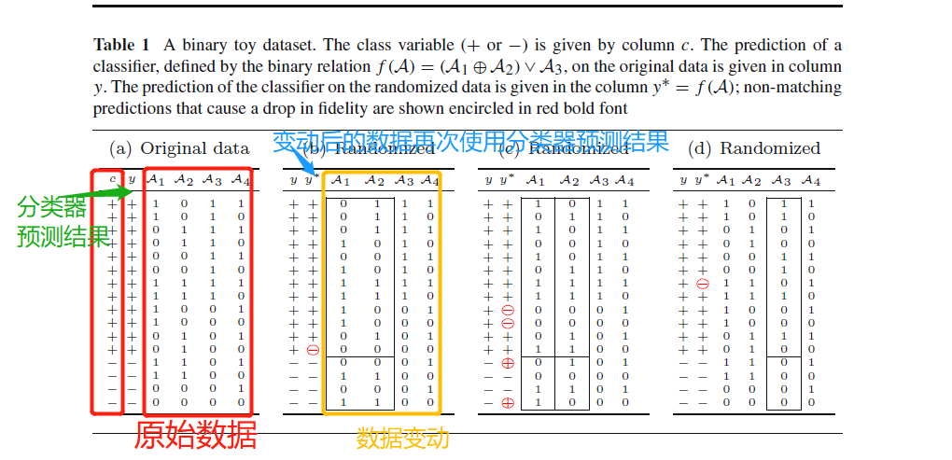
Part 2 基本定义

Slide 8
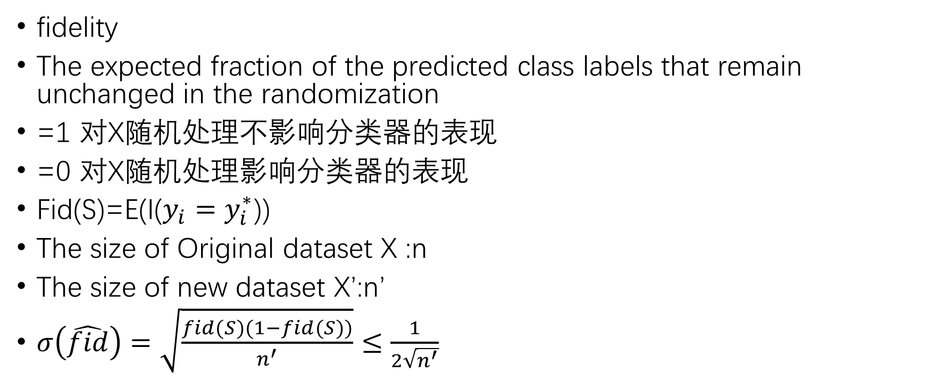
Part 2 基本定义
fidelity
The expected fraction of the predicted class labels that remain unchanged in the randomization
=1 对X随机处理不影响分类器的表现
=0 对X随机处理影响分类器的表现
Fid(S)=E(I($y_{i}=y_{i}^{∗}$))
The size of Original dataset X :n
The size of new dataset X’:n’
$σ\left(\hat{fid}\right)=\sqrt{\frac{fid(S)(1−fid(S))}{n^{′}}}≤\frac{1}{2\sqrt{n^{′}}}$

Slide 9
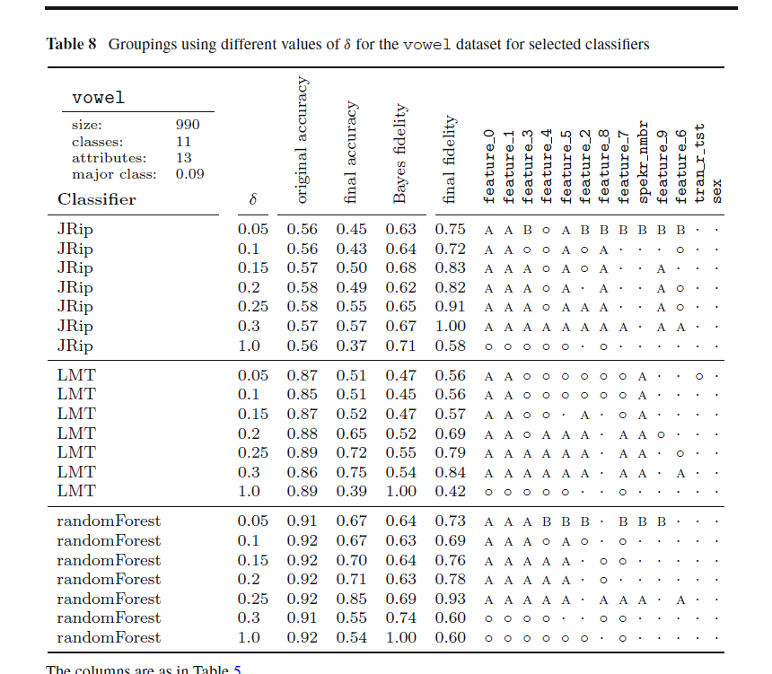

Slide 10
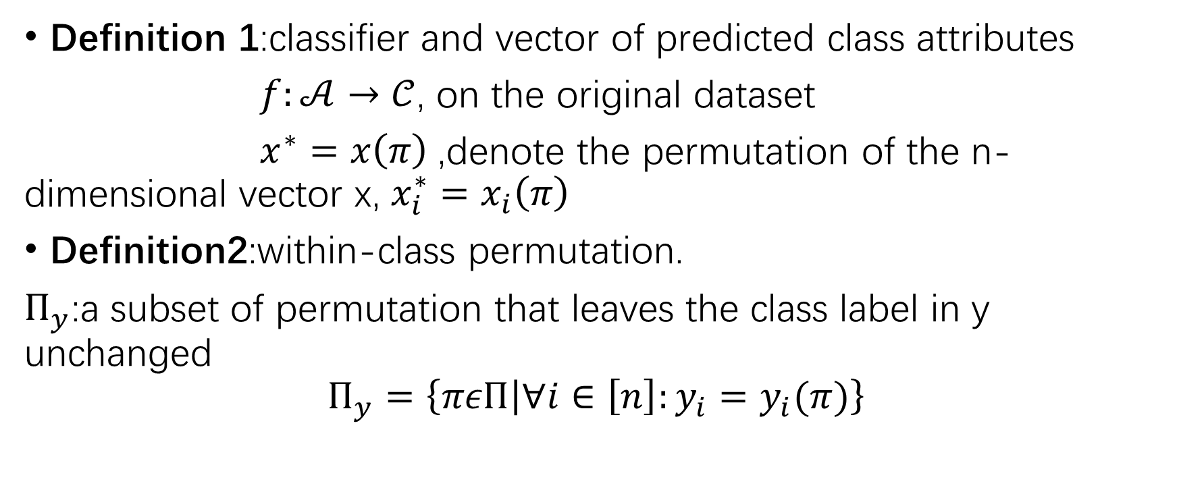
Part 2 基本定义
Definition 1:classifier and vector of predicted class attributes
$f:𝒜→𝒞$, on the original dataset
$x^{∗}=x\left(π\right)$,denote the permutation of the n-dimensional vector x, $x_{i}^{∗}=x_{i}\left(π\right)$
Definition2:within-class permutation.
$Π_{y}$:a subset of permutation that leaves the class label in y unchanged
$$Π_{y}=\left\{πεΠ | ∀i∈\left[n\right]:y_{i}=y_{i}(π)\right\}$$

Slide 11
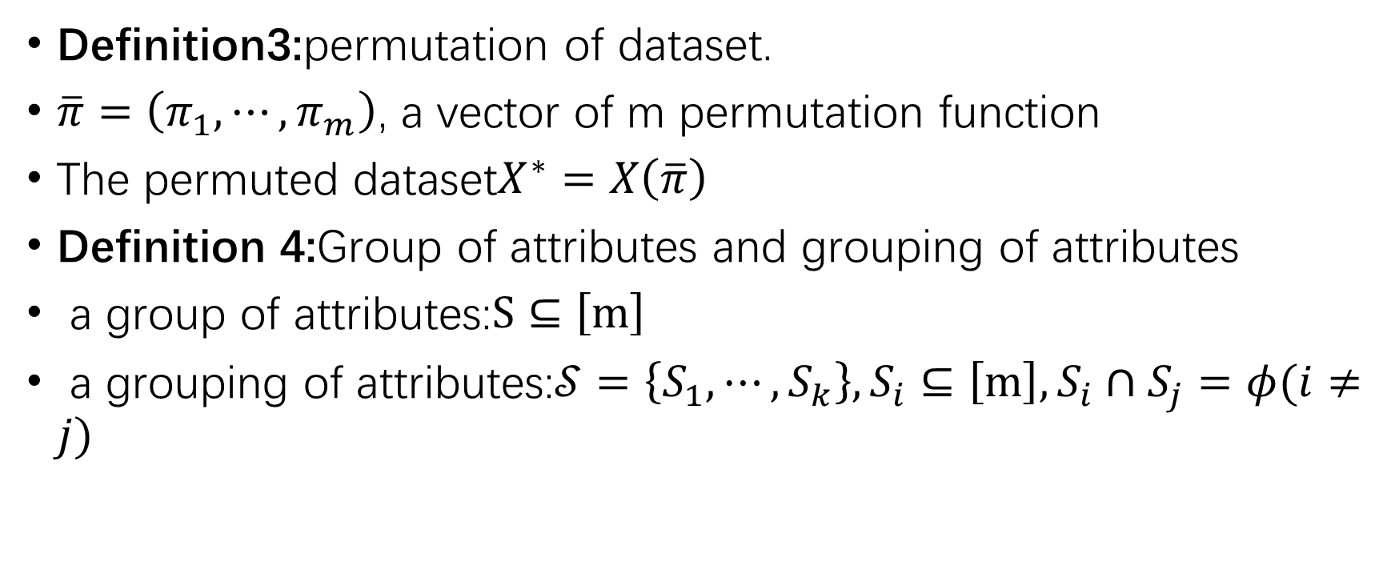
Part 2 基本定义
Definition3:permutation of dataset.
$\overline{π}=\left(π_{1},⋯,π_{m}\right)$, a vector of m permutation function
The permuted dataset$X^{∗}=X\left(\overline{π}\right)$
Definition 4:Group of attributes and grouping of attributes
a group of attributes:$S⊆\left[m\right]$
a grouping of attributes:$𝒮=\left\{S_{1},⋯,S_{k}\right\},S_{i}⊆\left[m\right],S_{i}∩S_{j}=φ(i≠j)$

Slide 12
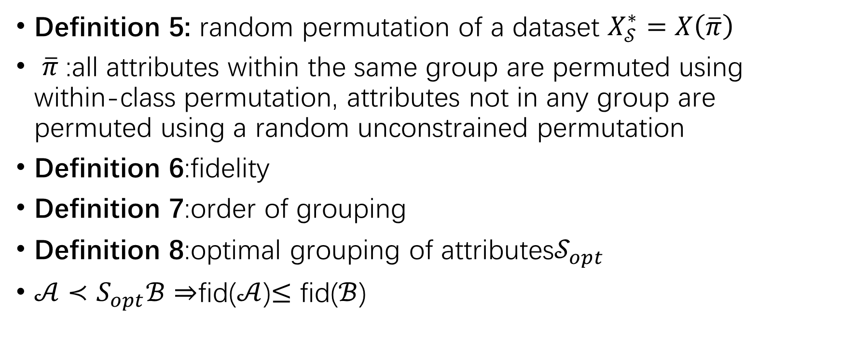
Part 2 基本定义
Definition 5: random permutation of a dataset $X_{𝒮}^{∗}=X\left(\overline{π}\right)$
$\overline{π}$:all attributes within the same group are permuted using within-class permutation, attributes not in any group are permuted using a random unconstrained permutation
Definition 6:fidelity
Definition 7:order of grouping
Definition 8:optimal grouping of attributes$𝒮_{opt}$
$𝒜≺S_{opt}ℬ$ $⇒$fid($𝒜$)$≤$ fid($ℬ$)

Slide 13
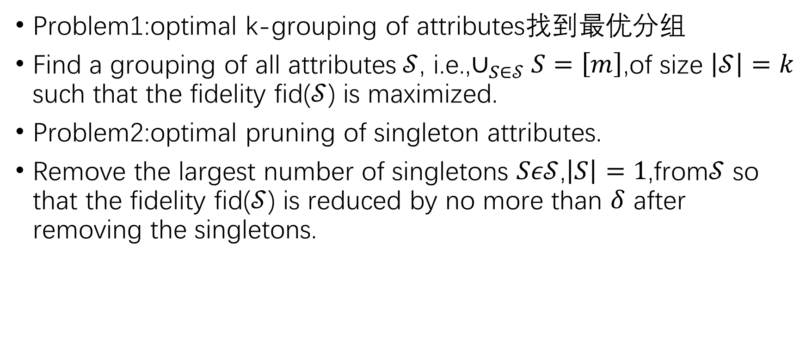
Part 2 基本定义
Problem1:optimal k-grouping of attributes找到最优分组
Find a grouping of all attributes$𝒮$, i.e.,$∪_{S∈𝒮}S=\left[m\right]$,of size $\left|𝒮\right|=k$ such that the fidelity fid($𝒮$) is maximized.
Problem2:optimal pruning of singleton attributes.
Remove the largest number of singletons $Sε𝒮$,$\left|S\right|=1$,from$𝒮$ so that the fidelity fid($𝒮$) is reduced by no more than $δ$ after removing the singletons.

Slide 14
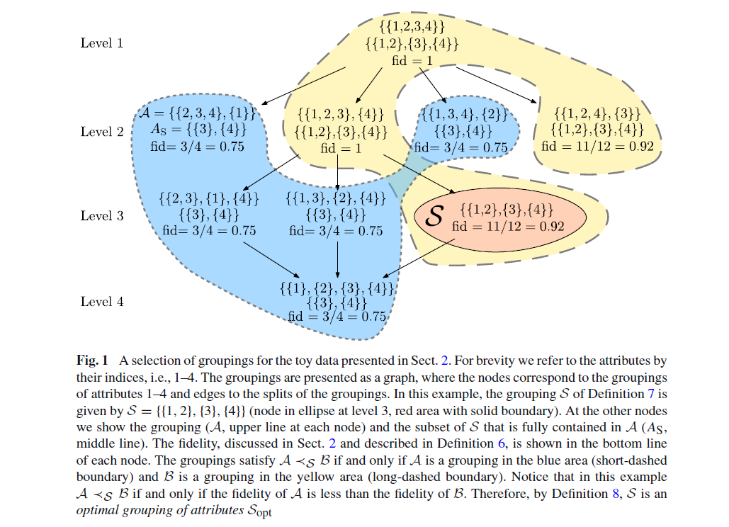
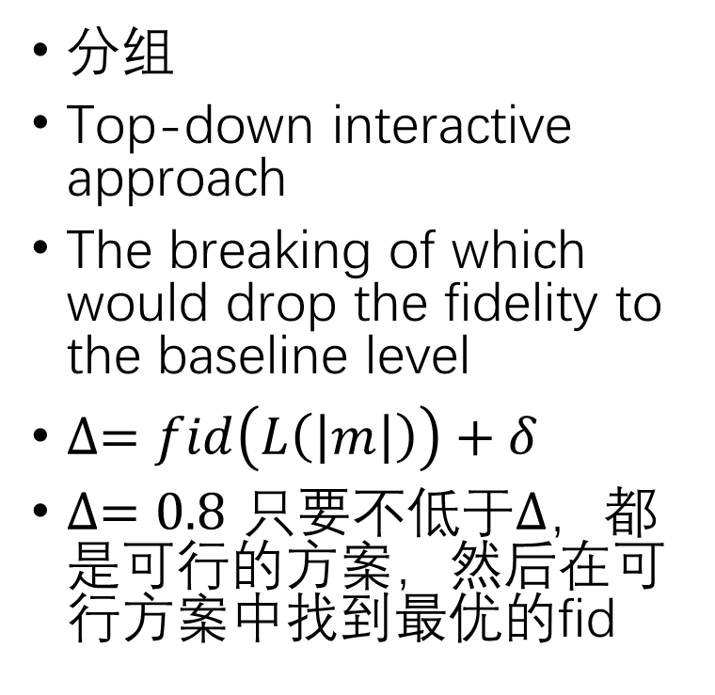
Part 3 迭代过程
分组
Top-down interactive approach
The breaking of which would drop the fidelity to the baseline level
$∆=fid\left(L\left(\left|m\right|\right)\right)+δ$
$∆=0.8$ 只要不低于$∆$，都是可行的方案，然后在可行方案中找到最优的fid

Slide 15
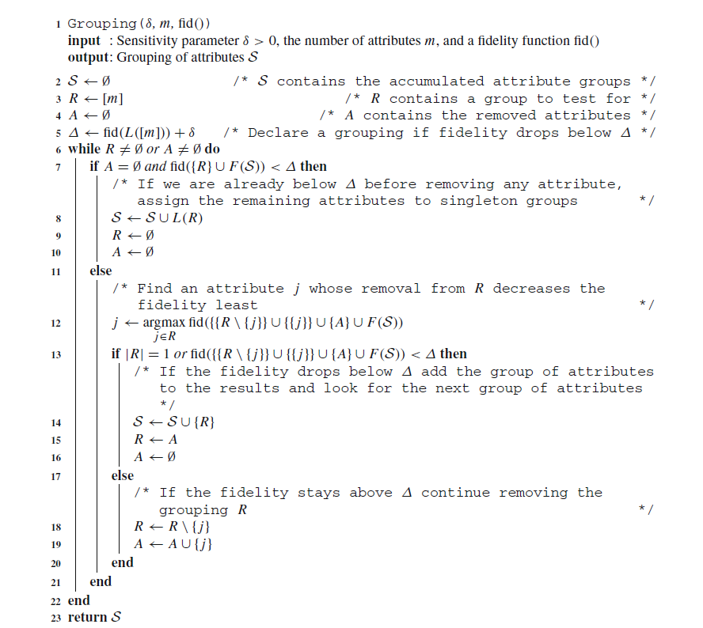

Slide 16

Part 3 迭代过程
修剪
$∆=fid\left(𝒮\right)−δ$
$fid\left(𝒮\right)−fid\left(𝒮\backslash \left\{X\right\}\right)<δ可以进行\text{修剪}$
$即fid\left(𝒮\backslash \left\{X\right\}\right)>fid\left(𝒮\right)−δ=∆$

Slide 17
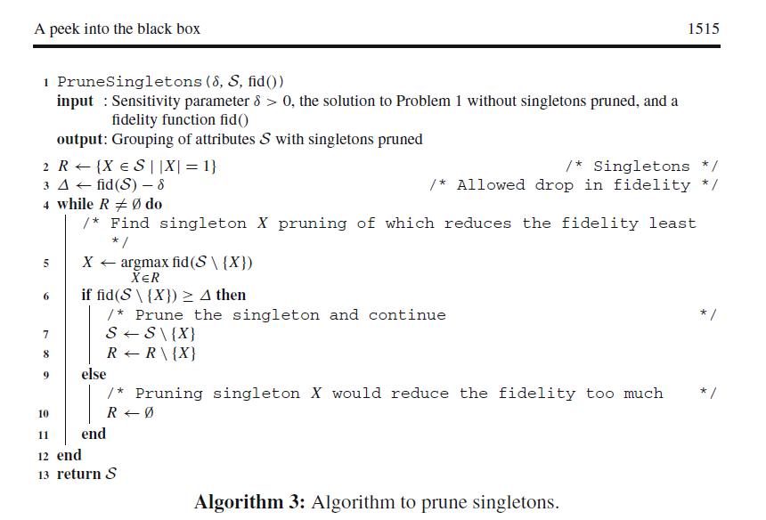

Slide 18
Part 4 实验结果
不同分类器准确率不同：有没有充分利用到数据的结构（structure of the dataset），有的分类器适合有关联的数据，有的分类器适合相互独立的数据
不同分类器属性分组不同
通过组和属性的个数的平均值确定关系

