Slide 1
Discovering additive structure in black box functions

Slide 2
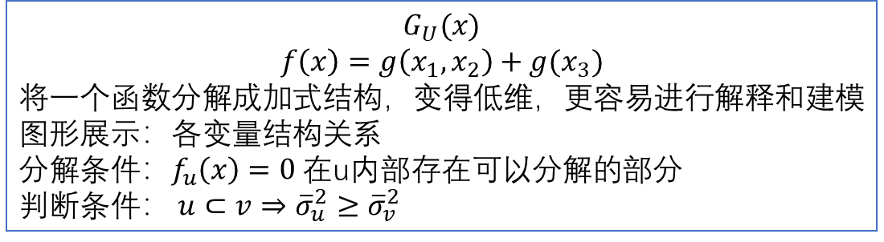
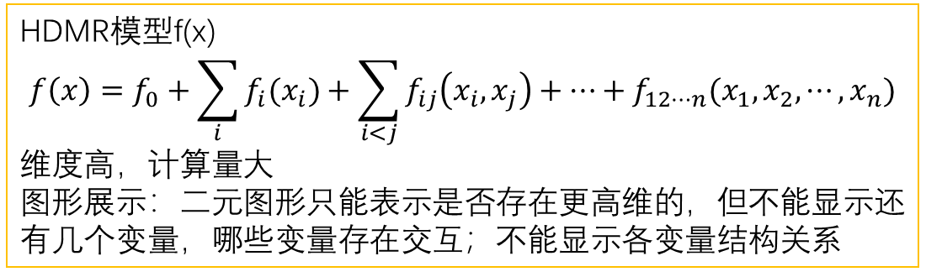
HDMR模型f(x)
$$f\left(x\right)=f_{0}+\sum_{i}{f_{i}(x_{i})}+\sum_{i<j}{f_{ij}\left(x_{i},x_{j}\right)+⋯+f_{12⋯n}(x_{1},x_{2},⋯,x_{n})}$$
维度高，计算量大
图形展示：二元图形只能表示是否存在更高维的，但不能显示还有几个变量，哪些变量存在交互；不能显示各变量结构关系
学习得到的模型F(x)（黑箱）
$$G_{U}(x)$$
$$f\left(x\right)=g\left(x_{1},x_{2}\right)+g(x_{3})$$
将一个函数分解成加式结构，变得低维，更容易进行解释和建模
图形展示：各变量结构关系
分解条件：$f_{u}\left(x\right)=0$ 在u内部存在可以分解的部分
判断条件： $u⊂v⇒{\overline{σ}}_{u}^{2}≥{\overline{σ}}_{v}^{2}$

Slide 3
abstract
普遍的解释方式是把一个已知函数与一个或两个预测因子的关系作图。
本文提出了一种方法，它不寻求显示函数，而是评估任何一组变量中非加性相互作用的重要性。提供了一个指示本质上高维的行为发生的地方。
交互重要性评分度量了与预测函数在可加模型空间上的投影相关的损失。

Slide 4
introduction
本文测量变量在确定函数输出时的重要性，以及寻找潜在的加法，变量子集之间的相互作用。
方便将函数分解为可加的部分，对每个小部分进行解释或建模。
方便生成函数交互的图形模型，查看分解结构中的重要组件。
当解释黑箱预测时，通常是用一个二元图矩阵。每个二元图描述两个预测因子上的聚合行为。
若函数是一阶相互作用的加法，那么矩阵可以捕捉了它的动态。
二元条件方差图可能指示某些本质上高维的东西在何处发生。但它们不指示相互作用中包含多少变量。这正是本文所解决的问题

Slide 5
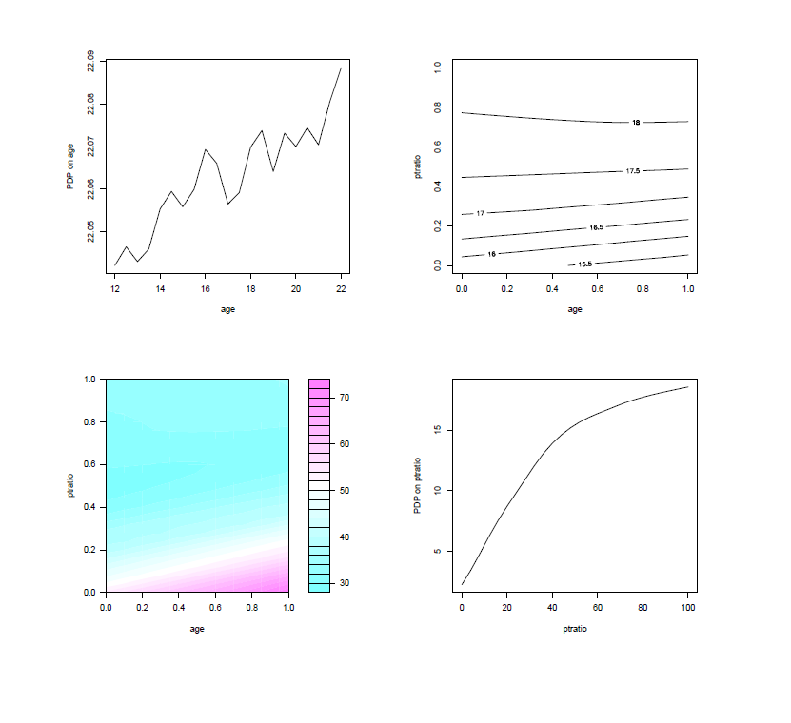

Slide 6
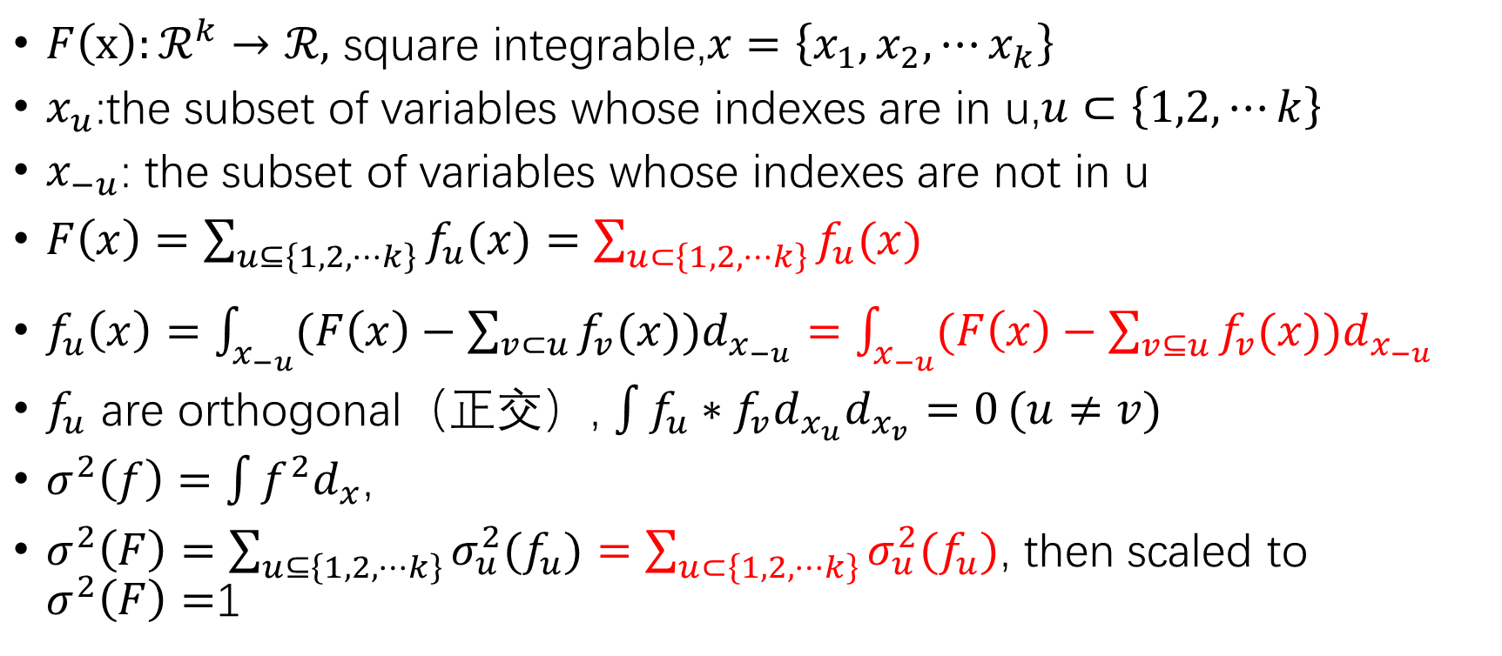
The functional ANOVA
$F\left(x\right):ℛ^{k}→ℛ,$ square integrable,$x=\left\{x_{1},x_{2},⋯x_{k}\right\}$
$x_{u}$:the subset of variables whose indexes are in u,$u⊂\left\{1,2,⋯k\right\}$
$x_{−u}$: the subset of variables whose indexes are not in u
$F\left(x\right)=\sum_{u⊆\left\{1,2,⋯k\right\}}{f_{u}(x)}=\sum_{u⊂\left\{1,2,⋯k\right\}}{f_{u}(x)}$
$f_{u}\left(x\right)=\int_{x_{−u}}{(F\left(x\right)−\sum_{v⊂u}{f_{v}(x)})d_{x_{−u}}}=\int_{x_{−u}}{(F\left(x\right)−\sum_{v⊆u}{f_{v}(x)})d_{x_{−u}}}$
$f_{u}$ are orthogonal（正交）, $\int{f_{u}∗f_{v}d_{x_{u}}d_{x_{v}}=0}(u≠v)$
$σ^{2}\left(f\right)=\int{f^{2}d_{x}}$,
$σ^{2}\left(F\right)=\sum_{u⊆\left\{1,2,⋯k\right\}}{σ_{u}^{2}(f_{u})}=\sum_{u⊂\left\{1,2,⋯k\right\}}{σ_{u}^{2}(f_{u})}$, then scaled to $σ^{2}\left(F\right)=$1

Slide 7
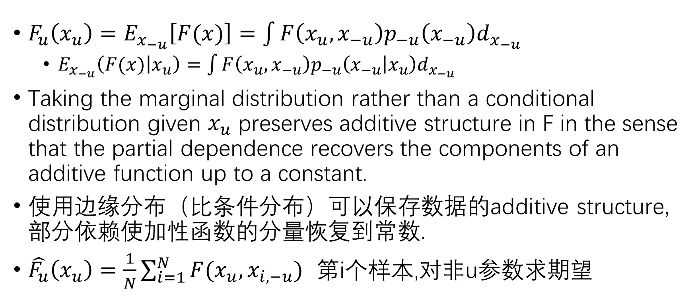
Partial dependence plots
$F_{u}\left(x_{u}\right)=E_{x_{−u}}\left[F(x)\right]=\int{F\left(x_{u},x_{−u}\right)p_{−u}\left(x_{−u}\right)d_{x_{−u}}}$
$E_{x_{−u}}\left(F(x) | x_{u}\right)=\int{F\left(x_{u},x_{−u}\right)p_{−u}\left(x_{−u} | x_{u}\right)d_{x_{−u}}}$
Taking the marginal distribution rather than a conditional distribution given $x_{u}$ preserves additive structure in F in the sense that the partial dependence recovers the components of an additive function up to a constant.
使用边缘分布（比条件分布）可以保存数据的additive structure,部分依赖使加性函数的分量恢复到常数.
$\hat{F_{u}}\left(x_{u}\right)=\frac{1}{N}\sum_{i=1}^{N}{F(x_{u},x_{i,−u})}$ 第i个样本,对非u参数求期望

Slide 8
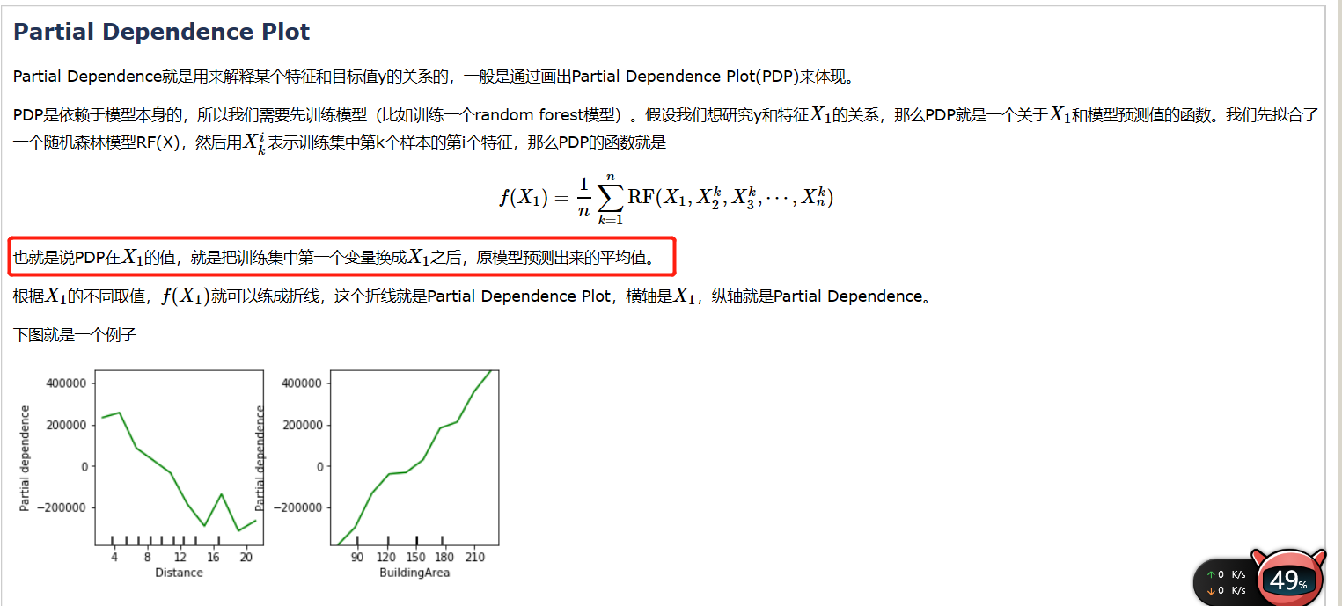

Slide 9
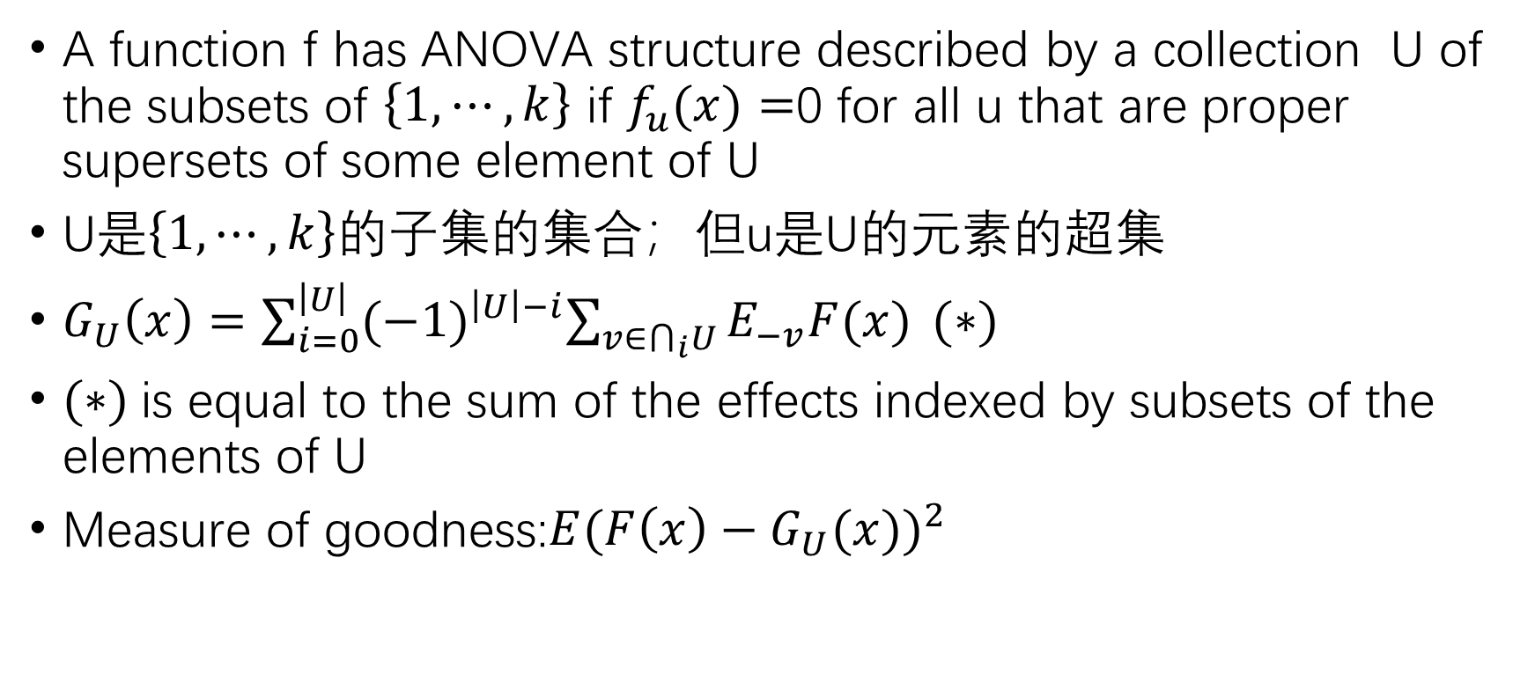
Test of ANOVA structure
A function f has ANOVA structure described by a collection U of the subsets of $\left\{1,⋯,k\right\}$ if $f_{u}(x)=$0 for all u that are proper supersets of some element of U
U是$\left\{1,⋯,k\right\}$的子集的集合；但u是U的元素的超集
$G_{U}\left(x\right)=\sum_{i=0}^{\left|U\right|}{{(−1)}^{\left|U\right|−i}\sum_{v∈⋂_{i}U}{E_{−v}F(x)}} (∗)$
$(∗)$is equal to the sum of the effects indexed by subsets of the elements of U
Measure of goodness:$E{(F\left(x\right)−G_{U}(x))}^{2}$

Slide 10
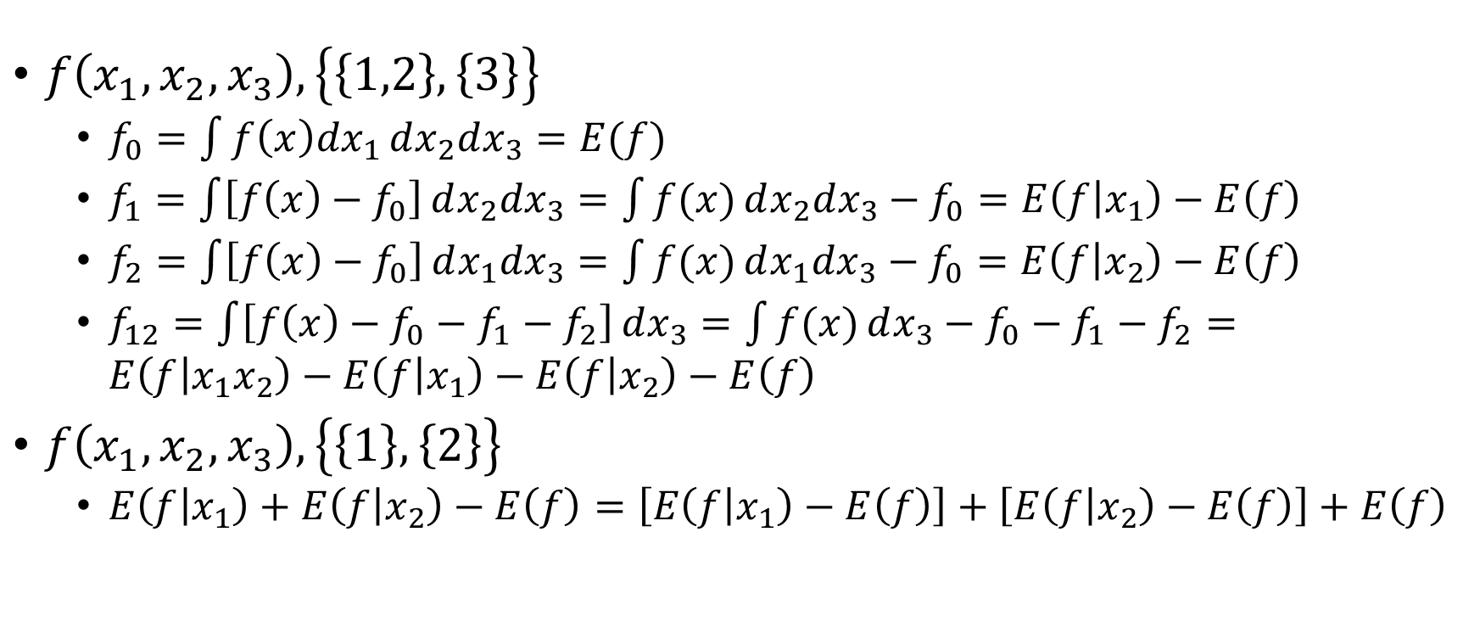
Test of ANOVA structure
$f\left(x_{1},x_{2},x_{3}\right),\left\{\left\{1,2\right\},\left\{3\right\}\right\}$
$f_{0}=\int{f\left(x\right)dx_{1}}dx_{2}dx_{3}=E(f)$
$f_{1}=\int{\left[f\left(x\right)−f_{0}\right]}dx_{2}dx_{3}=\int{f(x)}dx_{2}dx_{3}−f_{0}=E\left(f | x_{1}\right)−E\left(f\right)$
$f_{2}=\int{\left[f\left(x\right)−f_{0}\right]}dx_{1}dx_{3}=\int{f(x)}dx_{1}dx_{3}−f_{0}=E\left(f | x_{2}\right)−E\left(f\right)$
$f_{12}=\int{\left[f\left(x\right)−f_{0}−f_{1}−f_{2}\right]}dx_{3}=\int{f(x)}dx_{3}−f_{0}−f_{1}−f_{2}=E\left(f | x_{1}x_{2}\right)−E\left(f | x_{1}\right)−E\left(f | x_{2}\right)−E\left(f\right)$
$f\left(x_{1},x_{2},x_{3}\right),\left\{\left\{1\right\},\left\{2\right\}\right\}$
$E\left(f | x_{1}\right)+E\left(f | x_{2}\right)−E\left(f\right)=\left[E\left(f | x_{1}\right)−E\left(f\right)\right]+\left[E\left(f | x_{2}\right)−E\left(f\right)\right]+E\left(f\right)$

Slide 11
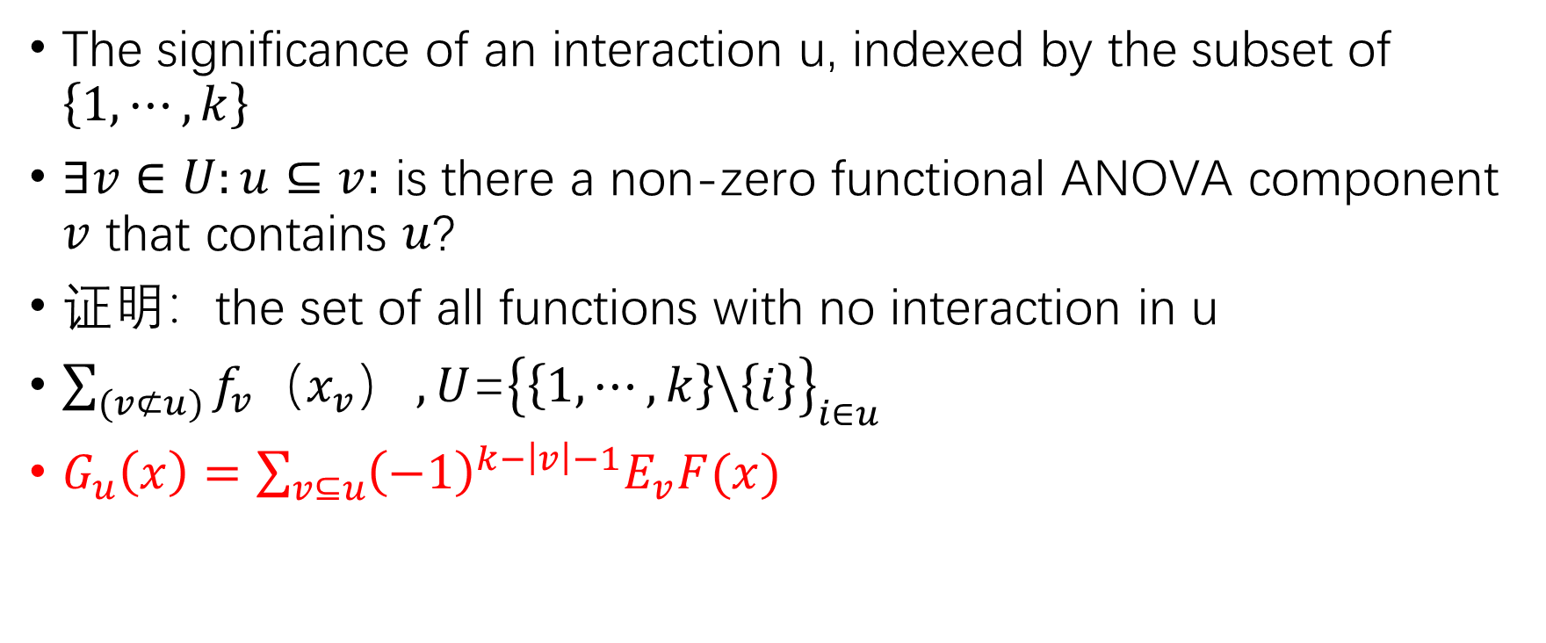
Test of ANOVA structure
The significance of an interaction u, indexed by the subset of $\left\{1,⋯,k\right\}$
$∃v∈U:u⊆v:$ is there a non-zero functional ANOVA component $v$ that contains $u$?
证明：the set of all functions with no interaction in u
$\sum_{(v⊄u)}{f_{v}（x_{v}）},U$=${\left\{\left\{1,⋯,k\right\}\backslash \left\{i\right\}\right\}}_{i∈u}$
$G_{u}\left(x\right)=\sum_{v⊆u}{{\left(−1\right)}^{k−\left|v\right|−1}E_{v}F(x)}$

Slide 12
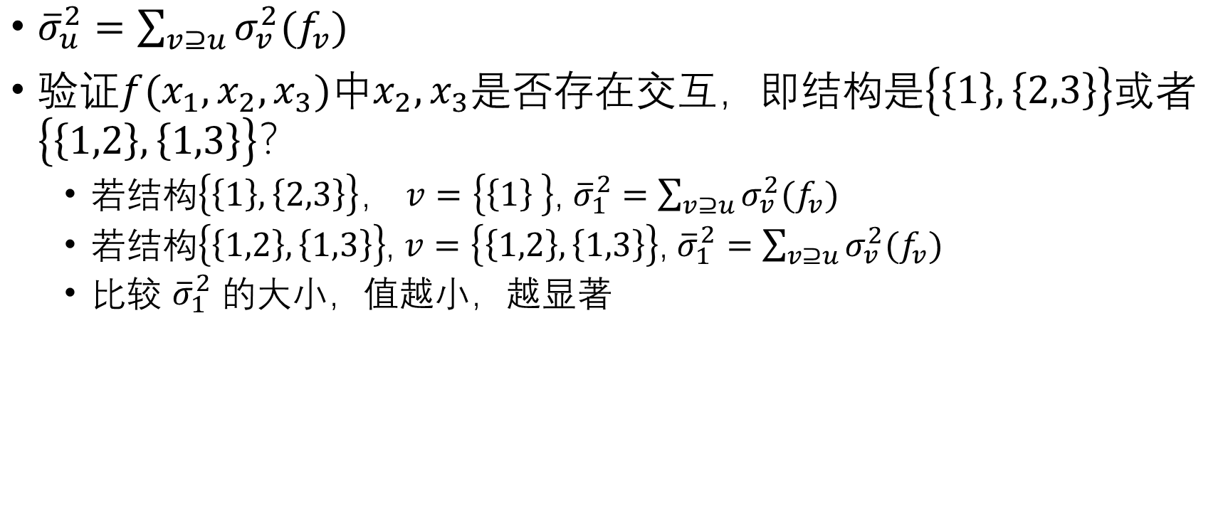
Test of ANOVA structure
${\overline{σ}}_{u}^{2}=\sum_{v⊇u}{σ_{v}^{2}(f_{v})}$
验证$f(x_{1},x_{2},x_{3})中x_{2},x_{3}$是否存在交互，即结构是$\left\{\left\{1\right\},\left\{2,3\right\}\right\}或者\left\{\left\{1,2\right\},\left\{1,3\right\}\right\}$？
若结构$\left\{\left\{1\right\},\left\{2,3\right\}\right\}$， $v=\left\{\left\{1\right\} \right\}$, ${\overline{σ}}_{1}^{2}=$ $\sum_{v⊇u}{σ_{v}^{2}(f_{v})}$
若结构$\left\{\left\{1,2\right\},\left\{1,3\right\}\right\}$, $v=\left\{\left\{1,2\right\},\left\{1,3\right\}\right\}$, ${\overline{σ}}_{1}^{2}=$ $\sum_{v⊇u}{σ_{v}^{2}(f_{v})}$
比较 ${\overline{σ}}_{1}^{2}$ 的大小，值越小，越显著

Slide 13
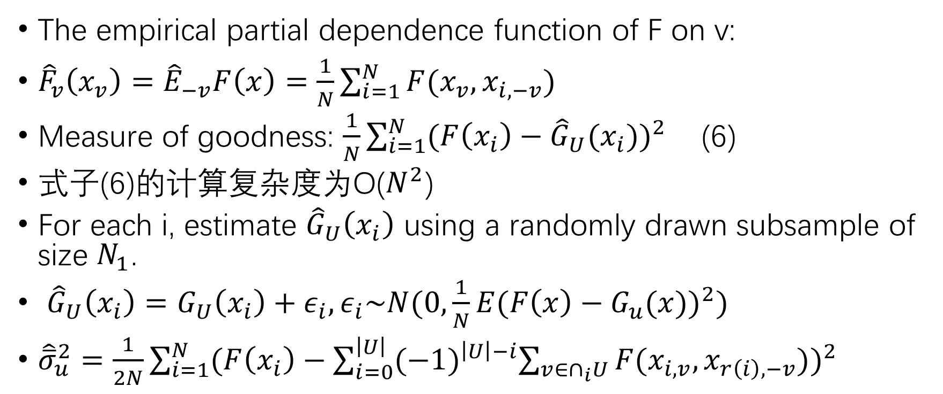
Empirical estimates
The empirical partial dependence function of F on v:
${\hat{F}}_{v}\left(x_{v}\right)={\hat{E}}_{−v}F\left(x\right)=\frac{1}{N}\sum_{i=1}^{N}{F(x_{v},x_{i,−v})}$
Measure of goodness: $\frac{1}{N}\sum_{i=1}^{N}{{(F\left(x_{i}\right)−{\hat{G}}_{U}(x_{i}))}^{2}}$ (6)
式子(6)的计算复杂度为O($N^{2}$)
For each i, estimate ${\hat{G}}_{U}\left(x_{i}\right)$ using a randomly drawn subsample of size $N_{1}$.
${\hat{G}}_{U}\left(x_{i}\right)=G_{U}\left(x_{i}\right)+ε_{i},ε_{i}\sim N(0,\frac{1}{N}E{(F\left(x\right)−G_{u}(x))}^{2})$
${\hat{\overline{σ}}}_{u}^{2}=\frac{1}{2N}\sum_{i=1}^{N}{{(F\left(x_{i}\right)−\sum_{i=0}^{\left|U\right|}{{(−1)}^{\left|U\right|−i}\sum_{v∈∩_{i}U}{F(x_{i,v},x_{r\left(i\right),−v})}})}^{2}}$

Slide 14
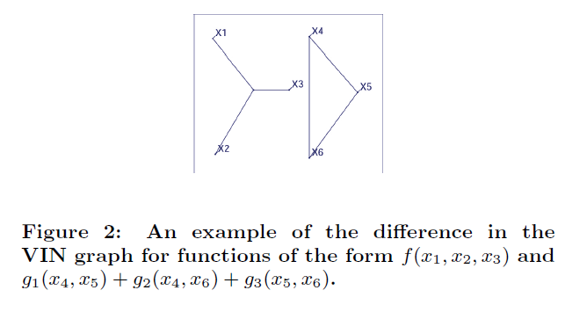
Graphical displays
变量作为节点。
如果变量间交互作用明显，则增加一条边。
节点间距离用L2CoE度量的倒数表示

Slide 15
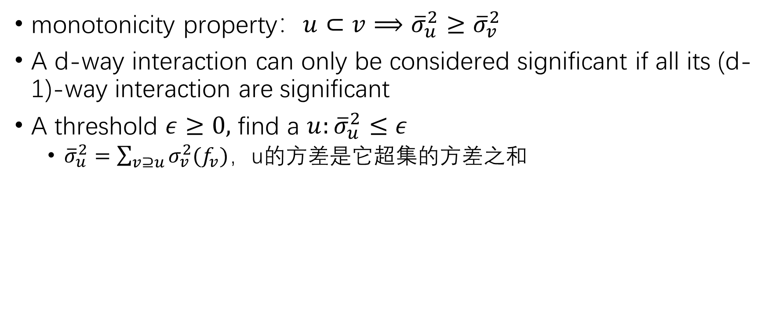
The vin algorithm
monotonicity property：$u⊂v⟹{\overline{σ}}_{u}^{2}≥{\overline{σ}}_{v}^{2}$
A d-way interaction can only be considered significant if all its (d-1)-way interaction are significant
A threshold $ε≥0,$ find a $u:{\overline{σ}}_{u}^{2}≤ε$
${\overline{σ}}_{u}^{2}=\sum_{v⊇u}{σ_{v}^{2}(f_{v})}$，u的方差是它超集的方差之和

Slide 16
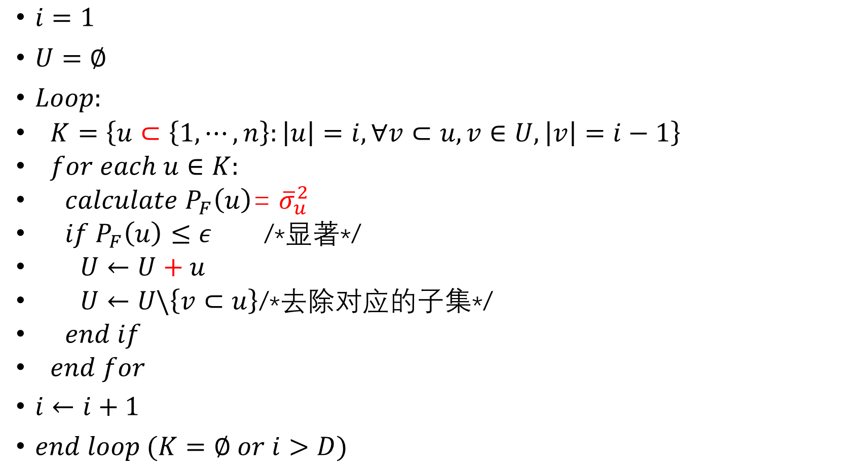
$i=1$
$U=∅$
$Loop:$
$K=\left\{u⊂\left\{1,⋯,n\right\}:\left|u\right|=i,∀v⊂u,v∈U,\left|v\right|=i−1\right\}$
$for each u∈K:$
$calculate P_{F}\left(u\right)$= ${\overline{σ}}_{u}^{2}$
$if P_{F}\left(u\right)≤ε$ /*显著*/
$U←U+u$
$U←U\backslash \left\{v⊂u\right\}$/*去除对应的子集*/
$end if$
$end for$
$i←i+1$
$end loop (K=∅ or i>D)$

Slide 17
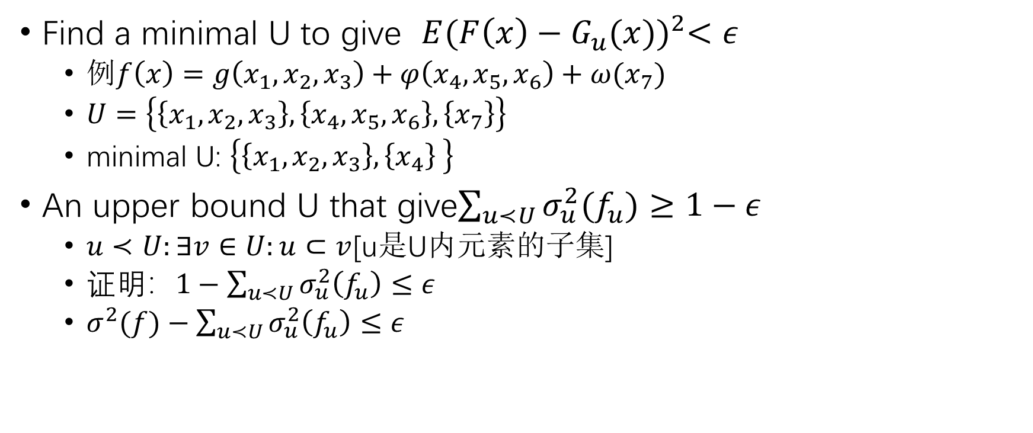
Upper bounds on lattice space
Find a minimal U to give $E{(F\left(x\right)−G_{u}(x))}^{2}<ε$
例$f\left(x\right)=g\left(x_{1},x_{2},x_{3}\right)+φ\left(x_{4},x_{5},x_{6}\right)+ω(x_{7})$
$U=\left\{\left\{x_{1},x_{2},x_{3}\right\},\left\{x_{4},x_{5},x_{6}\right\},\left\{x_{7}\right\}\right\}$
minimal U: $\left\{\left\{x_{1},x_{2},x_{3}\right\},\left\{x_{4}\right\} \right\}$
An upper bound U that give$\sum_{u≺U}{σ_{u}^{2}(f_{u})}≥1−ε$
$u≺U:∃v∈U:u⊂v$[u是U内元素的子集]
证明：$1−\sum_{u≺U}{σ_{u}^{2}\left(f_{u}\right)}≤ε$
$σ^{2}(f)−\sum_{u≺U}{σ_{u}^{2}\left(f_{u}\right)}≤ε$

Slide 18
conclusions
根据函数的非加性交互组件的大小来表示函数的复杂性，不仅提供了系统固有维度的指示，而且还提供了哪个变量是以非加性方式交互。
开发了一种图形化显示，使用户更容易获得结果，并证明它具有良好的解释性。

