Slide 1
Sensitivity analysis of correlated inputs: application to a riveting process model

Slide 2
HDMR 历史
RI Cukier, CM Fortuin, KE (1973)
start with a Fourier implementation
Sobol, Ilya M (1993)
Milestone : HDMR decomposition
Homma and Saltelli (1996)
The total sensitivity indices have been introduced
Genyuan Li
(2000)
CONCEPTS AND APPLICATIONS
Application in chemistry
(2002,2006,2008)
random-sampling high dimensional model representation (RS-HDMR)
(2010,2012)
a unified framework for the HDMR decomposition

Slide 3


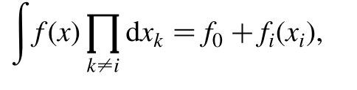
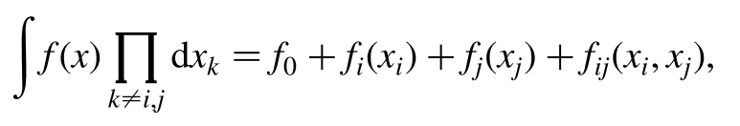


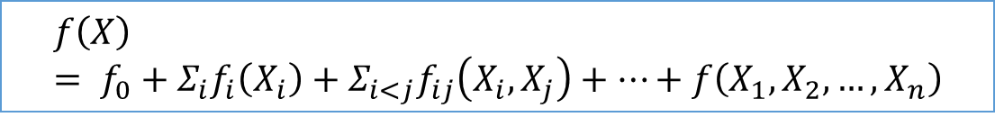
推导
Given a model of the form $Y=f\left(X\right)$
X=$\left(X_{1},X_{2},…,X_{n}\right)$
$$f\left(X\right)= f_{0}+Σ_{i}f_{i}\left(X_{i}\right)+Σ_{i<j}f_{ij}\left(X_{i},X_{j}\right)+…+f\left(X_{1},X_{2},…,X_{n}\right)$$
This expansion, called high dimensional model representation(HDMR)

Slide 4
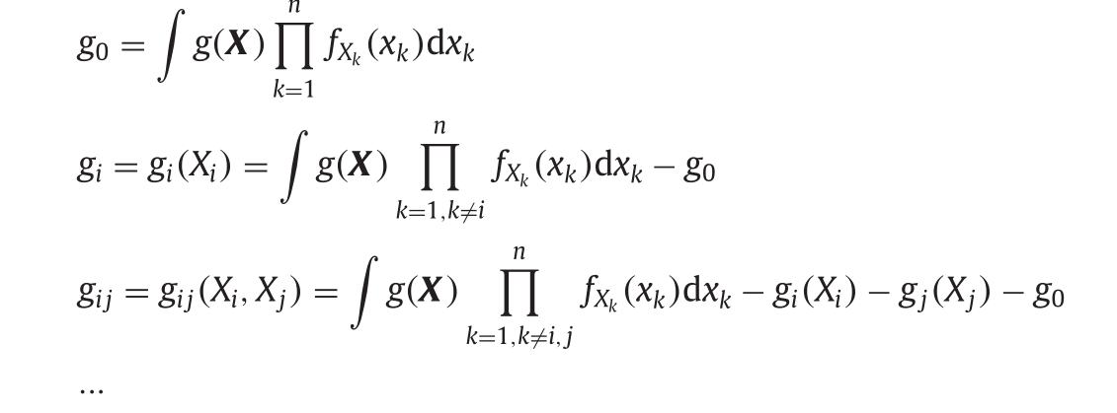


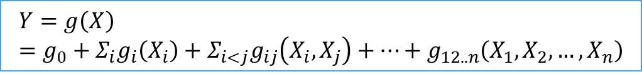
推导
Given a model of the form $Y=g\left(X\right)$
X=$\left(X_{1},X_{2},…,X_{n}\right)$
$$Y=g\left(X\right)=g_{0}+Σ_{i}g_{i}\left(X_{i}\right)+Σ_{i<j}g_{ij}\left(X_{i},X_{j}\right)+…+g_{12..n}\left(X_{1},X_{2},…,X_{n}\right)$$
This expansion, called high dimensional model representation(HDMR)
这里考虑了输入变量X的分布

Slide 5
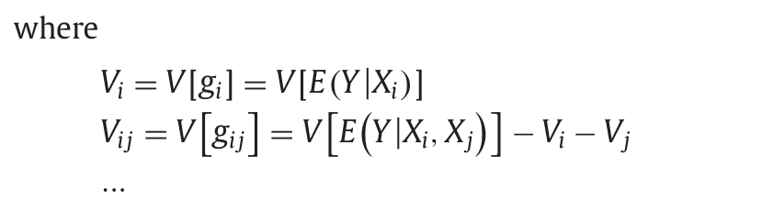
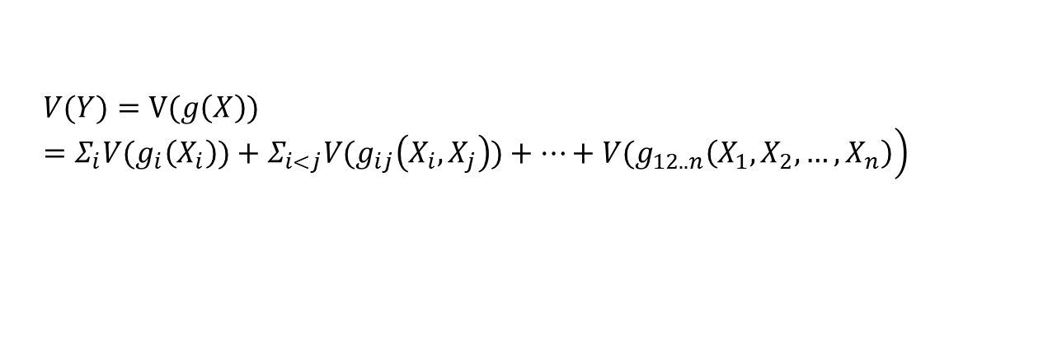
推导
For the independent inputs, all the component functions in HDMR are mutually orthogonal
$$\left.V(Y)=V(g\left(X\right))=Σ_{i}{V(g}_{i}\left(X_{i}\right))+Σ_{i<j}{V(g}_{ij}\left(X_{i},X_{j}\right))+…+{V(g}_{12..n}\left(X_{1},X_{2},…,X_{n}\right)\right)$$

Slide 6
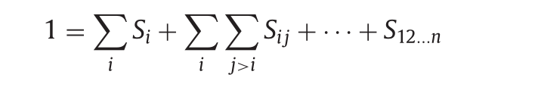
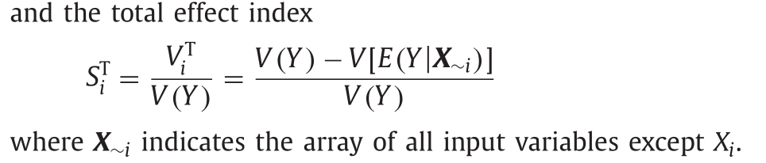
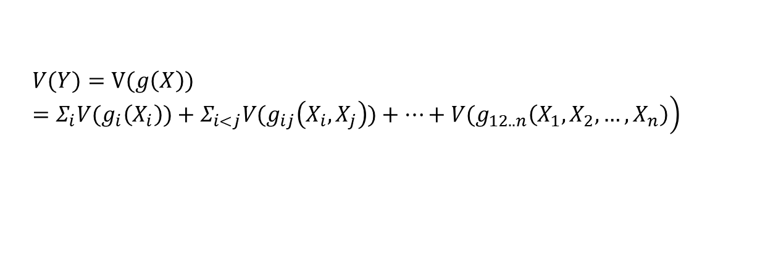
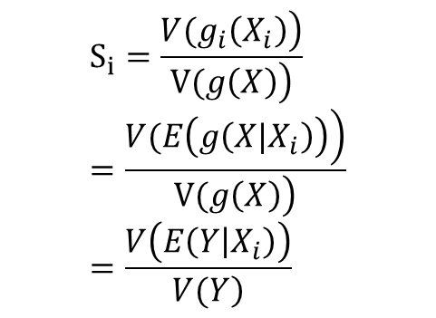
推导
For the independent inputs, all the component functions in HDMR are mutually orthogonal
$$\left.V(Y)=V(g\left(X\right))=Σ_{i}{V(g}_{i}\left(X_{i}\right))+Σ_{i<j}{V(g}_{ij}\left(X_{i},X_{j}\right))+…+{V(g}_{12..n}\left(X_{1},X_{2},…,X_{n}\right)\right)$$
And then we have the first-order index which is defined as
$$S_{i}=\frac{\left.{V(g}_{i}\left(X_{i}\right)\right)}{\left.V(g\left(X\right)\right)}=\frac{\left.V(E\left(g\left(X|X_{i}\right)\right)\right)}{\left.V(g\left(X\right)\right)}=\frac{V\left(E\left(Y | X_{i}\right)\right)}{\left.V(Y\right)}$$

Slide 7
文献综述
Li （2010）
proposed a random sampling high dimensional model representation (RS-HDMR) method to divide the contribution by an individual or a set of correlated inputs into correlative contribution and structural one.
Weakness :
the effectiveness of this method relies on the uniqueness of the HDMR of the correlated inputs which is usually a thorny problem to deal with.

Slide 8
文献综述
Mara and Tarantola (2012)
derived a set of variance-based sensitivity indices that can measure the marginal and total contributions of an individual correlated input to the output variance.
Weakness:
Therefore, to estimate all the sensitivity indices of the correlated inputs, one has to test n ! ( n is the number of the inputs) different orderings of the inputs and estimate the sensitivity indices for each of these orders.

Slide 9
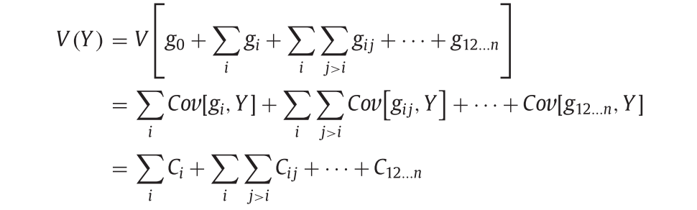
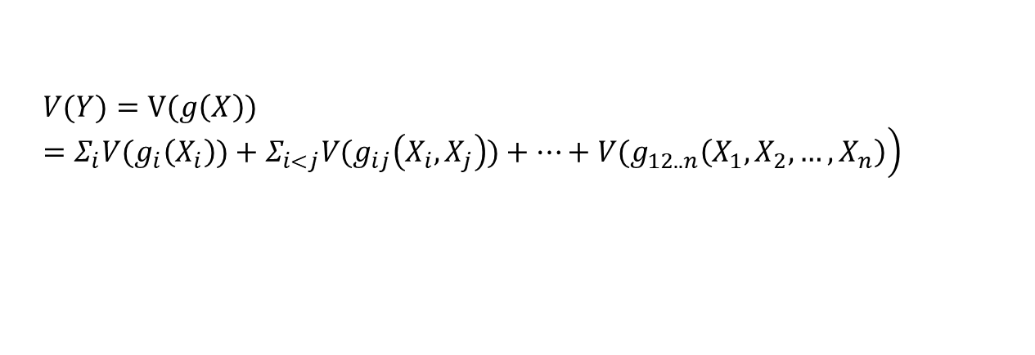

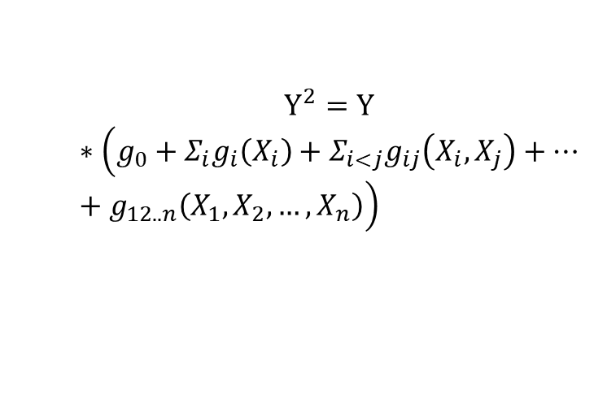
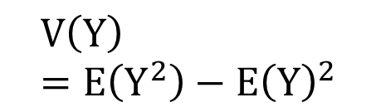
新方法的提出
$$Y=g\left(X\right)=g_{0}+Σ_{i}g_{i}\left(X_{i}\right)+Σ_{i<j}g_{ij}\left(X_{i},X_{j}\right)+…+g_{12..n}\left(X_{1},X_{2},…,X_{n}\right)$$
When the inputs are incorrelated
$$\left.V(Y)=V(g\left(X\right))=Σ_{i}{V(g}_{i}\left(X_{i}\right))+Σ_{i<j}{V(g}_{ij}\left(X_{i},X_{j}\right))+…+{V(g}_{12..n}\left(X_{1},X_{2},…,X_{n}\right)\right)$$
When the inputs are correlated
$$V\left(Y\right)=E\left(Y^{2}\right)−E{\left(Y\right)}^{2}$$
$$Y^{2}=Y$$
$$∗\left(g_{0}+Σ_{i}g_{i}\left(X_{i}\right)+Σ_{i<j}g_{ij}\left(X_{i},X_{j}\right)+…+g_{12..n}\left(X_{1},X_{2},…,X_{n}\right)\right)$$

Slide 10
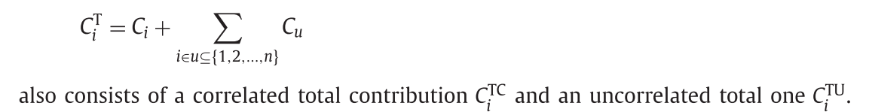
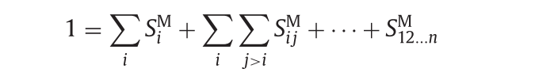
新方法的提出
The total contribution of the input Xi
The full marginal contribution sensitivity indices of the corresponding inputs:

Slide 11

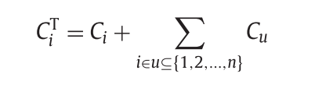

Decomposition
$$Y=g\left(X\right)=g_{0}+Σ_{i}g_{i}\left(X_{i}\right)+Σ_{i<j}g_{ij}\left(X_{i},X_{j}\right)+…+g_{12..n}\left(X_{1},X_{2},…,X_{n}\right)$$
For the purpose of conciseness, we first rewrite the HDMR
Then the total unconditional variance of the output can be written explicitly as follows：

Slide 12
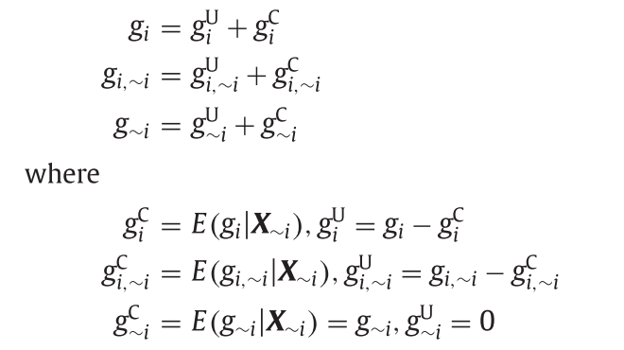


For the purpose of conciseness, we first rewrite the HDMR
In order to separate the correlated and uncorrelated contribution，
we first decompose each component function in g into two parts：
$$g_{i}^{u} 同非i标量无相关性的部分$$
$$g_{i}^{c} 同非i标量相关性的部分$$

Slide 13
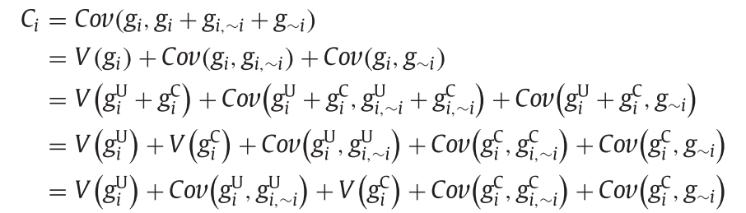
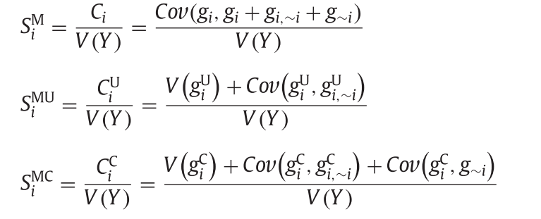

After the component functions being divided into correlated part and uncorrelated one,
the full marginal contribution can be decomposed as follows,
Three sensitivity indices correspondingly can be defined：

Slide 14
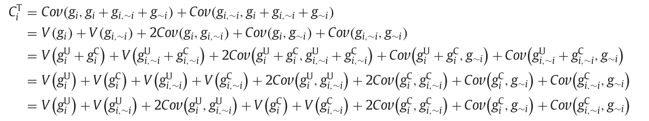

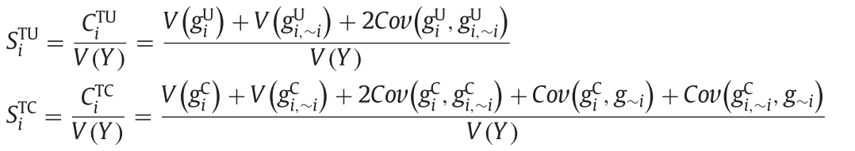

The total contribution can be decomposed as follows,
Three sensitivity indices correspondingly can be defined：

Slide 15

Comparison with Li
Li （2010）
proposed a random sampling high dimensional model representation (RS-HDMR) method to divide the contribution by an individual or a set of correlated inputs into correlative contribution and structural one.
Weakness :
the effectiveness of this method relies on the uniqueness of the HDMR of the correlated inputs which is usually a thorny problem to deal with.
This method is the generation of the unique HDMR for correlated inputs which is usually a complex process.(Hard to calculate)
Methods for estimating the HDMR in case of independent variables can be used directly for the sensitivity analysis in this paper without any specific change for correlation.(Calculation convenience)

