Slide 1
Treader
A GUI-based MP3 tag reading application
Heather Hoaglund-Biron

Slide 2
Overall Design
Modules: Tkinter, multiprocessing, SQLite3, mutagen (tag reading)
Application
Widgets
DatabaseHelper
TagReader
Database
File System

Slide 3
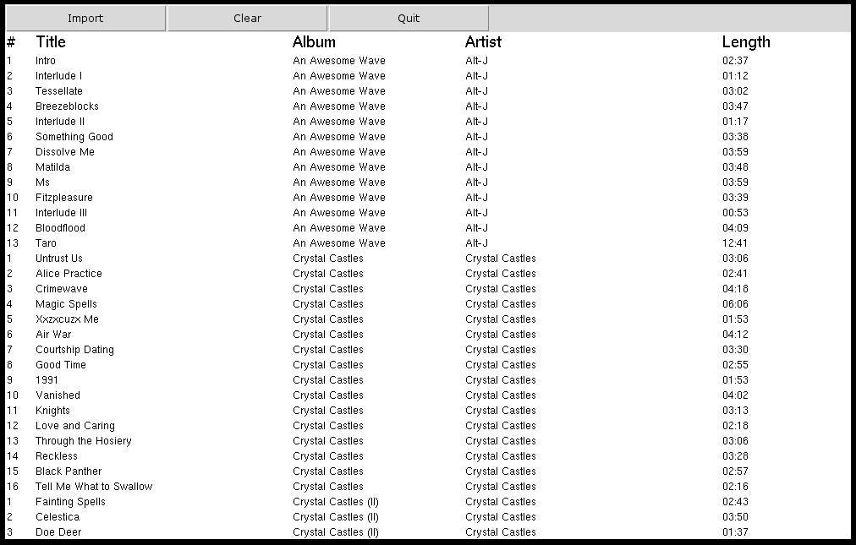

Slide 4
Multiprocess Design
Importing a song involves:
Reading tags from the .mp3 file (TagReader)
Writing song info to a database (DatabaseHelper)
Reading song info from the database (DatabaseHelper)
Displaying the song in the GUI (Application)
Two versions:
1 process
Each step is done for all songs at a time
3 processes
Each step is its own process except 1 & 2
Song by song, communication through Queues

Slide 5
Testing
Tested main classes separately
Timed import + display process (5x import and clear db per run)
Amount of Music | Processes | Run 1 avg. (seconds) | Run 2 avg. (seconds) | Run 3 avg. (seconds) | Average (seconds) | Difference (seconds)
0.5 GB | 1 | 1.590 | 1.530 | 1.586 | 1.569
 | 3 | 1.484 | 1.452 | 1.516 | 1.484 | -0.085
1.5 GB | 1 | 5.214 | 4.996 | 5.098 | 5.103
 | 3 | 4.972 | 4.954 | 4.812 | 4.913 | -0.190
2.5 GB | 1 | 7.250 | 7.546 | 7.304 | 7.367
 | 3 | 7.016 | 7.128 | 7.110 | 7.085 | -0.282
4.6 GB | 1 | 12.140 | 12.228 | 12.016 | 12.128
 | 3 | 12.986 | 12.526 | 12.394 | 12.635 | +0.507

Slide 6
Future Improvements
Add a scrollbar
More timed testing with a machine with higher RAM
More testing for robustness – tags are not reliable
Tags from other file types, .m4a, .FLAC, etc
Display songs as it imports them
Better GUI module
Make an .exe of the program

Slide 7
Questions?

