Slide 1
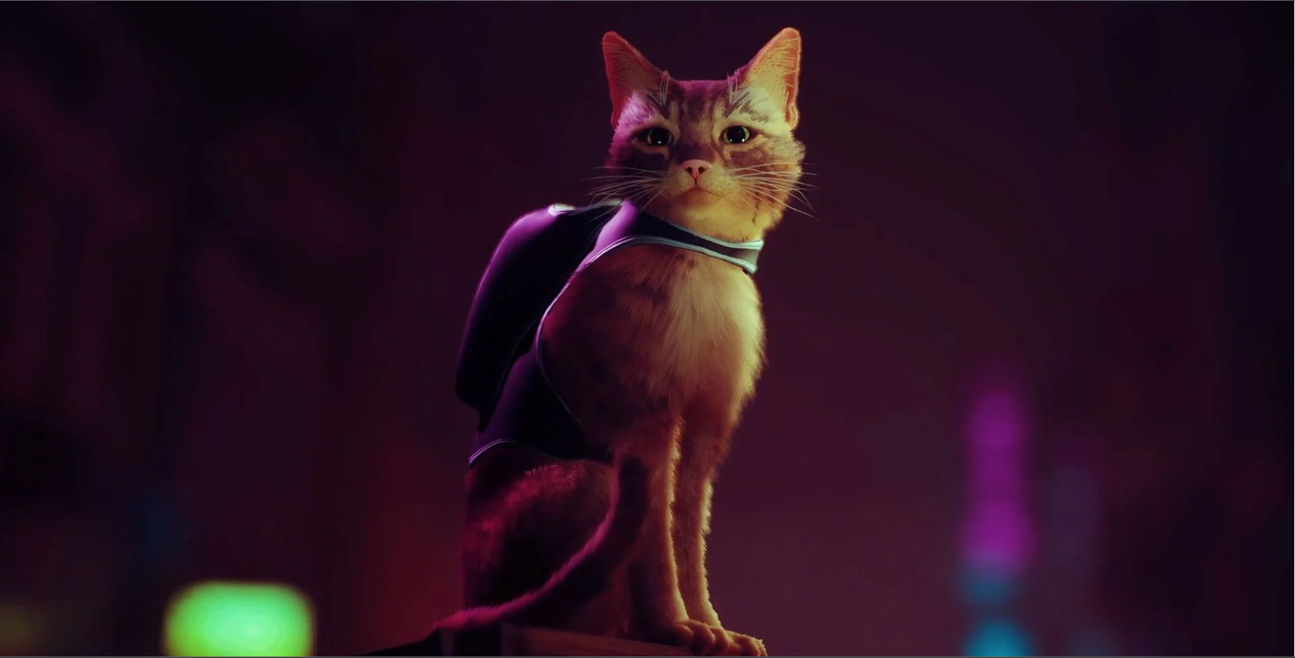
Feral

Slide 2
Game Story
Players are thrust into the world through the eyes of Luna, a feral cat living in the heart of New York City
On a mission to rescue recently kidnapped kittens
Simple plot, linear and easy to follow

Slide 3
Game Story Cont.
NOT intended to be a story driven experience
Basic plot points provide fundamental context of the world and the purpose of Luna’s adventure
Emphasis on complimenting the game mechanics through story elements

Slide 4
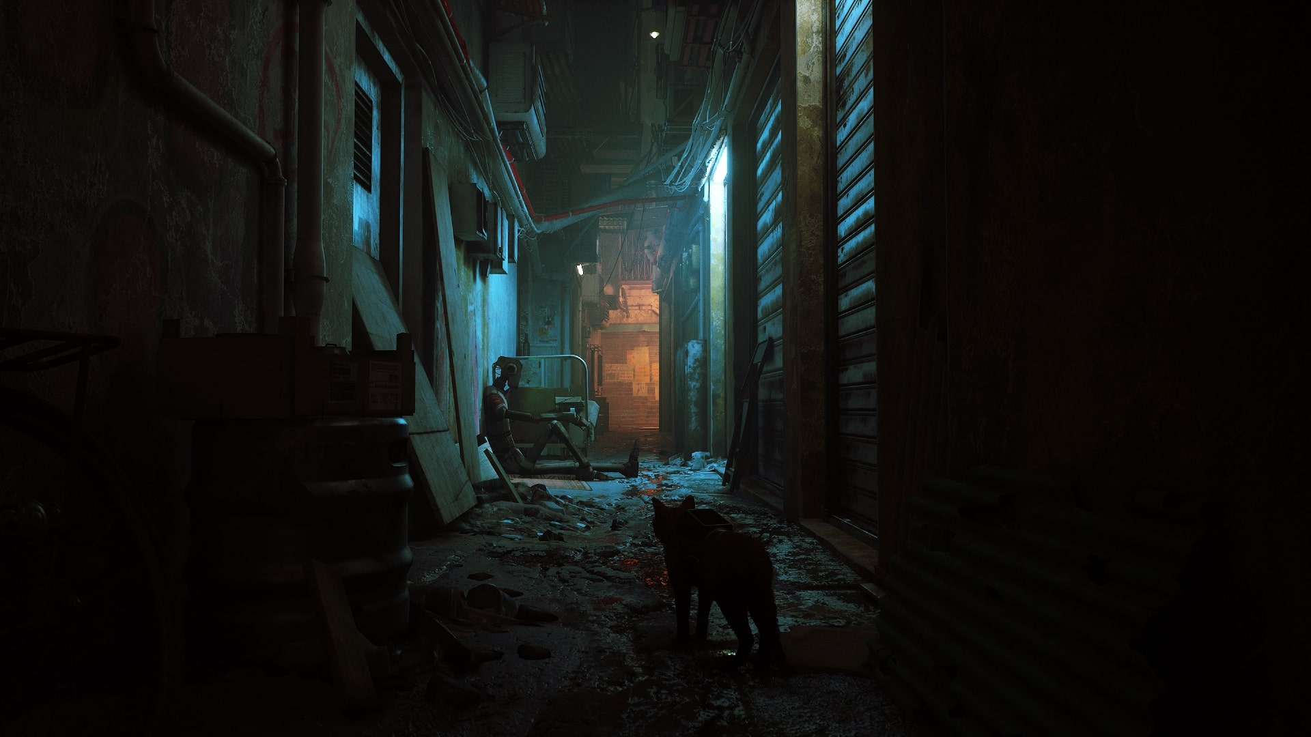
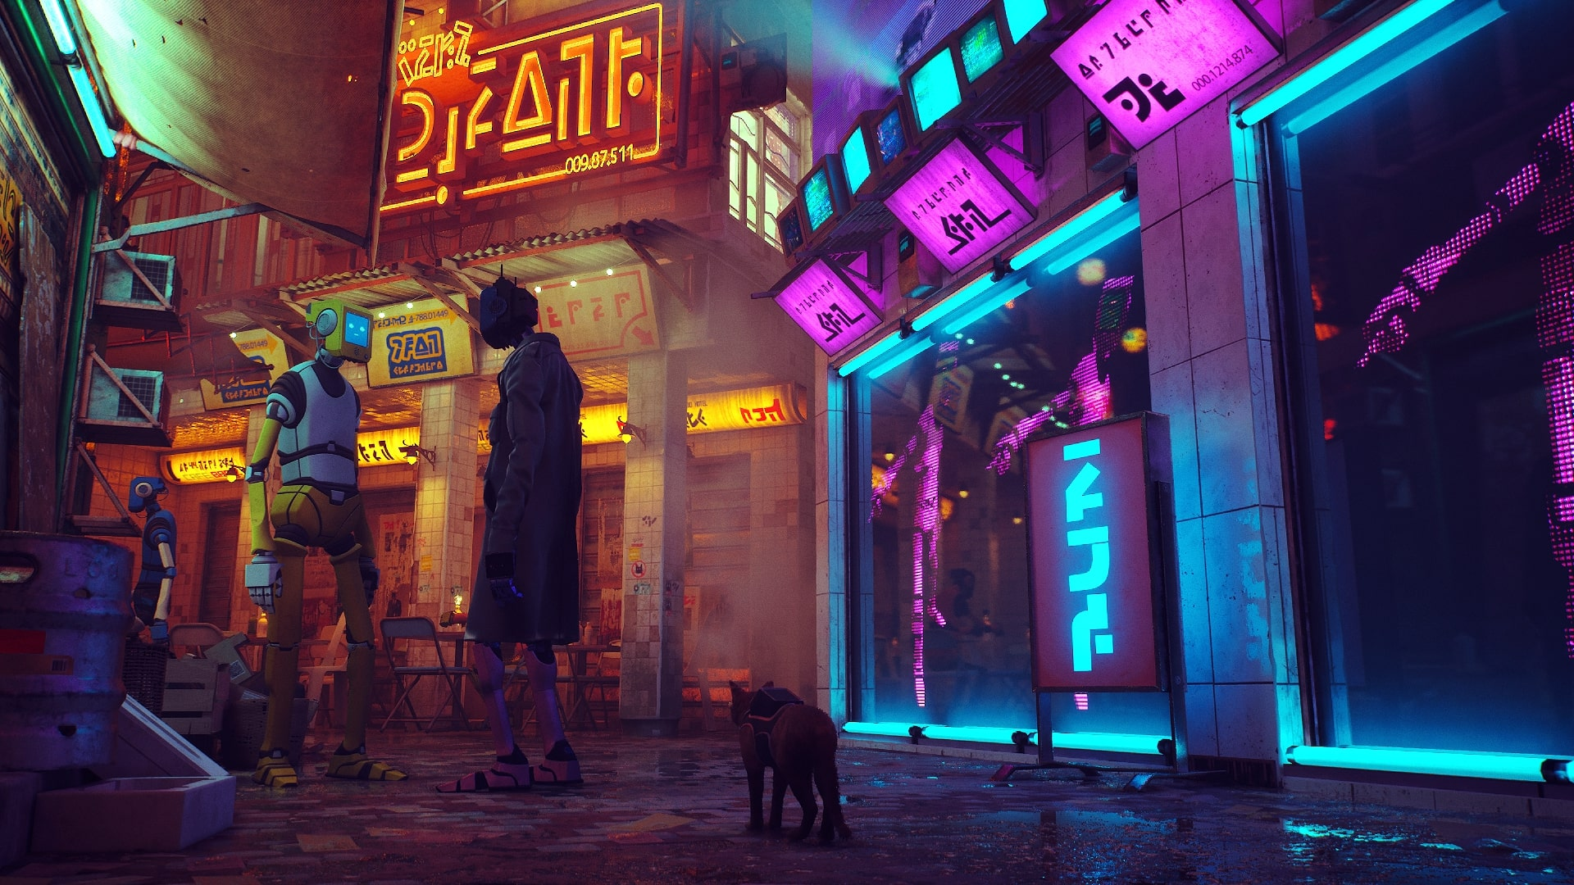
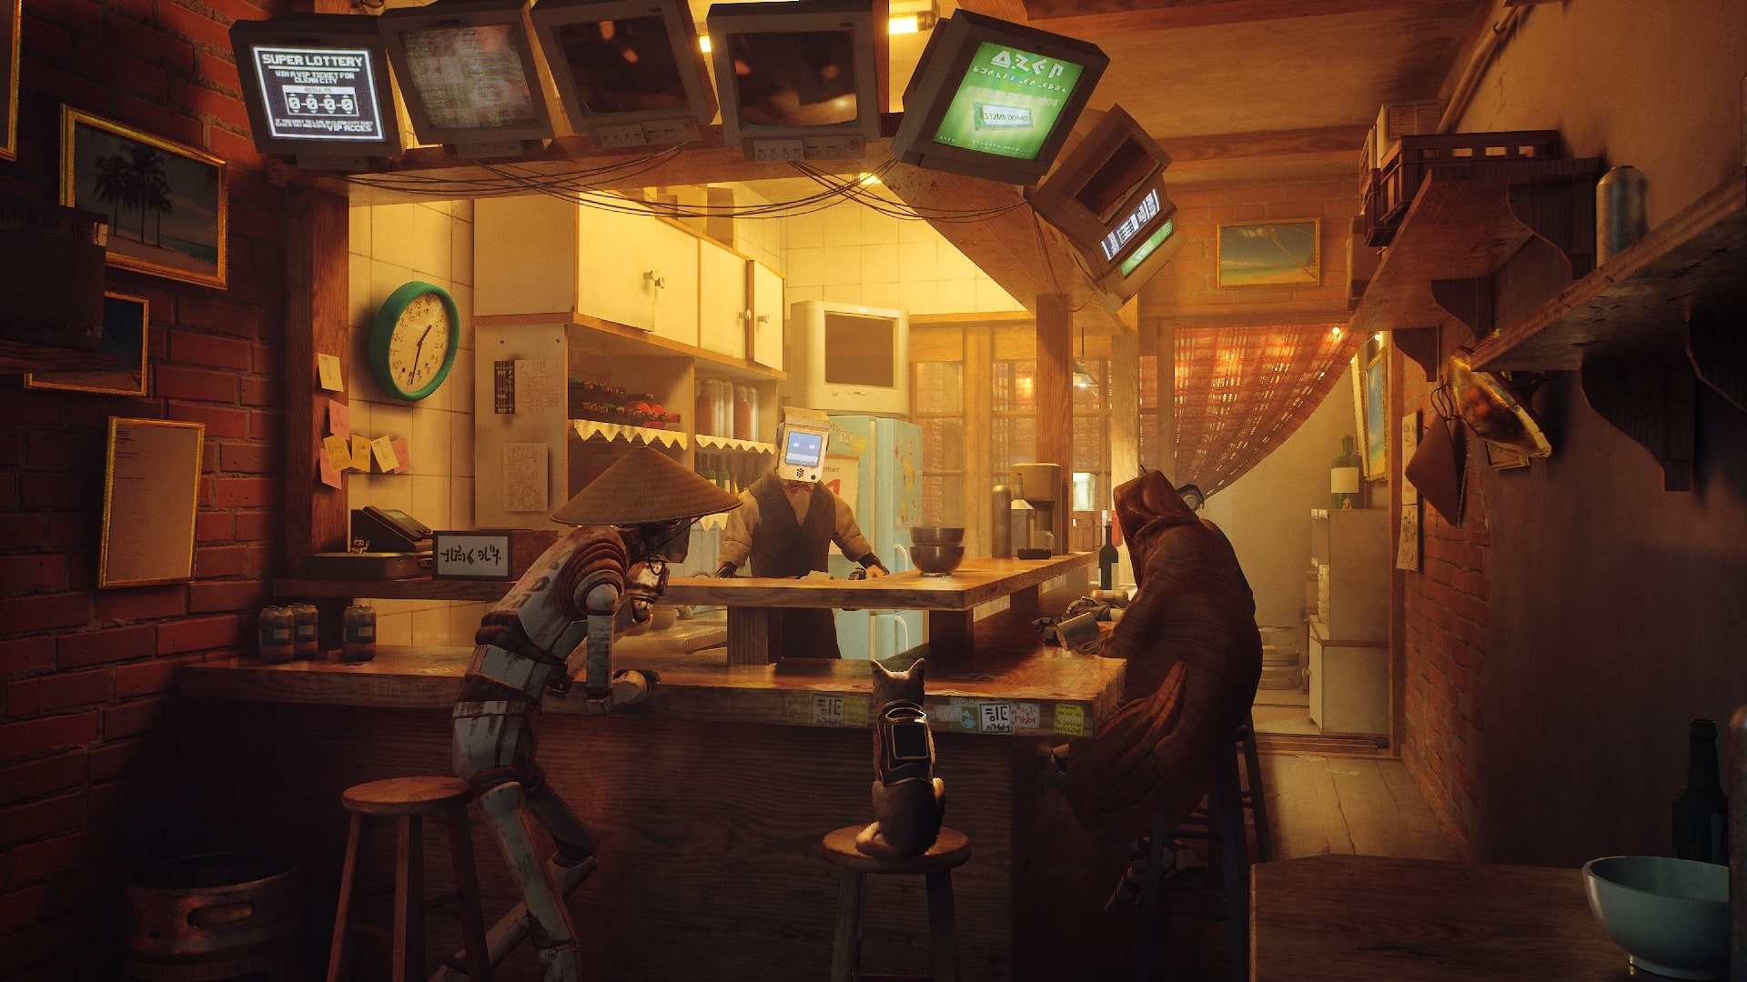
pics

