Slide 1

Facial detection
Metric learning for facial descriptors
RAAI summer school. 2019

Slide 2
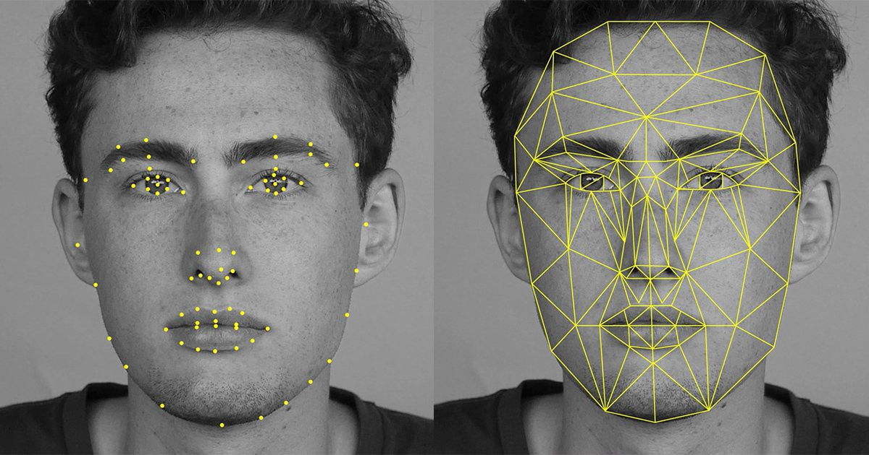
The main task..?!
The target is to get such a function which returns small values for the pairs of embeddings from the one class and big values for the pairs of embeddings from different classes.

Slide 3

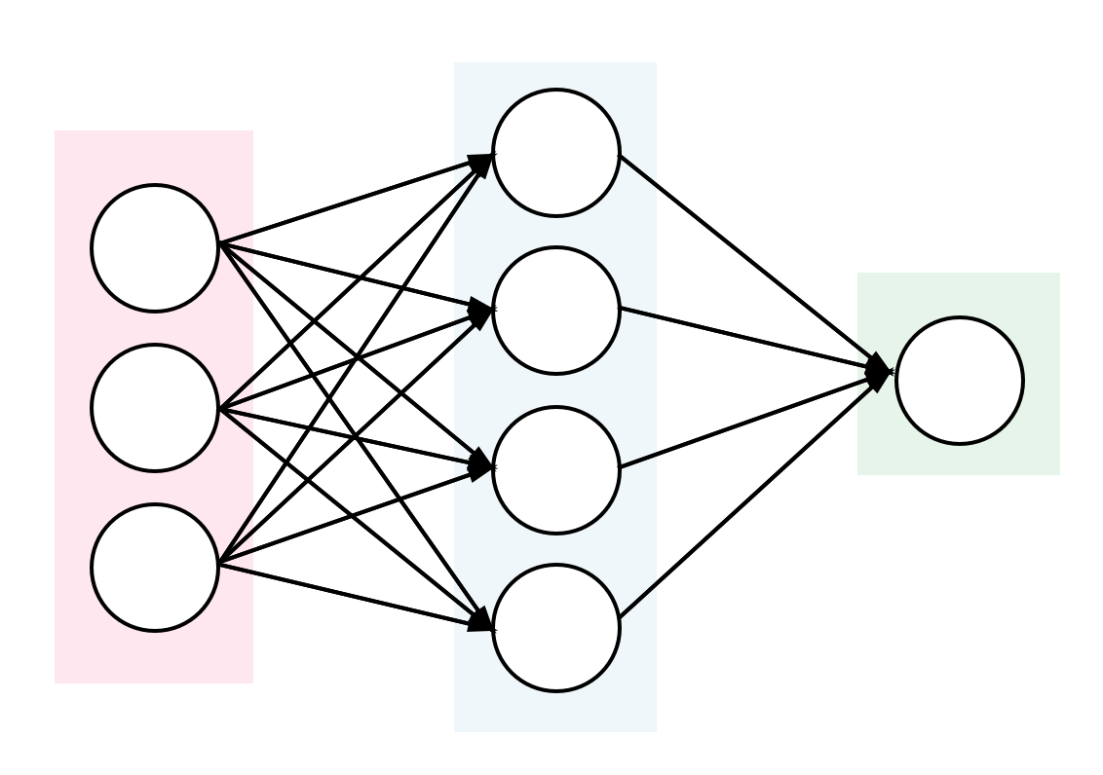
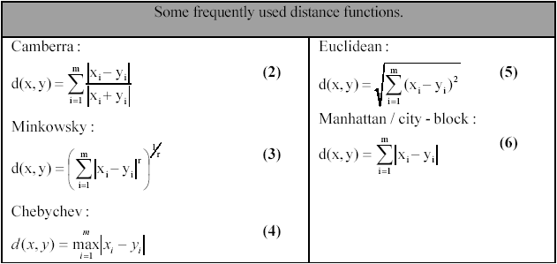
How to solve !
1- Neural Network that can tell if the pictures are for the same person or for different peoples.
2- Try to find a distance function that can do the differentiation

Slide 4

Neural Network..
Neural network model:
- input: (Vector 1024) tow features vectors.
- output: (2 outputs)the probability of being for the same class or from different classes.
Training:
Trained the network on 4 million different pairs, (94% accuracy on training data)
Testing:
We got 60% accuracy.

Slide 5
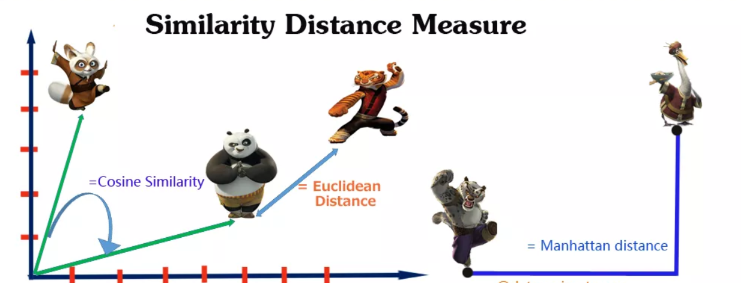
Distance Function:
Different distance functions:
Euclidean Distance
Manhattan Distance
Cosine Similarity
Chebyshev Distance
Canberra Distance
…

Slide 6
How to get the best results?
1- Evaluate each function.
2- study the range of the function.
3- scale the results of different functions to the same range
4- find the best coefficient for each distance function
5- calculate the final hybrid distance function

Slide 7

Our hybrid function.
$Dis= α_{c}∆_{cos}+α_{can}∆_{can}+α_{chy}∆_{chy}$
Results:
$85\% public dataset$
$86\% private dataset$

Slide 8
Thanks For Listening

