Slide 1



Trajectory prediction
By Petyushko Alexander, Komkov Stepan

Slide 2
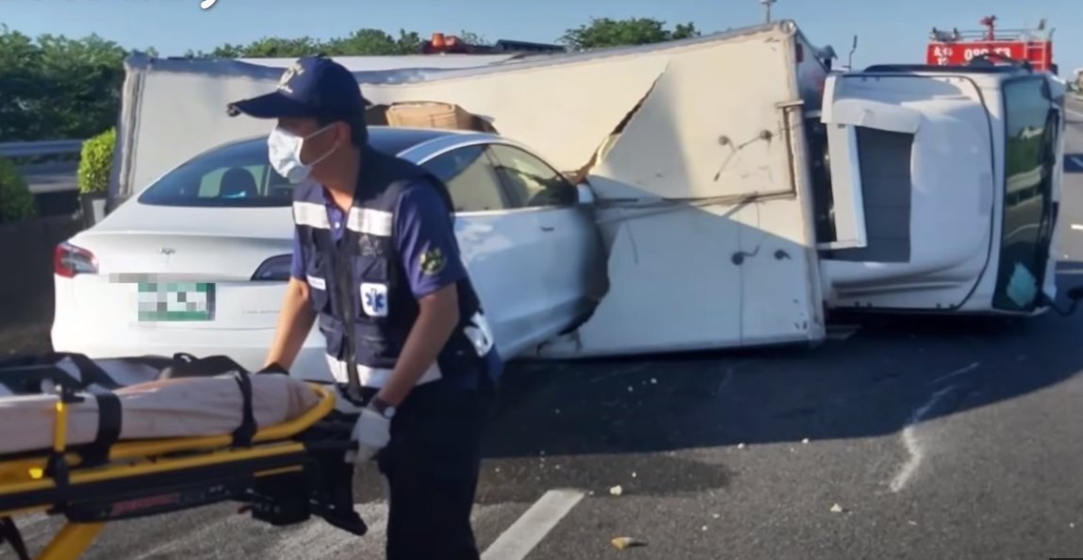
SDV: stack of technologies
SDV = Self-driving vehicle
SDV is one of the most theoretically and practically hard task that can be done using ML/DL
Safety is very critical

Slide 3
SDV: stack of technologies
Sensors
Input
HD-Map
Detection
Perception
Main SW parts are so-called P³:
Perception, Prediction and Planning
HW parts:
Input: Sensors
Output: Control (steering, acceleration)
High-Definition Map as the helper
HD-Map contains info about the road
Tracking
Prediction: other
Prediction
Planning: ego
Planning
Steering
Control
Acc
http://www.allaboutselfdriving.com

Slide 4
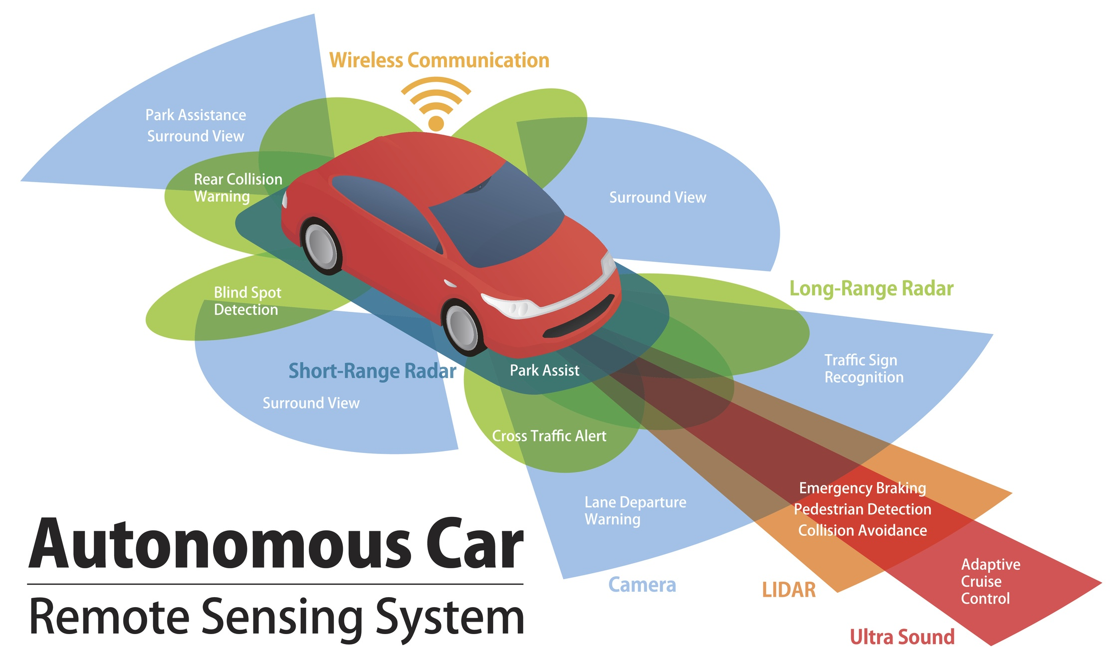
SDV: sensors
Sensors
Input
HD-Map
A bunch of sensors is used:
LIDAR
Radar
Ultra Sound
Cameras (x N)
Expensive
Hard to synchronize
Detection
Perception
Tracking
Prediction: other
Prediction
Planning: ego
Planning
Steering
Control
Acc

Slide 5
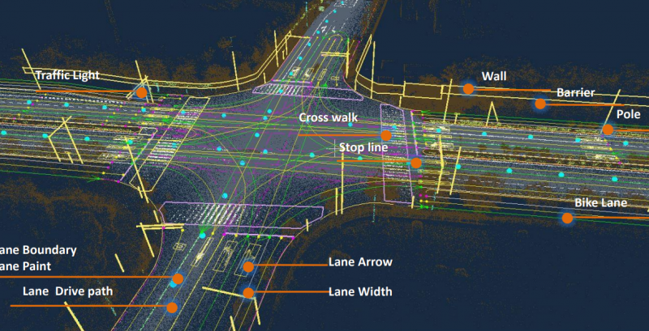
SDV: maps
Sensors
Input
HD-Map
Very helpful for prediction and planning
Contains info about road e.g. road lanes, crosswalks, traffic lights etc
Every company has its own format
Detection
Perception
Tracking
Prediction: other
Prediction
Planning: ego
Planning
Steering
Control
Acc

Slide 6
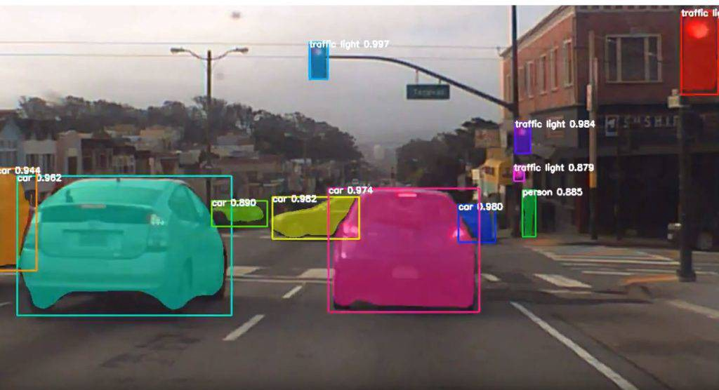
SDV: detection
Sensors
Input
HD-Map
First step of Perception part:
To detect the objects around
Detection
Perception
Tracking
Prediction: other
Prediction
Planning: ego
Planning
Steering
Control
Acc

Slide 7
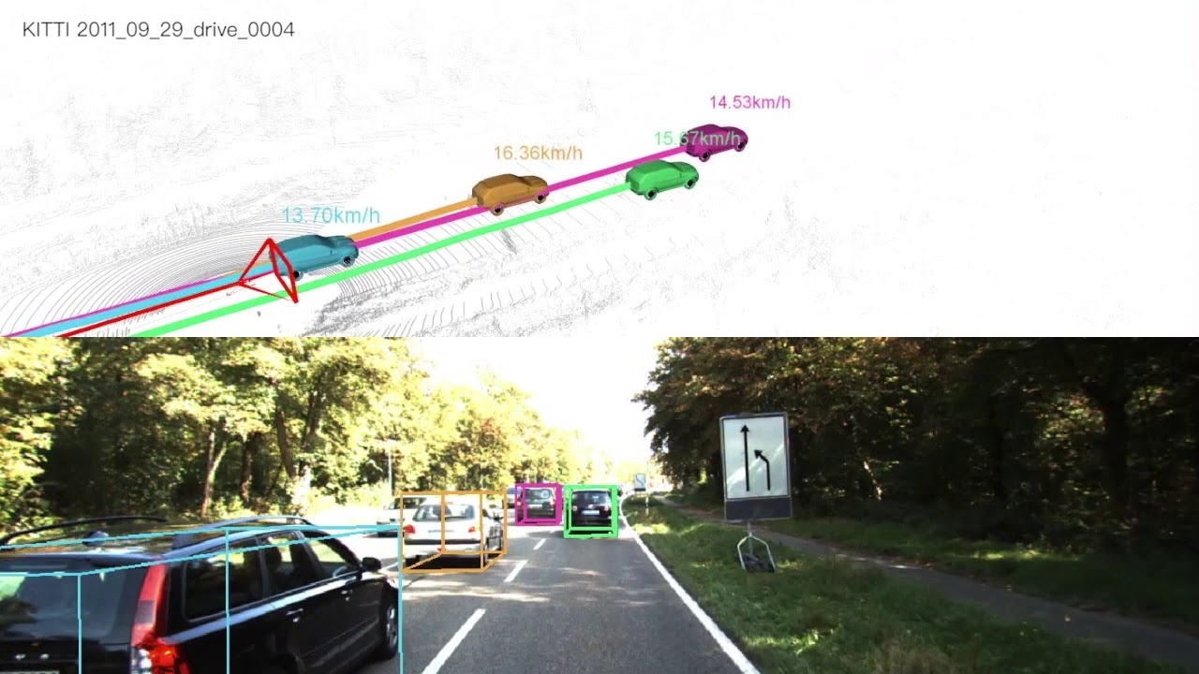
SDV: tracking
Sensors
Input
HD-Map
Second step of Perception part:
To track the detected objects and provide the coordinates for the Prediction part
Detection
Perception
Tracking
Prediction: other
Prediction
Planning: ego
Planning
Steering
Control
Acc

Slide 8
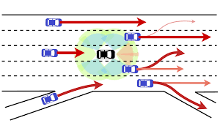
SDV: Prediction
Sensors
Input
HD-Map
Need to do, based on the tracking history, the forecast (usually 1-10 seconds) of all the objects positions around
Detection
Perception
Tracking
Prediction: other
Prediction
Planning: ego
Planning
Steering
Control
Acc

Slide 9
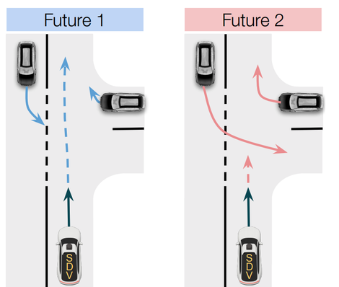
SDV: Planning
Sensors
Input
HD-Map
Need to do, based on the predicted environment, the motion plan for SDV itself
Detection
Perception
Tracking
Prediction: other
Prediction
Planning: ego
Planning
Steering
Control
Acc

Slide 10
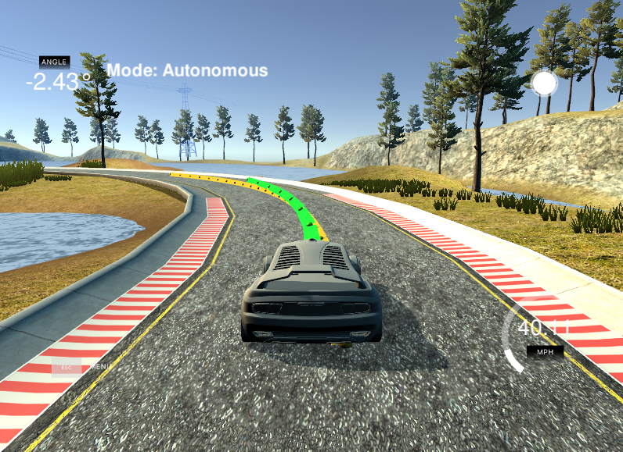
SDV: Control
Sensors
Input
HD-Map
Based on motion plan, control steering mechanism and acceleration
Detection
Perception
Tracking
Prediction: other
Prediction
Planning: ego
Planning
Steering
Control
Acc

Slide 11
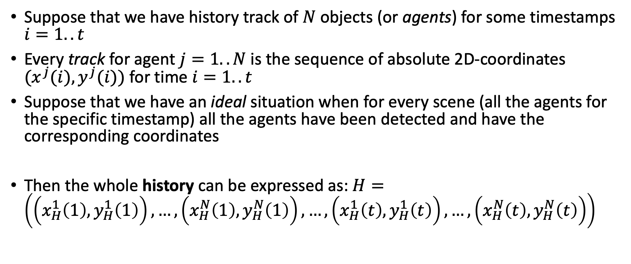
Prediction: definitions
Suppose that we have history track of $N$ objects (or agents) for some timestamps $i=1..t$
Every track for agent $j=1..N$ is the sequence of absolute 2D-coordinates $(x^{j}(i),y^{j}(i))$ for time $i=1..t$
Suppose that we have an ideal situation when for every scene (all the agents for the specific timestamp) all the agents have been detected and have the corresponding coordinates
Then the whole history can be expressed as: $H=\left(\left(x_{H}^{1}\left(1\right), y_{H}^{1}\left(1\right)\right), …,\left(x_{H}^{N}\left(1\right), y_{H}^{N}\left(1\right)\right),…,\left(x_{H}^{1}\left(t\right), y_{H}^{1}\left(t\right)\right), …,\left(x_{H}^{N}\left(t\right), y_{H}^{N}\left(t\right)\right)\right)$

Slide 12
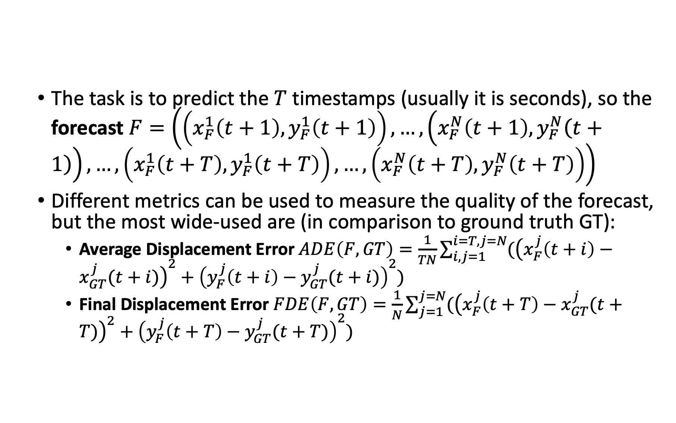
Prediction: task
The task is to predict the $T$ timestamps (usually it is seconds), so the forecast $F=\left(\left(x_{F}^{1}\left(t+1\right), y_{F}^{1}\left(t+1\right)\right), …,\left(x_{F}^{N}\left(t+1\right), y_{F}^{N}\left(t+1\right)\right),…,\left(x_{F}^{1}\left(t+T\right), y_{F}^{1}\left(t+T\right)\right), …,\left(x_{F}^{N}\left(t+T\right), y_{F}^{N}\left(t+T\right)\right)\right)$
Different metrics can be used to measure the quality of the forecast, but the most wide-used are (in comparison to ground truth GT):
Average Displacement Error $ADE\left(F,GT\right)=\frac{1}{TN}\sum_{i,j=1}^{i=T,j=N}{({\left(x_{F}^{j}\left(t+i\right)−x_{GT}^{j}(t+i)\right)}^{2}+{\left(y_{F}^{j}\left(t+i\right)−y_{GT}^{j}(t+i)\right)}^{2})}$
Final Displacement Error $FDE\left(F,GT\right)=\frac{1}{N}\sum_{j=1}^{j=N}{({\left(x_{F}^{j}\left(t+T\right)−x_{GT}^{j}(t+T)\right)}^{2}+{\left(y_{F}^{j}\left(t+T\right)−y_{GT}^{j}(t+T)\right)}^{2})}$

