Slide 1



Trajectory Prediction
By Petyushko Alexander, Komkov Stepan

Slide 2
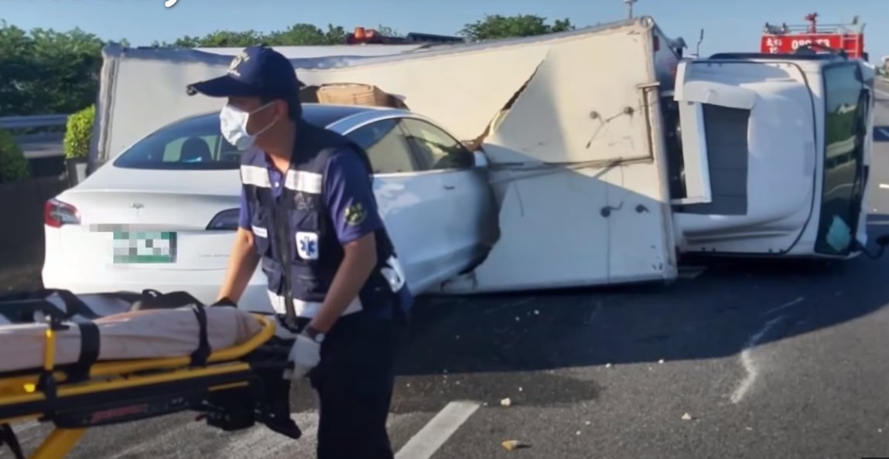
SDV: Stack of technologies
SDV = Self-Driving Vehicle
SDV is one of the most complex tasks theoretically and practically
Safety is crucial

Slide 3
SDV: Stack of technologies
Sensors
Input
HD-Map
Detection
Perception
The main software parts are the so-called P³:
Perception, Prediction and Planning
Hardware parts:
Input: Sensors
Output: Control (steering, acceleration)
High-Definition Map as the helper
HD-Map contains info about the road
Tracking
Prediction: other
Prediction
Planning: ego
Planning
Steering
Control
Acc
http://www.allaboutselfdriving.com

Slide 4
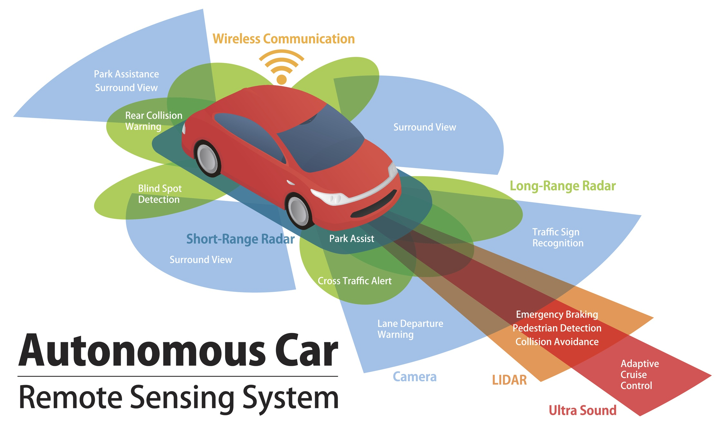
SDV: Sensors
Sensors
Input
HD-Map
Various sensors are used:
LIDAR
Radar
Ultra Sound
Cameras (x N)
Expensive
Hard to synchronize
Detection
Perception
Tracking
Prediction: other
Prediction
Planning: ego
Planning
Steering
Control
Acc

Slide 5
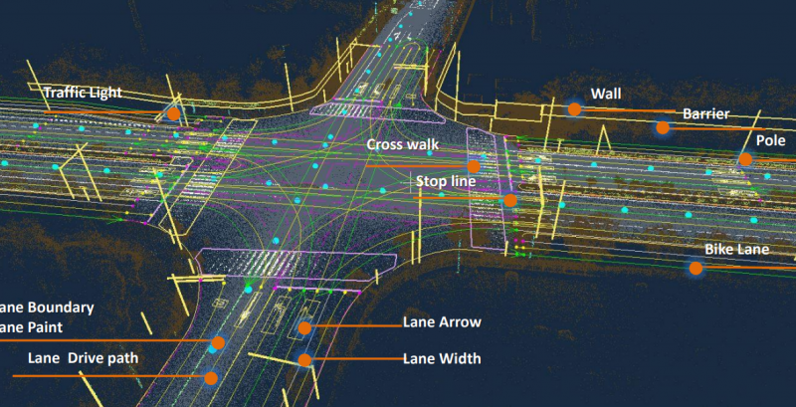
SDV: HD-Map
Sensors
Input
HD-Map
Helpful for prediction and planning
Contains information about road:
Lanes, crosswalks, traffic lights, etc.
Every company has its own format
Detection
Perception
Tracking
Prediction: other
Prediction
Planning: ego
Planning
Steering
Control
Acc

Slide 6
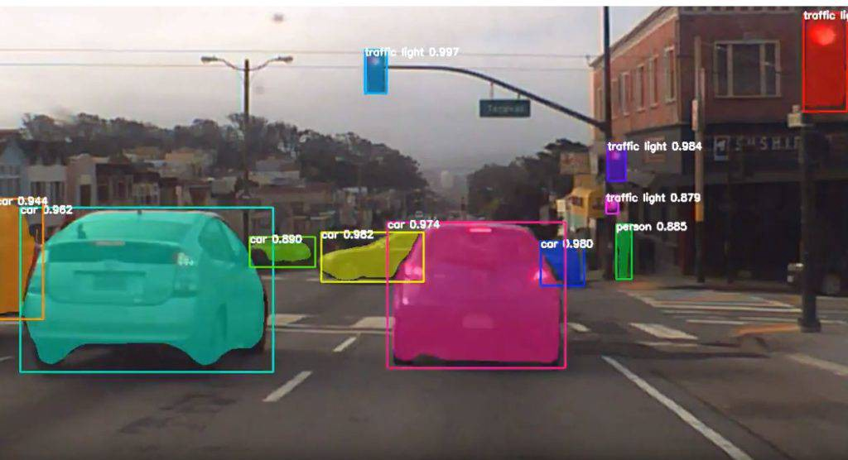
SDV: Detection
Sensors
Input
HD-Map
The first step of the Perception part:
Detection (segmentation, depth-estimation, etc.) of the objects around
Detection
Perception
Tracking
Prediction: other
Prediction
Planning: ego
Planning
Steering
Control
Acc

Slide 7
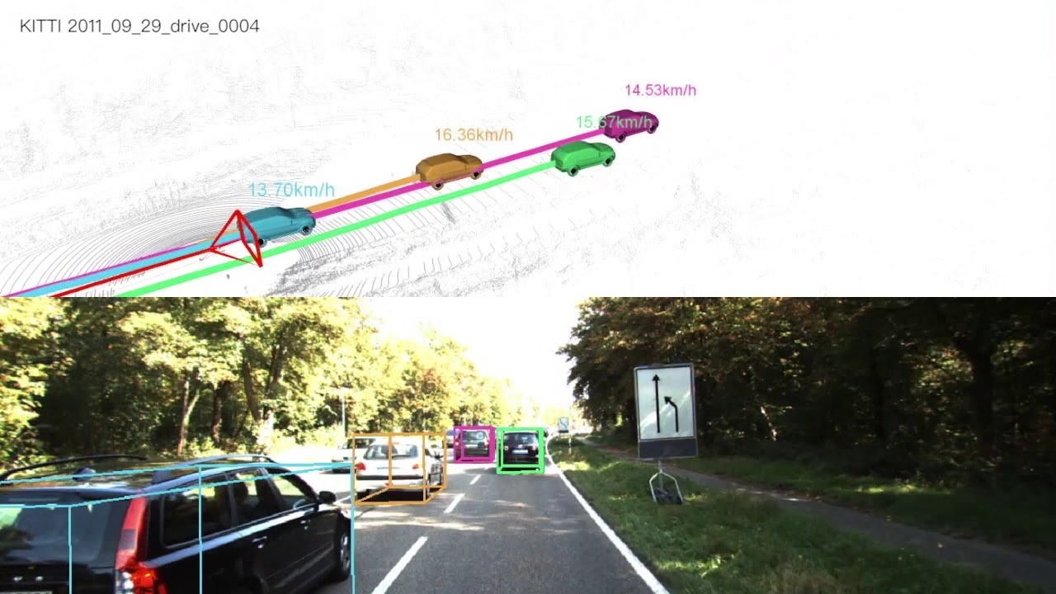
SDV: Tracking
Sensors
Input
HD-Map
The second step of the Perception part:
Tracking of the detected objects and estimation of their coordinates for the Prediction part
Detection
Perception
Tracking
Prediction: other
Prediction
Planning: ego
Planning
Steering
Control
Acc

Slide 8
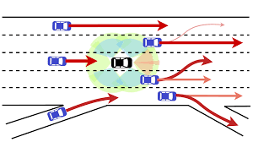
SDV: Prediction
Sensors
Input
HD-Map
Future trajectories prediction of all surrounding objects based on the tracking history and HD-Map
Usually, 1-10 second
Detection
Perception
Tracking
Prediction: other
Prediction
Planning: ego
Planning
Steering
Control
Acc

Slide 9
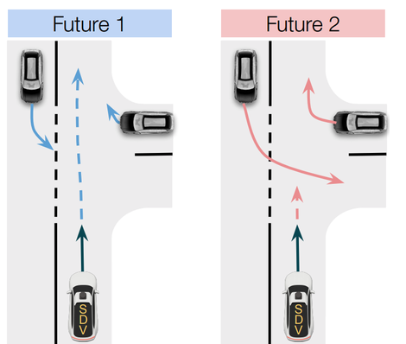
SDV: Planning
Sensors
Input
HD-Map
Planning of SDV future actions based on the predictions and HD-Map
Detection
Perception
Tracking
Prediction: other
Prediction
Planning: ego
Planning
Steering
Control
Acc

Slide 10
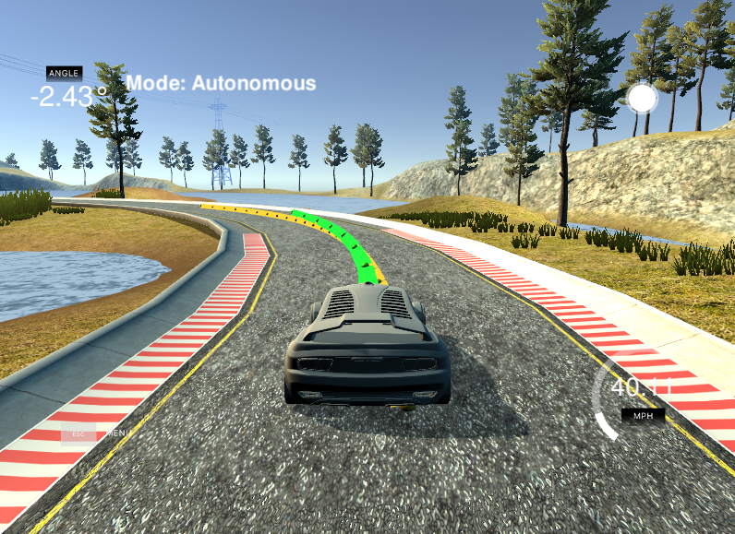
SDV: Control
Sensors
Input
HD-Map
Realization and control of SDV actions based motion plan
Steering control, acceleration control, etc.
Detection
Perception
Tracking
Prediction: other
Prediction
Planning: ego
Planning
Steering
Control
Acc

Slide 11
Task formulation

Slide 12
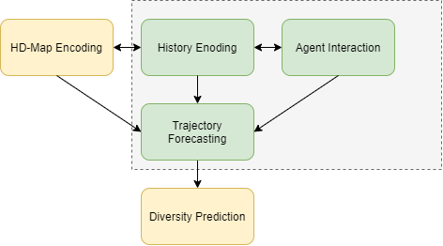
More about Prediction
Sensors
Input
HD-Map
Usually, consists of 5 blocks
We are going to concentrate on 3 basic blocks
Detection
Perception
Tracking
Prediction: other
Prediction
Planning: ego
Planning
Steering
Control
Acc

Slide 13
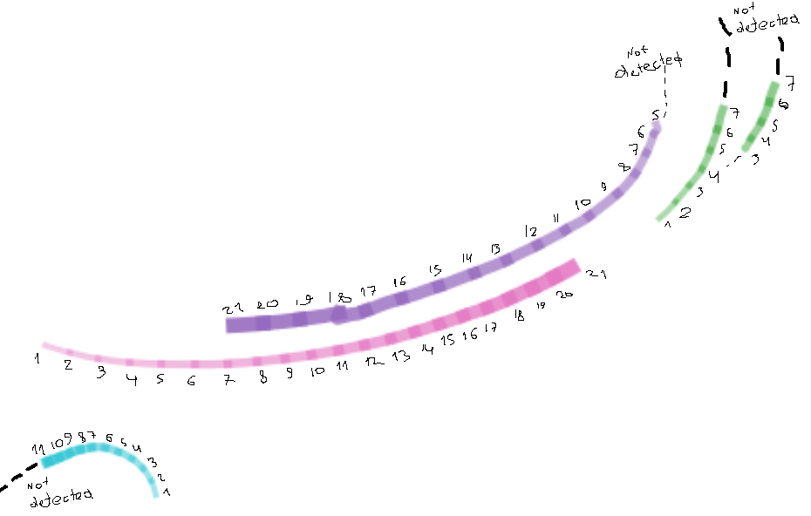




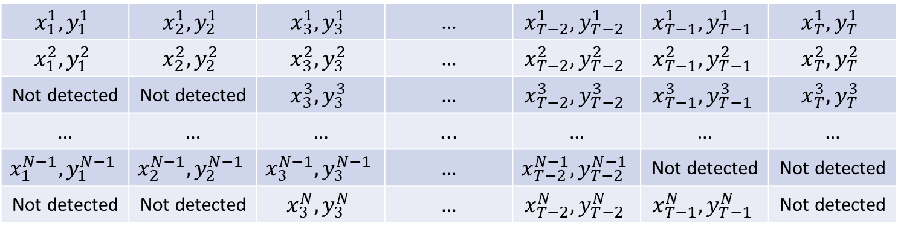


What we have
Set of observed coordinates for each agent in the scene for the last $T$ timestamps
Agent 1
$$x_{1}^{1},y_{1}^{1}$$ | $$x_{2}^{1},y_{2}^{1}$$ | $$x_{3}^{1},y_{3}^{1}$$ | … | $$x_{T−2}^{1},y_{T−2}^{1}$$ | $$x_{T−1}^{1},y_{T−1}^{1}$$ | $$x_{T}^{1},y_{T}^{1}$$
$$x_{1}^{2},y_{1}^{2}$$ | $$x_{2}^{2},y_{2}^{2}$$ | $$x_{3}^{2},y_{3}^{2}$$ | … | $$x_{T−2}^{2},y_{T−2}^{2}$$ | $$x_{T−1}^{2},y_{T−1}^{2}$$ | $$x_{T}^{2},y_{T}^{2}$$
Not detected | Not detected | $$x_{3}^{3},y_{3}^{3}$$ | … | $$x_{T−2}^{3},y_{T−2}^{3}$$ | $$x_{T−1}^{3},y_{T−1}^{3}$$ | $$x_{T}^{3},y_{T}^{3}$$
… | … | … | ... | … | … | …
$$x_{1}^{N−1},y_{1}^{N−1}$$ | $$x_{2}^{N−1},y_{2}^{N−1}$$ | $$x_{3}^{N−1},y_{3}^{N−1}$$ | … | $$x_{T−2}^{N−1},y_{T−2}^{N−1}$$ | Not detected | Not detected
Not detected | Not detected | $$x_{3}^{N},y_{3}^{N}$$ | … | $$x_{T−2}^{N},y_{T−2}^{N}$$ | $$x_{T−1}^{N},y_{T−1}^{N}$$ | Not detected
Agent 2
Agent 3
Agent $N$-1
Agent $N$
Timestamp 1
Timestamp 2
Timestamp 3
Timestamp $T$-2
Timestamp $T$-1
Timestamp $T$
Available history of agents positions

Slide 14

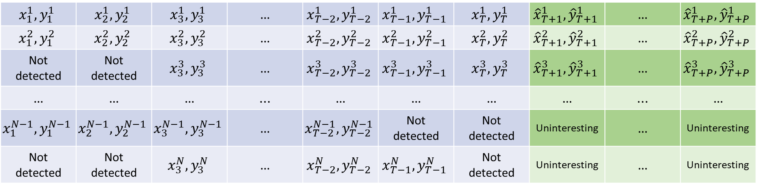
What we need
We need to predict the next $P$ positions for the predefined set of agents
$$x_{1}^{1},y_{1}^{1}$$ | $$x_{2}^{1},y_{2}^{1}$$ | $$x_{3}^{1},y_{3}^{1}$$ | … | $$x_{T−2}^{1},y_{T−2}^{1}$$ | $$x_{T−1}^{1},y_{T−1}^{1}$$ | $$x_{T}^{1},y_{T}^{1}$$ | $${\hat{x}}_{T+1}^{1},{\hat{y}}_{T+1}^{1}$$ | … | $${\hat{x}}_{T+P}^{1},{\hat{y}}_{T+P}^{1}$$
$$x_{1}^{2},y_{1}^{2}$$ | $$x_{2}^{2},y_{2}^{2}$$ | $$x_{3}^{2},y_{3}^{2}$$ | … | $$x_{T−2}^{2},y_{T−2}^{2}$$ | $$x_{T−1}^{2},y_{T−1}^{2}$$ | $$x_{T}^{2},y_{T}^{2}$$ | $${\hat{x}}_{T+1}^{2},{\hat{y}}_{T+1}^{2}$$ | … | $${\hat{x}}_{T+P}^{2},{\hat{y}}_{T+P}^{2}$$
Not detected | Not detected | $$x_{3}^{3},y_{3}^{3}$$ | … | $$x_{T−2}^{3},y_{T−2}^{3}$$ | $$x_{T−1}^{3},y_{T−1}^{3}$$ | $$x_{T}^{3},y_{T}^{3}$$ | $${\hat{x}}_{T+1}^{3},{\hat{y}}_{T+1}^{3}$$ | … | $${\hat{x}}_{T+P}^{3},{\hat{y}}_{T+P}^{3}$$
… | … | … | ... | … | … | … | … | ... | …
$$x_{1}^{N−1},y_{1}^{N−1}$$ | $$x_{2}^{N−1},y_{2}^{N−1}$$ | $$x_{3}^{N−1},y_{3}^{N−1}$$ | … | $$x_{T−2}^{N−1},y_{T−2}^{N−1}$$ | Not detected | Not detected | Uninteresting | … | Uninteresting
Not detected | Not detected | $$x_{3}^{N},y_{3}^{N}$$ | … | $$x_{T−2}^{N},y_{T−2}^{N}$$ | $$x_{T−1}^{N},y_{T−1}^{N}$$ | Not detected | Uninteresting | … | Uninteresting
Available history of agents positions
Positions that are needed to be predicted

Slide 15
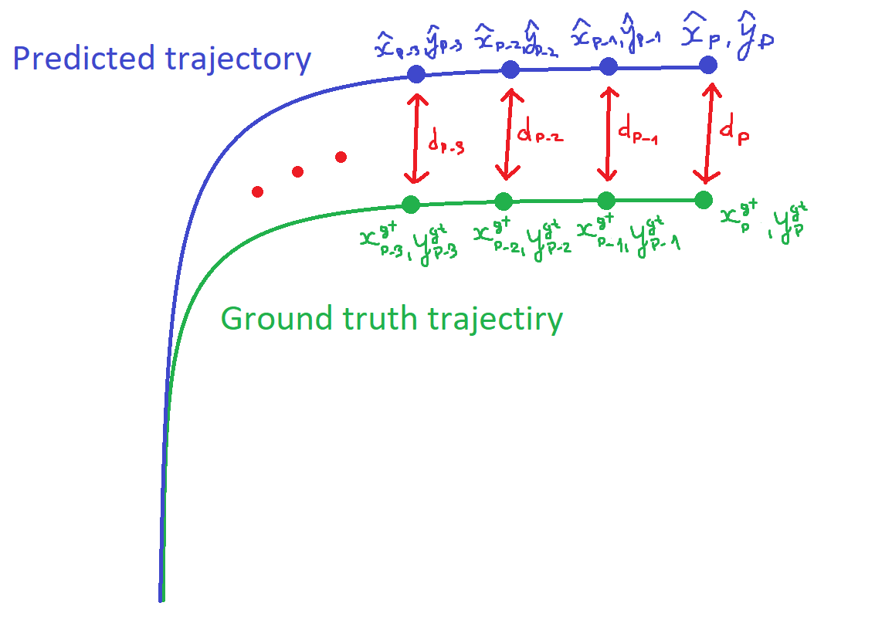
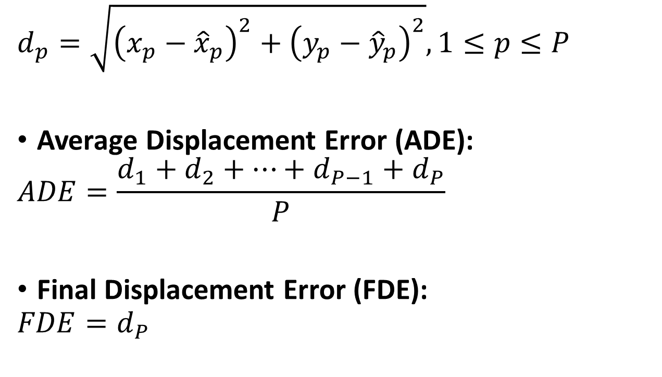
How to measure
$$d_{p}=\sqrt{{\left(x_{p}−{\hat{x}}_{p}\right)}^{2}+{\left(y_{p}−{\hat{y}}_{p}\right)}^{2}}, 1≤p≤P$$
Average Displacement Error (ADE):
$$ADE=\frac{d_{1}+d_{2}+…+d_{P−1}+d_{P}}{P}$$
Final Displacement Error (FDE):
$$FDE=d_{P}$$

Slide 16
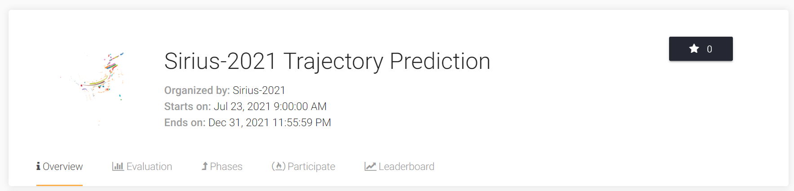
How it will be
Automatic system to evaluate your solutions on the subset of the test set
https://eval.ai/web/challenges/challenge-page/1194/phases
The final results will be ranked based on the full test results

Slide 17
Task benefits
Data is simple enough to process on an ordinary laptop
The whole dataset takes less than 7 Gbyte
GPU is helpful but not necessary
Despite the small scale of data, the task formulation is close to the real product tasks
Findings for this challenge may be beneficial for the state-of-the-art solutions
Trajectory Prediction solution consists of several blocks
Scene preprocessing, history encoder, agents interaction, trajectory forecaster, loss function, etc.
So, there are a wealth of ways to improve baseline solutions

Slide 18

Contacts
Stepan Komkov
Until the July 31st
Alexander Petyushko
From the July 29th
Chat of the challenge
https://t.me/joinchat/Km7p_wYqHcU3MGFi
News of the challenge
https://t.me/joinchat/GewH2zFxBpYyZGRi

