Slide 1
20191105 PRESENTATION
Spatio-Temporal Attentive RNN
(STAR)
Xu D, et al. Spatio-Temporal Attentive RNN for Node Classification in Temporal Attributed Graphs[C]//Proceedings of IJCAI, 2019

Slide 2
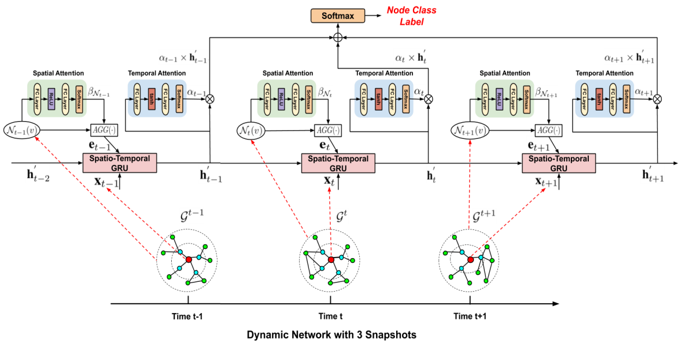
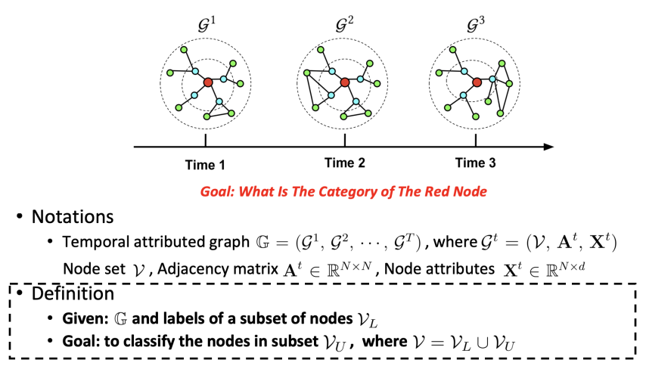
Spatio-Temporal Attentive RNN for Node Classification in Temporal Attributed Graphs
Motivation
Node classiﬁcation in graph-structured data aims to classify the nodes where the labels are only available for a subset of nodes. In real world applications, both graph topology and node attri-butes evolve over time. Existing approaches, however, mainly focus on static graphs and lack the capability to simultaneously learn both temporal and spatial/structural features. Besides, as temporal and spatial dimensions are entangled, to learn the fea-ture representation of one target node, it’s desirable and chall-enging to differentiate the relative importance of different fac-tors.
Model Architecture
Problem
1

Slide 3
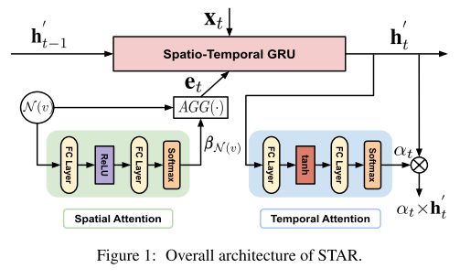
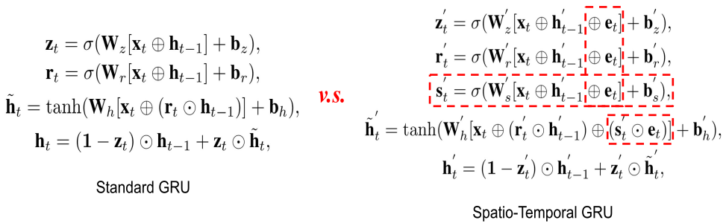
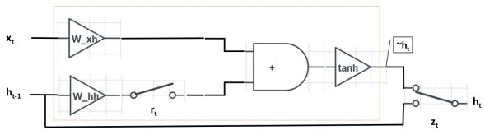
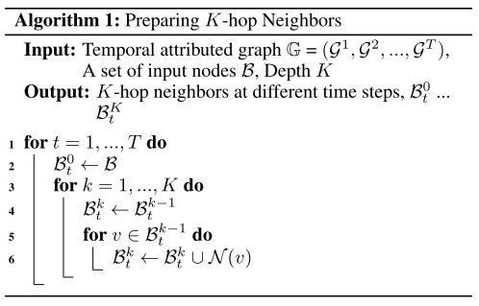
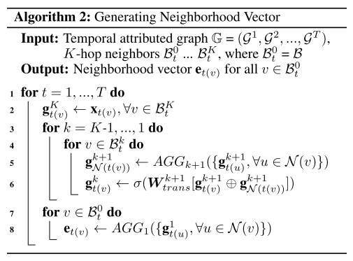











Spatio-Temporal Attentive RNN for Node Classification in Temporal Attributed Graphs
Spatio-Temporal GRU
w\
$$W_{z}$$
Vector Representation of Neighborhood
w\
$$W_{r}$$
w\
$${W′}_{z}$$
$$s_{t}^{′}$$
Spatial Attention
$$e_{t}$$
w\
$${W′}_{s}$$
w\
$$h_{t−1}^{′}$$
$${W′}_{r}$$
$$h_{t}^{′}$$
$$r_{t}^{′}$$
$$z_{t}^{′}$$
2

Slide 4

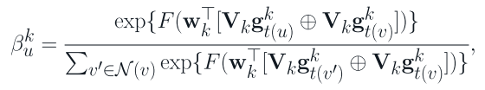









Spatio-Temporal Attentive RNN for Node Classification in Temporal Attributed Graphs
Dual Attention Mechanism - Spatial Attention
Spatial Attention
Dual Attention Mechanism - Temporal Attention
Objective Function
3

Slide 5
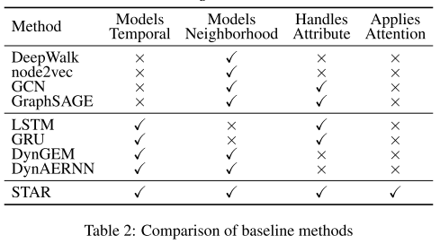
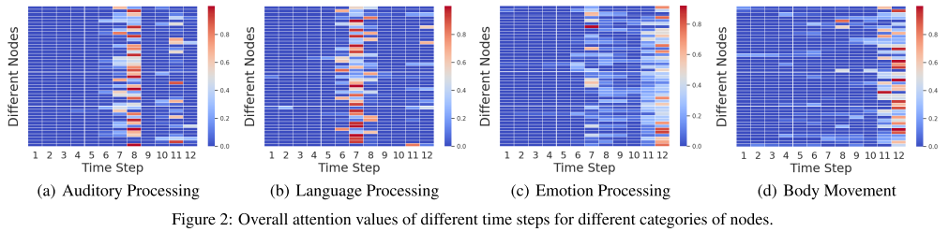
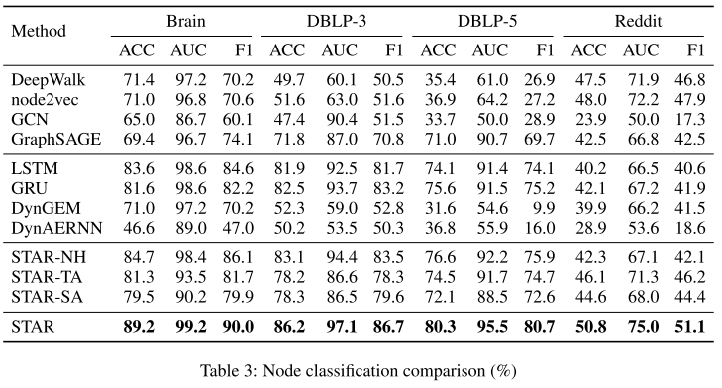
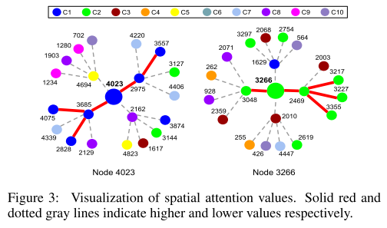
Spatio-Temporal Attentive RNN for Node Classification in Temporal Attributed Graphs
Experimental Results

Slide 6
Thanks.

