Slide 1
20200703 PRESENTATION
An Attention-based Graph Neural Network for
Heterogeneous Structural Learning

Slide 2
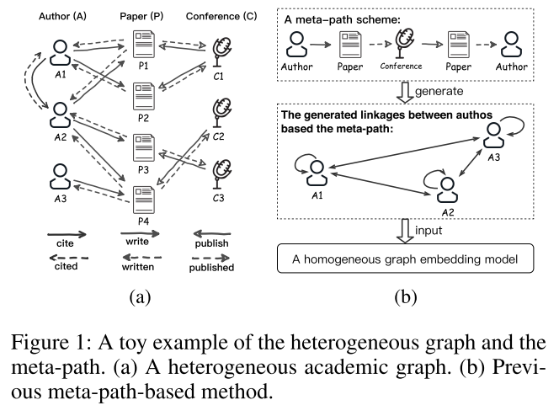
An Attention-based Graph Neural Network for Heterogeneous Structural Learning
Motivations
The real-world data tends to be presented as a heterogeneous graph
HIN combines different aspects of information together and contains rich senses to data mining.
C1: how to model the entity space of multiple types of nodes?
C2: how to preserve the semantic of different relationships between nodes?
Meta-path schemes suffer two predominant problems: (1) Meta-path relies on experts. (2) Information is lost in the process of generating meta-path based node pairs.
Contributions
Propose Heterogeneous Graph Structural Attention Neural Network (HetSANN).
Discuss three extensions of HetSANN: (E1) Multi-task learning. (E2) Voices-sharing product. (E3) Cycle-consistency Loss.
Full contrast experiments and ablation studys on three heterogeneous graph datasets.

Slide 3
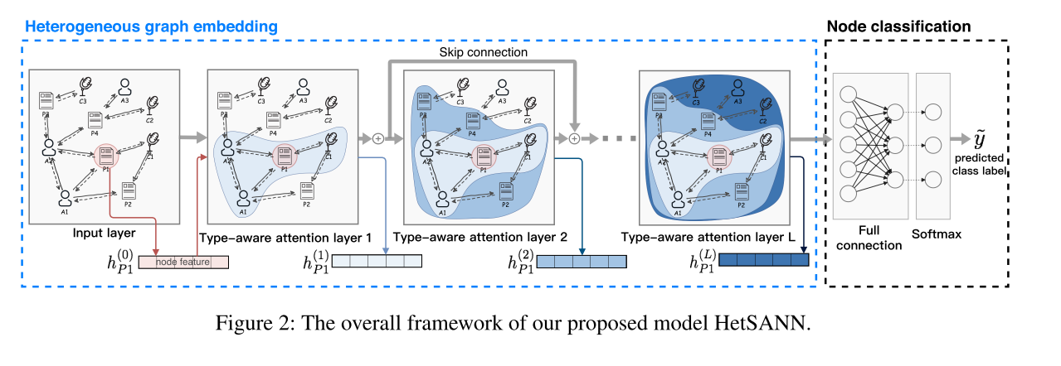
An Attention-based Graph Neural Network for Heterogeneous Structural Learning
2 Heterogeneous Graph Structural Attention Neural Network (HetSANN)

Slide 4





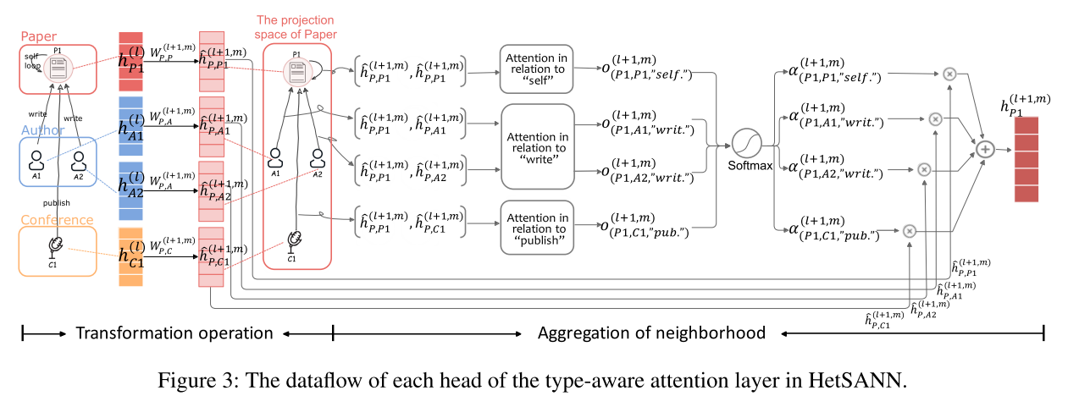


An Attention-based Graph Neural Network for Heterogeneous Structural Learning
2 Heterogeneous Graph Structural Attention Neural Network (HetSANN)
Concatenate the vectors of M attention heads
Skip Connection

Slide 5
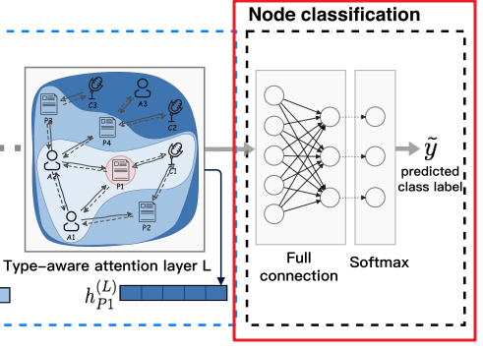
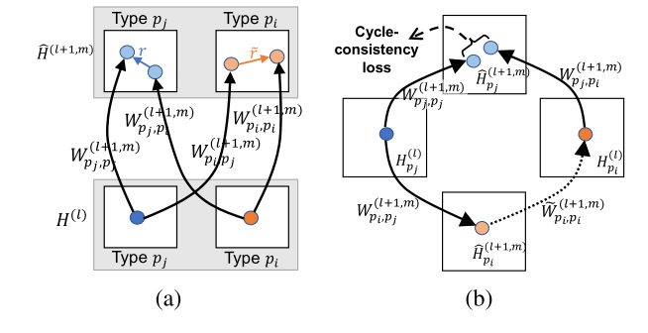




An Attention-based Graph Neural Network for Heterogeneous Structural Learning
2.2 Model Training and Three Extensions
E1: Multi-task Learning
A node classifier：
Several node classiﬁers
Parameters sharing
Reduces the risk of overﬁtting
E2: Voice-sharing Product
2.1(3)

Slide 6

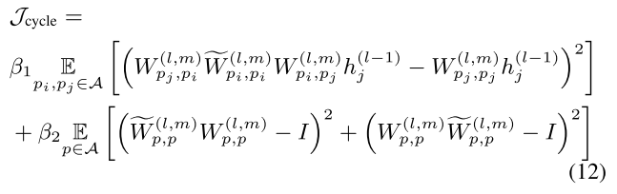

An Attention-based Graph Neural Network for Heterogeneous Structural Learning
2.2 Model Training and Three Extensions
E3: Cycle-consistency Loss
Background：“back-translation”
cycle-consistency loss:
Final loss:
2.1(1)
Inversion is notorious
time-consuming problem.

Slide 7
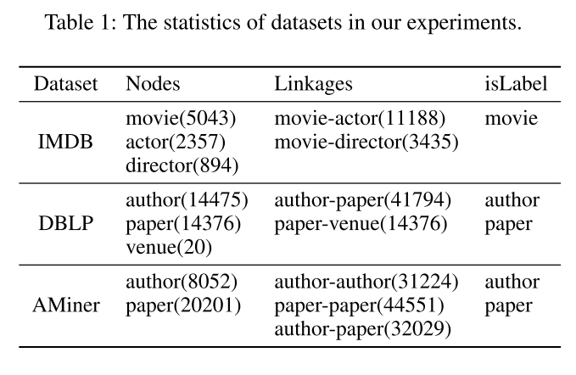
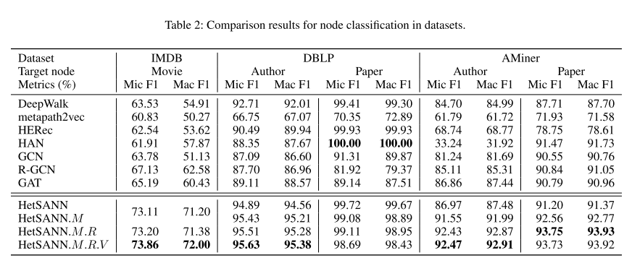
An Attention-based Graph Neural Network for Heterogeneous Structural Learning
3 Experiments
Dataset
Comparison results
7

Slide 8
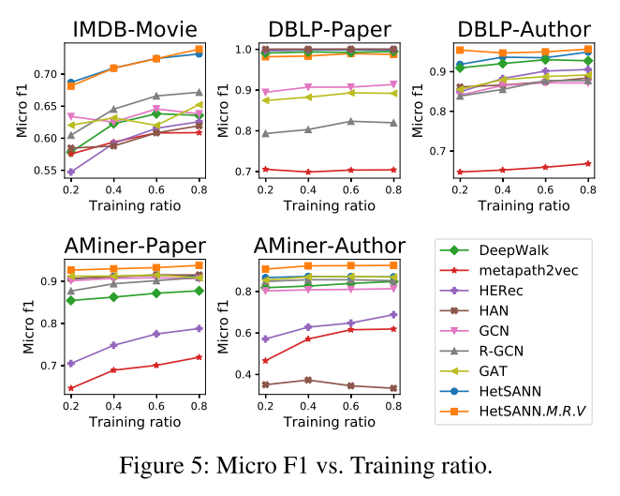
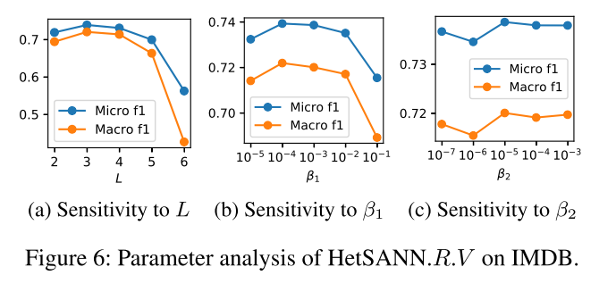
An Attention-based Graph Neural Network for Heterogeneous Structural Learning
3 Experiments
Varying the value of training ratio
Parameter analysis

Slide 9
Thanks.

