Slide 1
20200807 PRESENTATION
Cluster-GCN: An Efficient Algorithm for Training Deep and Large Graph Convolutional Networks

Slide 2
Cluster-GCN: An Efficient Algorithm for Training Deep and Large Graph Convolutional Networks
Motivations
Training loss：Tradition convolution (individual terms) : Graph convolution (node dependence)
The efficiency of a mini-batch algorithm can be characterized by the notion of “embedding utilization”
Methods | Characteristic | Memory | Time / epoch | Convergence speed / epoch
GCN | Full-batch gradient descent | × | √ | ×
GraphSAGE / FastGCN | Mini-batch SGD Neighborhood sampling | √ | × | √
VR-GCN | Neighborhood sampling | × | √ | √
Cluster-GCN | Mini-batch SGD Graph clustering algorithms | √ | √ | √
Contributions
Achieve the best memory usage on large-scale graphs, especially on deep GCN.
A similar training speed with VR-GCN for shallow networks but can be faster than VR-GCN when the network goes deeper.
Cluster-GCN is able to train a very deep network that has a large embedding size. Obtain a new benchmark accuracy 99.36 for PPI dataset, comparing with the highest reported one 98.71.

Slide 3
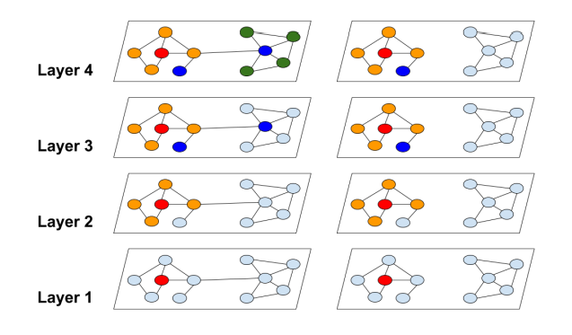


Cluster-GCN: An Efficient Algorithm for Training Deep and Large Graph Convolutional Networks
3 PROPOSED ALGORITHM : The bottleneck of previous training methods

Slide 4


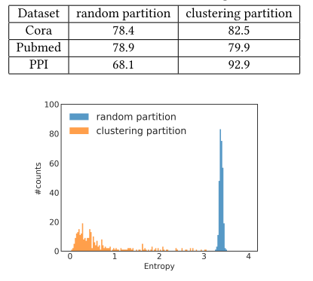

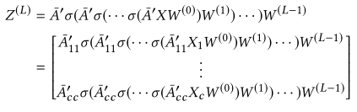


Cluster-GCN: An Efficient Algorithm for Training Deep and Large Graph Convolutional Networks
3.1 Vanilla Cluster-GCN
Metis[8] (An clustering method)
${\overline{A} }^{′}$ denotes the normalized version of $\overline{A}$

Slide 5
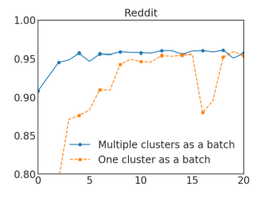
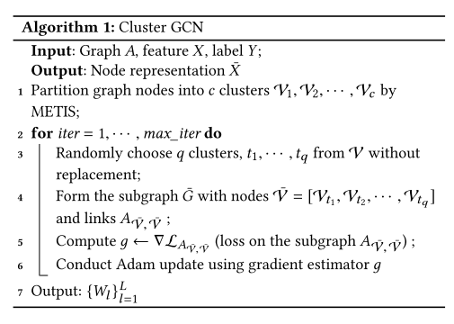
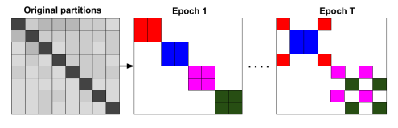



Cluster-GCN: An Efficient Algorithm for Training Deep and Large Graph Convolutional Networks
3.2 Stochastic Multiple Partitions
3.3 Issues of training deeper GCNs
Put more weights on the representation from the previous layer

Slide 6
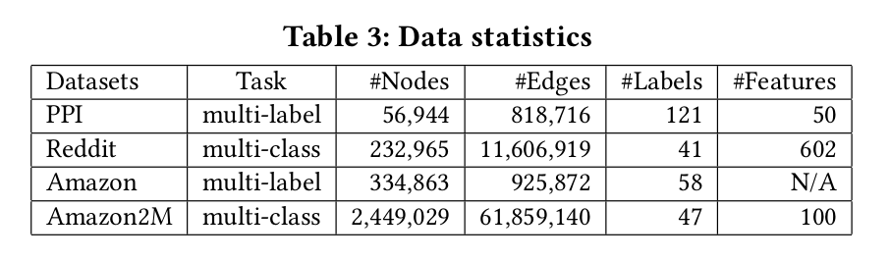
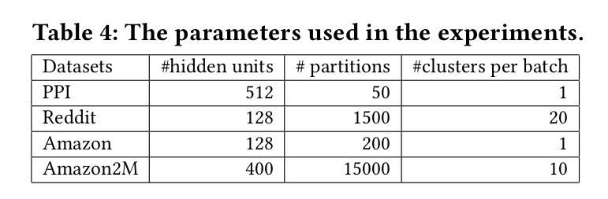
Cluster-GCN: An Efficient Algorithm for Training Deep and Large Graph Convolutional Networks
4 EXPERIMENTS

Slide 7
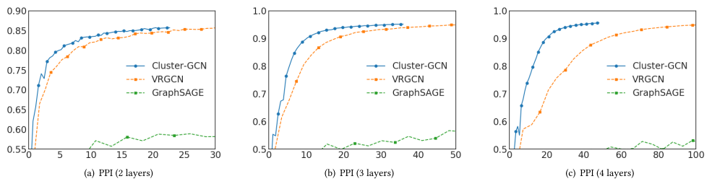
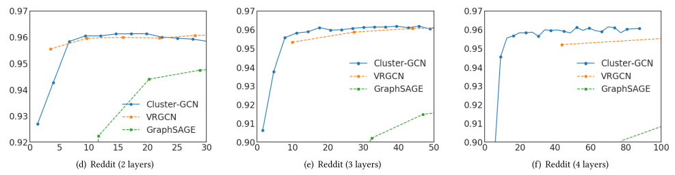
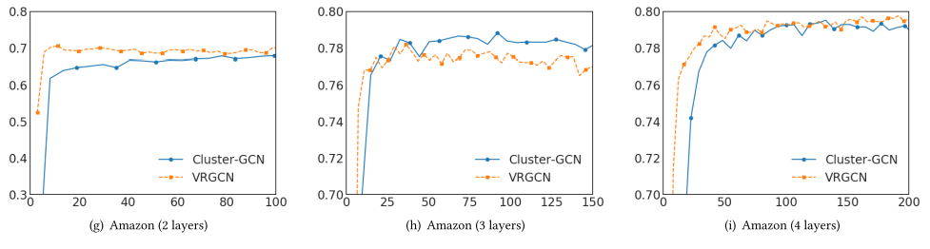
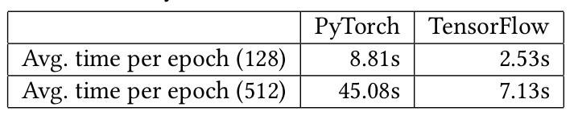
Cluster-GCN: An Efficient Algorithm for Training Deep and Large Graph Convolutional Networks
4 EXPERIMENTS: Training Time vs Accuracy

Slide 8
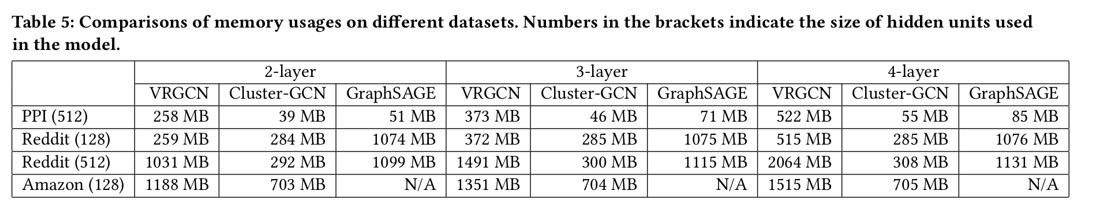
Cluster-GCN: An Efficient Algorithm for Training Deep and Large Graph Convolutional Networks
4 EXPERIMENTS: Memory usage comparison

Slide 9
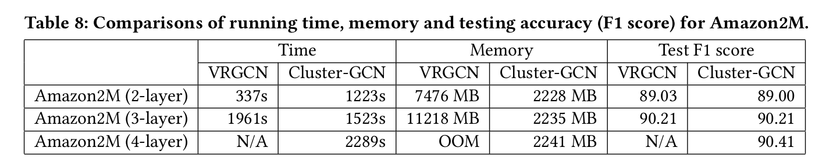
Cluster-GCN: An Efficient Algorithm for Training Deep and Large Graph Convolutional Networks
4 EXPERIMENTS: A new GCN dataset: Amazon2M

Slide 10
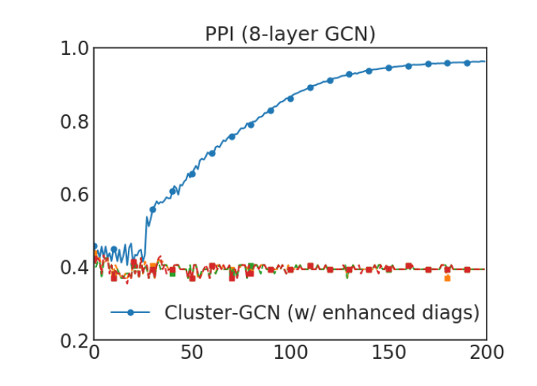
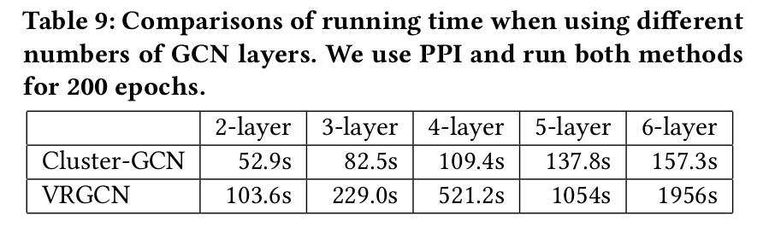
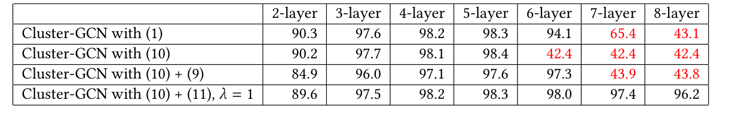
Cluster-GCN: An Efficient Algorithm for Training Deep and Large Graph Convolutional Networks
4 EXPERIMENTS: Training Deeper GCN

Slide 11
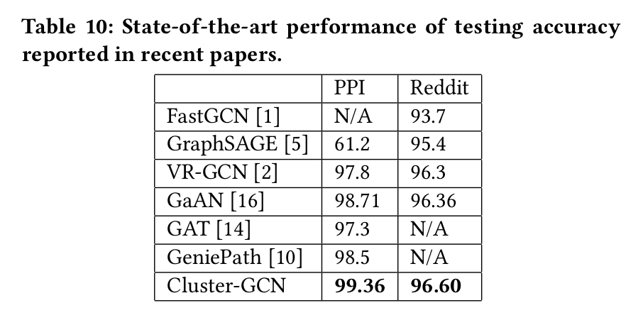
Cluster-GCN: An Efficient Algorithm for Training Deep and Large Graph Convolutional Networks
4 EXPERIMENTS: Training Deeper GCN

Slide 12
Thanks.

