Slide 1
20200522 PRESENTATION
Heterogeneous Graph Transformer

Slide 2
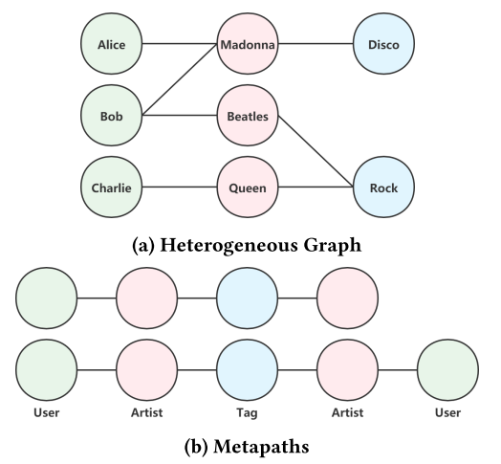
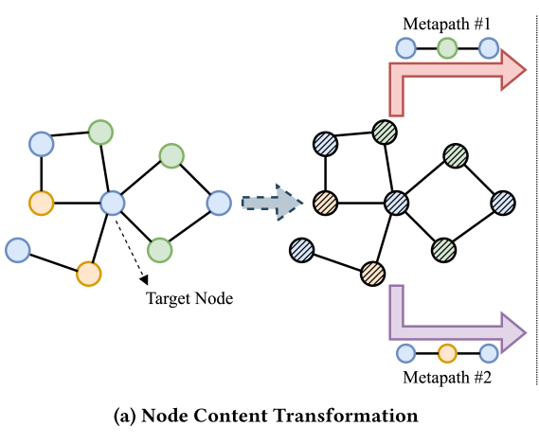
Heterogeneous Graph Transformer
Motivations
An example：MAGNN
the design of meta paths requiring specific domain knowledge;
Different types of nodes/edges share the same feature and representation space or keep distinct non-sharing weights for either node type or edge type alone;
Ignore the dynamic nature;
Incapable of modeling Web-scale heterogeneous graphs.
Contributions
Propose the Heterogeneous Graph Transformer (HGT) architecture to model dynamic Web-scale heterogeneous graphs.
Maintain node- and edge-type dependent representations: meta relation triplet, i.e., <node type of s , edge type of e between s & t , node type of t >
Capturing network dynamics: Relative temporal encoding (RTE) strategy
Being scalable to Web-scale graphs: Design the first heterogeneous sub-graph sampling algorithm—HGSampling—for mini-batch GNN training.
1

Slide 3
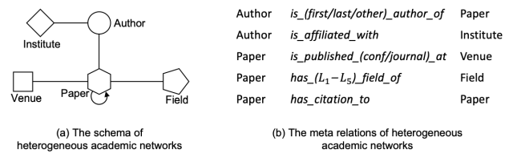

Heterogeneous Graph Transformer
2 PRELIMINARIES
Model dynamic Web-scale heterogeneous graphs.
1. Heterogeneous Graph:
2. Meta Relation:
3. Dynamic Heterogeneous Graph: Timestamp
Plain node: e.g. Venue (WWW@1994, WWW@2020)
Event node: e.g. paper
2

Slide 4
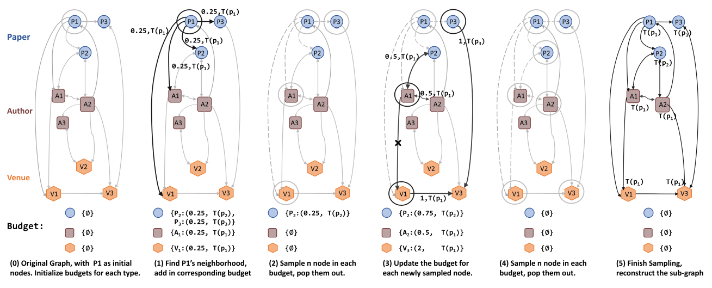


Heterogeneous Graph Transformer
4 WEB-SCALE HGT TRAINING
HGSampling: 1) keep a similar number of nodes and edges for each type; 2) keep the sampled sub-graph dense to minimize the information loss and reduce the sample variance; 3) each node t is assigned with a timestamp T(t).
3

Slide 5
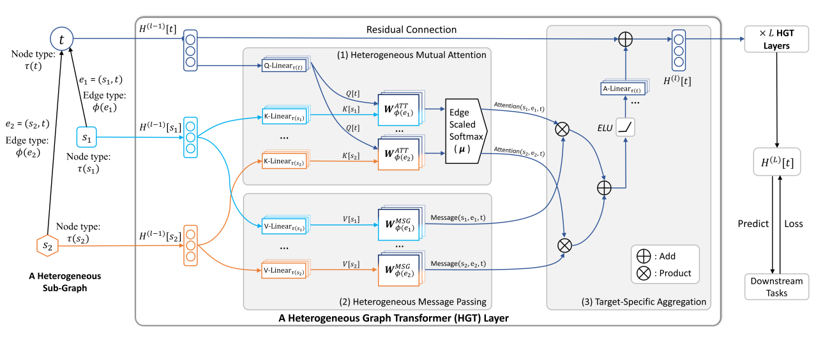
Heterogeneous Graph Transformer
3.1 Overall HGT Architecture
4

Slide 6

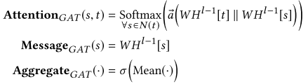
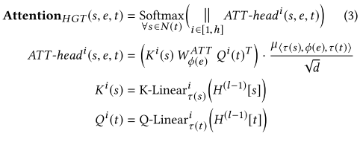




Heterogeneous Graph Transformer
3.1 Overall HGT Architecture
5

Slide 7
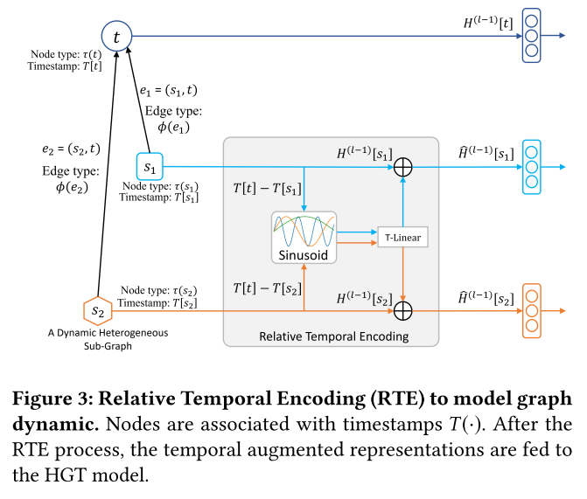
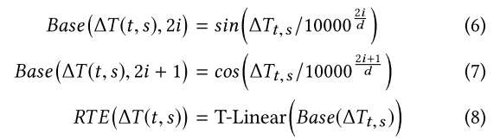
Heterogeneous Graph Transformer
3.5 Relative Temporal Encoding
6

Slide 8
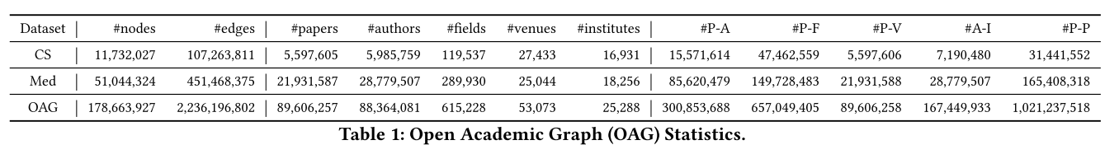
Heterogeneous Graph Transformer
5 EVALUATION
7

Slide 9
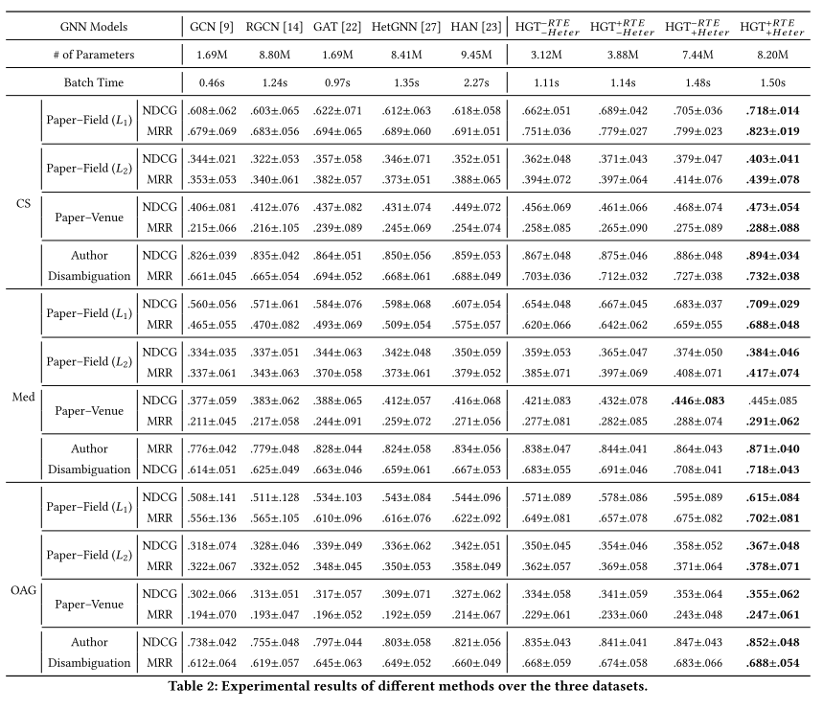
8

Slide 10
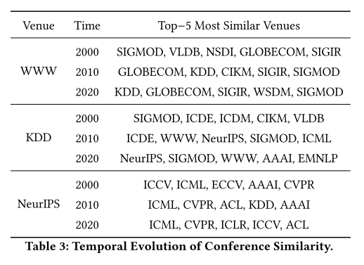
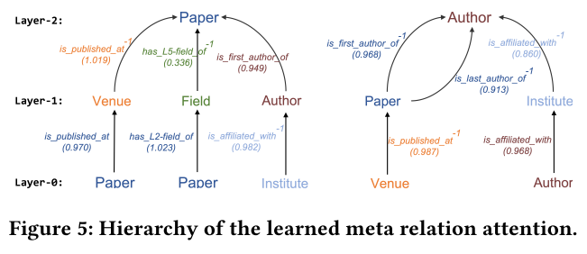
Heterogeneous Graph Transformer
5 EVALUATION
9

Slide 11
Thanks.

