Slide 1
Get To The Point: Summarization with Pointer-Generator Networks
Hu Wenxin

Slide 2
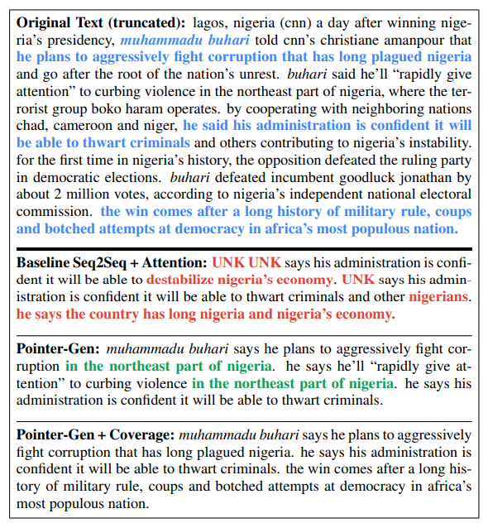
Background of the Question
（1）难以准确复述原文的事实细节、无法处理原文中的未登录词(OOV)
（2）生成的摘要倾向于生成重复的片段

Slide 3
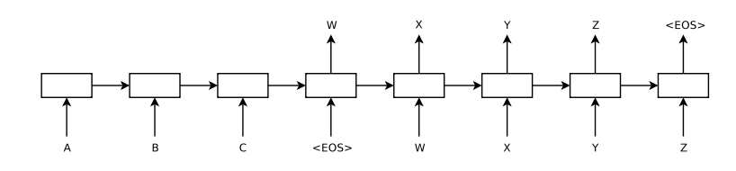
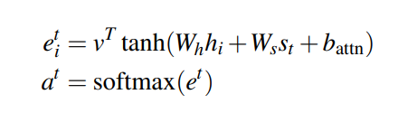

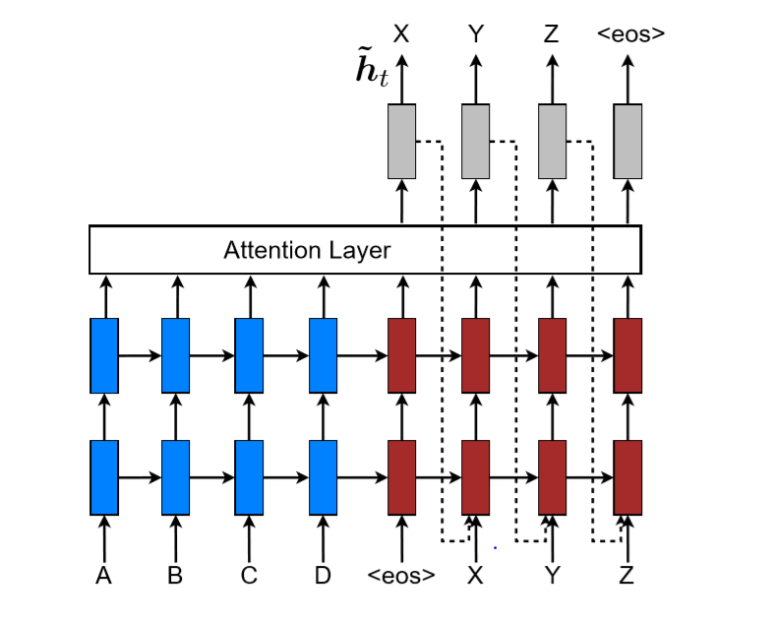




Seq2Seq + Attention

Slide 4
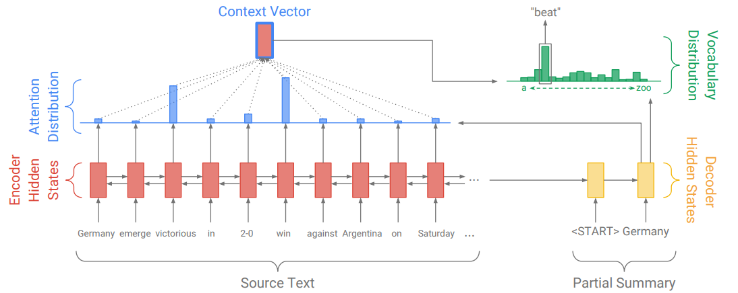

Slide 5
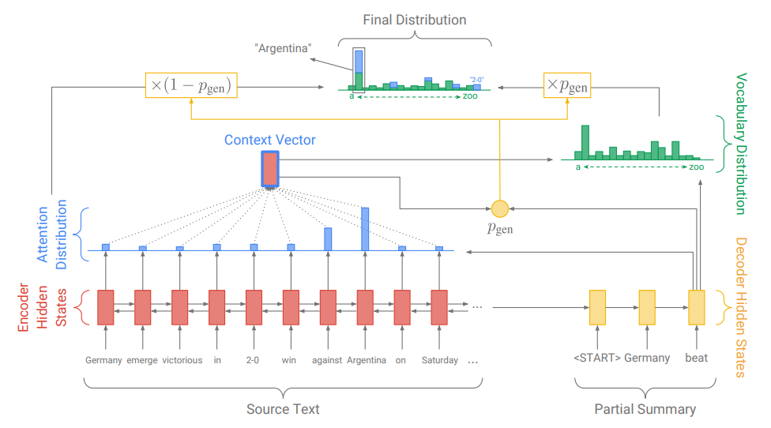


Pointer-generator network

Slide 6

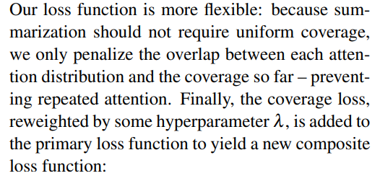



Coverage mechanism
Coverage 机制的理解：
如果该单词生成阶段出现过
则它的c_t 就很大
为了减少loss，需要a_t变小
a_t代表这个位置的注意力概率减小

Slide 7
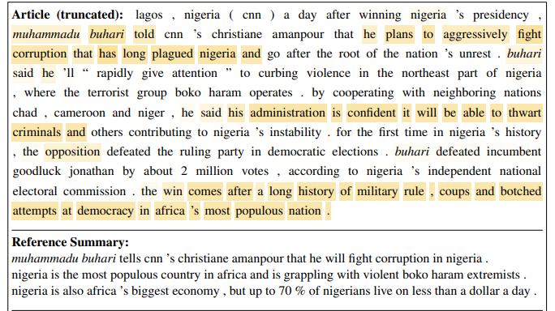
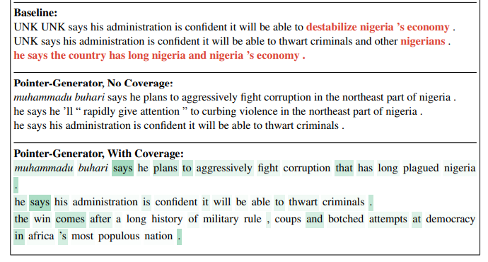
yellow shading intensity represents final value of the coverage vector at the end of final model’s summarization process
摘要覆盖的最终单词
red denotes factual errors in the summaries
摘要中的错误事实
green shading intensity represents the value of the generation probability
生成概率的值

