Slide 1
AutoFIS: Automatic Feature Interaction Selection in Factorization Models for Click-Through Rate Prediction
Speaker：Liqi Yang
Date: 2020/06/05

Slide 2

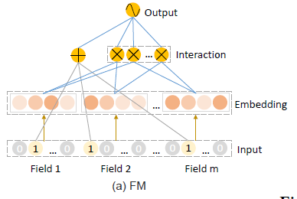
Introduction & background
Background
Motivation
CTR
predict the probability of the user clicking on the recommended items
core
extract significant low-order and high-order feature interaction
not all interactions are conductive
Tree-based method
Enumerating, designing manually
Memory, cost, accuracy
useless interactions:
unnecessary noise and complicate the training process
Problem for factorized model
removing the useless or even harmful interactions
perform better with reduced computation cost.

Slide 3
Introduction & background
Contribution
motivation
verify that removing the redundant feature interactions is beneficial for RS
two-stage algorithm AutoFIS
Search space explosion
Efficient: computational cost, memory
not all interactions are conductive
Tree-based method
Enumerating, designing manually
Memory, cost, accuracy
useless interactions:
unnecessary noise and complicate the training process
Problem for factorized model
removing the useless or even harmful interactions
perform better with reduced computation cost.

Slide 4
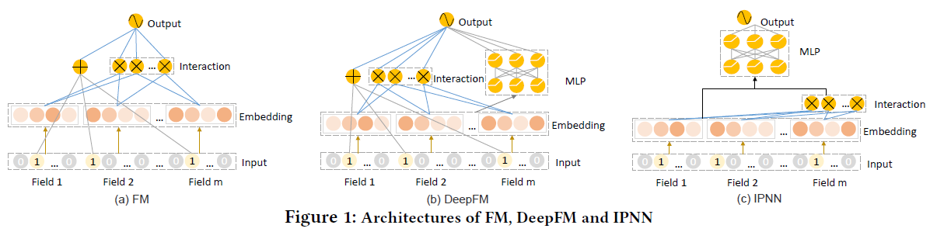

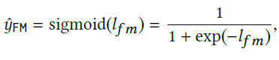



Methodology
FM models

Slide 5
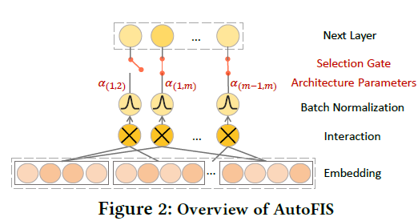




Methodology
AutoFIS
Two stages：search, re-training
Search Stage
Batch Normalization
Reason： more stable
Original：
In this paper：

Slide 6


Methodology
Two stages：search, re-training
Optimization
Search Stage
Batch Normalization
Reason： more stable
Original：
In this paper：
GRDA Optimizer : a sparse solution
Assumption: the network weights are properly learned so that can "make its proper decision"α
One-level Optimization
Adam
Notes:
Assuming: the model can select the operation only when the network weights are properly learned so that can "make its proper decision"α

Slide 7



Methodology
Re-training stage
$α$ kept in the model, a attention unit
Adam optimizer

Slide 8
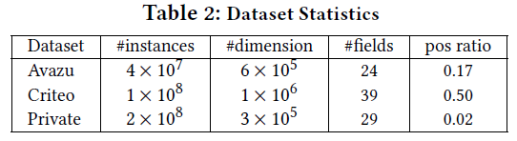
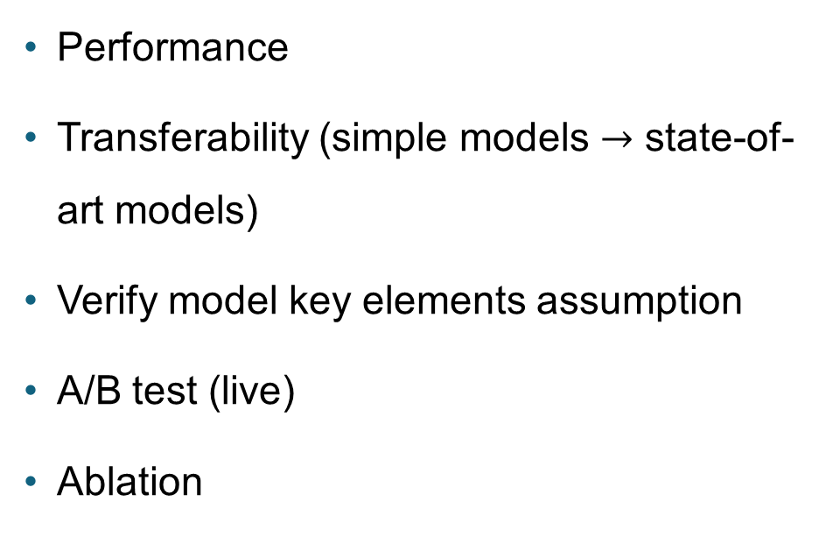
Experiments
Experiments design
datasets
Performance
Transferability (simple models $→$ state-of-art models)
Verify model key elements assumption
A/B test (live)
Ablation

Slide 9
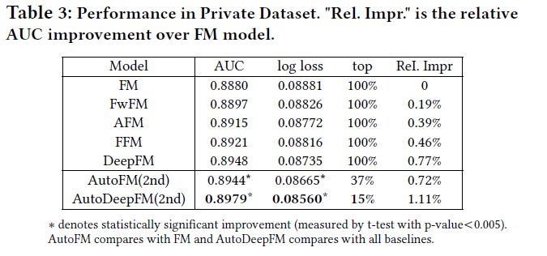
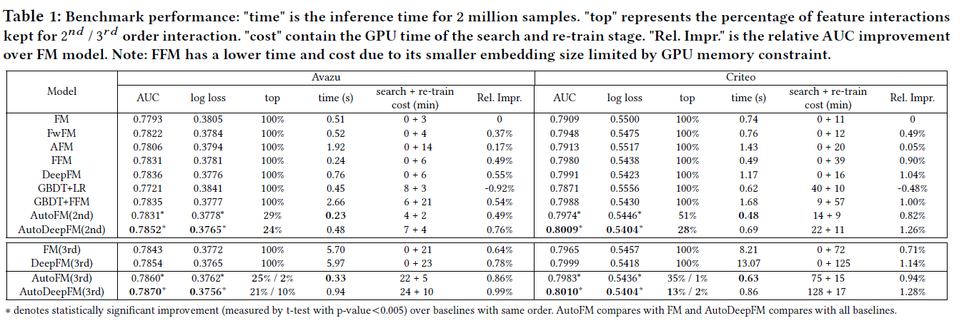
Experiments
Performance
Prediction time cost

Slide 10
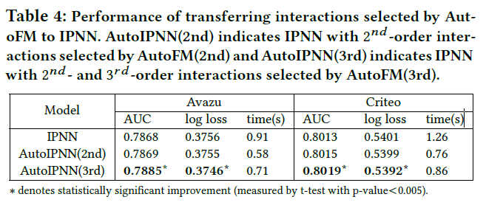
Experiment
Transferability of the Selected Feature Interactions

Slide 11
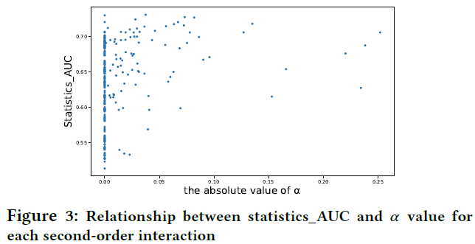
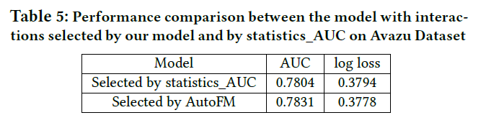
Experiment
The Effectiveness of Feature Interaction
Selected by AutoFIS
Real data

Slide 12
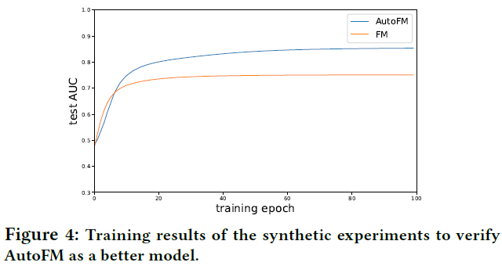
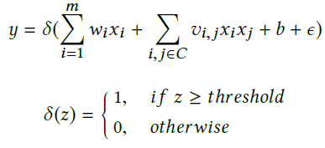
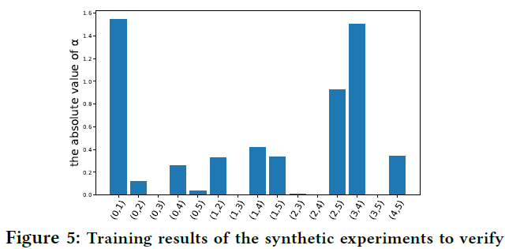
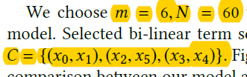
Experiment
The Effectiveness of Feature Interaction
Selected by AutoFIS
Synthetic Data.
$x :$randomly sampled from N categories of$m$ fields.

Slide 13
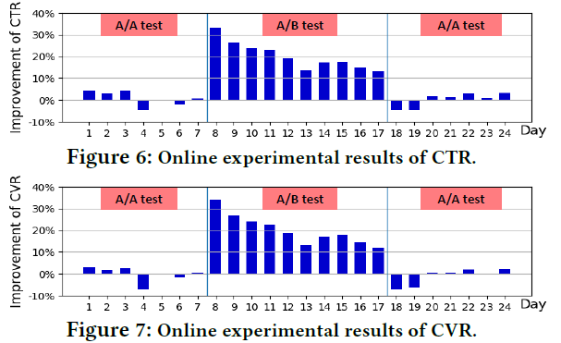
Experiment
A/B test： DeepFM, AutoDeepFM

Slide 14
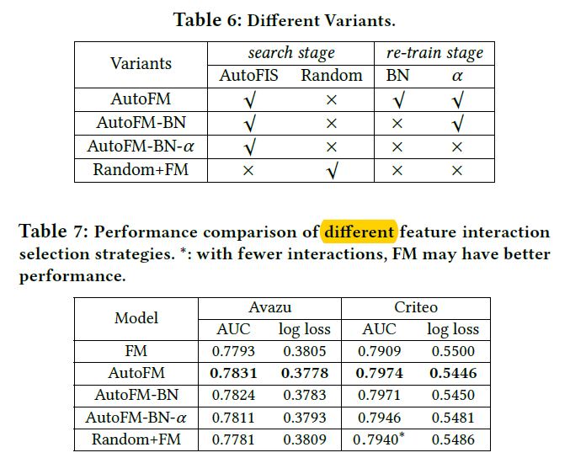
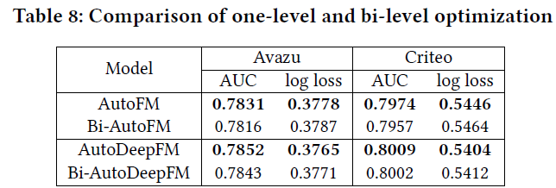

Experiment
Ablation Study
Effectiveness of components in AutoFIS
Stability of $α$ estimation across different seeds
Dataset： Avazu
Pearson correlation of $α$：0.86
Remove BN：0.65
One-level V.S. bi-level optimization

Slide 15
Thanks for your listening!
Q & A

Slide 16
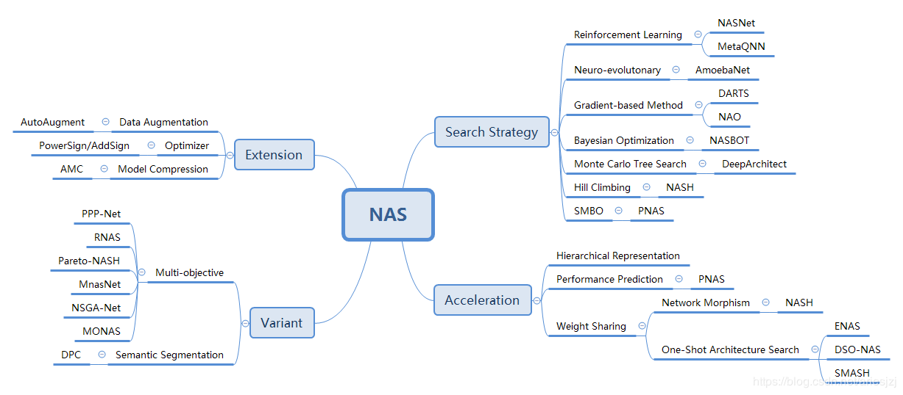
Neural Architecture Search
对于深度学习说，超参数主要可为两类：一类是训练参数（如learning rate，batch size，weight decay等）；另一类是定义网络结构的参数（比如有几层，每层是啥算子，卷积中的filter size等），它具有维度高，离散且相互依赖等特点。前者的自动调优仍是HO的范畴，而后者的自动调优一般称为网络架构搜索（Neural Architecture Search，NAS）
基于梯度的方法：这是比较新的一类方法。如果搜索空间连续，目标函数可微，那基于梯度信息可以更有效地搜索。DARTS：最关键的trick是将候选操作使用softmax函数进行混合。这样就将搜索空间变成了连续空间，目标函数成为了可微函数。这样就可以用基于梯度的优化方法找寻最优结构了。搜索结束后，这些混合的操作会被权重最大的操作替代，形成最终的结果网络
https://blog.csdn.net/jinzhuojun/article/details/84698471

Slide 17
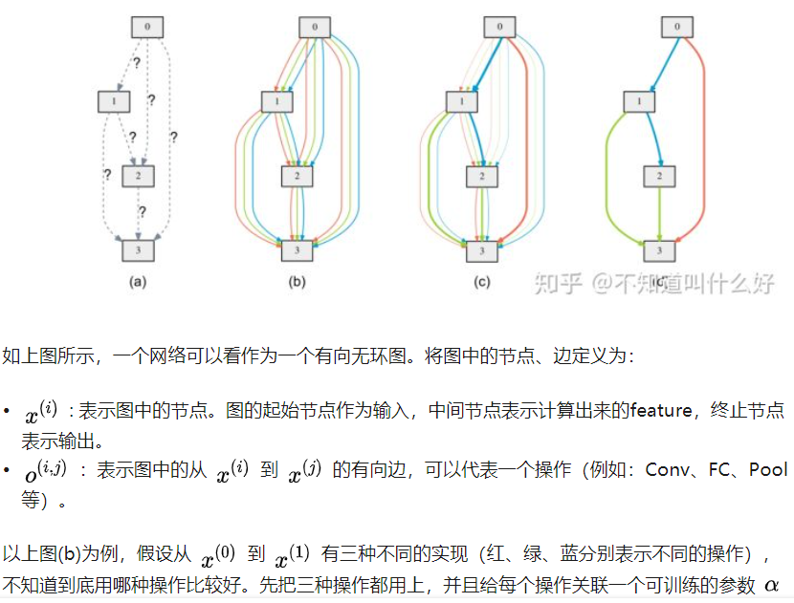
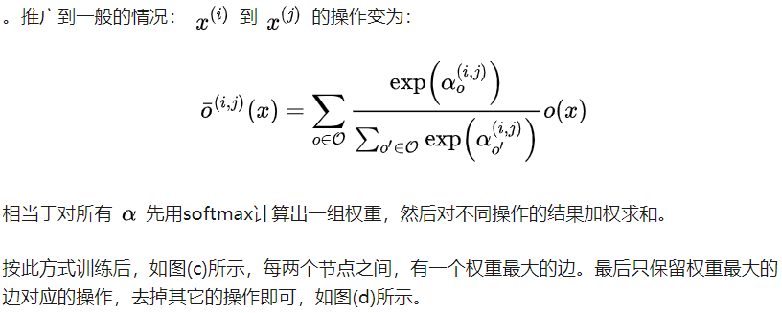
DARTS
2019ICLR. DARTS: Differentiable Architecture Search
https://zhuanlan.zhihu.com/p/97640485

Slide 18
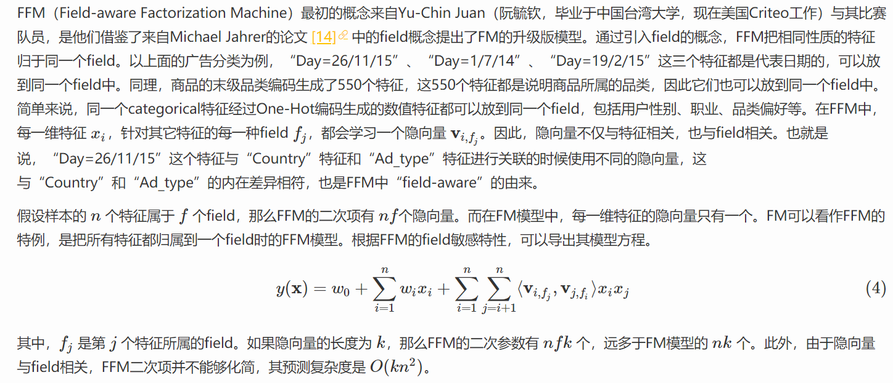
FFM
https://tech.meituan.com/2016/03/03/deep-understanding-of-ffm-principles-and-practices.html

Slide 19
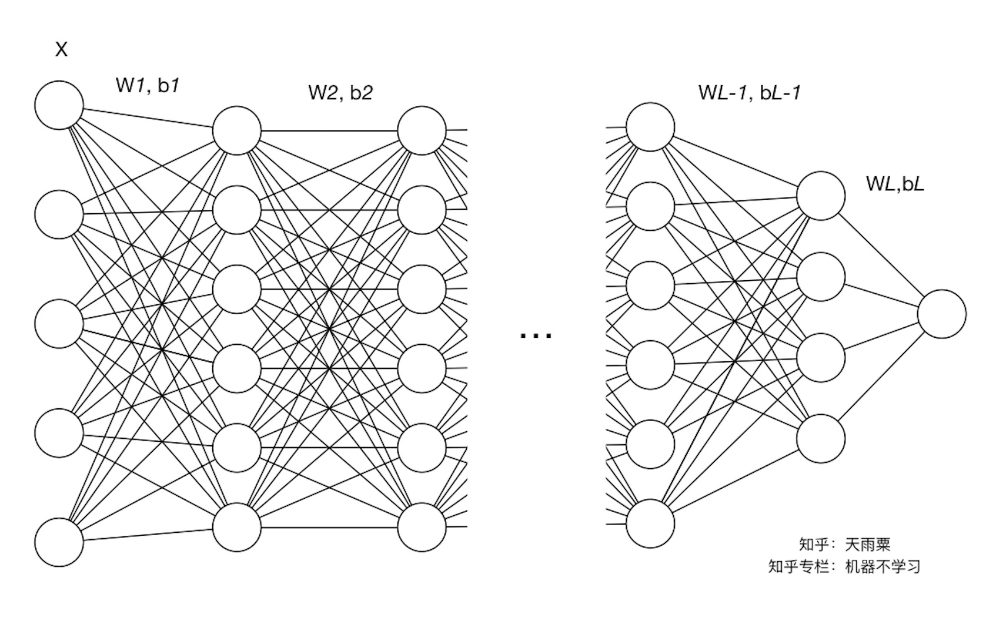
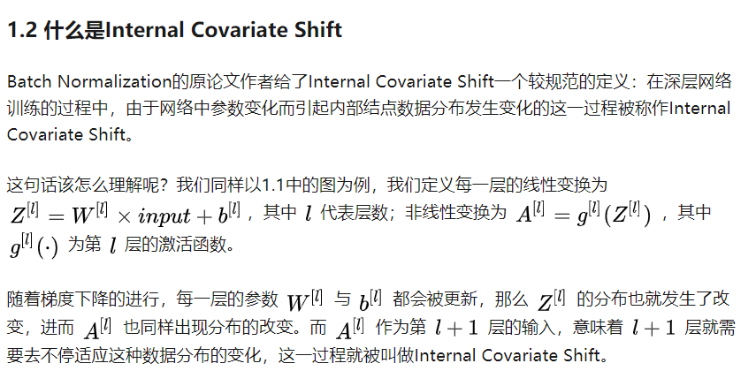
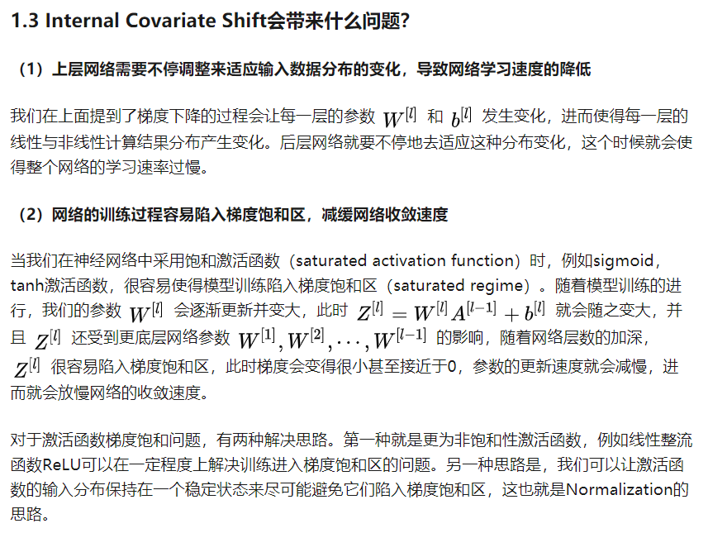
Batch Normalization
一方面，当底层网络中参数发生微弱变化时，由于每一层中的线性变换与非线性激活映射，这些微弱变化随着网络层数的加深而被放大（类似蝴蝶效应）；另一方面，参数的变化导致每一层的输入分布会发生改变，进而上层的网络需要不停地去适应这些分布变化，使得我们的模型训练变得困难。上述这一现象叫做Internal Covariate Shift。
Reference: https://zhuanlan.zhihu.com/p/34879333

Slide 20
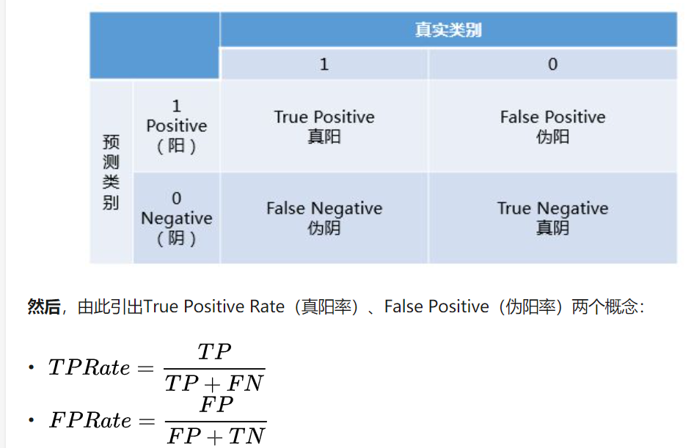
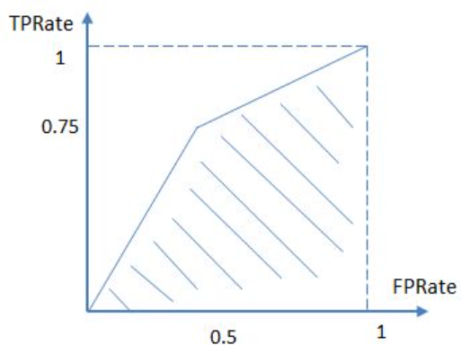

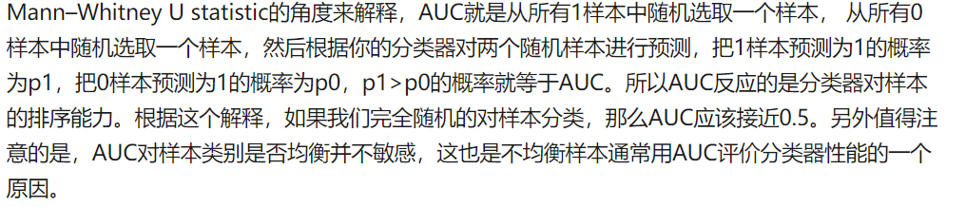
分类评价指标之-AUC & ROC
AUC是一个模型评价指标，只能用于二分类模型的评价
Accuracy：需要将概率转为label，手动设置阈值，会影响accuracy的计算

Slide 21
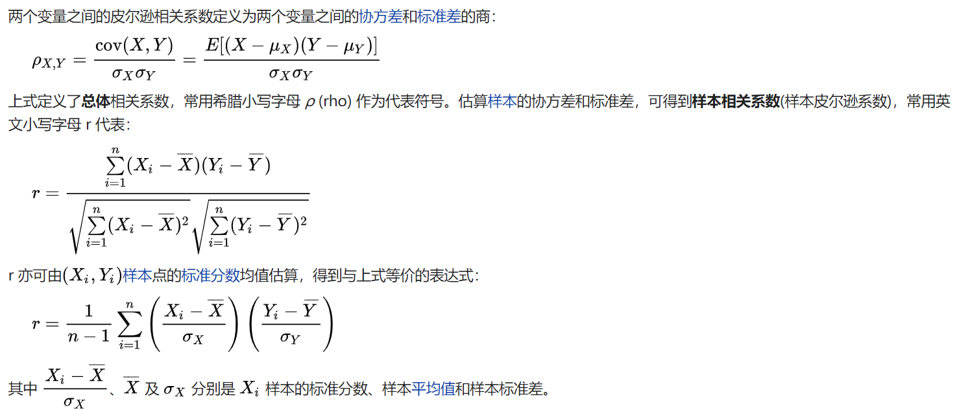
皮尔逊相关系数

Slide 22
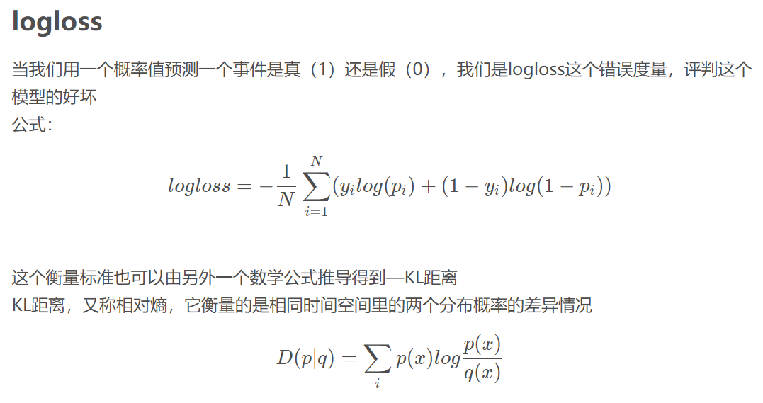
分类评价指标之log loss

