Slide 1
20200408 PRESENTATION
Attributed Graph Clustering: A Deep Attentional Embedding Approach

Slide 2
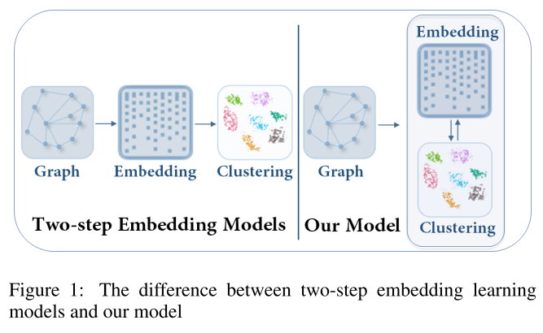
Attributed Graph Clustering: A Deep Attentional Embedding Approach
Motivations
Further for attributed graph clustering, a key problem is how to capture the structural relationship and exploit the node content information.
Based on the learned graph embedding, simple clustering algorithms such as k-means are applied. Most embedding-based methods are two-step approaches.
Traditional goal-directed training models are mostly applied to the classiﬁcation task. Fewer studies on goal-directed embedding methods for graph clustering exist.
Contributions
A goal-directed graph attentional autoencoder based attributed graph clustering framework in this paper.
The ﬁrst graph attention-based autoencoder to effectively integrate both structure and content information.
A self-training module to guide the optimizing procedure.
The experimental results show that our algorithm outperforms state-of-the-art graph clustering methods.
1

Slide 3
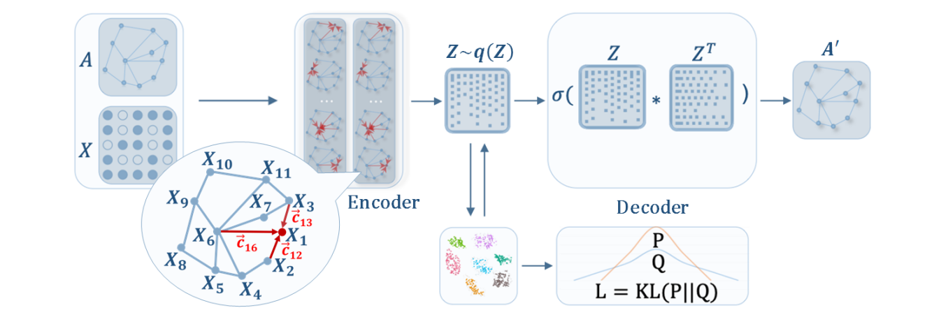
Attributed Graph Clustering: A Deep Attentional Embedding Approach
Framework
Mutual benefit
1
Graph Attentional Autoencoder
2
Self-training Clustering
2

Slide 4
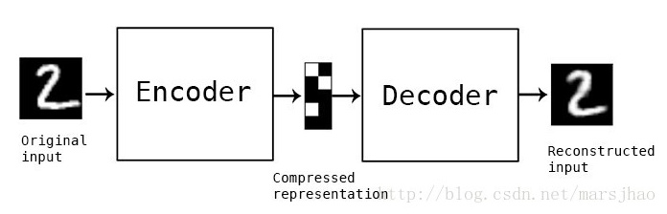
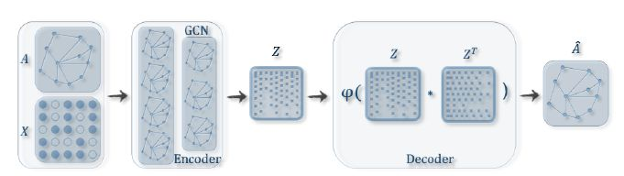
Attributed Graph Clustering: A Deep Attentional Embedding Approach
Preliminaries：Graph Auto-encoder
3

Slide 5



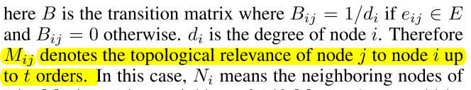

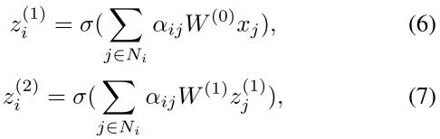


Attributed Graph Clustering: A Deep Attentional Embedding Approach
4.1 Graph Attentional Autoencoder
Graph attentional encoder:
Inner product decoder:
Reconstruction loss:
4

Slide 6
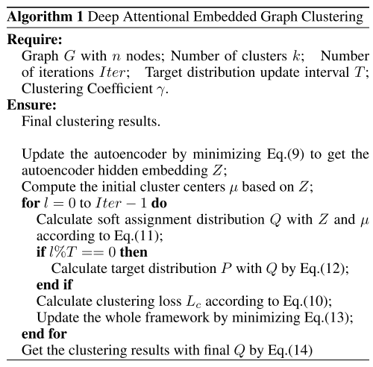







Attributed Graph Clustering: A Deep Attentional Embedding Approach
4.2 Self-optimizing Embedding
4.3 Joint Embedding and Clustering Optimization
5

Slide 7
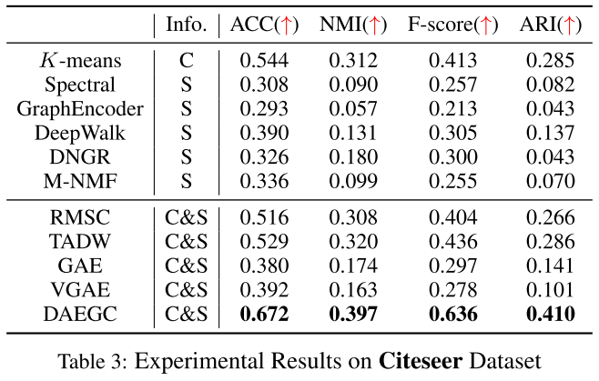
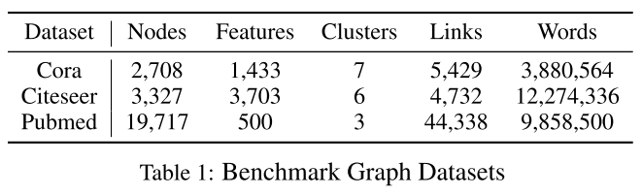
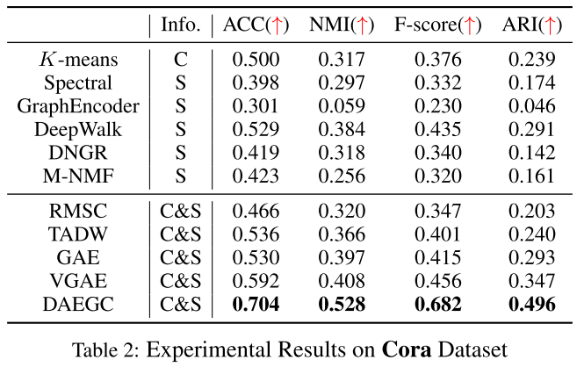
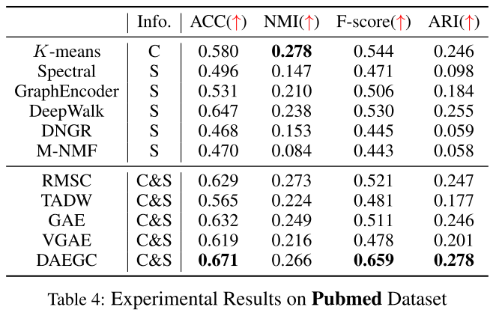
Attributed Graph Clustering: A Deep Attentional Embedding Approach
5 Experiments
5

Slide 8
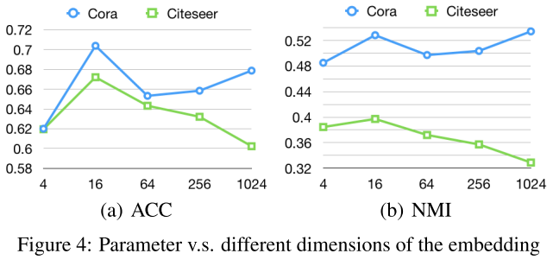
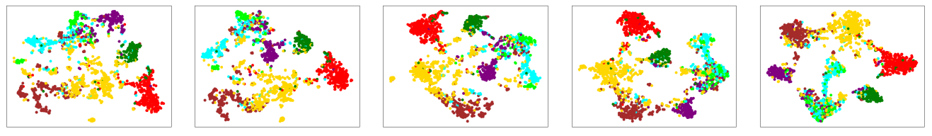
Attributed Graph Clustering: A Deep Attentional Embedding Approach
5 Experiments
5

Slide 9
Thanks.

