Slide 1
Sets2Sets: Learning from Sequential Sets with Neural Networks
Speaker：Liqi Yang
Date: 2020/07/20

Slide 2
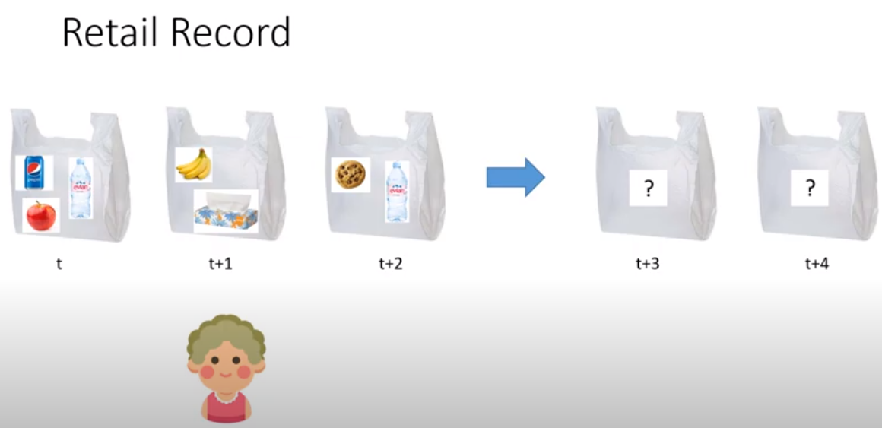
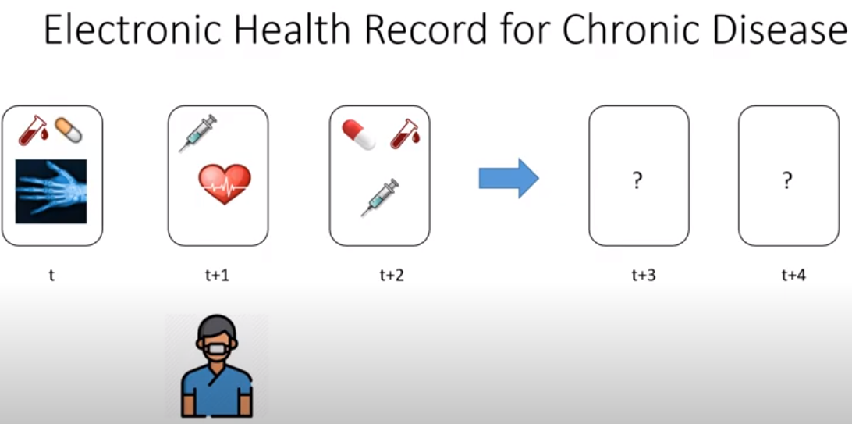
1. Introduction & background
Sets2sets

Slide 3
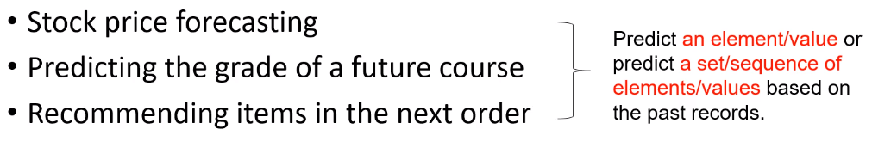

1. Introduction & background
Temporal data forecasting
Sets2sets
a new type of problem
the difference with next set recommendation
Limitations of next set prediction
1) max number of sets
2) introduce errors and loss part of temporal correlations in the subsequent sets
motivation

Slide 4
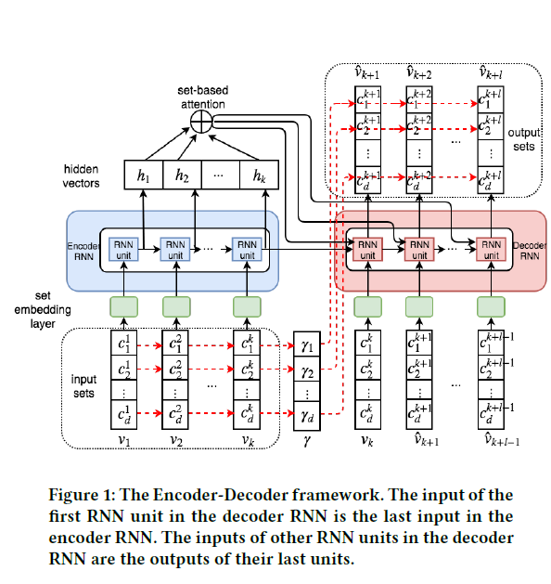
2. Methodology
set encoding
the size of set predicted
model
framework
set embedding
observation
repeated elements

Slide 5
2. Methodology
Encoder-decoder framework
Encoder: Rnn unit
Decoder:
Repeat pattern:
recorded in vector
probability of the corresponding element appearing in the past sets of a given person

Slide 6
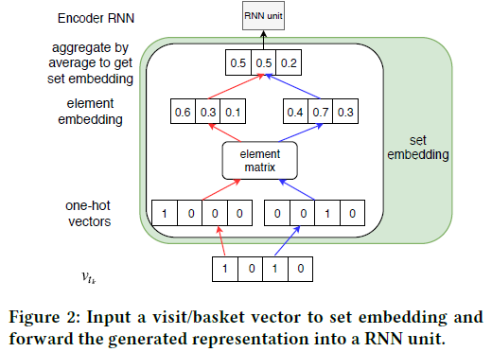


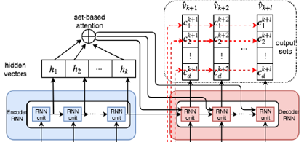
2. Methodology
Set Embedding
Set-based Attention
multi-layer perception

Slide 7






2. Methodology
Modeling Repeated Elements
Training and Inference
observation:
15%-60% of the elements in the future sets have appeared in the past sets
weighted mean square loss (WMSE)
partitioned set margin constraint (PSM)

Slide 8
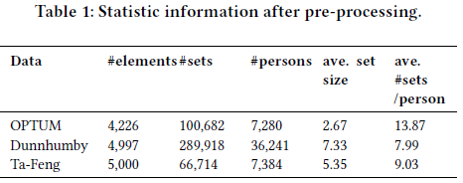
3. Experiments
performance：
recall， NDGG, personwise hit ratio (PHR)
the benifit of decoder RNN
the problems in recurrently predicting the next set and directly predicting the subsequent sets
contributions of the repeated-element-specified element-element interaction
Dataset
Compared methods

Slide 9
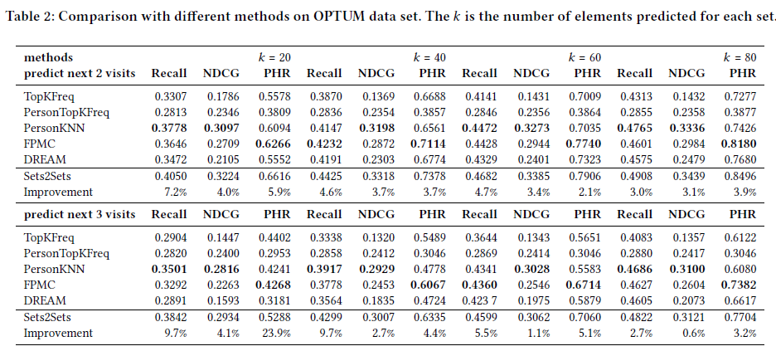
3. Experiments
performance

Slide 10
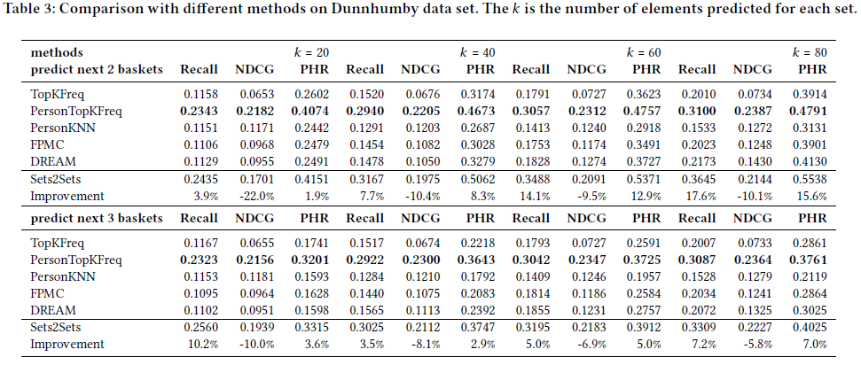
3. Experiments
performance

Slide 11
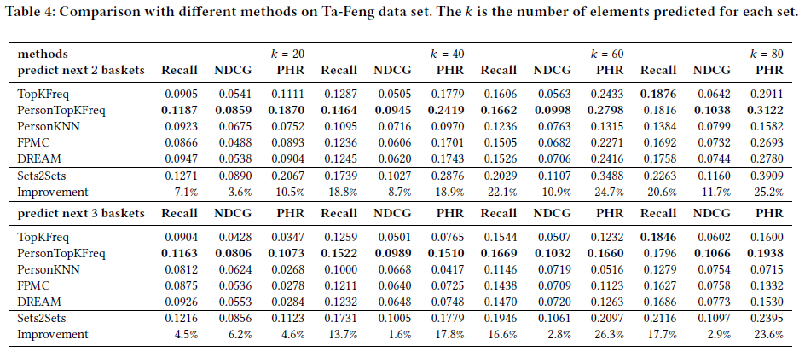
3. Experiments
performance

Slide 12
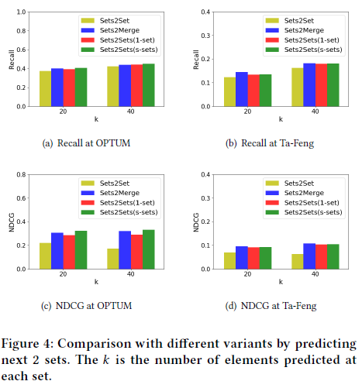
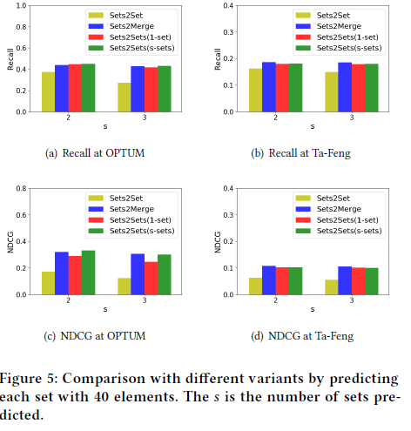
3. Experiments
Decoder RNN

Slide 13
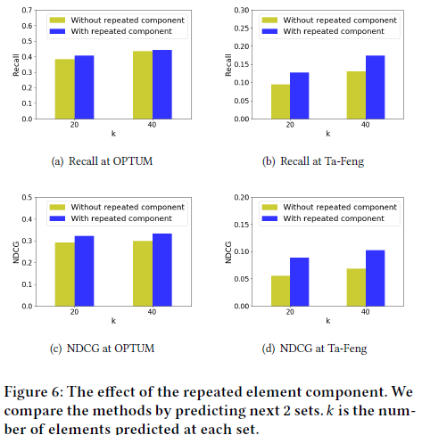
3. Experiments
Repeated element component

Slide 14
Thanks for your listening!
Q & A

Slide 15
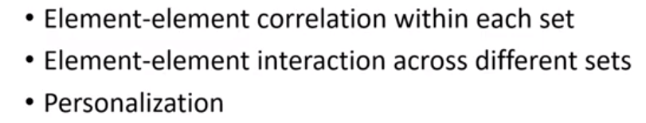
1. Introduction & background
Temporal data forecasting
Sets2sets
a new type of problem
the difference with next set recommendation
Limitations of next set prediction
1) max number of sets
2) introduce errors and loss part of temporal correlations in the subsequent sets
motivation

