Slide 1
20200311 PRESENTATION
MAGNN: Metapath Aggregated Graph Neural Network for Heterogeneous Graph Embedding

Slide 2
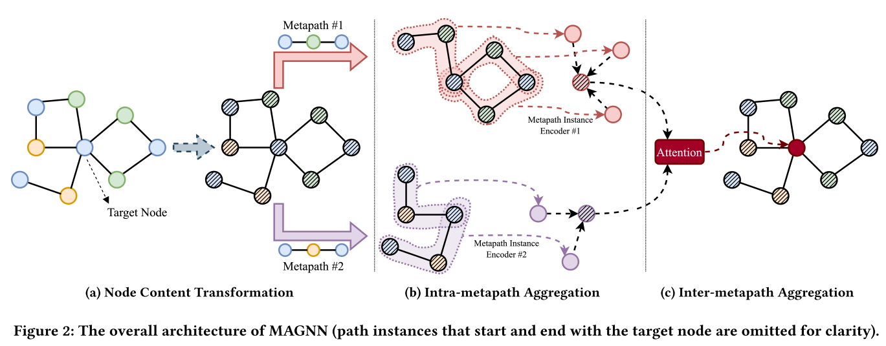
MAGNN: Metapath Aggregated Graph Neural Network for Heterogeneous Graph Embedding
Motivation
Most real-world graphs consist of various types of nodes and edges associated with attributes in different feature spaces.
Existing metapath-based methods still suffer from at least one of the following three limitations:
(1) The model does not leverage node content features (e.g. metapath2vec, Hin2vec)
(2) The model discards all intermediate nodes along the metapath by only considering two end nodes, which results in information loss. (e.g. HERec, HAN)
(3) The model relies on a single metapath to embed the heterogeneous graph. (e.g. metapath2vec [9]).
Model Architecture
1

Slide 3
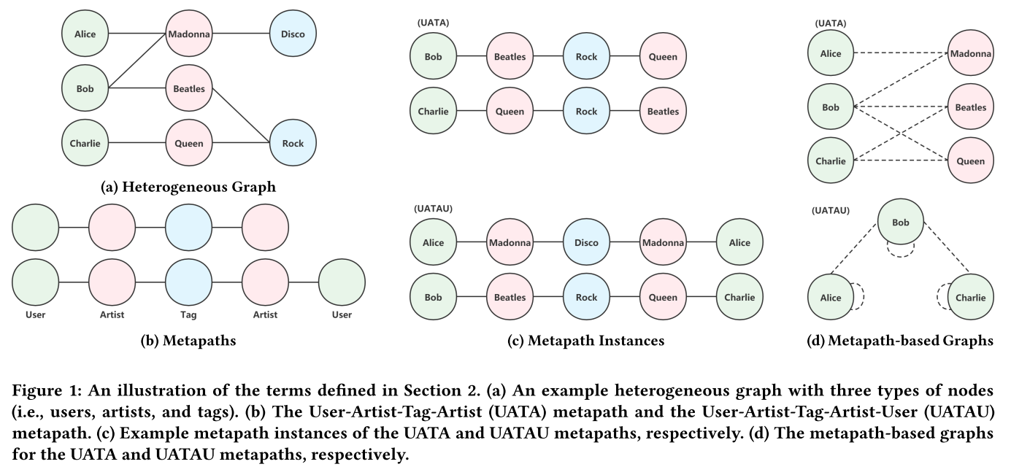
MAGNN: Metapath Aggregated Graph Neural Network for Heterogeneous Graph Embedding
Preliminary
2

Slide 4
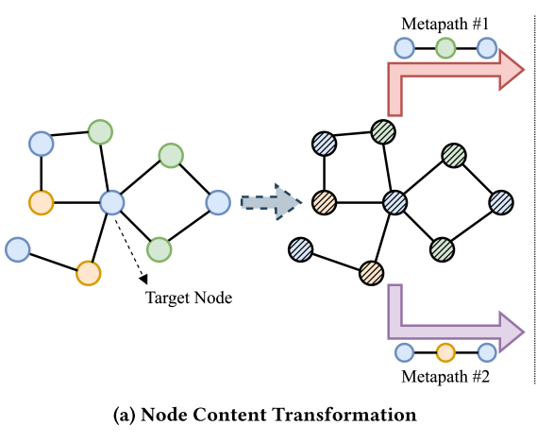

MAGNN: Metapath Aggregated Graph Neural Network for Heterogeneous Graph Embedding
4.1 Node Content Transformation
3

Slide 5

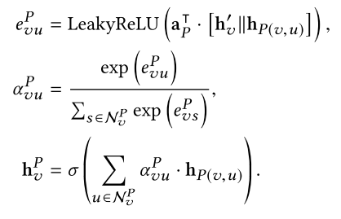
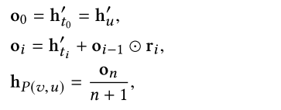
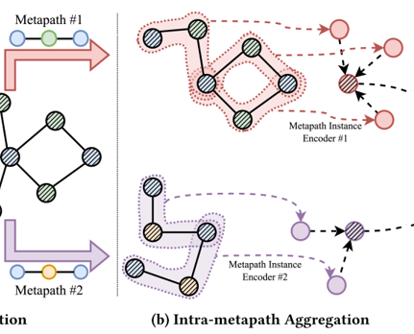
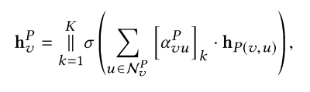




MAGNN: Metapath Aggregated Graph Neural Network for Heterogeneous Graph Embedding
4.2 Intra-metapath Aggregation
Mean encoder.
Linear encoder
Relational rotation encoder. (RotatE [24])
Multi-head Attention
4

Slide 6
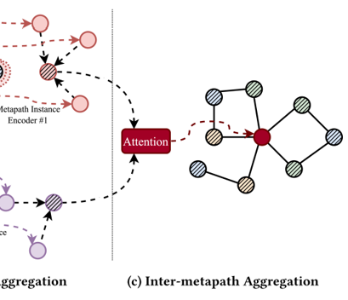

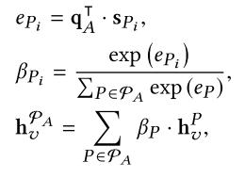


MAGNN: Metapath Aggregated Graph Neural Network for Heterogeneous Graph Embedding
4.3 Inter-metapath Aggregation
5

Slide 7
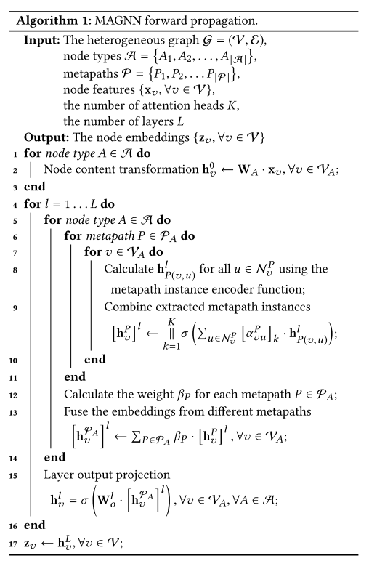


MAGNN: Metapath Aggregated Graph Neural Network for Heterogeneous Graph Embedding
4.5 Training
Semi-supervised learning
Unsupervised learning
6

Slide 8
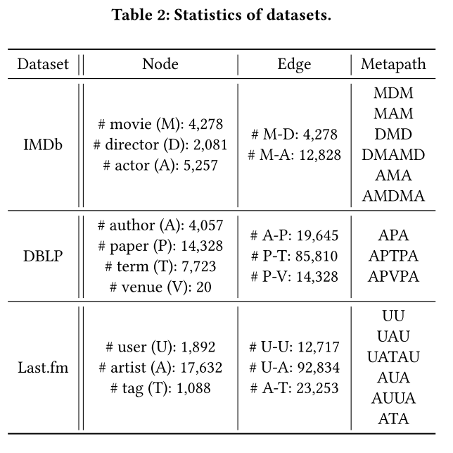
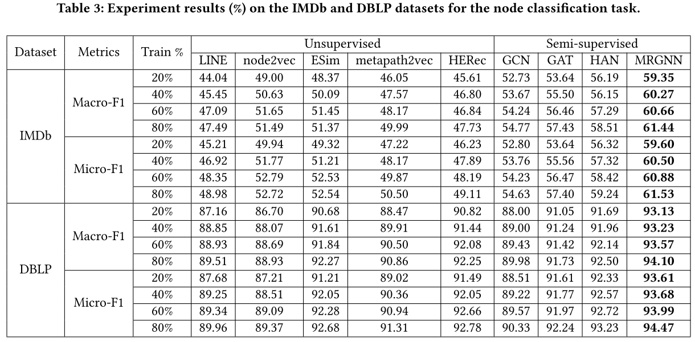
MAGNN: Metapath Aggregated Graph Neural Network for Heterogeneous Graph Embedding
5 Experiments
7

Slide 9
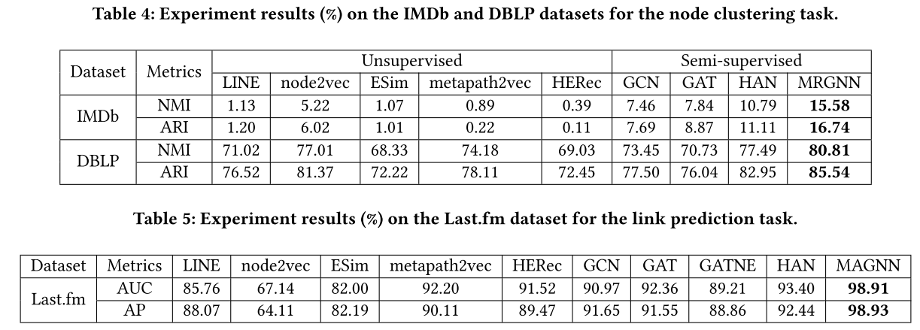
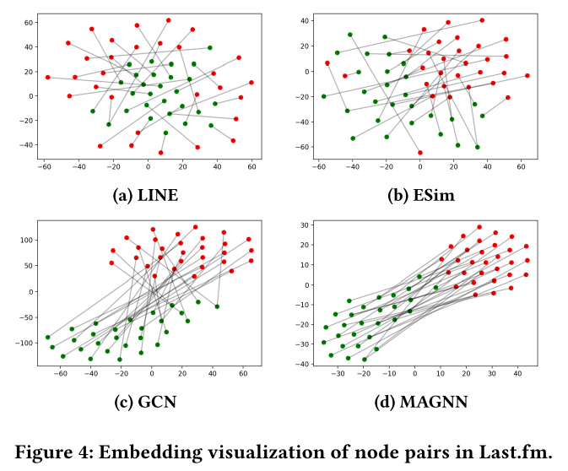
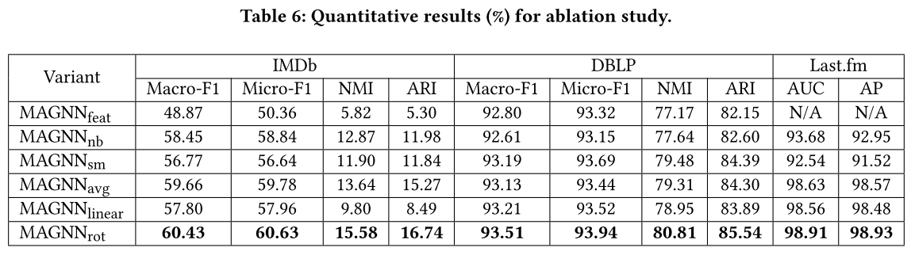
MAGNN: Metapath Aggregated Graph Neural Network for Heterogeneous Graph Embedding
5 Experiments
8

Slide 10
Thanks.

