Slide 1

Fuhua (Hefei) Precision Manufacturing Co., Ltd
Address: Taohua Industrial Zone, Hejing District,
Hefei City, Anhui 230601 China
Website: http://www.hefeifh.com
Business Contact: BD@hefeifh.com

Slide 2
Company Development
Company History
Certification and Qualification

Slide 3
Fuhua Development
2017
Machining, Fabrication and SP
Solution Provider
60+ Engine Brackets NPI completed.
150+ Connector and Adapter NPI completed.
2015
2013
Engine Brackets
Surface Treatment Capability in house
2014. GE S1000, Honeywell qualification
2015. FPI & Welding GE SPTC approved
2010
2013. Over 50 P/Ns awarded from GE Systems
2014. NADCAP accreditation
First Aviation NPI PO (GE Systems)
2007, Fuhua registered
2009, New Facility

Slide 4
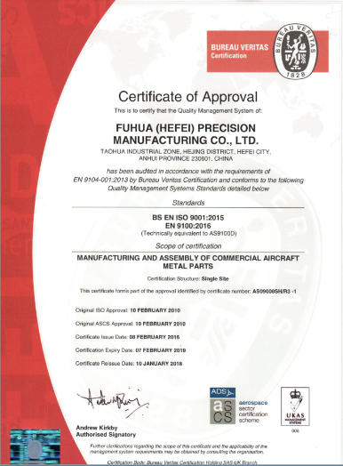
AS9100D Certificate

Slide 5
Team Introduction
Key Team Member /
Company Organization /
Human Resource /

Slide 6
Company Organization Chart
General Manager
Engineering Department
Quality
Sales Team
Customer Service
SQE
Commercial Department
Machining Team
Finance
HR & Admin Director
Special process
Production
Technician
QA
Sheet Metal Team
Sourcing Team
Operators
Material Planning
Purchase
Customs Specialist

Slide 7
Human Resource
Quality Engineers | 4 | Honeywell SPOC training; GE S Spec training, DSQR
Machinery Engineers | 5 | GE UK, ELMs & SUEs & RAAs: GE US, Leap Machinery & Unison
Fabrication Engineers | 4 | Corbus brackets & 737 Chassis & 787 RDC..
Sourcing Team | 3 | Support Over 100 P/Ns, Raw material & Special processes outsource

Slide 8
Core Competences
Fabrication Capability and Capacity
Special process capability and Capacity
Future Capability Invest Plan

Slide 9
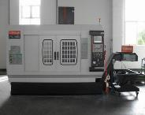
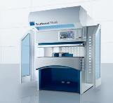
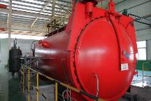
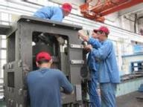
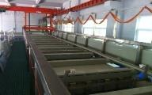
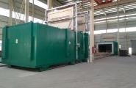
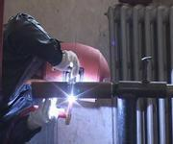
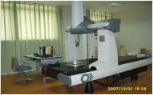
Core Competence
Machining
Sheet Metal
Composite
Assembly
Chemical Process
Heat Treatment
Welding
Inspection

Slide 11
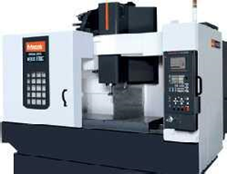
Vertical CNC
Mazak QSM Series: 4 Sets
35%
45%
12%
8%
Customer 1
Customer 2
Customer 3
TEXT HERE

Slide 12
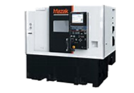
CNC Turning
Mazak VTC-200BN
(1120*510*510mm | 10000RPM) 45 Sets
Mazak VTC-200CN
(1950*510*510mm | 10000RPM) 6 Sets
Highland (2.5*6*1M *3 Sets | 3*8*1M Sets)
25%
12%
23%
40%
Customer 1
Customer 2
Customer 3
TEXT HERE

Slide 13
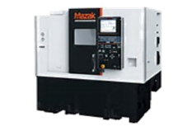
Horizontal CNC
Mazak HCN5000-L 1 Set | Spindle Speed: 12000RPM
Highland 1 Set | Spindle Speed: 12000 RPM
55%
20%
13%
12%
Customer 1
Customer 2
Customer 3
TEXT HERE

Slide 14

WEDM
6 Sets BAOMA
2 Sets Sodic
22%
50%
20%
8%
Customer 1
Customer 2
Customer 3
TEXT HERE

Slide 15



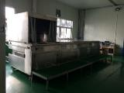
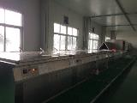
Special process capability and Capacity
Special process
Process | Approval Scope | Accreditation
Chemical Conversion | MIL-DTL-5541 TYPE I/II | NADCAP
Sulfuric Acid anodizing | MIL-A-8625 TYPE II AMS 2471 | NADCAP
Chromic Acid anodizing | MIL-A-8625 TYPE I AMS 2470 | NADCAP | GE Avionics approved
Painting | 0726-108 | NADCAP
Passivation | AMS 2700 ASTM A380 ASTM A967 | NADCAP
Hard anodizing | AMS 2469 MIL-A-8625 TYPE III | NADCAP
Swab etch | P4TF8 | NADCAP |GEAE Approved
Welding | P8TF3 | NADCAP |GEAE Approval
FPI | P3TF47 | NADCAP |GE Approval
Certification
Special process Capacity
Process line
1.5m×0.8m×0.5m
自乳化 1.5×1.2×1M
后乳化 0.8×0.8×0.5M

Slide 16
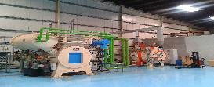
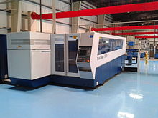
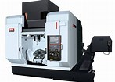
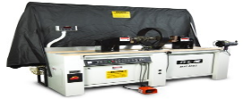
Future Capability Invest Plan
Heat Treatment
Fiber Laser
5 Axis CNC
New NDT method
Al solution heat treatment | 2019
Fiber Laser cutting machine | 2018
1. 5 Axis CNC | 2 Sets | 2019
MT
X-Ray

Slide 17
Safety protects people, Quality protects jobs.
Weaving Dreams Into Reality——Fuhua
Leeroy Li
BD@hefeifh.com

