Slide 1

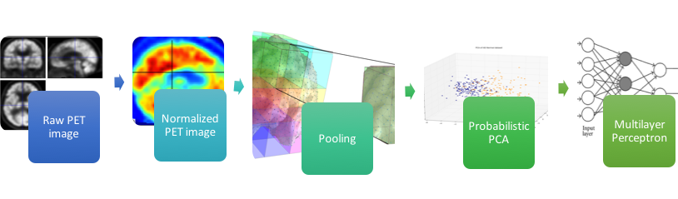
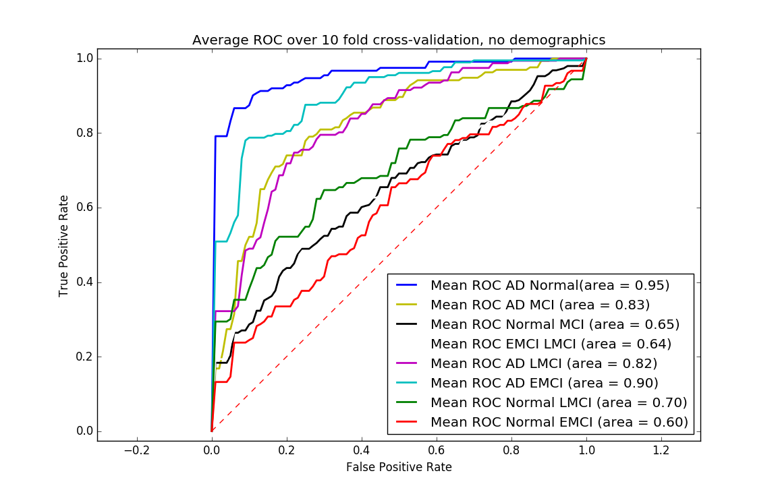
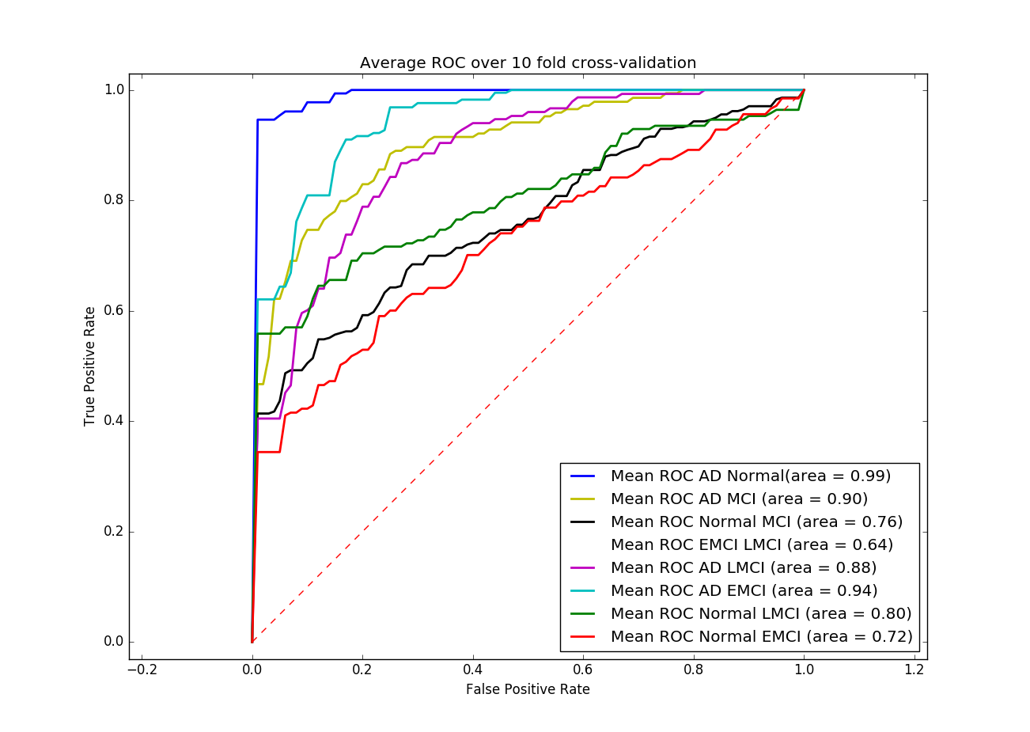
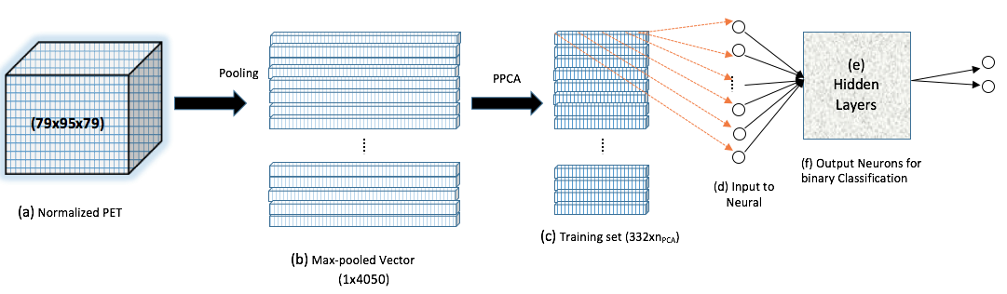
Deep Learning based Classification of FDG-PET Data for Alzheimer's Disease
Shibani Singh MS¹, Anant Srivastava MS¹, Liang Mi PhD¹, Dhruman Goradia PhD²,
Kewi Chen PhD², Eric M. Riemann MD², Yalin Wang PhD¹
¹School of Computing, Informatics, and Decision Systems Engineering, Arizona State University, Tempe, AZ, USA.
²Banner Alzheimer’s Institute and Banner Good Samaritan PET Center, Phoenix, AZ, USA.
ssing138@asu.edu
Introduction
Alzheimer’s Disease (AD), a neurodegenerative disease is a progressive disease that affects the brain gradually with time and worsens. Reliable and early diagnosis of AD and its prodromal stages (i.e. Mild Cognitive Impairment(MCI)) is essential. Deep learning has recently been applied to the analysis of structural and functional brain imaging data [1]. Here we introduce a deep learning based classification using neural networks with dimensionality reduction techniques to classify the different stages of AD based on FDG-PET image analysis.
Processing Pipeline
The image is preprocessed and normalized to a common space. It is further max-pooled to reduce feature dimensionality.
The features are further reduced to enhance classifier performance using probabilistic principal component analysis.
These are then passed through the simplest of all neural networks, a multi-layer perceptron for binary classification experiments
10 fold cross validation is used to validate classifier performance.
An algorithm is also devised to enhance the performance of an n-layered multi-layered perceptron.
Discussion
As per the Universal Approximation theorem, we should be able to find a 1-hidden layer MLP that perfectly fits over the given data. Regional analysis can be done using Grid Long Short Term Memory (LSTM) and Parallel LSTM to enhance accuracies. Instead of PPCA, deep learning architectures could be used to learn high level feature abstractions. Other disease could be classified using the architecture proposed.
Experiments
668 patients were studied from the ADNI (Alzheimer’s Disease Neuroimaging Initiative) [2] and we studied the patients at baseline and screening. The extent of linear separability of the data is tested using Linear SVM as a classifier. Using Rectified Linear Units in the neural network induces sparsity in feature representation for network layers, enhancing linear separability. Increasing the number of hidden layers in the MLP displays an increase in accuracy. Max-pooled features values outperform mean-pooled feature values. Patch size of 10x10x10 was selected after varying the patch sizes from 5 to 15 to select the best size for AD/CU. The addition of demographic features such as Age, Gender, APOE (gene information) and FAQ (Functional Assessment Questionnaire) scores significantly improved performance.
Methods
Data | Measure | AD/CU | AD/MCI | CU/MCI | AD/EMCI | AD/LMCI | CU/LMCI | CU/EMCI | LMCI/EMCI
Max-pooled | F-1 Score | 0.94 | 0.87 | 0.75 | 0.87 | 0.77 | 0.69 | 0.63 | 0.68
Max-pooled with Demographic data | F-1 Score | 0.98 | 0.91 | 0.79 | 0.90 | 0.82 | 0.83 | 0.72 | 0.65
Figure 2. Comparison of the classification performance with addition of demographic features
Table 1. Summary of results
Acknowledgement
This This work was funded, in part, by National Institutes of Health (R21AG043760, R21AG-049216, RF1AG051717, U54020403) and National Science Foundation (DMS-1413417 and IIS-1421165).
References
Plis S.M., et al., Deep Learning for neuro-imaging: a validation study, Frontiers in Neuroscience, 2014, vol 8
Weiner, M.W., et al., The Alzheimer’s Disease Neuroimaging Initiative: a review of papers published since its inception. Alzheimers Dement, 2012. 8(1 Suppl):p. S1-68.
Figure 1. The pipelines (Classification and Multilayer Perceptron)

