Slide 1
Milestone One
KVM-Based eBPF Malware Detection Engine

Slide 2
Project Team & Overview
Luis Abraham • Dylin Irons • Dominick Morales • Braiden Ames
Faculty Advisor: Dr. Ribeiro
Client: Amy Alvarez, NASA Scientist
Advisor meetings: monthly, TR 2:00–3:15pm (office hours) • Client meetings: monthly, when available
09/28/2026
RootView Project Plan
(Slide No.) ‹#›

Slide 3
Milestone Overview
Laying foundation for future work
Web UI design
Easy user setup and interaction w/ tool
Base VMI
08/25/2026
RootView Project Plan
(Slide No.) ‹#›

Slide 4
Web Server
Two Views
Dashboard - anything wrong in one line
Introspection - raw eBPF data for closer inspection
Swappable engine
The site is built to talk to a clean interface to allow for easy adjustments as we build the tool
Website updates in real time
Server scans each guest VM on a timer and pushes new findings to browser
Web Server
Python
FastAPI
08/25/2026
RootView Project Plan
(Slide No.) ‹#›

Slide 5
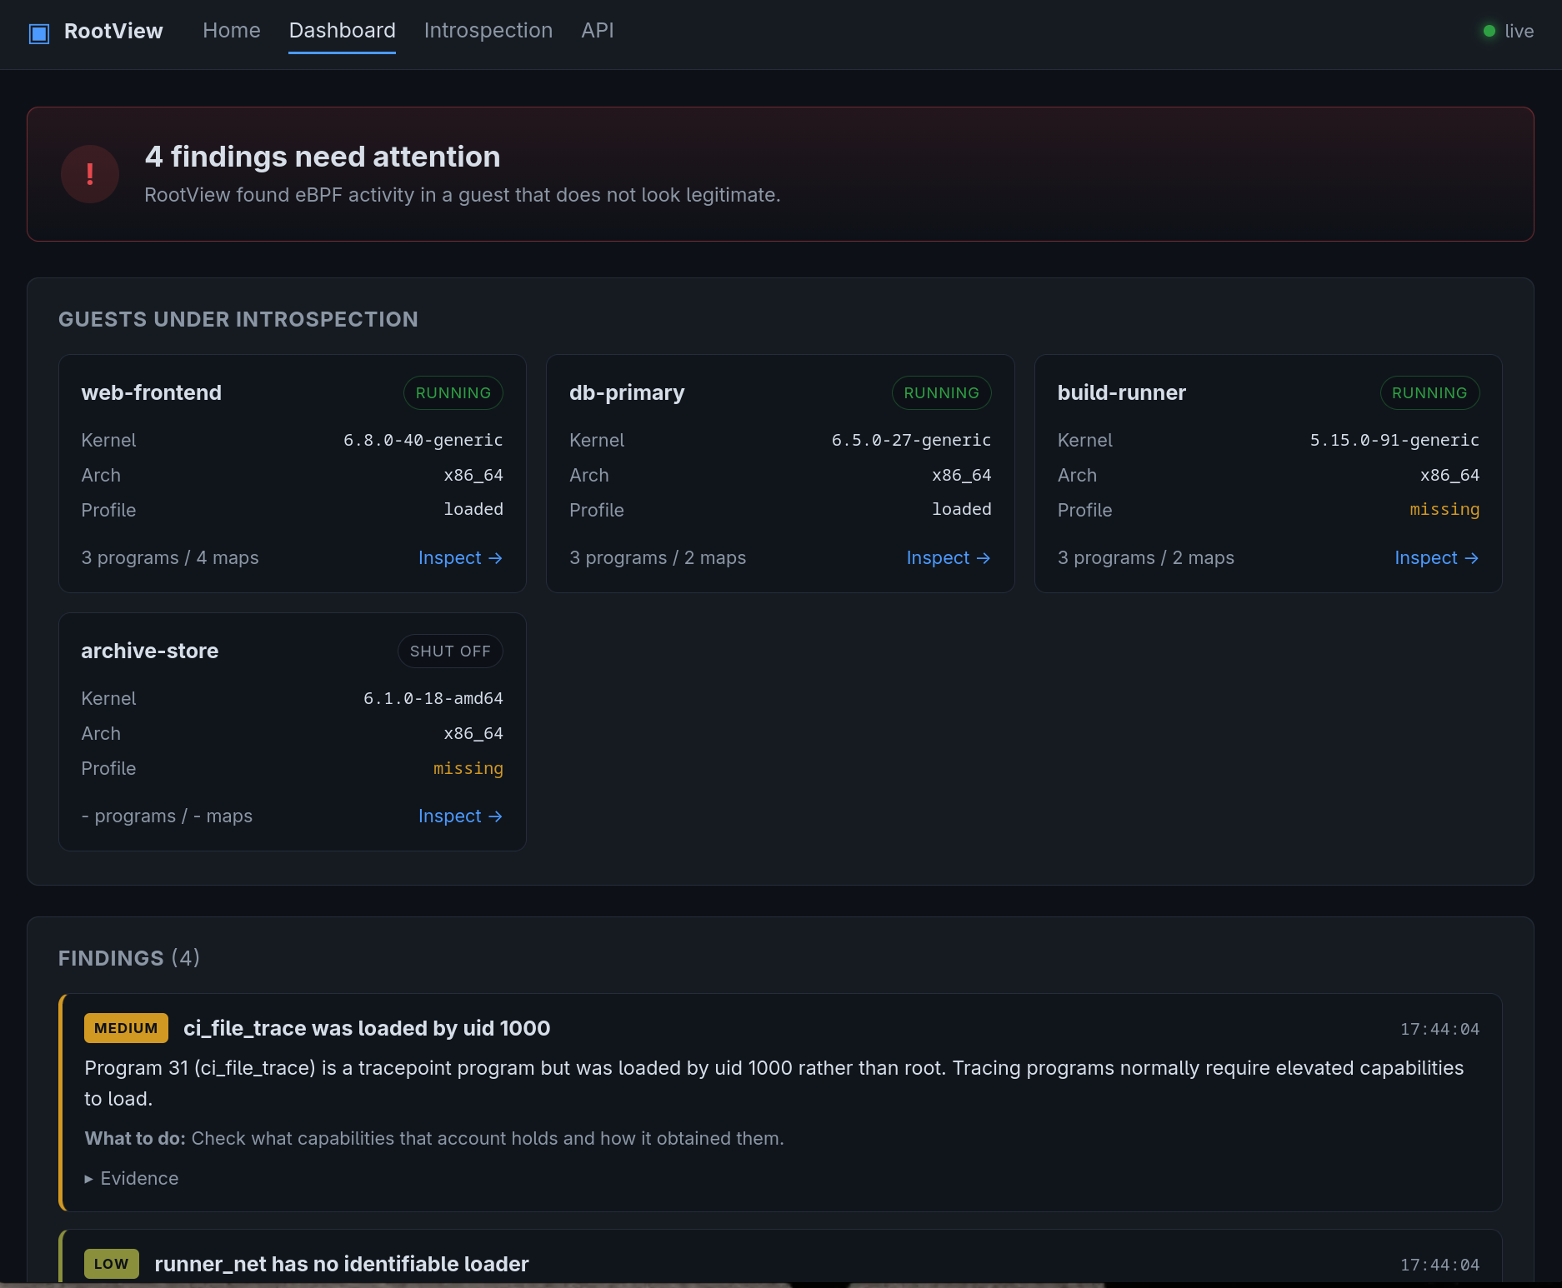
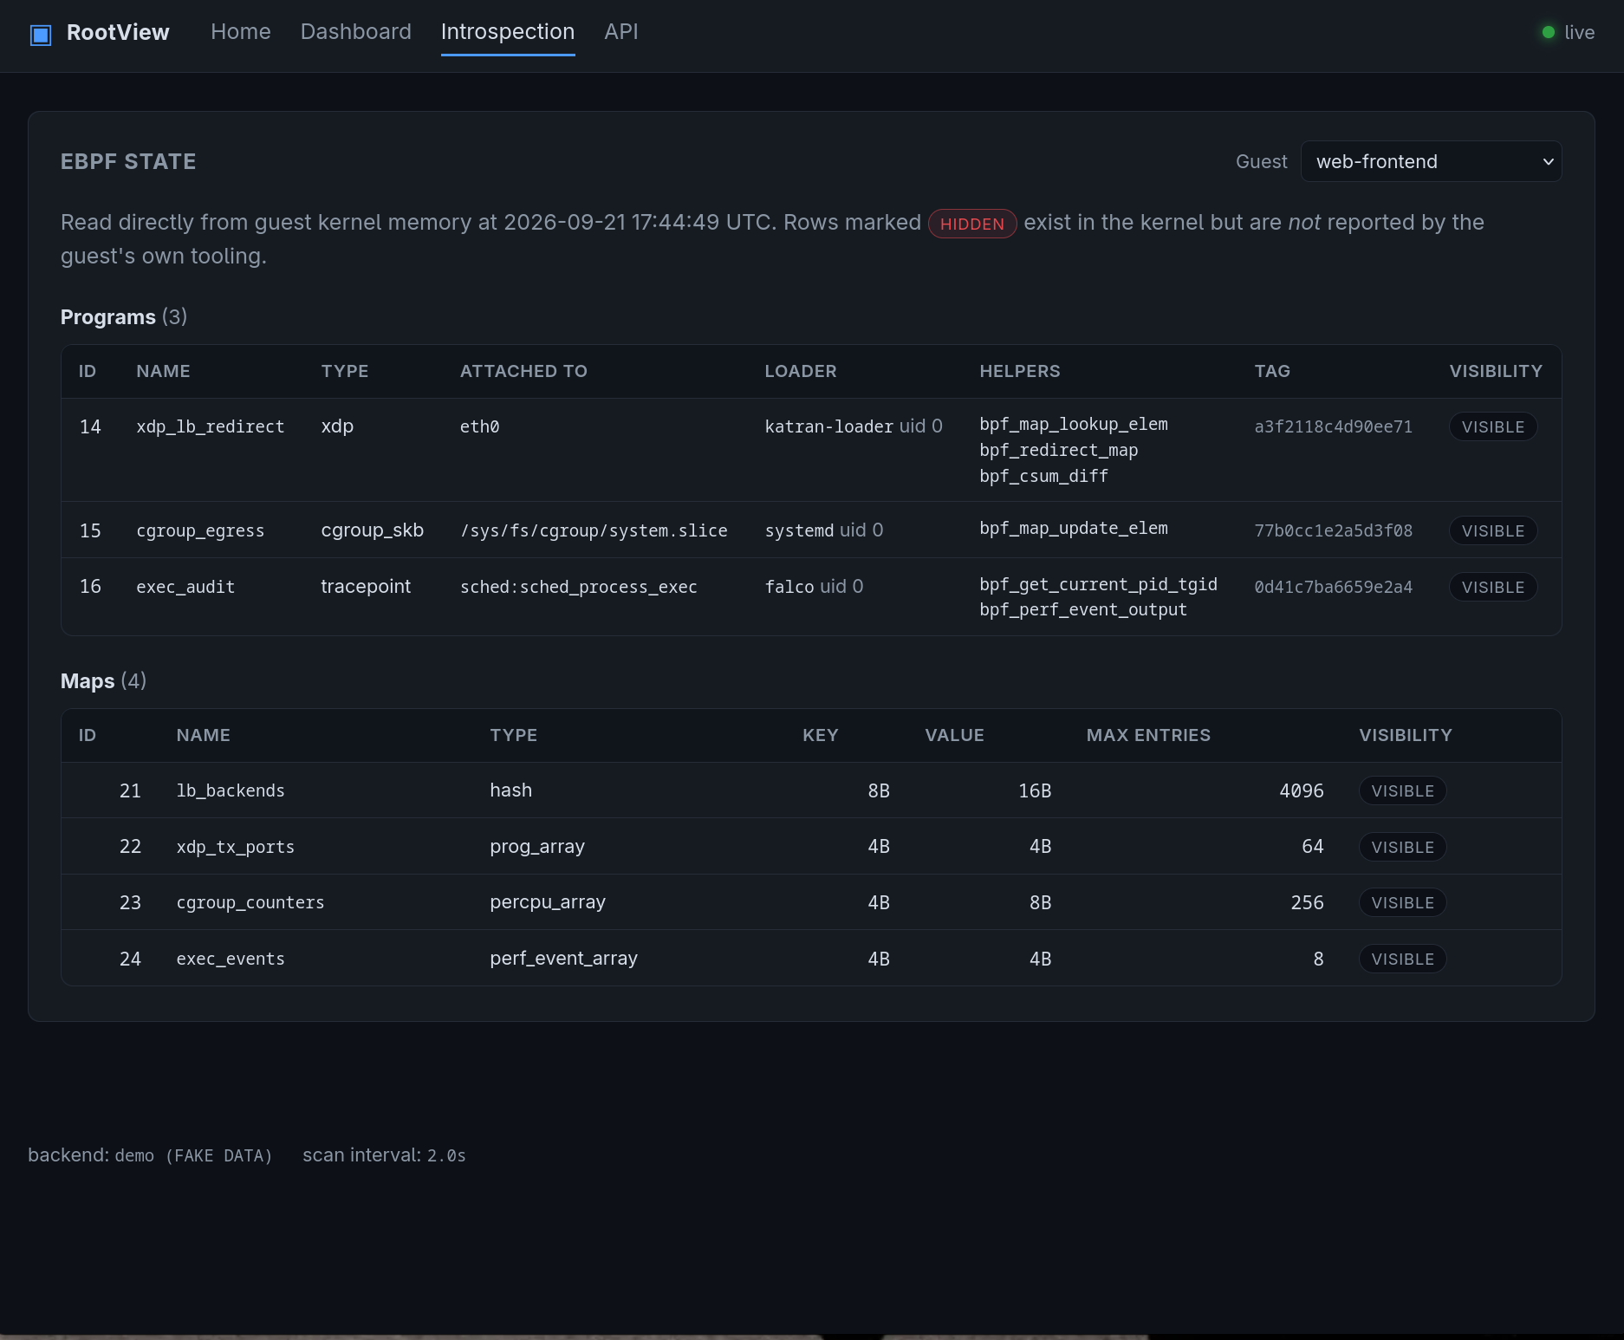
Web UI
08/25/2026
RootView Project Plan
(Slide No.) ‹#›

Slide 6
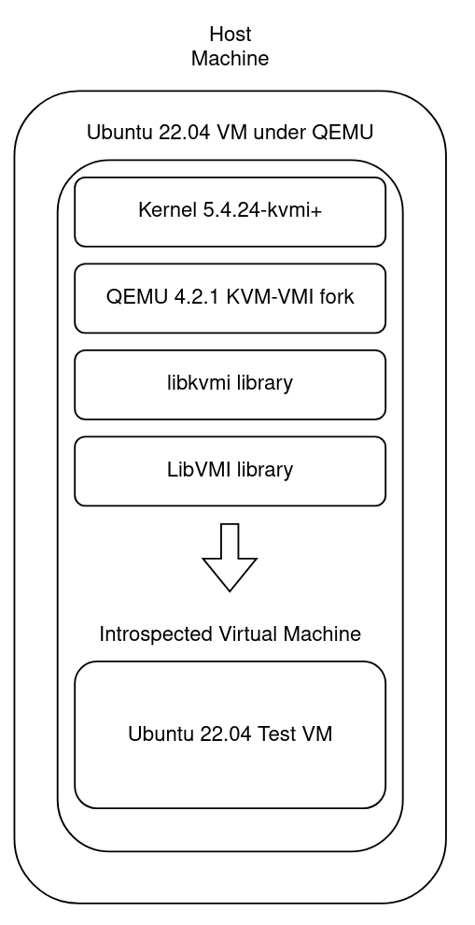
KVMI VM
To get introspection working, you need specific software
Issues:
  KVM-VMI requires you to compile a modified kernel
  Said kernel is also old (5.4 - 5.15)
  Requires modified QEMU
  Need libvmi and libkvmi libraries
We can make this easier by providing it in a package
08/25/2026
RootView Project Plan
(Slide No.) ‹#›

Slide 7
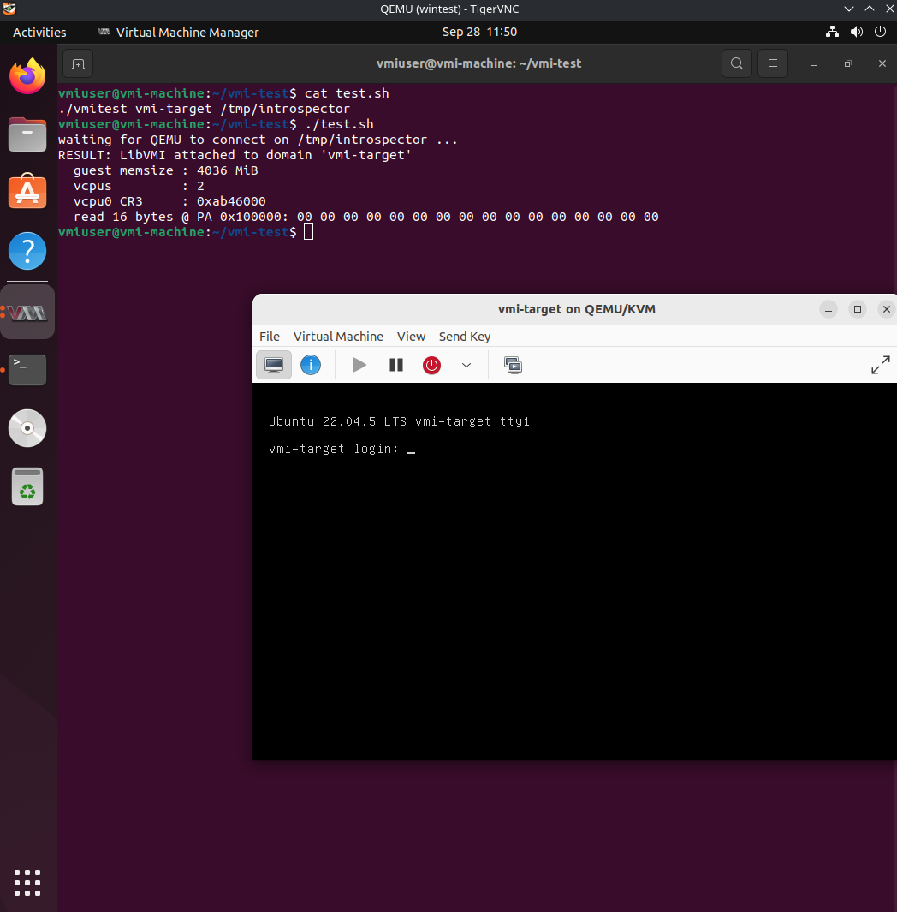
KVMI VM
Ubuntu 22.04 qcow2 image created and ready for use
Virtual machine allows the user to introspect on nested VMs
What is inside:
  KVM-VMI Linux Kernel 5.4
  Modified QEMU 4.2.1 installed systemwide
  Docker
  Upstream libvmi
  Bitdefender libkvmi
  Libvirt with apparmor rules
08/25/2026
RootView Project Plan
(Slide No.) ‹#›

Slide 8
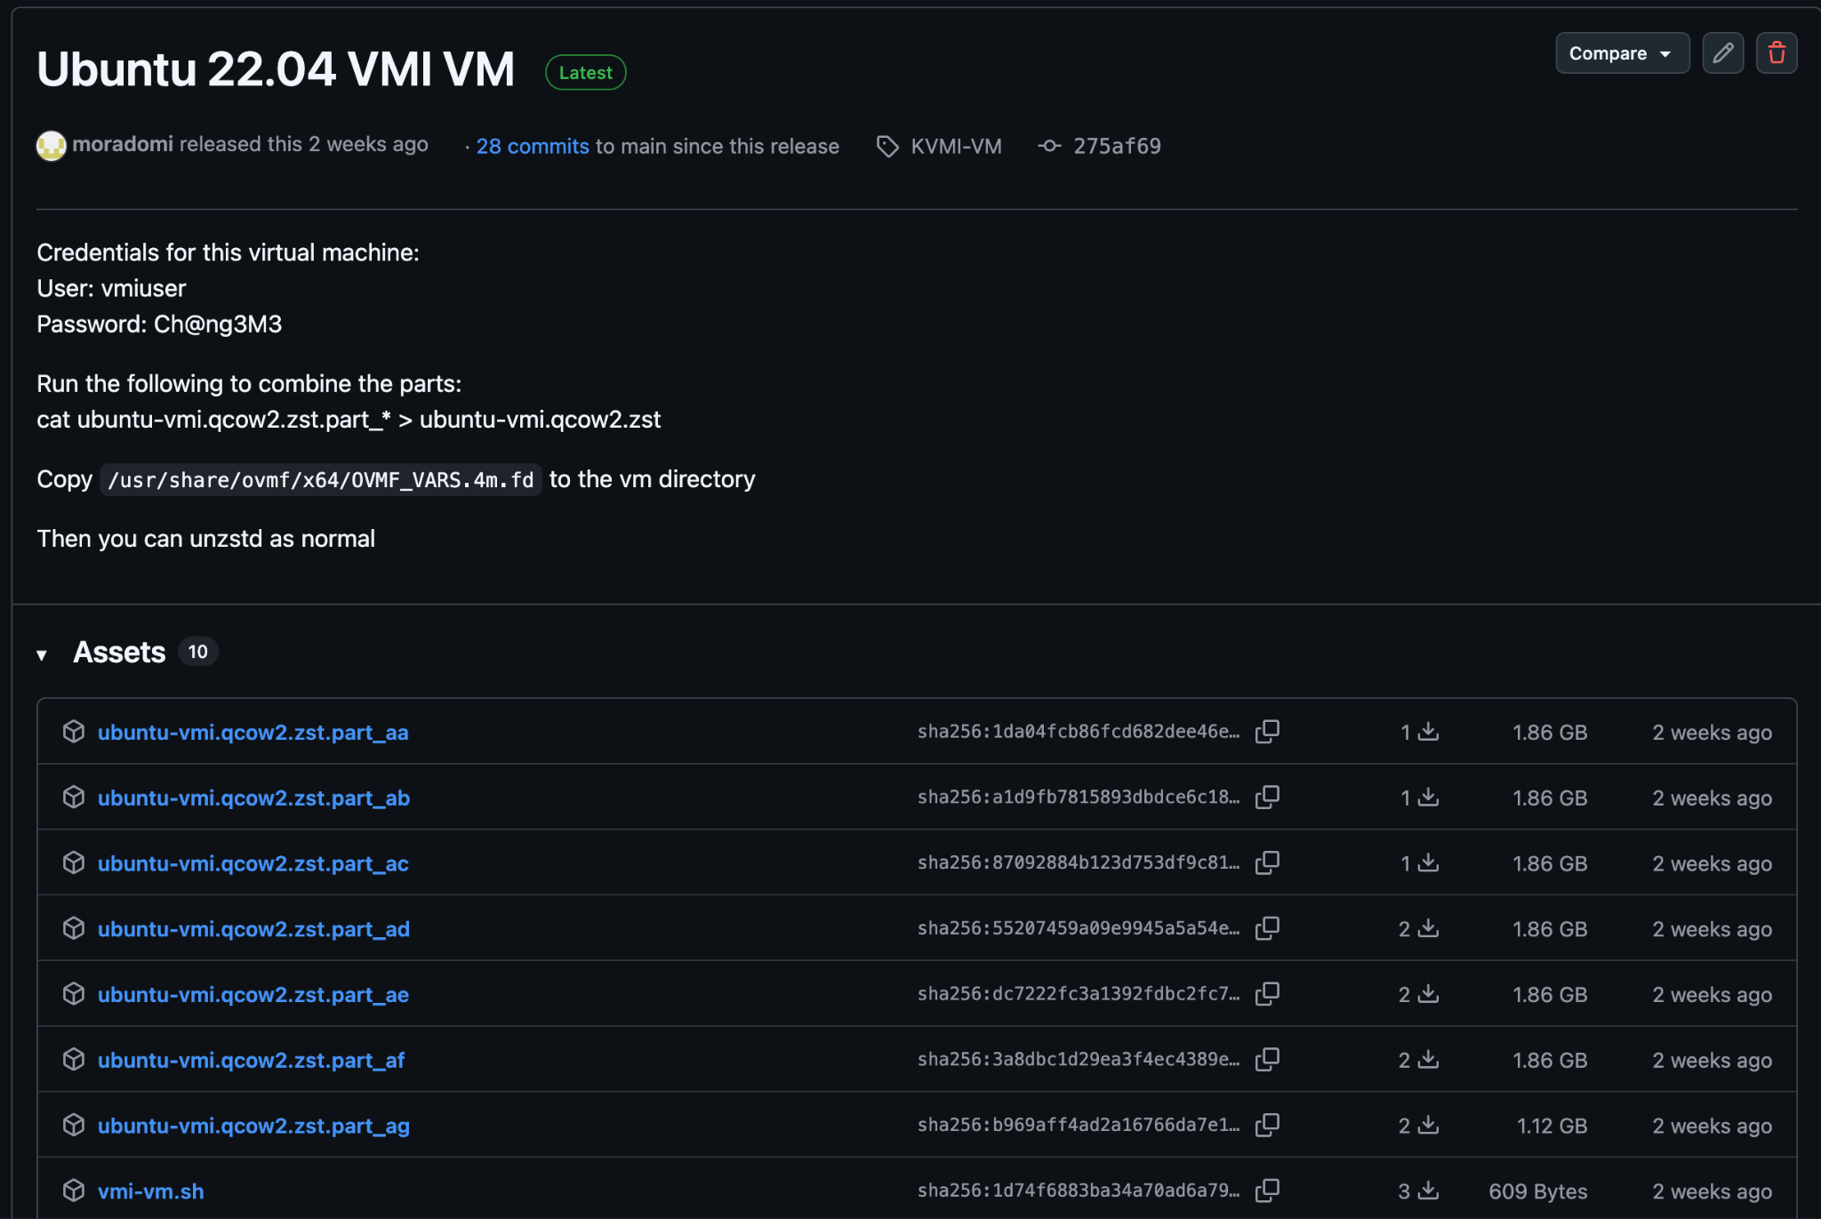
KVMI VM
Result
  User can download VM image from github releases
  User is able to run it in QEMU
  User can introspect on nested virtual machines using RootView or other software utilizing libvmi
08/25/2026
RootView Project Plan
(Slide No.) ‹#›

Slide 9
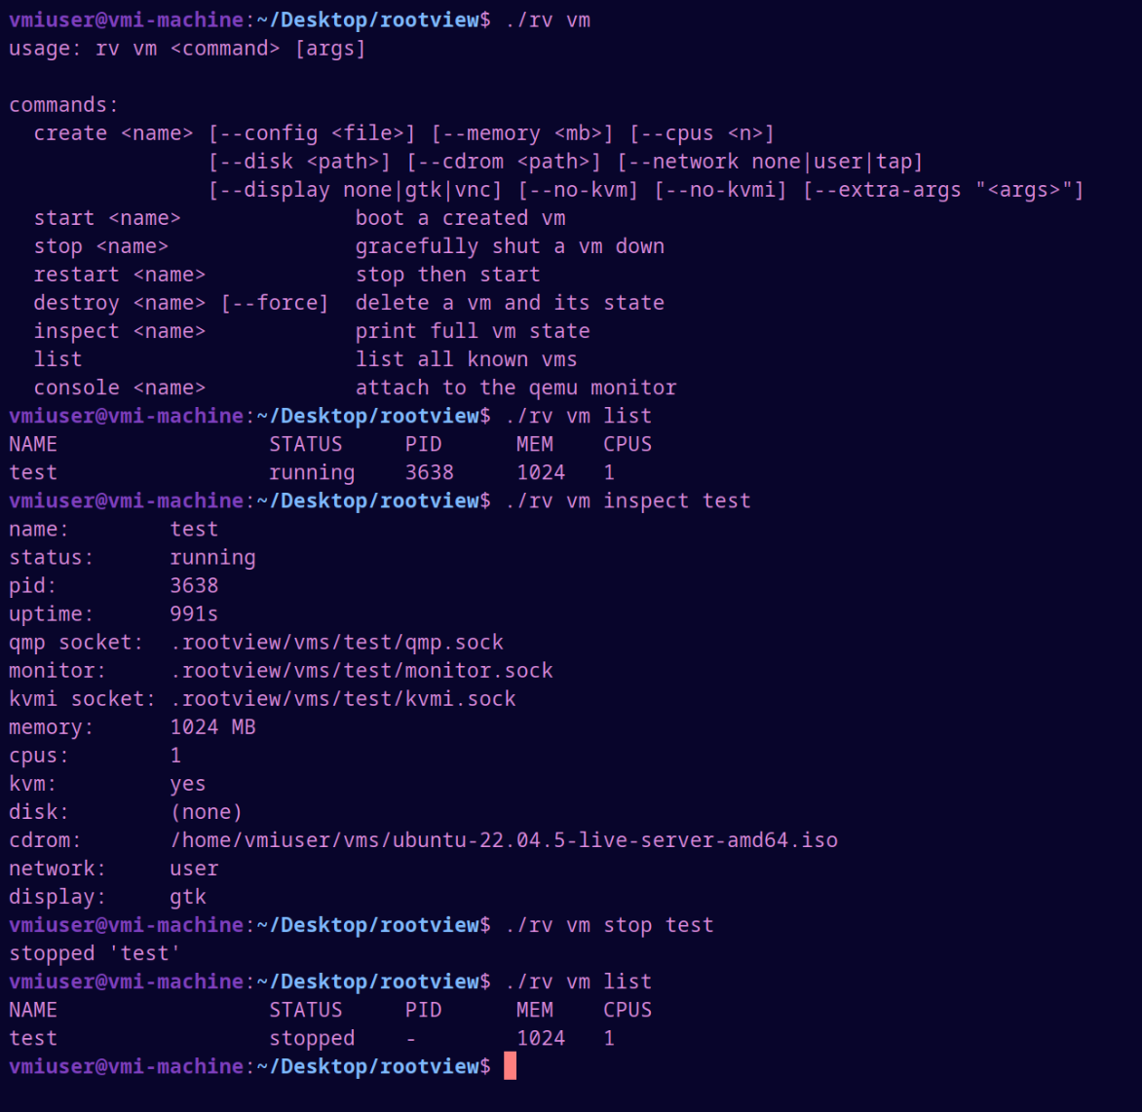
VM CLI
Full VM lifecycle CLI
  create, start, stop, restart, destroy, inspect, list, console
JSON-based configs
08/25/2026
RootView Project Plan
(Slide No.) ‹#›

Slide 10
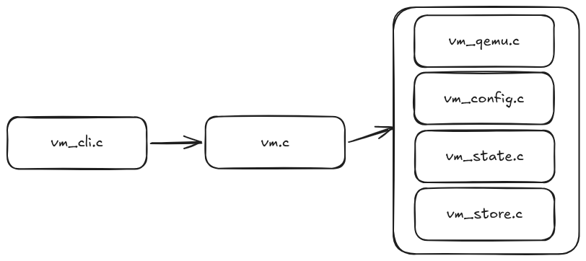
VM Internals
Custom-built JSON parser/serializer
Clean separation of concerns
  CLI, lifecycle logic, QEMU process management, state persistence, and on-disk storage each in their own module
08/25/2026
RootView Project Plan
(Slide No.) ‹#›

Slide 11
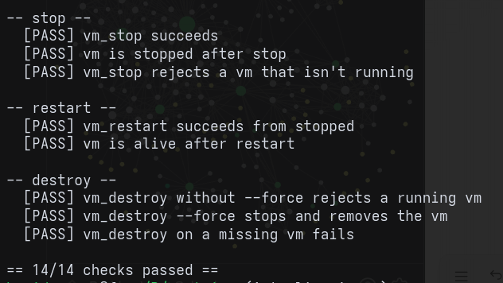
VM Safety and Validation
State-aware: blocks invalid transitions (double-start, destroying a running VM without --force) and detects stale/crashed PIDs
console command attaches directly to the QEMU monitor over a Unix socket for live debugging
Validated with an automated smoke test covering every lifecycle transition
08/25/2026
RootView Project Plan
(Slide No.) ‹#›

Slide 12
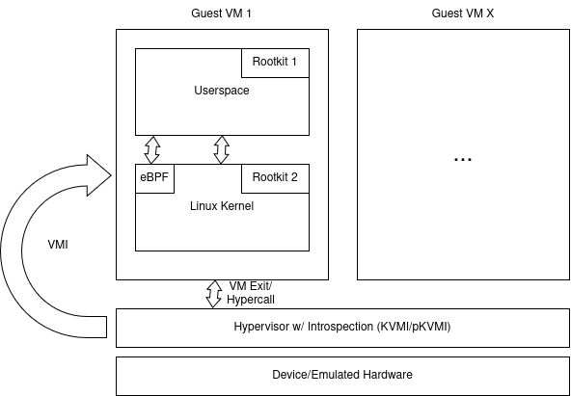
VMI Tooling
Low-level interfaces with KVMI
R/W GPA and GVA
R/W guest system registers
VM-Exit hooks
user can use these
08/25/2026
RootView Project Plan
(Slide No.) ‹#›

Slide 13
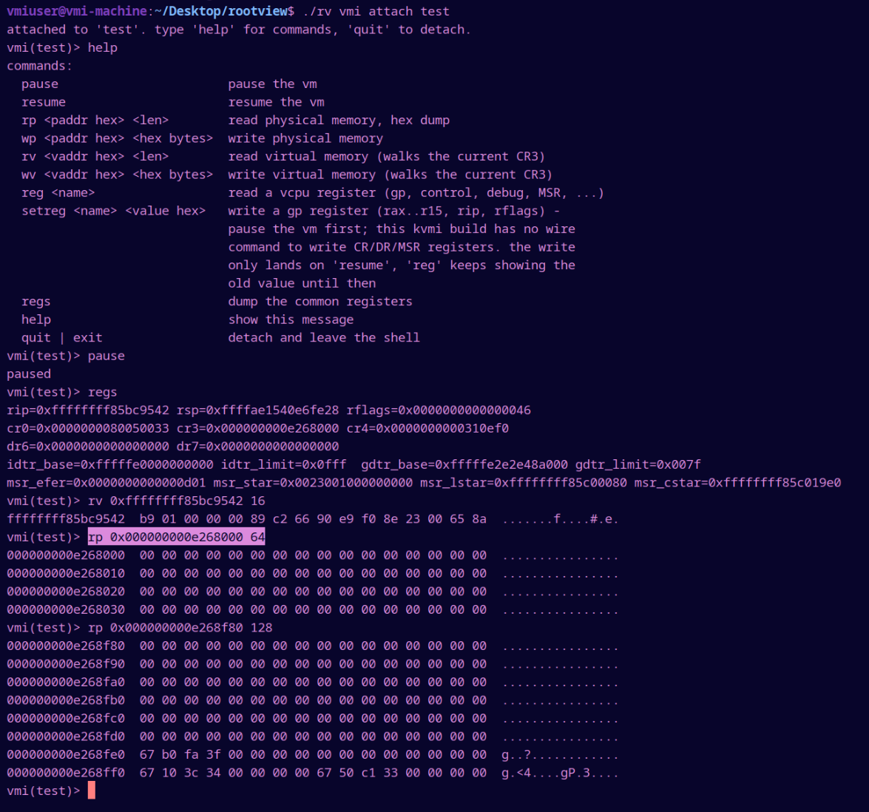
VMI Tooling
system regs
virt mem read
phys mem read
last few entries of the L4 page table
(kernel address space)
08/25/2026
RootView Project Plan
(Slide No.) ‹#›

Slide 14
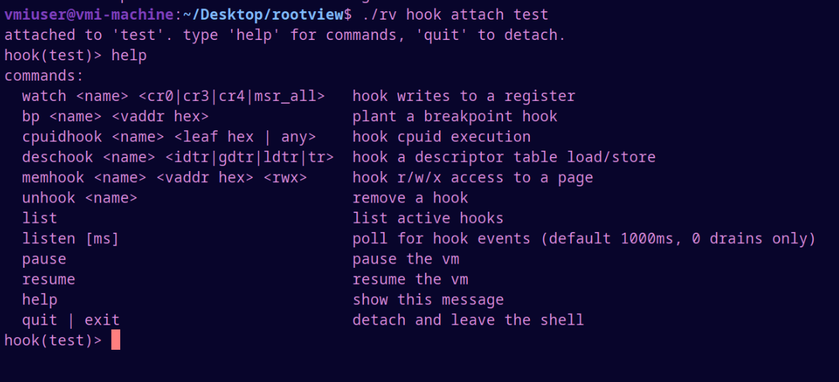
Exit Hook Tooling
Hooks on:
KVMI_EVENT_CPUID
KVMI_EVENT_DESC
KVMI_EVENT_PF
(EPT access)
08/25/2026
RootView Project Plan
(Slide No.) ‹#›

Slide 15
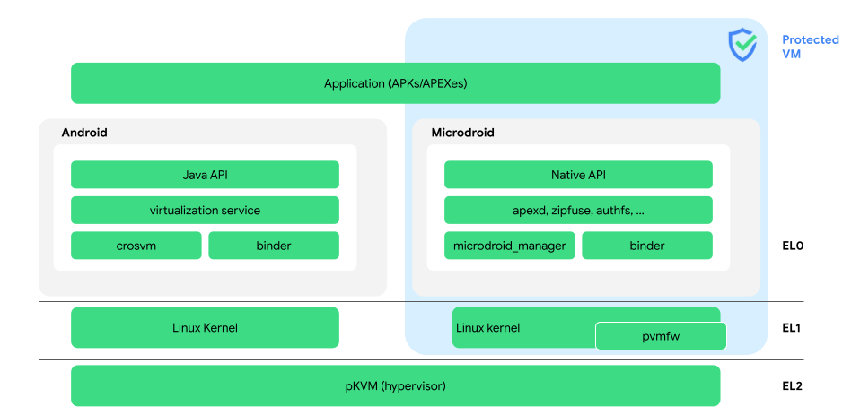
pKVMI tooling???
a lot of newer android phones use pKVM in EL2
this is a fairly new implementation (2022/2023)
no tools like KVMI exist for it
08/25/2026
RootView Project Plan
(Slide No.) ‹#›

Slide 16
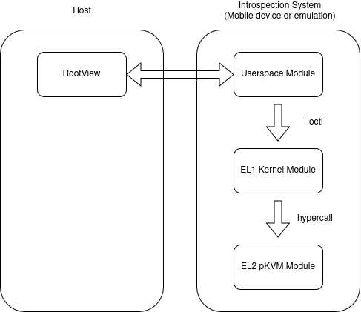
pKVMI tooling???
luckily unlocked pixel phones allow us to write modules (usually its for hardware manufacturers)
the goal is to write a module that will give us introspection
circumvents the whole purpose of pKVM
it is not safe for non-research devices
08/25/2026
RootView Project Plan
(Slide No.) ‹#›

Slide 17
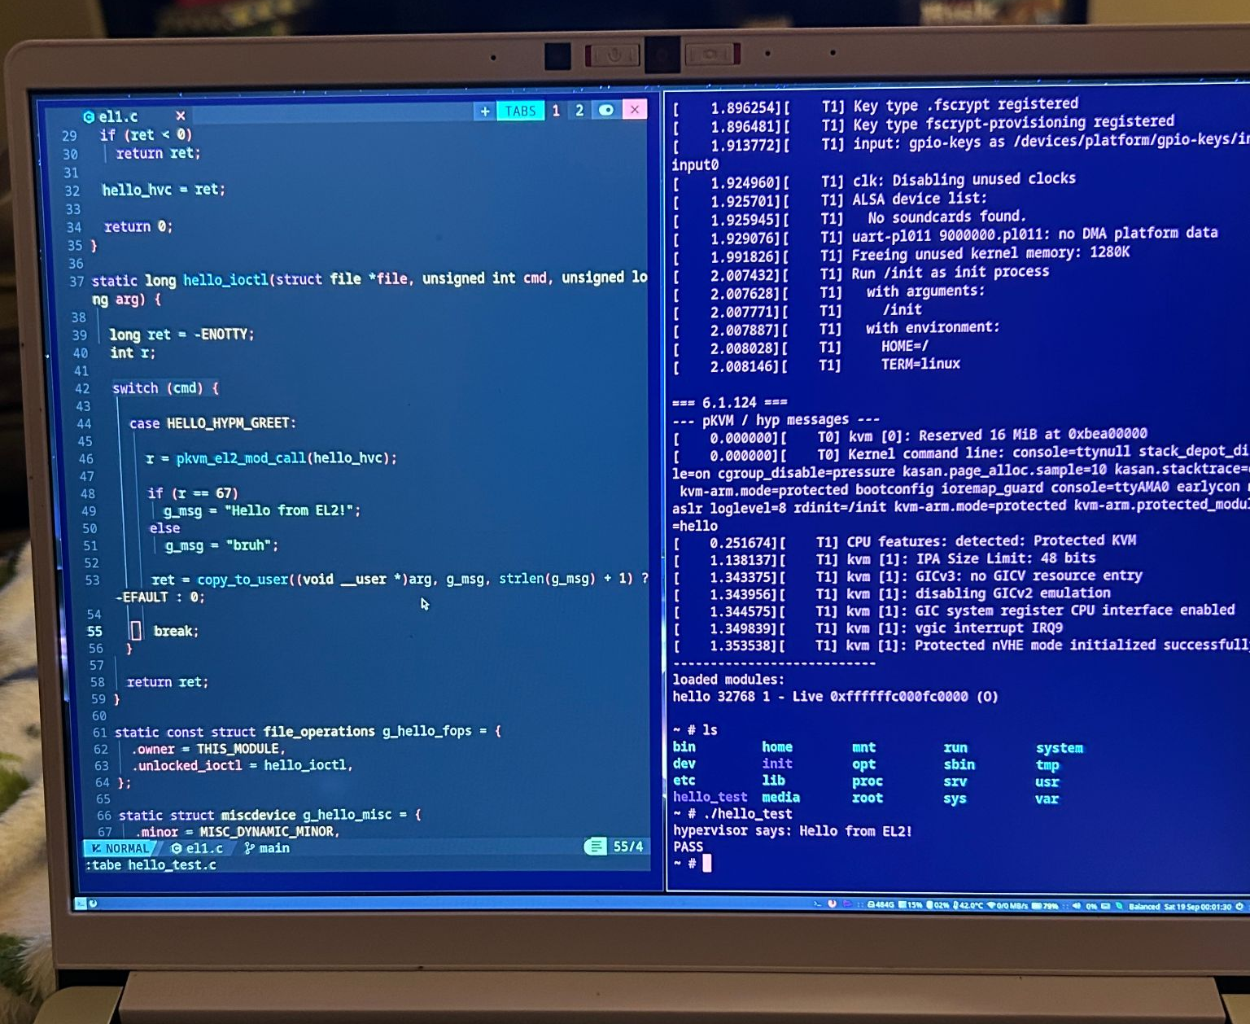
Hello from EL2!!
Emulation for development
08/25/2026
RootView Project Plan
(Slide No.) ‹#›

Slide 18
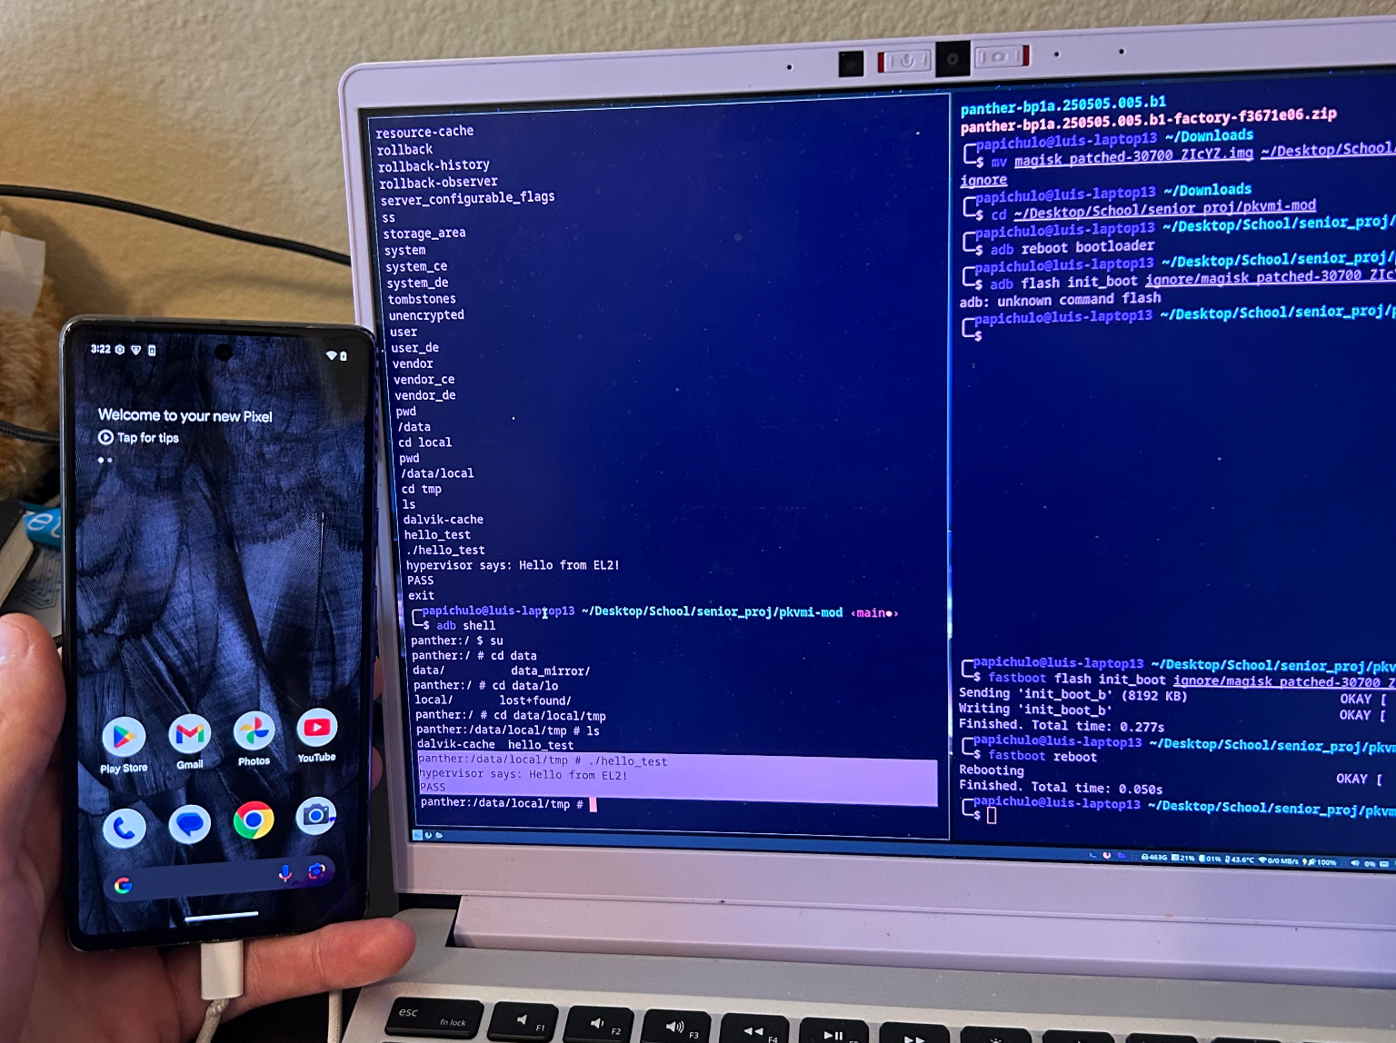
Hello from EL2!!
Works on a real Pixel 7 phone
08/25/2026
RootView Project Plan
(Slide No.) ‹#›

Slide 19
Milestone 1 Progress
Task | Completion | Luis | Braiden | Dominick | Dylin
Develop VM setup tooling (CLI, JSON configs, introspection integration) | 100% | 10% | 45% | 45% | 0%
Develop web server for users | 100% | 0% | 0% | 0% | 100%
Write LibVMI introspection backend | 100% | 100% | 0% | 0% | 0%
Requirements Document | 100% | 25% | 25% | 25% | 25%
Design Document | 100% | 25% | 25% | 25% | 25%
Test Plan | 100% | 25% | 25% | 25% | 25%
08/25/2026
RootView Project Plan
(Slide No.) ‹#›

Slide 20
Milestone 2
Expand capabilities via pKVM tooling
OS and eBPF Analysis
Web UI integration with M1 work
“what is going on here?”
08/25/2026
RootView Project Plan
(Slide No.) ‹#›

Slide 21
Milestone 2 Responsibilities
Task | Luis | Braiden | Dominick | Dylin
pKVM module VMI | 100% | 0% | 0% | 0%
Linux Kernel Introspection | 10% | 90% | 0% | 0%
Initial eBPF Introspection | 10% | 0% | 90% | 0%
Initial Python Bindings | 0% | 0% | 0% | 100%
Bindings Integrations w/ web UI | 0% | 0% | 0% | 100%
08/25/2026
RootView Project Plan
(Slide No.) ‹#›

Slide 22
Questions?
08/25/2026
RootView Project Plan
(Slide No.) ‹#›

