Slide 1
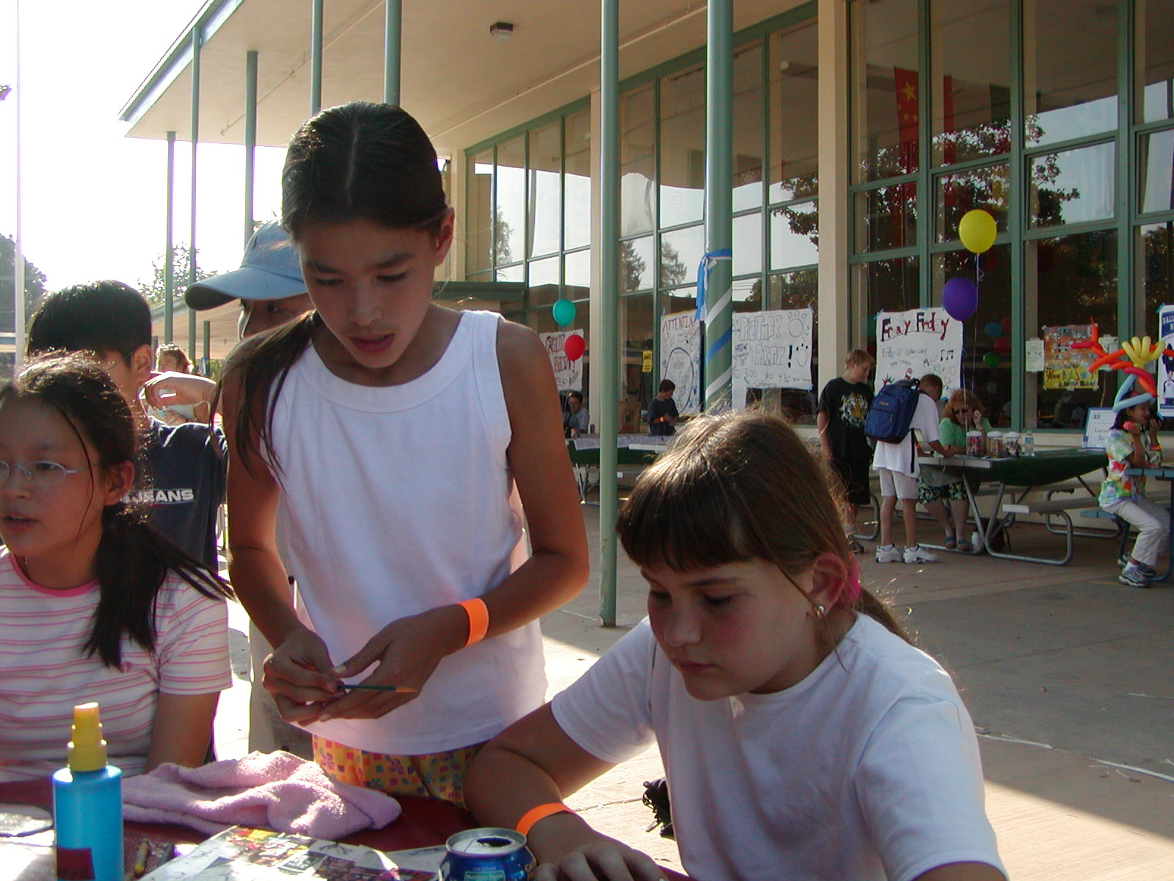
Sustaining a
Community Tradition of Extraordinary Education

Slide 2
Who are We?
Palo Alto Partners in Education is a nonprofit 501c-3 that is dedicated to sustaining outstanding public education in Palo Alto.
Raises private funds for all Palo Alto public schools
Protects our schools from politics and the economy
Provides predictable revenue to enable longer-term program planning and implementation
Partners with PTAs, Boosters, principals and PAUSD
Is the result of the merger of ASF and PAFE

Slide 3


Our School District
PAUSD: Excellence By Design
Standard & Poors “Outperformer”
  “we outperformed demographically similar school districts in reading and math proficiency for two consecutive years (2001-2003).”
Outstanding SAT scores, averaging 1278
92% of high school graduates go onto college
Numerous awards and recognitions
Whole child orientation

Slide 4
What is a ‘Basic Aid’ District?
“A district whose property tax revenues exceed the ‘revenue limit’ and therefore keeps all of their property tax revenue.”
Only 60 of 1000 districts in CA are Basic Aid
Experience Higher Revenue from Property Taxes than ‘revenue limit’ districts
Deal with Uncertainty due to fluctuations in property tax
Enrollment Growth Not Funded
Revenue Info delayed until after the fiscal year is over

Slide 5
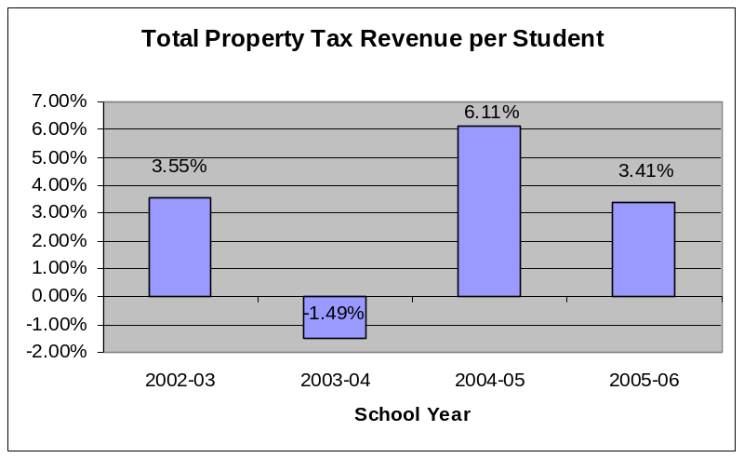
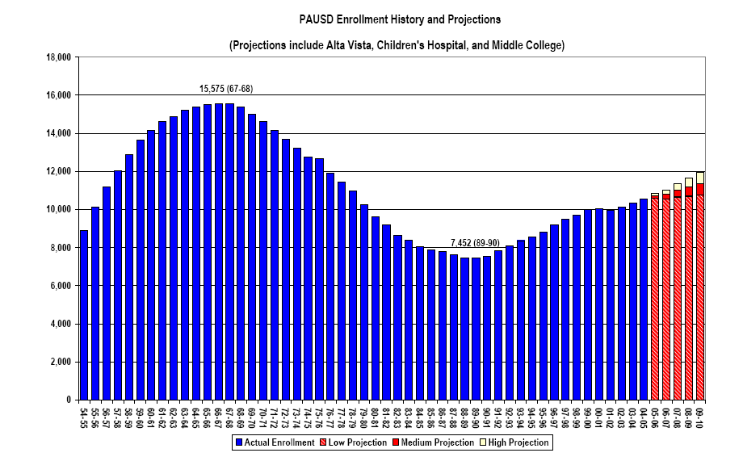
2002-05: Challenging Times
$6.5 million in budget cuts
$3.4 million in reserves used
Uncertain property tax revenue
Rising costs and enrollment
District ‘cut to the bone’

Slide 6
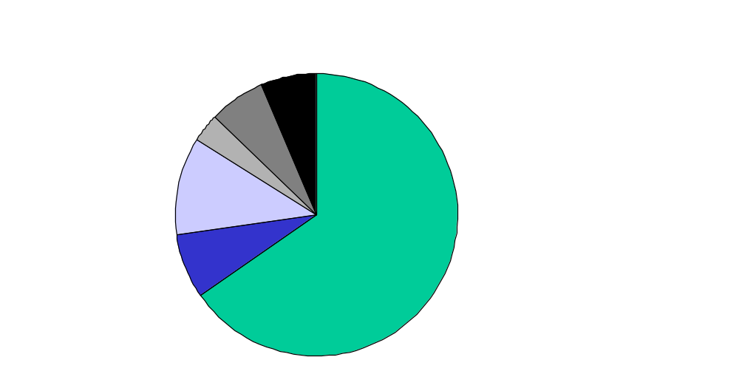
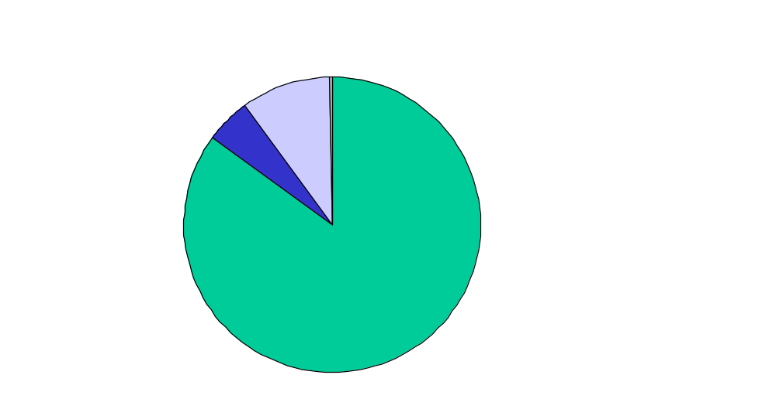
2005-06 PAUSD Budget Overview
Source of Funds ($M)
$121.7M Total
Use of Funds ($M)
$124.0M Total
Other
$7.9
Contract
Services
$11.4
Capital &
Other
$1.7
Lease
$7.8
Supplies & Mat’ls
$6.2
Federal
$4.0
State
$13.4
Property
Tax
$79.6
Parcel Tax
$9.0
Salaries &
Benefits
$104.7
Source: PAUSD 2005-06 Revised September Budget
Notes:
Source: PAUSD 2003-04 Fiscal Facts

Slide 7

How Palo Alto Ranks
(Data Unadjusted for Cost of Living)
2004-05 Survey Data
Palo Alto
$10,768
Per Student
New Trier, IL
$15,800
Per Student
Chappaqua, NY
$19,811
Per Student
Data Source: Excerpt from Campaign for Excellence issue paper authored by Lauren Janov. Figures above are based on each school district’s 2004-05 projected expenditures collected in a Spring 2005 telephone survey. Different school districts may calculate their expenditures differently, and so may not be directly comparable.

Slide 8
Palo Alto
Partners in Education is here to step into the gap.

Slide 9
Accomplishments in 2004-2005
Successfully implemented a joint stand-alone direct appeal campaign
Successful Fundraising Year:
  Donated $1,272,628 for elementary schools ($269/student)
  Donated $500,000 for secondary schools ($71/student)
    Paly is receiving $121,115
  Raised additional $120K through Realtor Campaign, Honor Your Teacher and Online Auction
Completed the merger of ASF and PAFE and elected new Board

Slide 10
Major Goals for the Year
May 2005 – April 2006
Create a Marketing & Communications Plan
Raise $2M+ Total for Three Funds
      Elementary
      Secondary
      Teacher Grant
Maintain close working relationship with district to ensure funds are put to good use
Conduct long range strategic planning

Slide 11
2005 -2006 Campaigns
Campaign | Date | Fund Supported
Italian Street Fair | August 2005 | Teacher Grant
Parent Direct Appeal | Sep 2005 – Feb 2006 | Elementary, Secondary
Major Donor | Sep 2005 – Feb 2006 | Elementary, Secondary
Alumni / Community | Nov 2005 – Feb 2006 | Unrestricted
Corporate/Business | Sep 2005 – Feb 2006 | Unrestricted
Realtor | Apr 2006 – May 2006 | Unrestricted
Honor Your Teacher DA | May 2006 | Teacher Grant
May Fete Town Fair | May 2006 | Teacher Grant

Slide 12
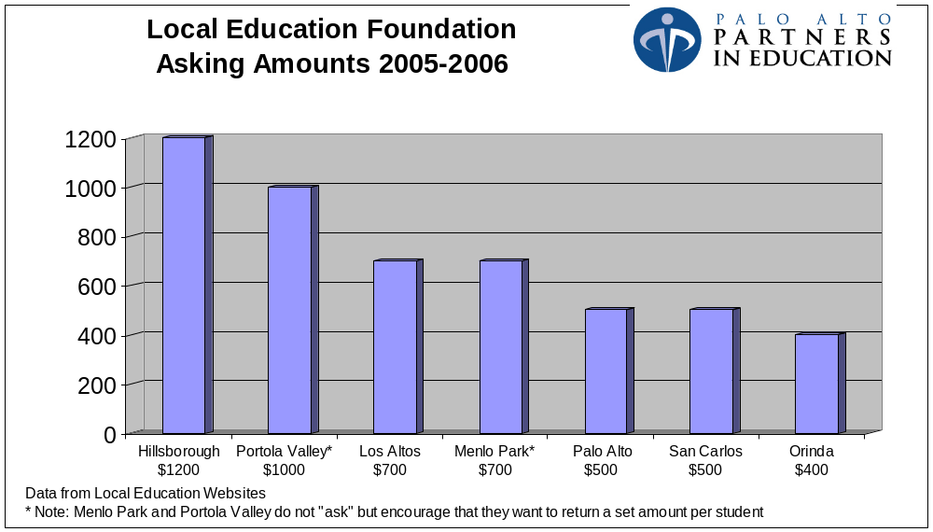

Slide 13
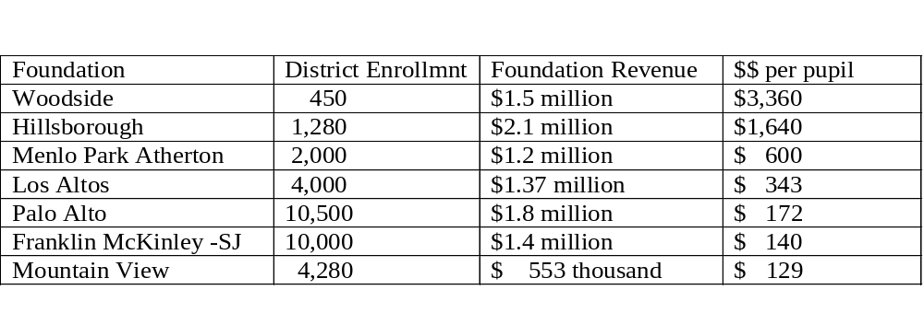
Local Education Foundation Revenues
Most data is from 2003/2004

Slide 14
Direct Appeal Status
Data as of 1/27/06
  Elementary Fund $811,000
  Secondary Fund $288,000
  Teacher Grant Fund $6,500
  Unrestricted $290,000
  TOTAL $1,395,000

Slide 15
How Privately Raised Funds Make a Difference
(Elementary School example)
Private funds (PTA + PIE) account for 40-67% of principals discretionary spending
PIE funds pay for
  classroom aides
  reading/math specialists
  counseling services
  field duty
  PA Junior Museum science program
  expanded Spectra Art

Slide 16
How Privately Raised Funds Make a Difference
(Secondary School example - Paly)
PIE funds pay for:
~$90,000 in classified support
  .5 man level campus supervisor/security
  .75 man level college center
  .5 man level attendance
  .5 man level student support services
~$30,000 in elective support

Slide 17

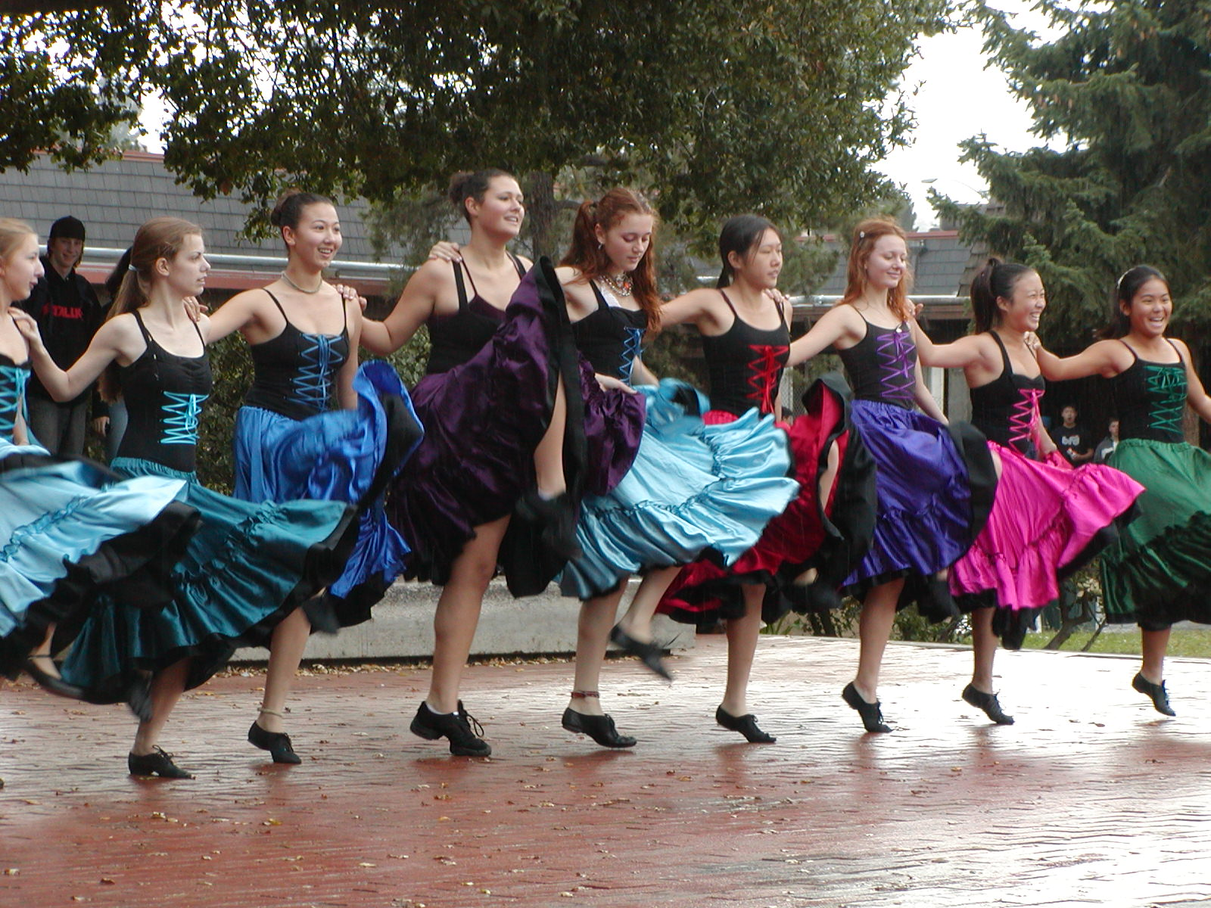
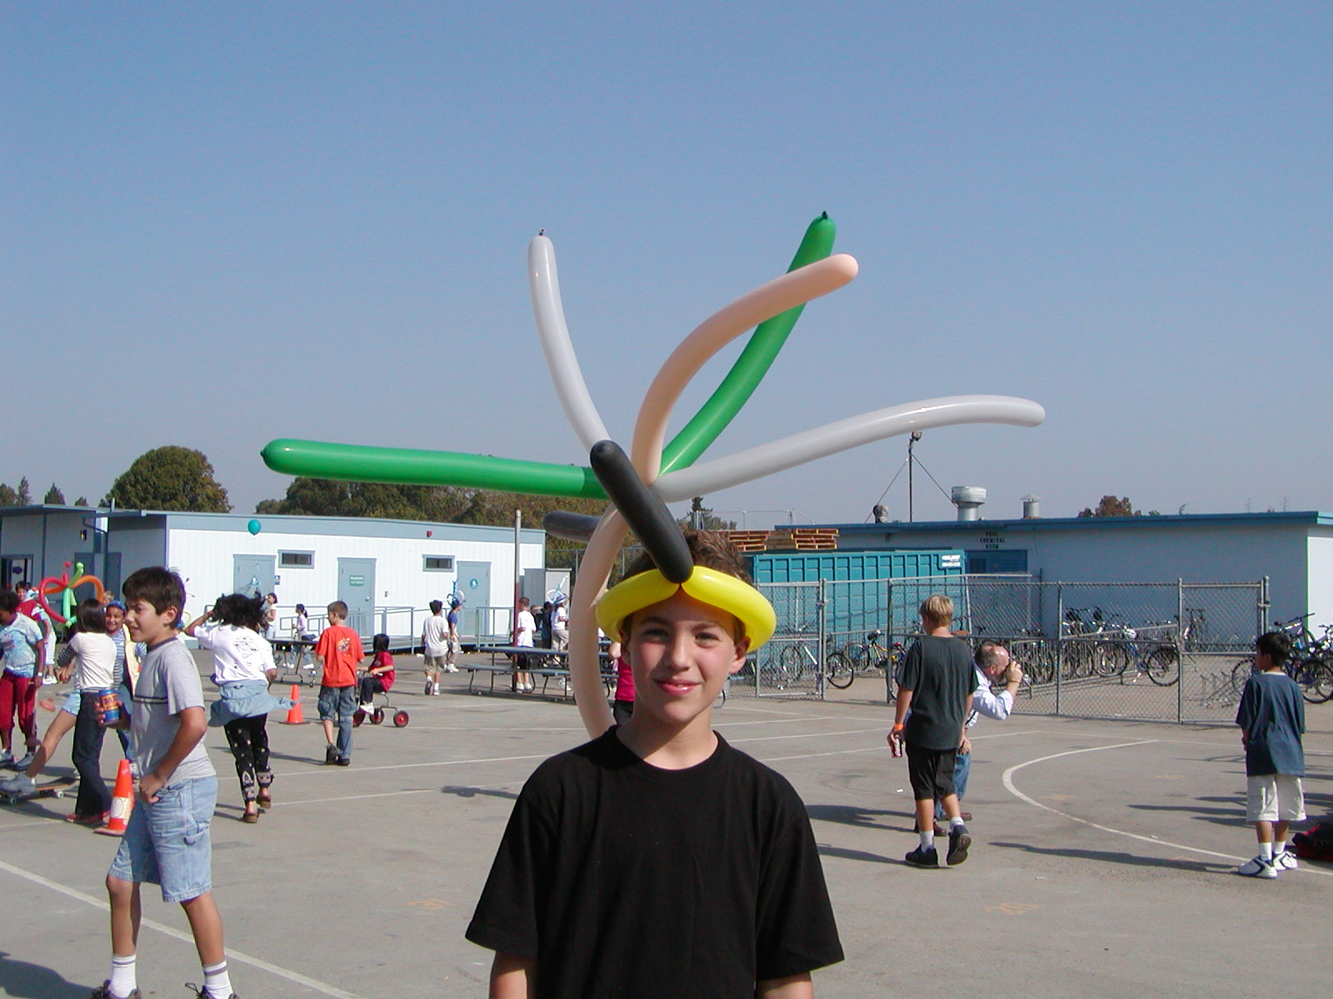
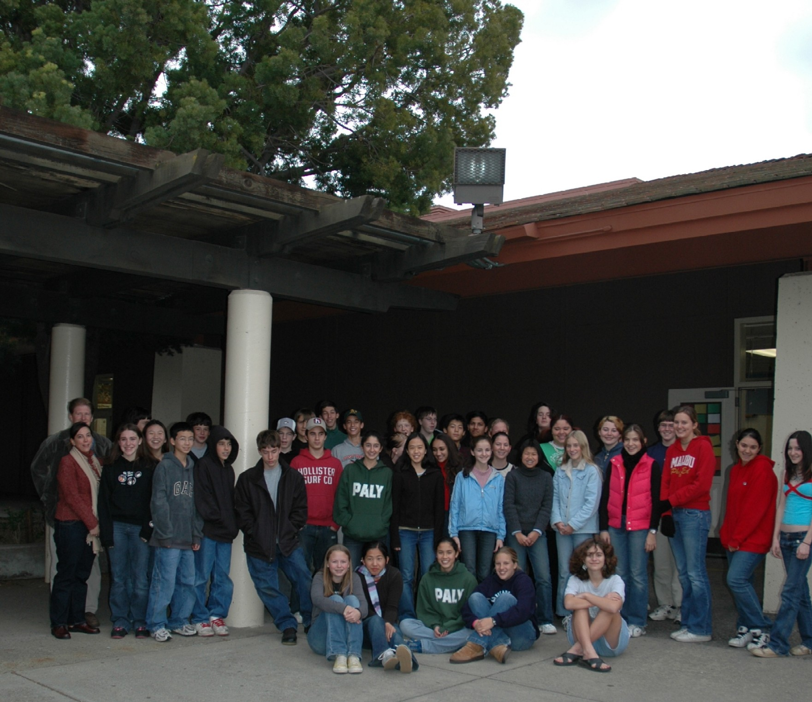
Can You Help?
Every gift makes a difference
You can support vital programs in our schools
Only with your leadership can we keep PAUSD great!

Slide 18
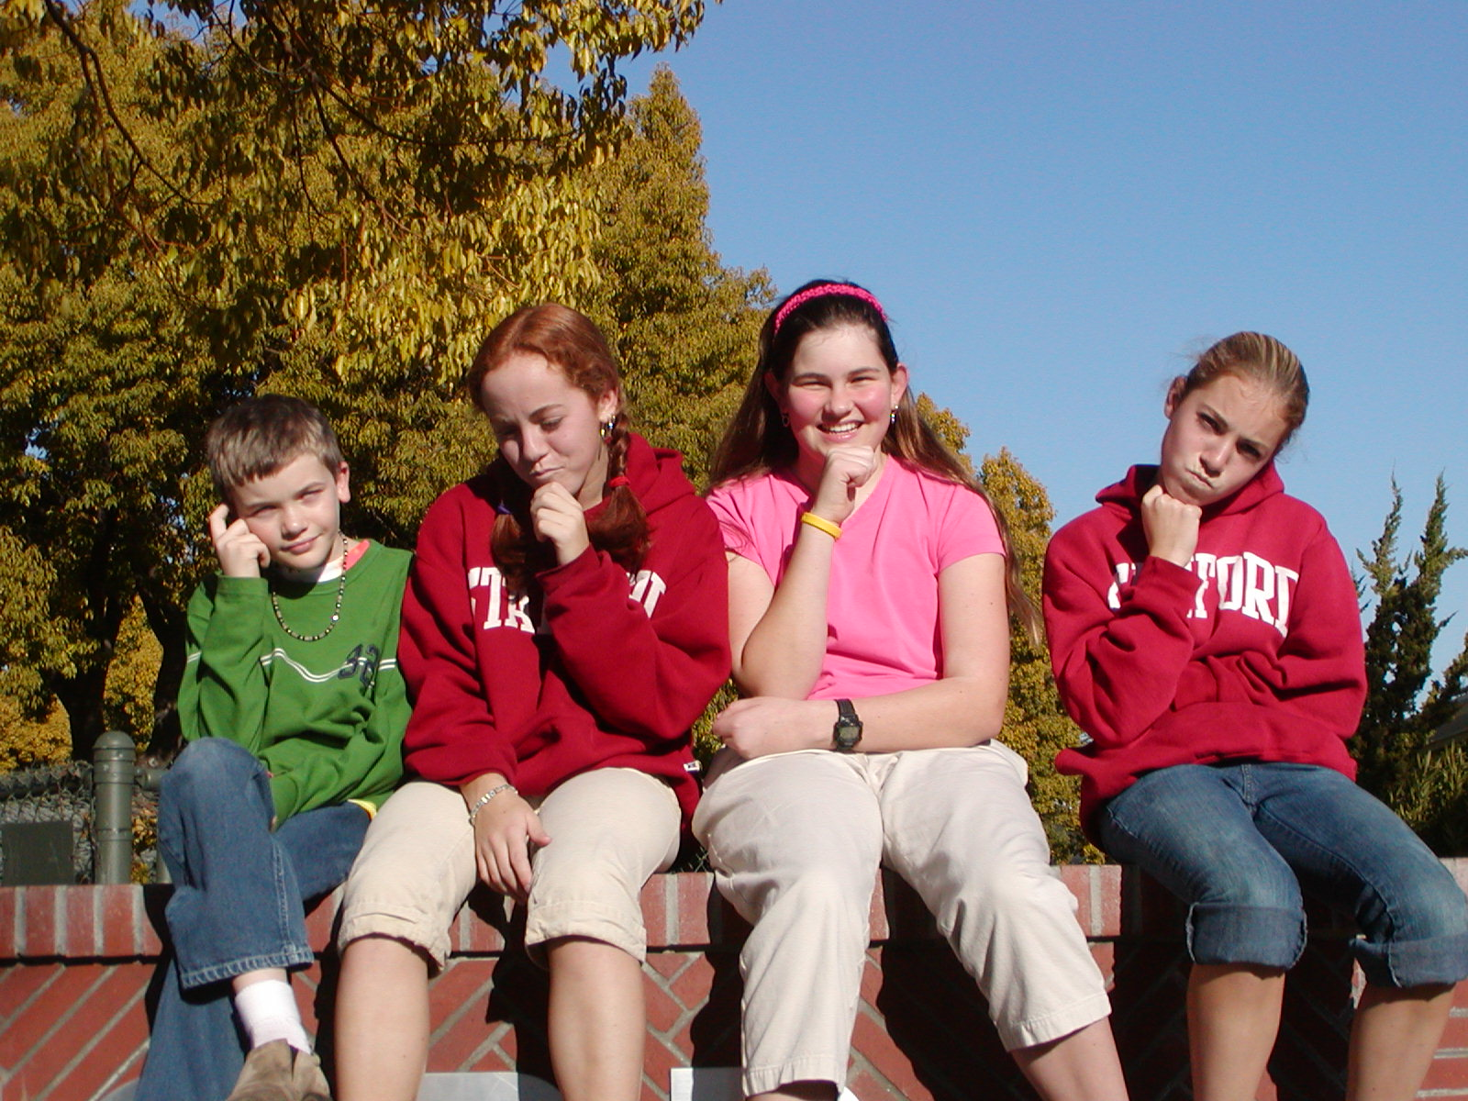
Palo Alto Leaders Investing in PAUSD’s Brightest Future: Its Children

