Slide 1
Company XYZ - TV Campaign Report Establishing a baseline: Overall Metrics
Total Purchases: 236 / Mean # of Purchases: 8 per network
Total Spend: $221,436.84 / Mean Spend: $11,654.57 per network
Total Lift: 20,487 visitors / Mean Lift: 1078 visitors per network
Overall Cost Per Visitor: $10.81 / Average Cost Per Visitor: $23
Overall Conversion Rate: 1.15% / Average Conversion Rate: 1.4%
Overall Cost Per Acquisition: $938.29 / Average Cost Per Acquisition: $1841.35
236 Purchases were attributed to 28 distinct channels.
Out of 236 purchases, 61 of them came from channels where there was no spend, spread across 13 distinct channels. Three of these purchases coming from (blank) and 13 purchases from other.

Slide 2
How much does it cost to acquire a customer through TV?
Total purchases 236, attributed to 28 distinct channels.
Of these purchases, 61 of them came from channels where there was no spend, spread across 13 distinct channels.
Three of these purchases coming from (blank) and 13 purchases from other.
Total Spend: $221,436.84
On average, it cost $1265.35 per acquisition.
On average, it cost $10.81 to bring one visitor to your website
Total Lift: 20,487 visitors

Slide 3
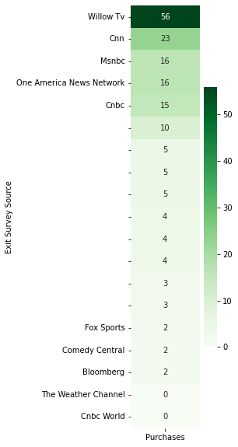
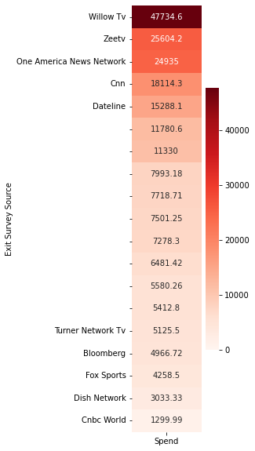
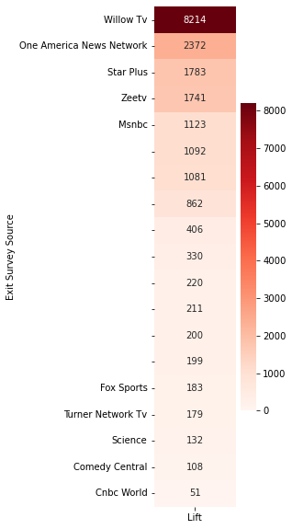
Purchases, Spend, and Lift – Top and Bottom 5 Channels – Recurring Characters
At the top, we see the following channels in all three categories:
Willow TV
One America News
With the following in two out of three categories
ZeeTV
CNN
MSNBC
At the bottom, we see the following channels in all three categories:
Fox Sports
With the following in two out of three categories
Comedy Central
Bloomberg
CNBC World
Turner Network TV (TNT)

Slide 4
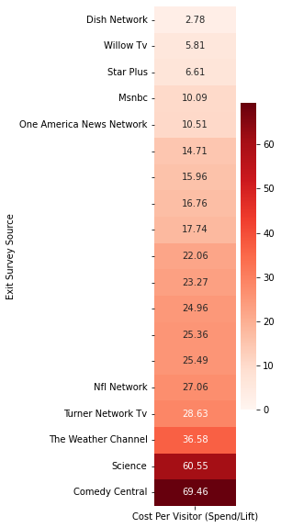
Cost efficiency – Cost Per Visitor Per Network (Spend/Lift)
At the top:
WillowTV, MSNBC, and One America News Network are among the top 5 in terms of Cost Per Visitor and are in the top 5 in terms of purchases.
Key Benchmark: Overall Cost Per Visitor (Total Spend / Total Lift): $10.81
Only the top 5 companies (pictured left) outperformed this metric.
At the bottom:
Comedy Central and The Weather Channel have very few purchases and are among the costliest in terms of generating Lift

Slide 5
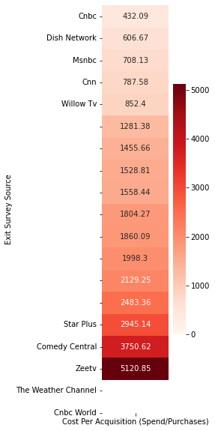
Cost efficiency – Cost Per Acquisition (CPA) (Spend/Purchases)
At the top:
WillowTV, CNN, MSNBC, and CNBC are among the top 5 in terms of Cost Per Acquisition and are in the top 5 in terms of purchases.
Key Benchmark: Overall Cost Per Acquisition (Total Spend / Total Purchases): $1265.35
Only the top 5 companies (pictured left) outperformed this metric.
At the bottom:
Comedy Central, The Weather Channel, and CNBC World have very few, or no purchases, and are among the costliest in terms of generating purchases.
Note: Weather Channel and CNBC World had zero purchases and calculating CPA isn’t possible.

Slide 6
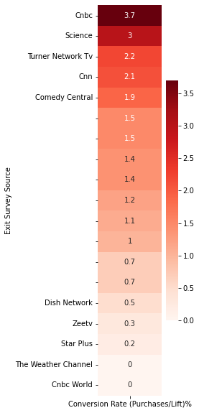
Conversion Rate (Purchases/Lift)%
At the top:
CNN and CNBC are among the top 5 in terms of Conversion Rate and are in the top 5 in terms of purchases.
Key Benchmark: Overall Conversion Rate (Total Purchases / Total Total): 0.9%
Most companies outperformed this metric.
At the bottom:
The Weather Channel and CNBC World have no purchases and thus have a conversion rate of 0%.
Of note: Comedy Central has low purchases but high conversion rate
Note: As mentioned earlier, Weather Channel and CNBC World are dead last because both had zero purchases.

Slide 7
What have we learned so far?
The good
The following channels ranked in top 5 for 2/3 of your metrics:
WillowTV (+2/3 metrics)
Highest Spend Overall
Highest Lift Overall
Highest Purchases Overall
MSNBC (+2/3 metrics)
Third Highest Purchases
Fourth Highest Lift
CNN (+2/3 metrics)
Second highest purchases
CNBC (+2/3 metrics)
Fourth Highest purchases
The bad
The following channels ranked in the bottom 5 for 2/3 of your metrics:
Comedy Central (-2/3 metrics)
Costliest in generating lift
Second costliest in generating purchases
Despite low purchases, has high conversion rate
CNBC World (-2/3 metrics)
Zero Purchases
CPA can’t be calculated
The following channels ranked in the bottom 5 for all three of your metrics:
The Weather Channel (-3/3 metrics)
Zero Purchases
CPA can’t be calculated
Third Costliest in generating lift

Slide 8
What else can we learn?

Slide 9
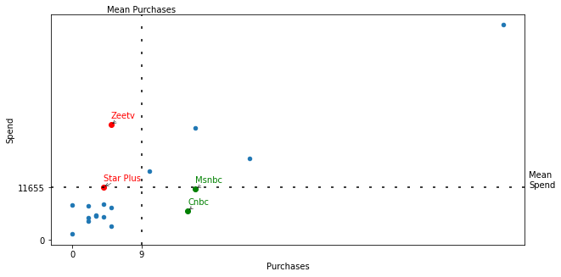
Purchases vs. Spend
Below Average Purchases, Above Average Spend:
ZeeTV
Star Plus
You’re spending more and getting less purchases, that’s bad!
Above Average Purchases, Below Average Spend: Good!
MSNBC
CNBC
You’re spending less and getting more purchases, that’s good!
Note: the graph is divided into four quadrants, sectioned off by Average Purchases (x) and Average Spend (y)

Slide 10
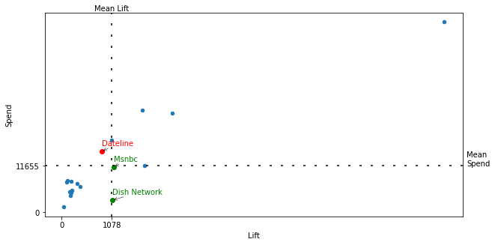
Lift vs. Spend
Below Average Lift, Above Average Spend:
Dateline
You’re getting less lift for your buck, that’s bad!
Above Average Lift, Below Average Spend: Good!
MSNBC
Dish Network
You’re getting more lift for your buck, that’s good!
Note: the graph is divided into four quadrants, sectioned off by Average Lift (x) and Average Spend (y)

Slide 11
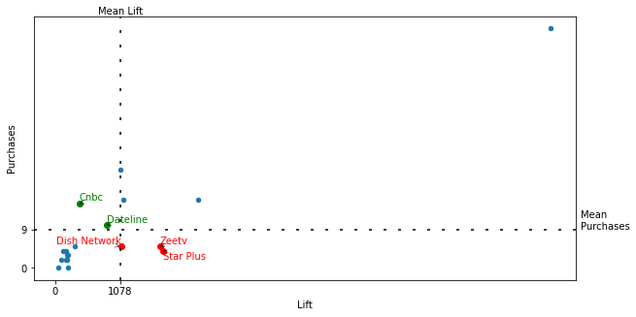
Lift vs. Purchases
Below Average Lift, yet Above Average Purchases: Good!
CNBC
Dateline
You’re getting less lift, but more purchases despite it, that’s good!
Above Average Lift, Below Average Purchases: Bad!
ZeeTV
Star Plus
Dish Network
Despite increased traffic, these customers don’t seem to want your product, that’s bad!
Note: the graph is divided into four quadrants, sectioned off by Average Lift (x) and Average Purchases (y)

Slide 12
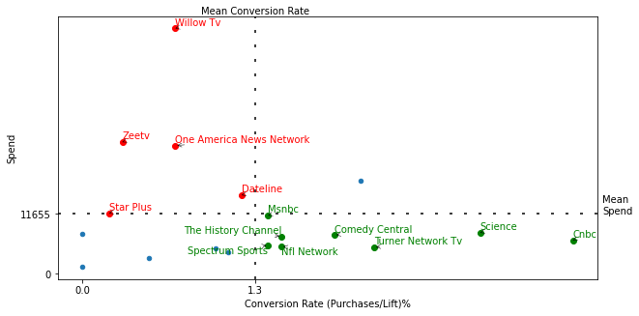
Conversion Rate vs. Spend
Low Conversion Rate, High Spend:
Willow TV
ZeeTV
One America News Network
Dateline
Star Plus
These channels have a low likelihood of a sale and are more expensive to advertise on, that’s bad!
High Conversion Rate, Low Spend:
CNBC
Science
Turner Network TV
Comedy Central
NFL Network
The History Channel
MSNBC
Spectrum Sports
These channels have a higher likelihood of a sale and are cheaper to advertise on, that’s good!
Note: the graph is divided into four quadrants, sectioned off by Average Conversion Rate (x) and Average Spend (y)

Slide 13
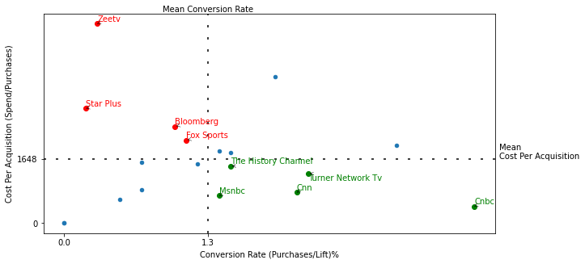
Conversion Rate vs. Cost Per Acquisition (CPA)
Low Conversion Rate, High Cost Per Acquisition
ZeeTV
Star Plus
Bloomberg
Fox Sports
These channels have a low likelihood of a sale and it’s costly to acquire a customer, that’s bad!
High Conversion Rate, Low Cost Per Acquisition
CNBC
Turner Network TV
CNN
The History Channel
NFL Network
These channels have a high likelihood of a sale and it’s cheaper to acquire a customer, that’s good!
Note: the graph is divided into four quadrants, sectioned off by Average Conversion Rate (x) and Average CPA (y)

Slide 14
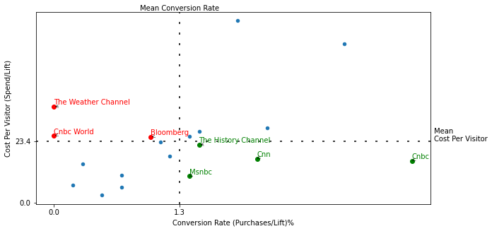
Conversion Rate vs. Cost Per Visitor
Low Conversion Rate, High Cost Per Visitor:
The Weather Channel
No Purchases
CNBC World
No Purchases
Bloomberg
These channels have a lower likelihood of acquiring a customer and a higher cost to get them to your website, that’s bad!
High Conversion Rate, Low Cost Per Visitor: Good!
CNBC
CNN
The History Channel
MSNBC
These channels have a higher likelihood of acquiring a customer and a lower cost to get them to your website, that’s good!
Note: the graph is divided into four quadrants, sectioned off by Average Conversion Rate (x) and Average Cost Per Visitor (y)

Slide 15
Which networks to spend more money?
MSNBC (+4)
CNBC (+5)
Science (+1)
Turner Network TV (+2)
Comedy Central (+1)
NFL Network (+2)
The History Channel (+3)
CNN (+2)
Spectrum Sports (+1)
Maybe?
Dish Network (+1 / -1)
Dateline (+ 1 / -2)
Honorable Mentions, no spend yet customers attributed their purchase to these channels:
Fox News (+2)
Aapka Colors
HGTV
ESPN
Sony Entertainment TV
Television Food Network
Other

Slide 16
Which networks to stop spending on?
ZeeTV (-4)
Star Plus (-4)
WillowTV (-1) (Highest number of purchases though…)
One America News Network (-1)
Bloomberg (-2)
Fox Sports (-1)
Weather Channel (-1) (no purchases)
CNBC World (-1) (no purchases)

Slide 17
Some Channels have no spend, but high purchases
ADD GRAPH SHOWING % BREAKDOWN OF CHANNELS WITH NO SPEND BUT PURCHASES
Fox news accounts for 23.0% of the

Slide 18
How can the exit survey be improved?

Slide 19
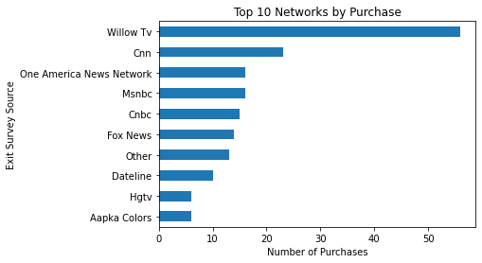
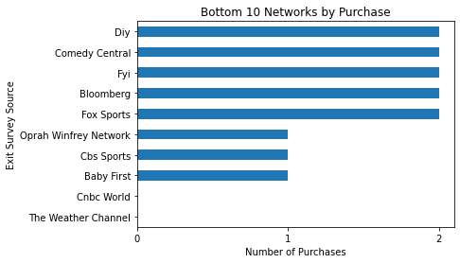
Purchases by Network
Which Networks had the highest number of purchases?
Which Networks had the lowest number of purchases?
Summary:
Willow TV was by far the best performer
CNBC World and Weather Channel had 0 purchases

