Slide 1
Company XYZ - TV Campaign Report
Establishing a baseline: Overall Metrics
Total Purchases: 236
Total Spend: $221,436.84
Total Lift: 20,487 visitors

Slide 2
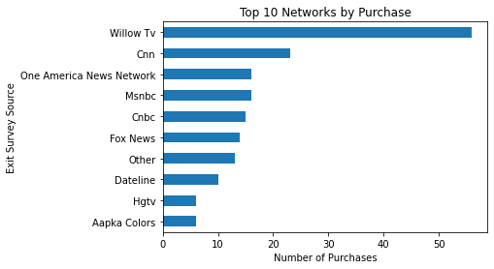
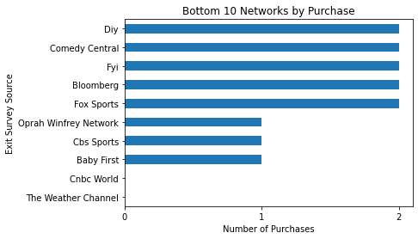
Purchases by Network
Which Networks had the highest number of purchases?
Which Networks had the lowest number of purchases?
Summary:
Willow TV was by far the best performer
CNBC World and Weather Channel had 0 purchases

