Slide 1
Company XYZ - TV Campaign Report Establishing a baseline: Overall Metrics
Total Purchases: 236 / Mean # of Purchases: 8 per network
Total Spend: $221,436.84 / Mean Spend: $11,654.57 per network
Total Lift: 20,487 visitors / Mean Lift: 1078 visitors per network
Overall Cost Per Visitor: $10.81 / Average Cost Per Visitor: $23
Overall Conversion Rate: 1.15% / Average Conversion Rate: 1.4%
Overall Cost Per Acquisition: $938.29 / Average Cost Per Acquisition: $1841.35
236 Purchases were attributed to 28 distinct channels.
Out of 236 purchases, 61 of them came from channels where there was no spend, spread across 13 distinct channels. Three of these purchases coming from (blank) and 13 purchases from other.

Slide 2
How Much does it cost to acquire a customer through TV?

Slide 3
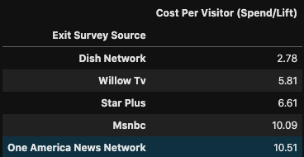
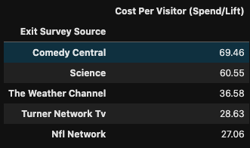
Cost efficiency – Cost Per Visitor (Spend / Lift)
Most Cost Efficient
Dish Network
Willow TV
Star Plus
MSNBC
One America News Network
Least Cost Efficient
Comedy Central
Science
The Weather Channel
Turner Network TV
NFL Network

Slide 4
Cost efficiency – Cost Per Acquisition (Spend / Purchases)
Best
CNBC
Dish Network
MSNBC
CNN
WillowTV
Worst
Weather Channel
No Purchases
CNBC World
No Purchases
ZeeTV
Comedy Central
Star Plus

Slide 5
Conversion rate (Purchases/Lift)
Best
CNBC
Science
Turner Network TV
CNN
Comedy Central
Worst
Weather Channel
No Purchases
CNBC World
No Purchases
Star Plus
ZeeTV
Dish Network

Slide 6
Some Channels have no spend, but high purchases
Fox news accounts for 23.0% of the

Slide 7
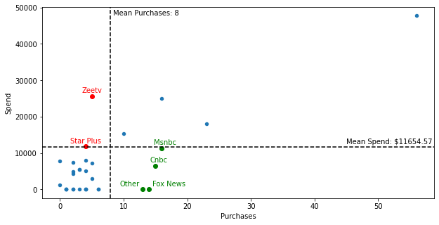
Purchases vs. Spend
High Purchases, Low Spend: Good!
MSNBC
CNBC
Fox News
Zero Spend but 5.9% of total purchases
Other
Zero Spend but 5.5% of total purchases
Low Purchases, High Spend: Bad!
ZeeTV
Star Plus

Slide 8
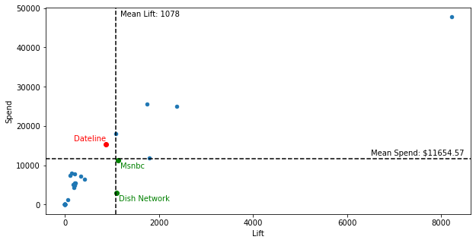
Lift vs. Spend
High Lift, Low Spend: Good!
MSNBC
Dish Network
Low Lift, High Spend: Bad!
Dateline

Slide 9
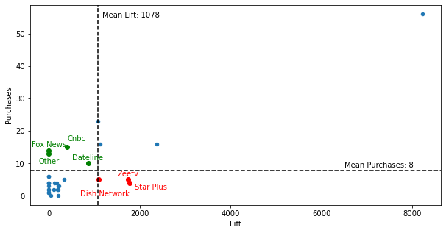
Lift vs. Purchases
Low Lift, High Purchases: Good!
CNBC
Dateline
Fox News
No Lift, but 5.9% of total purchases
Other
No Lift, but 5.5% of total purchases
High Lift, Low Purchases: Bad! These customers don’t seem to want your product despite visiting the website
ZeeTV
Star Plus
Dish Network

Slide 10
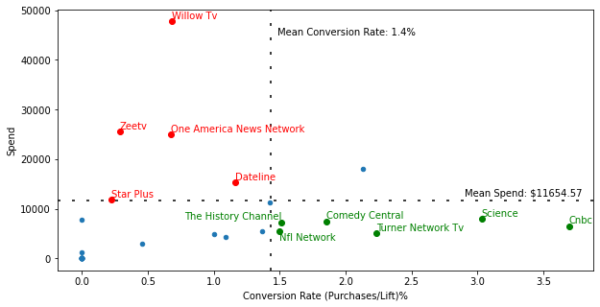
Conversion Rate vs. Spend
High Conversion Rate, Low Spend: Good!
CNBC
Science
Turner Network TV
Comedy Central
NFL Network
The History Channel
Low Conversion Rate, High Spend: Bad!
Willow TV
ZeeTV
One America News Network
Dateline
Star Plus

Slide 11
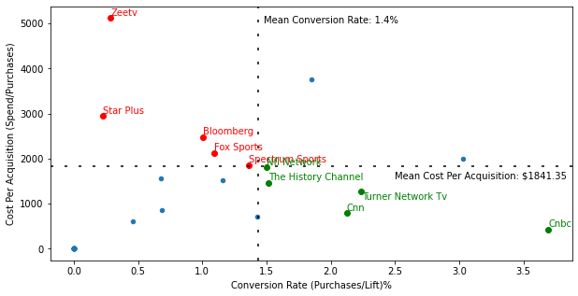
Conversion Rate vs. Cost Per Acquisition
High Conversion Rate, Low Cost Per Acquisition: Good!
CNBC
Turner Network TV
CNN
The History Channel
NFL Network
Low Conversion Rate, High Cost Per Acquisition
ZeeTV
Star Plus
Bloomberg
Fox Sports
Spectrum Sports

Slide 12
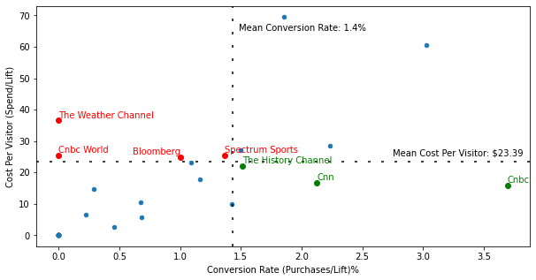
Conversion Rate vs. Cost Per Visitor
High Conversion Rate, Low Cost Per Visitor: Good!
CNBC
CNN
The History Channel
Low Conversion Rate, High Cost Per Visitor:
The Weather Channel
No Purchases
CNBC World
No Purchases
Bloomberg
Spectrum Sports

Slide 13
Which networks to spend more money?
MSNBC (+2)
CNBC (+5)
Science (+1)
Turner Network TV (+2)
Comedy Central (+1)
NFL Network (+2)
The History Channel (+3)
CNN (+2)
Maybe?
Dish Network (+1 / -1)
Dateline (+ 1 / -2)
Honorable Mentions, no spend yet customers attributed their purchase to these channels:
Fox News (+2)
Aapka Colors
HGTV
ESPN
Sony Entertainment TV
Television Food Network
Other

Slide 14
Which networks to stop spending on?
ZeeTV (-4)
Star Plus (-4)
WillowTV (-1) (Highest number of purchases though…)
One America News Network (-1)
Bloomberg (-2)
Fox Sports (-1)
Spectrum Sports (-2)
Weather Channel (-1) (no purchases)
CNBC World (-1) (no purchases)

Slide 15
How can the exit survey be improved?

Slide 16
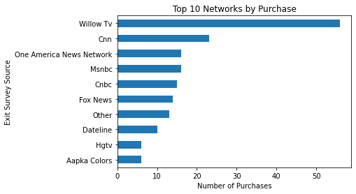
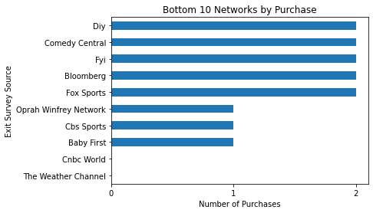
Purchases by Network
Which Networks had the highest number of purchases?
Which Networks had the lowest number of purchases?
Summary:
Willow TV was by far the best performer
CNBC World and Weather Channel had 0 purchases

