Slide 1

Company XYZ - TV Campaign Report
Jonathan Papir
Date: 3-30-22

Slide 2
Establishing a baseline: Overall Metrics
Total purchases: 236
236 purchases over 28 distinct channels.
61 purchases from 13 channels that had no spend.
3 purchases from “blank”; 13 purchases from other.
Average: 9 purchases per channel.
Total Spend: $221,436.84
$1265.35 average cost per acquisition.
$10.81 average cost to bring one visitor to your website.
Total Lift: 20,487 visitors

Slide 3
How much does it cost to acquire a customer through TV?

Slide 4
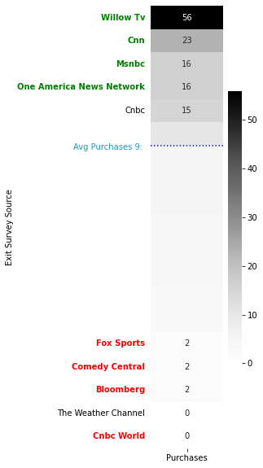
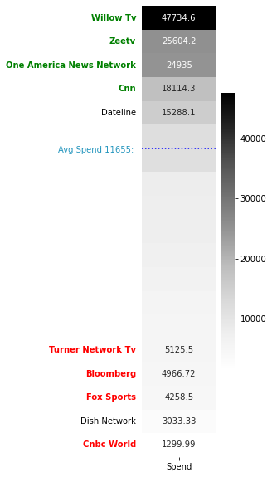
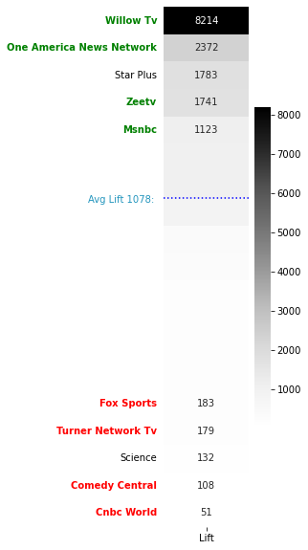
Purchases, Spend, and Lift – Top and Bottom 5 Channels – Recurring Characters
Key results:
Highest ranking in at least two of three areas:
Willow TV
One America News
ZeeTV
CNN
MSNBC
Lowest ranking in at least two of three areas:
Fox Sports
CNBC World
Comedy Central
Bloomberg
Turner Network TV (TNT)
Low spend could be causing low purchases and lift
Notes:
At the top, we see the following channels in all three categories:
Willow TV
One America News
With the following in two out of three categories
ZeeTV
CNN
MSNBC
At the bottom, we see the following channels in all three categories:
Fox Sports
CNBC World
With the following in two out of three categories
Comedy Central
Bloomberg
Turner Network TV (TNT)
Low spend could be causing low purchases and lift for:
CNBC World
Fox Sports
TNT
Pay Extra close attention to the following companies as we progress further into the presentation:
ZeeTV, CNN, MSNBC, CNBC World

Slide 5
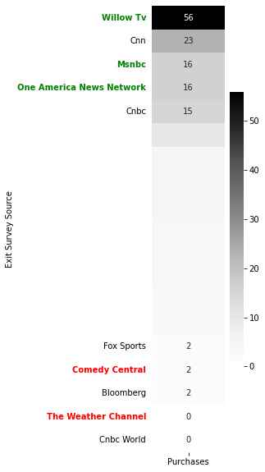
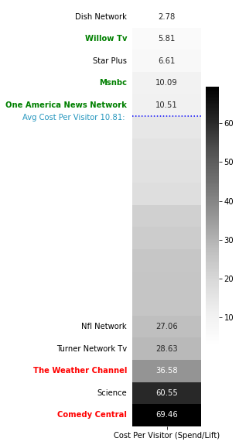
Cost efficiency – Cost Per Visitor Per Network (Spend/Lift)
High Performers:
WillowTV
MSNBC
One America News Network
Key Benchmark: Average Cost Per Visitor (Total Spend / Total Lift): $10.81
Low Performers:
Comedy Central
The Weather Channel
Notes:
WillowTV, MSNBC, and One America News Network are among the top 5 in terms of Cost Per Visitor and are in the top 5 in terms of purchases.
Key Benchmark: Average Cost Per Visitor (Total Spend / Total Lift): $10.81
Only the top 5 companies (pictured left) outperformed this metric.
Comedy Central and The Weather Channel have very few purchases and are among the costliest in terms of generating Lift

Slide 6
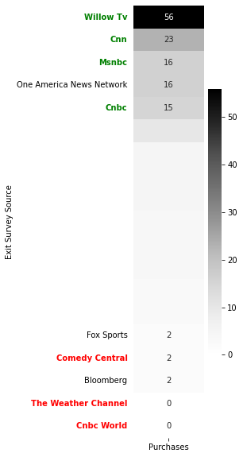
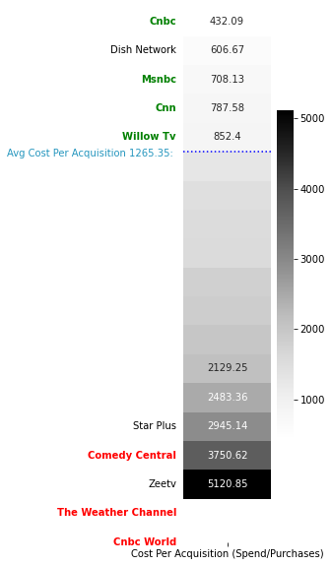
Cost efficiency – Cost Per Acquisition (CPA) Per Network (Spend/Purchases)
High Performers:
WillowTV
CNN
MSNBC
CNBC
Key Benchmark: Average Cost Per Acquisition (Total Spend / Total Purchases): $1265.35
Low Performers:
Comedy Central
The Weather Channel
CNBC World
Note: Weather Channel and CNBC World had zero purchases and calculating CPA isn’t possible.
Notes:
At the top:
WillowTV, CNN, MSNBC, and CNBC are among the top 5 in terms of Cost Per Acquisition and are in the top 5 in terms of purchases.
Key Benchmark: Average Cost Per Acquisition (Total Spend / Total Purchases): $1265.35
Only the top 5 companies (pictured left) outperformed this metric.
At the bottom:
Comedy Central has very few purchases and The Weather Channel and CNBC World have no purchases. All are among the costliest in terms of generating purchases.

Slide 7
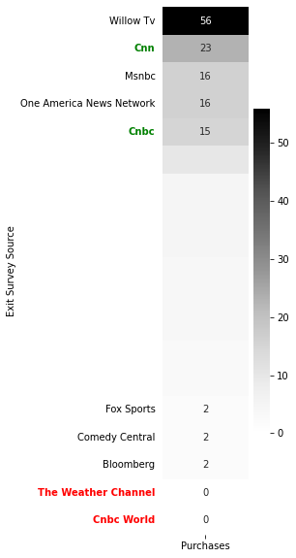
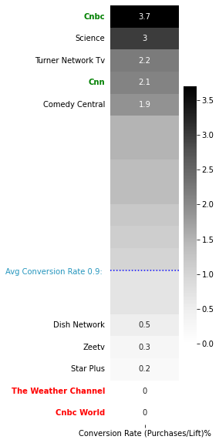
Conversion Rate Per Network (Purchases/Lift)%
High Performers:
CNN
CNBC
Key Benchmark: Average Conversion Rate (Total Purchases / Total Lift): 0.9%
Low Performers:
The Weather Channel
CNBC World
Note: Weather Channel and CNBC World are dead last in Conversion Rate because both had zero purchases.
Notes:
At the top:
CNN and CNBC are among the top 5 in terms of Conversion Rate and are in the top 5 in terms of purchases.
Key Benchmark: Average Conversion Rate (Total Purchases / Total Total): 0.9%
Most companies outperformed this metric.
At the bottom:
The Weather Channel and CNBC World have no purchases and thus have a conversion rate of 0%.
Of note: Comedy Central has low purchases but high conversion rate

Slide 8
What have we learned so far?
The good… In top 5 for 2/3 of your metrics | …the bad… In bottom 5 for 2/3 of your metrics | …and the ugly… In bottom 5 for all three metrics
WillowTV | Comedy Central | The Weather Channel Zero Purchases
MSNBC | CNBC World Zero Purchases
CNN
CNBC
Notes:
The good
In the top 5 for 2/3 of your metrics:
WillowTV (+2/3 metrics)
Highest Spend Overall
Highest Lift Overall
Highest Purchases Overall
MSNBC (+2/3 metrics)
Third Highest Purchases
Fourth Highest Lift
CNN (+2/3 metrics)
Second highest purchases
CNBC (+2/3 metrics)
Fourth Highest purchases
The bad
In the bottom 5 for 2/3 of your metrics:
Comedy Central (-2/3 metrics)
Costliest in generating lift
Second costliest in generating purchases
Low purchases, but high conversion rate
CNBC World (-2/3 metrics)
Zero Purchases
In the bottom 5 for all three of your metrics:
The Weather Channel (-3/3 metrics)
Zero Purchases
CPA can’t be calculated
Third Costliest in generating lift
CPA can’t be calculated

Slide 9
What else can we learn?

Slide 10
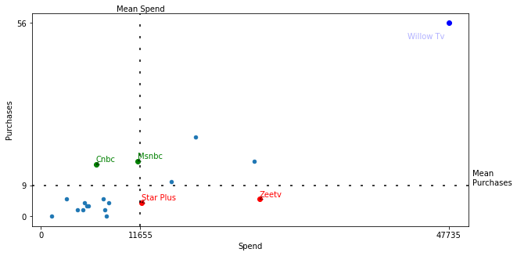
Spend vs. Purchases
Good:
Above avg purchases, below avg spend
Bad: above avg spend, above avg purchases
Key observation: CNBC and ZeeTV
Notes:
Note: the graph is divided into four quadrants, sectioned off by Average Purchases (x) and Average Spend (y).
Above average purchases, below average spend:
You’re spending less and getting more purchases, that’s good!
Below average purchases, above average spend:
You’re spending more and getting less purchases, that’s bad!
Key Observation: ZeeTVwell above avg spend and on lower end of purchases

Slide 11
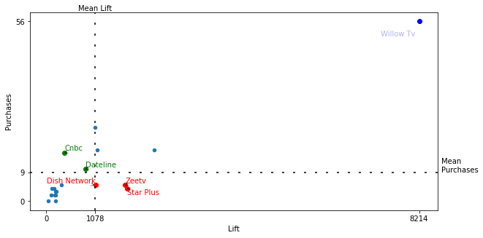
Lift vs. Purchases
Good: Above avg purchases, below avg lift
Bad: Below avg purchases, above avg lift
Key observation: CNBC, ZeeTV, and Star Plus
Notes:
Note: the graph is divided into four quadrants, sectioned off by Average Lift (x) and Average Purchases (y)
Below average lift, yet above average purchases:
You’re getting less lift, but more purchases despite it, that’s good!
Above average lift, below average purchases:
Despite increased traffic, these customers don’t seem to want your product, that’s bad!

Slide 12
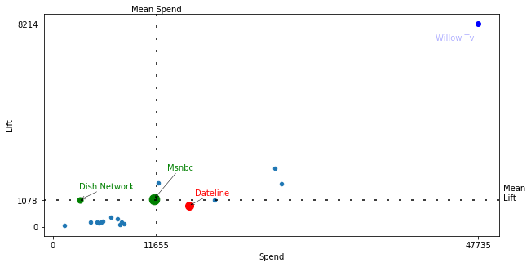
Spend vs. Lift
Good: Above avg lift,
Below avg spend
Bad: Below avg lift, above avg spend
Notes:
Note: the graph is divided into four quadrants, sectioned off by Average Lift (x) and Average Spend (y). The size of each colored point corresponds to number of purchases made there.
Below average lift, above average spend:
You’re getting less lift for your buck, that’s bad!
Above average lift, below average spend:
You’re getting more lift for your buck, that’s good!

Slide 13
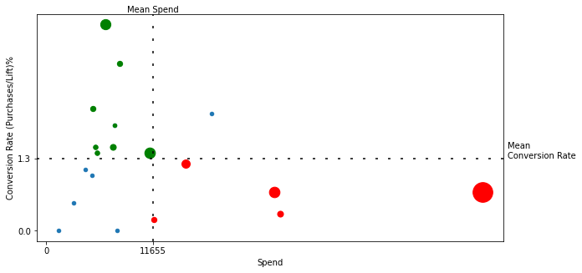
Spend vs. Conversion Rate
CNBC
Good: Below avg spend, above avg conversion rate
Science
Turner Network Television
Comedy Central
NFL Network
History Channel
Spectrum Sports
MSNBC
Dateline
Willow TV
One America News Network
Star Plus
ZeeTV
Bad: Above avg spend, below avg conversion rate
Key Observations: CNBC, ZeeTV, Star Plus
Notes:
Note: the graph is divided into four quadrants, sectioned off by Average Conversion Rate (x) and Average Spend (y).
The size of each colored point corresponds to number of purchases made there.
Low conversion rate, high spend:
These channels have a low likelihood of a sale and are more expensive to advertise on, that’s bad!
High conversion rate, low spend:
These channels have a higher likelihood of a sale and are cheaper to advertise on, that’s good!

Slide 14
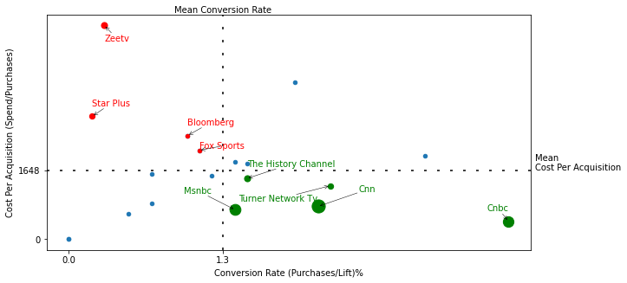
Conversion Rate vs. Cost Per Acquisition (CPA)
Bad: below avg conversion rate, above avg CPA
Good: above avg conversion rate, below avg CPA
Key Observations: CNBC, CNN, ZeeTV, Star Plus
Notes:
Note: the graph is divided into four quadrants, sectioned off by Average Conversion Rate (x) and Average CPA (y).
The size of each colored point corresponds to number of purchases made there.
Low conversion rate, high cost per acquisition
These channels have a low likelihood of a sale and it’s costly to acquire a customer, that’s bad!
High conversion rate, low cost per acquisition
These channels have a high likelihood of a sale and it’s cheaper to acquire a customer, that’s good!

Slide 15
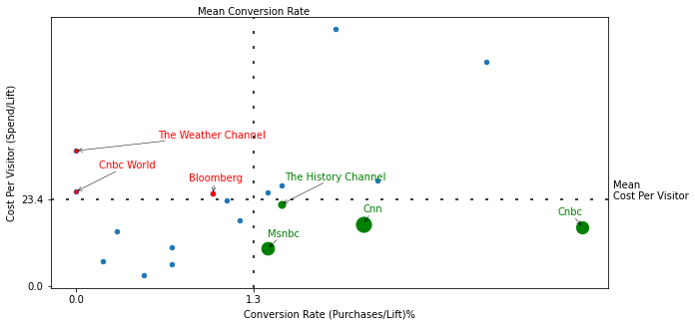
Conversion Rate vs. Cost Per Visitor
Bad: Below avg conversion rate, above avg cost per visitor
Good: Above avg conversion rate, below avg cost per visitor
Key Observations: CNBC, CNN, CNBC World, The Weather Channel
Notes:
Note: the graph is divided into four quadrants, sectioned off by Average Conversion Rate (x) and Average Cost Per Visitor (y).
The size of each colored point corresponds to number of purchases made there.
Low conversion rate, high cost per visitor:
These channels have a lower likelihood of acquiring a customer and a higher cost to get them to your website, that’s bad!
High conversion rate, low cost per visitor:
These channels have a higher likelihood of acquiring a customer and a lower cost to get them to your website, that’s good!

Slide 16
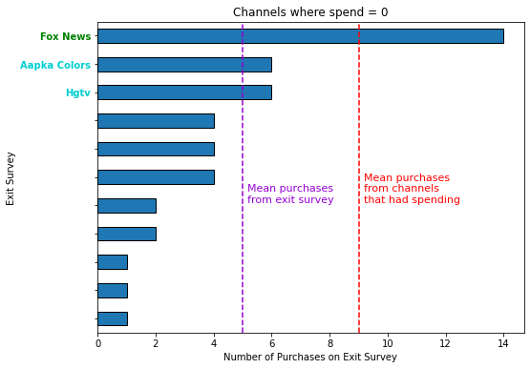
Some Channels have no spend, but high purchases
High Performers:
Fox News
Way ahead of average number of purchases from channels with spending (19 channels).
Decent performers:
Aapka Colors and HGTV
Beat average number of purchases from channels on exit survey (30 channels).
Notes:
This was really interesting to me…
Fox News was way ahead in terms of mean number of purchases, when considering only channels where money was spent on ads (19 channels).
Other channels, like Aapka Colors and HGTV, performed better than average, if we look average over any channel from the exit survey (30 channels).

Slide 17
What new information have we gained?
The great… Performed well in at least 4/6 scatter plots | …the good… Performed well in 2/6 or 3/6 scatter plots | …and the bad… Performed poorly in 4/6 scatter plots
CNBC | The History Channel | ZeeTV
MSNBC | CNN | Star Plus
 | Turner Network TV
 | NFL Network
Notes:
The good
CNBC (+5)
Performed well in 5/6 of the previous graphs
MSNBC (+4)
Performed well in 4/6 of the previous graphs
The History Channel (+3)
Performed well in 3/6 of the previous graphs
CNN (+2)
Performed well in 2/6 of the previous graphs
Turner Network TV (+2)
Performed well in 2/6 of the previous graphs
NFL Network (+2)
Performed well in 2/6 of the previous graphs
The bad
ZeeTV (-4)
Performed poorly in 4/6 of the previous graphs
Star Plus (-4)
Performed poorly in 4/6 of the previous graphs

Slide 18
Recommendation: Which networks to spend more money?
Big Winners | Honorable Mentions (Performed well in at least 2 scatter plots) | Channels with no spend
CNBC In top 5 for 2/3 metrics Performed well in 5/6 scatter plots | The History Channel | Fox News 5.9% of all purchases
MSNBC In top 5 for 2/3 metrics Performed well in 4/6 scatter plots | Turner Network TV | Aapka Colors 2.5% of all purchases
CNN In top 5 for 2/3 metrics Performed well in 2/6 scatter plots | NFL Network | HGTV 2.5% of all purchases
Notes:
MSNBC
Third highest purchases
Fourth highest lift
In top 5 of 2/3 of your metrics
Performed well in 4/6 of the scatter plots
CNN
Second highest purchases
In top 5 of 2/3 of your metrics
Performed well in 2/6 of the scatter plots
CNBC
Fourth highest purchases
In top 5 of 2/3 of your metrics
Performed well in 5/6 of the scatter plots
Honorable Mentions
Weren’t in top 5 of any of your metrics, but performed well in at least 2 of the scatter plots:
The History Channel
Turner Network TV
Was in bottom 5 in terms of spending, perhaps more exposure would lead to even stronger performance
NFL Network
No money spent on advertising, yet customers attributed their purchase to these channels, which accounted for a sizeable chunk of all 236 purchases:
Fox News (5.9%)
Aapka Colors (2.5%)
HGTV (2.5%)

Slide 19
Recommendation: Which networks to cut spending?
Cut spending ASAP | Consider cutting spending
The Weather Channel In bottom 5 for all three metrics Zero Purchases | Bloomberg Performed poorly in 2/6 scatter plots
CNBC World In bottom 5 for 2/3 metrics Zero Purchases
ZeeTV Performed poorly in 4/6 scatter plots
Star Plus Performed poorly in 4/6 scatter plots
Comedy Central In bottom 5 for 2/3 metrics
Notes:
CNBC World
Zero Purchases
Ranked in bottom 5 for 2/3 of your metrics
The Weather Channel
Zero Purchases
Third costliest in generating lift
Ranked in bottom 5 for 3/3 of your metrics
ZeeTV
Performed poorly in 4/6 of the scatter plots
Star Plus
Performed poorly in 4/6 of the scatter plots
Comedy Central
Costliest for generating lift
Second costliest in generating purchases
Ranked in bottom 5 for 2/3 of your metrics
Honorable mentions
Bloomberg
Performed poorly in 2/6 of the scatter plots

Slide 20
How can the exit survey be improved?
Remove channels that you haven’t spent money on
CBS Sports
DIY
ESPN
Fox News
FYI
HGTV
Oprah Winfrey Network
Remove Other:______
When a customer marks Other, it gives us just as much information as if they had left this question blank. It’s unnecessary to have two different choices that yield the same information.
If a customer chooses ”TV Commercial,” force them to choose a TV station.
Include a few more questions on demographics, such as age or gender.
Notes:
Force the user to choose a channel. If they don’t want to choose a channel, they can leave it blank.

